Slide 1



CARE & CLIMATE IN AN AGE OF VULNERABILITY
HELSINKI CITY HALL
26th MAY 2026
KNOWLEDGE IN ACTION
ACTIVATING CLIMATE ADAPTATION THROUGH TAILORED EDUCATION
· ANNA HAKOLA · DUC CHU · FERNANDA ORDORICA ·
· JUTTA PIHLAMO · KAITLIN SAFKA · TESSA LEHMUSSAARI ·
Creative Commons CC BY 4.0 2026
Anna Hakola · Duc Chu · Fernanda Ordorica · Jutta Pihlamo · Kaitlin Safka · Tessa Lehmussaari
Design for Government course · Aalto University

Slide 2
AGENDA
1 INTRODUCTION
2 VISION
3 PROPOSAL
4 LIMITATIONS
5 FUTURE OPPORTUNITIES
Creative Commons CC BY 4.0 2026
Anna Hakola · Duc Chu · Fernanda Ordorica · Jutta Pihlamo · Kaitlin Safka · Tessa Lehmussaari
Design for Government course · Aalto University

Slide 3
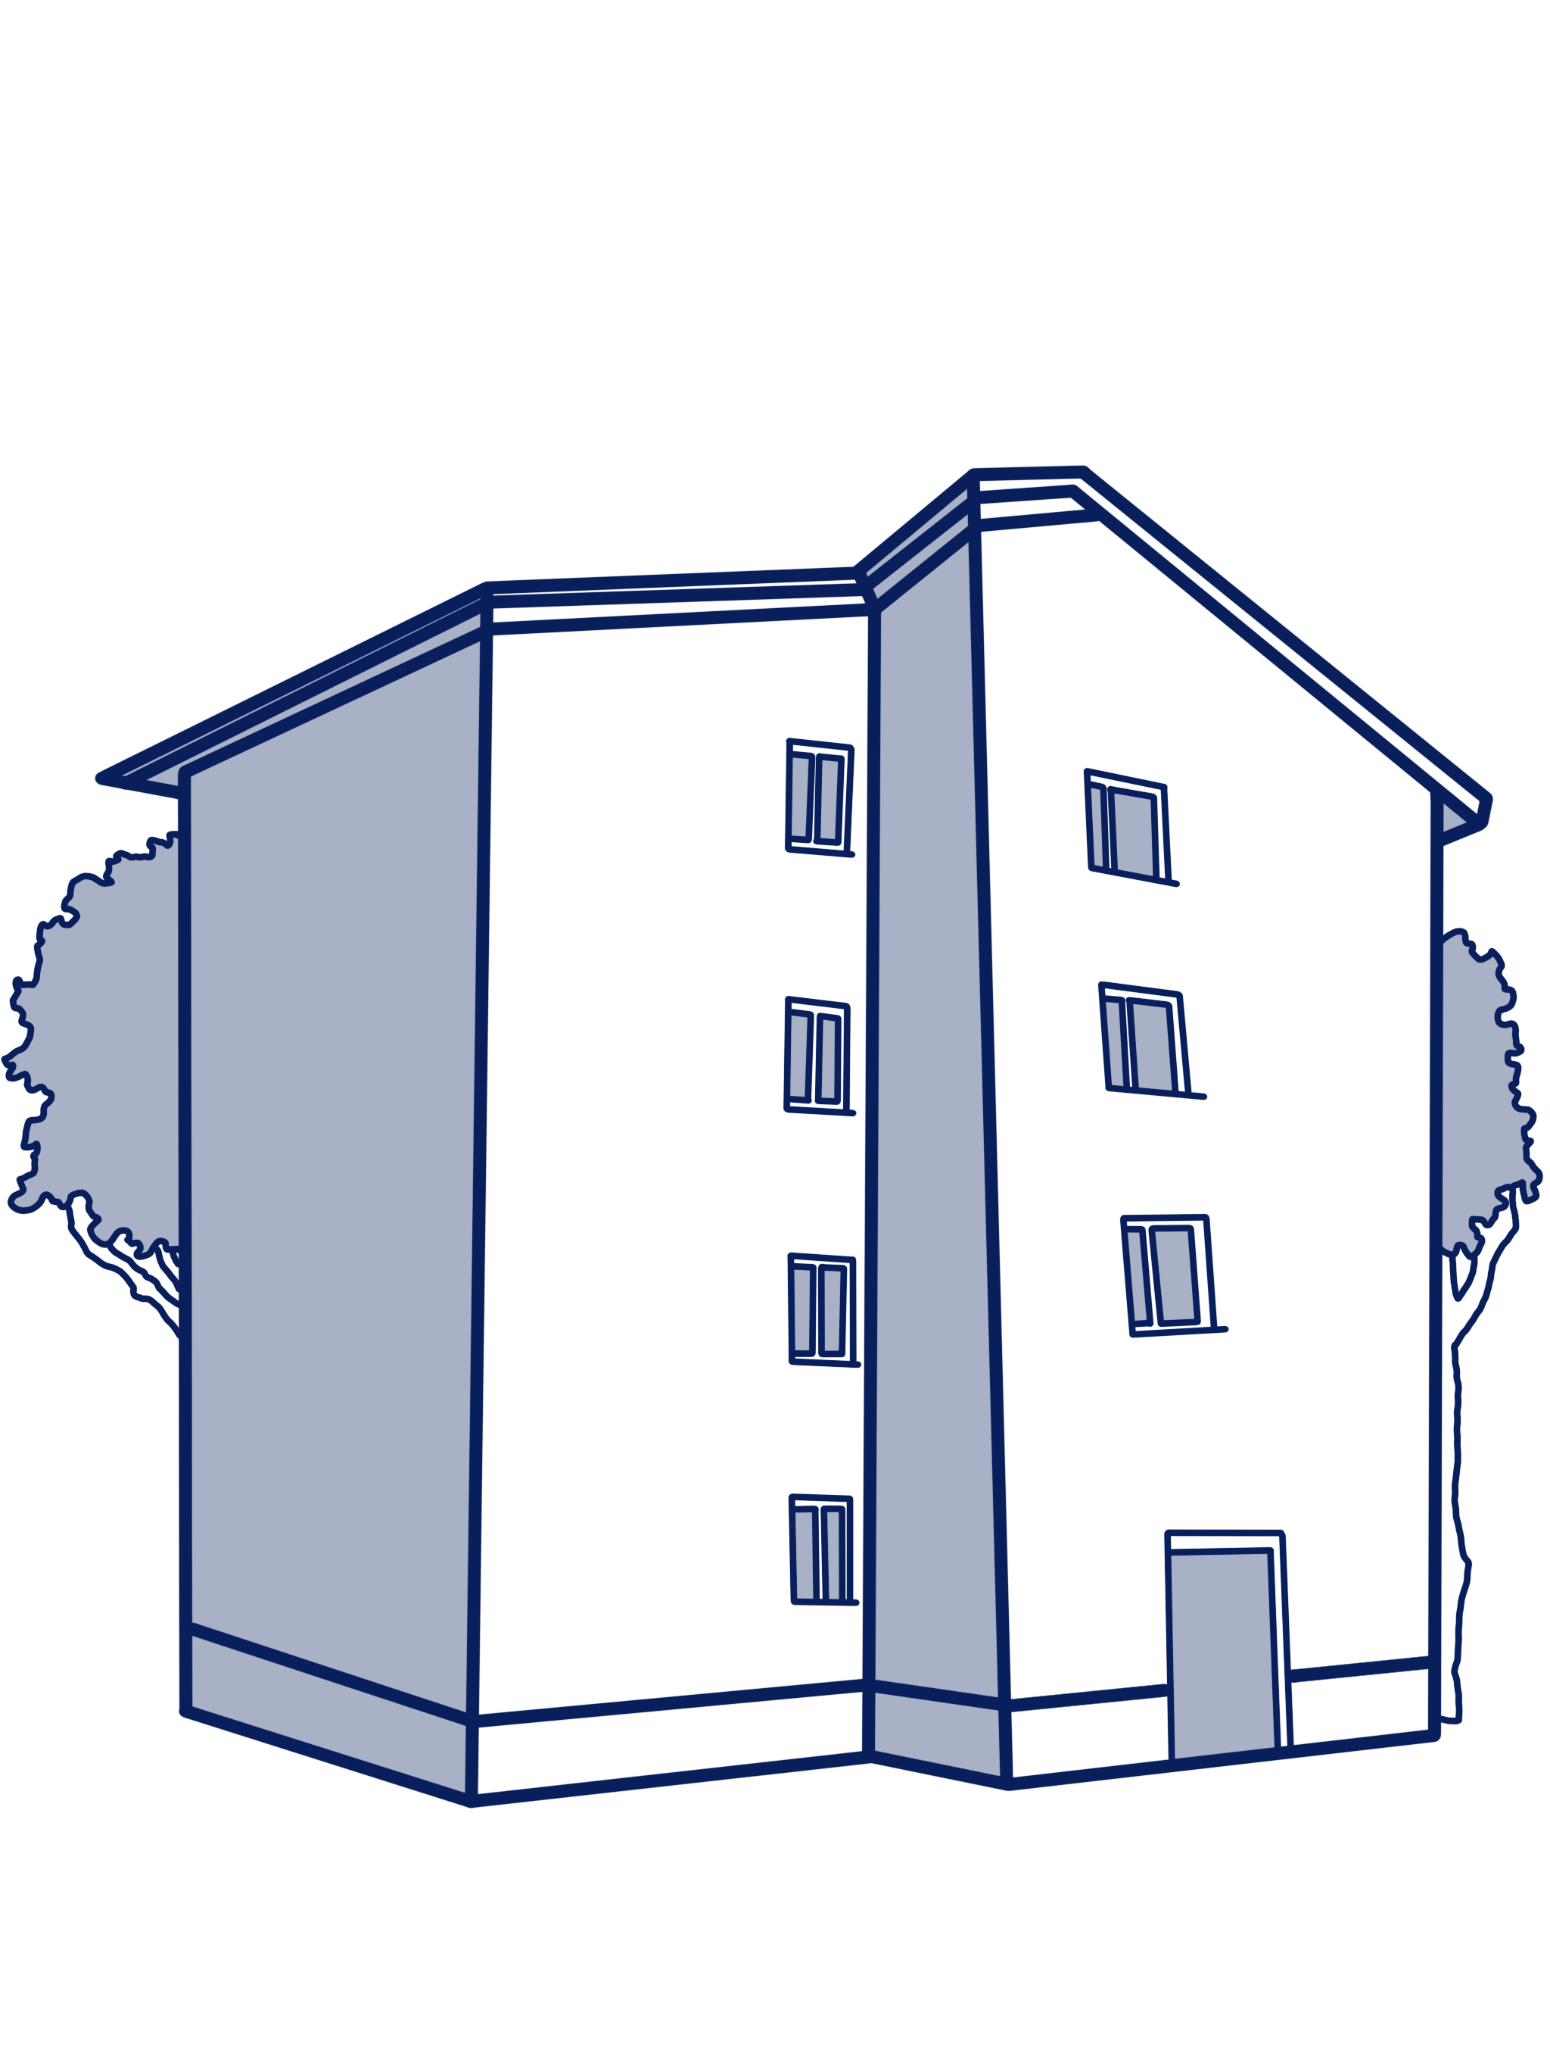
INTRODUCTION | OPTIMISM BIAS
Creative Commons CC BY 4.0 2026
Anna Hakola · Duc Chu · Fernanda Ordorica · Jutta Pihlamo · Kaitlin Safka · Tessa Lehmussaari
Design for Government course · Aalto University
3

Slide 4
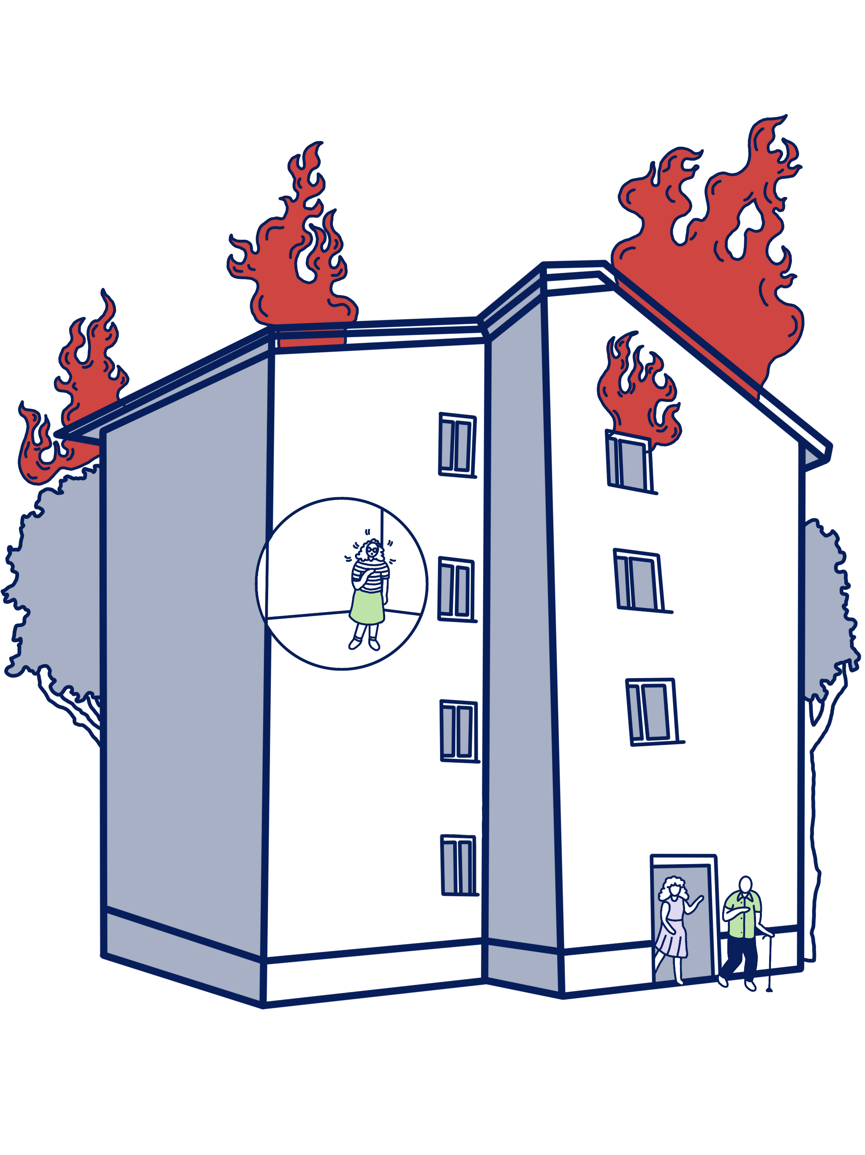
INTRODUCTION | OPTIMISM BIAS
Creative Commons CC BY 4.0 2026
Anna Hakola · Duc Chu · Fernanda Ordorica · Jutta Pihlamo · Kaitlin Safka · Tessa Lehmussaari
Design for Government course · Aalto University
3

Slide 5
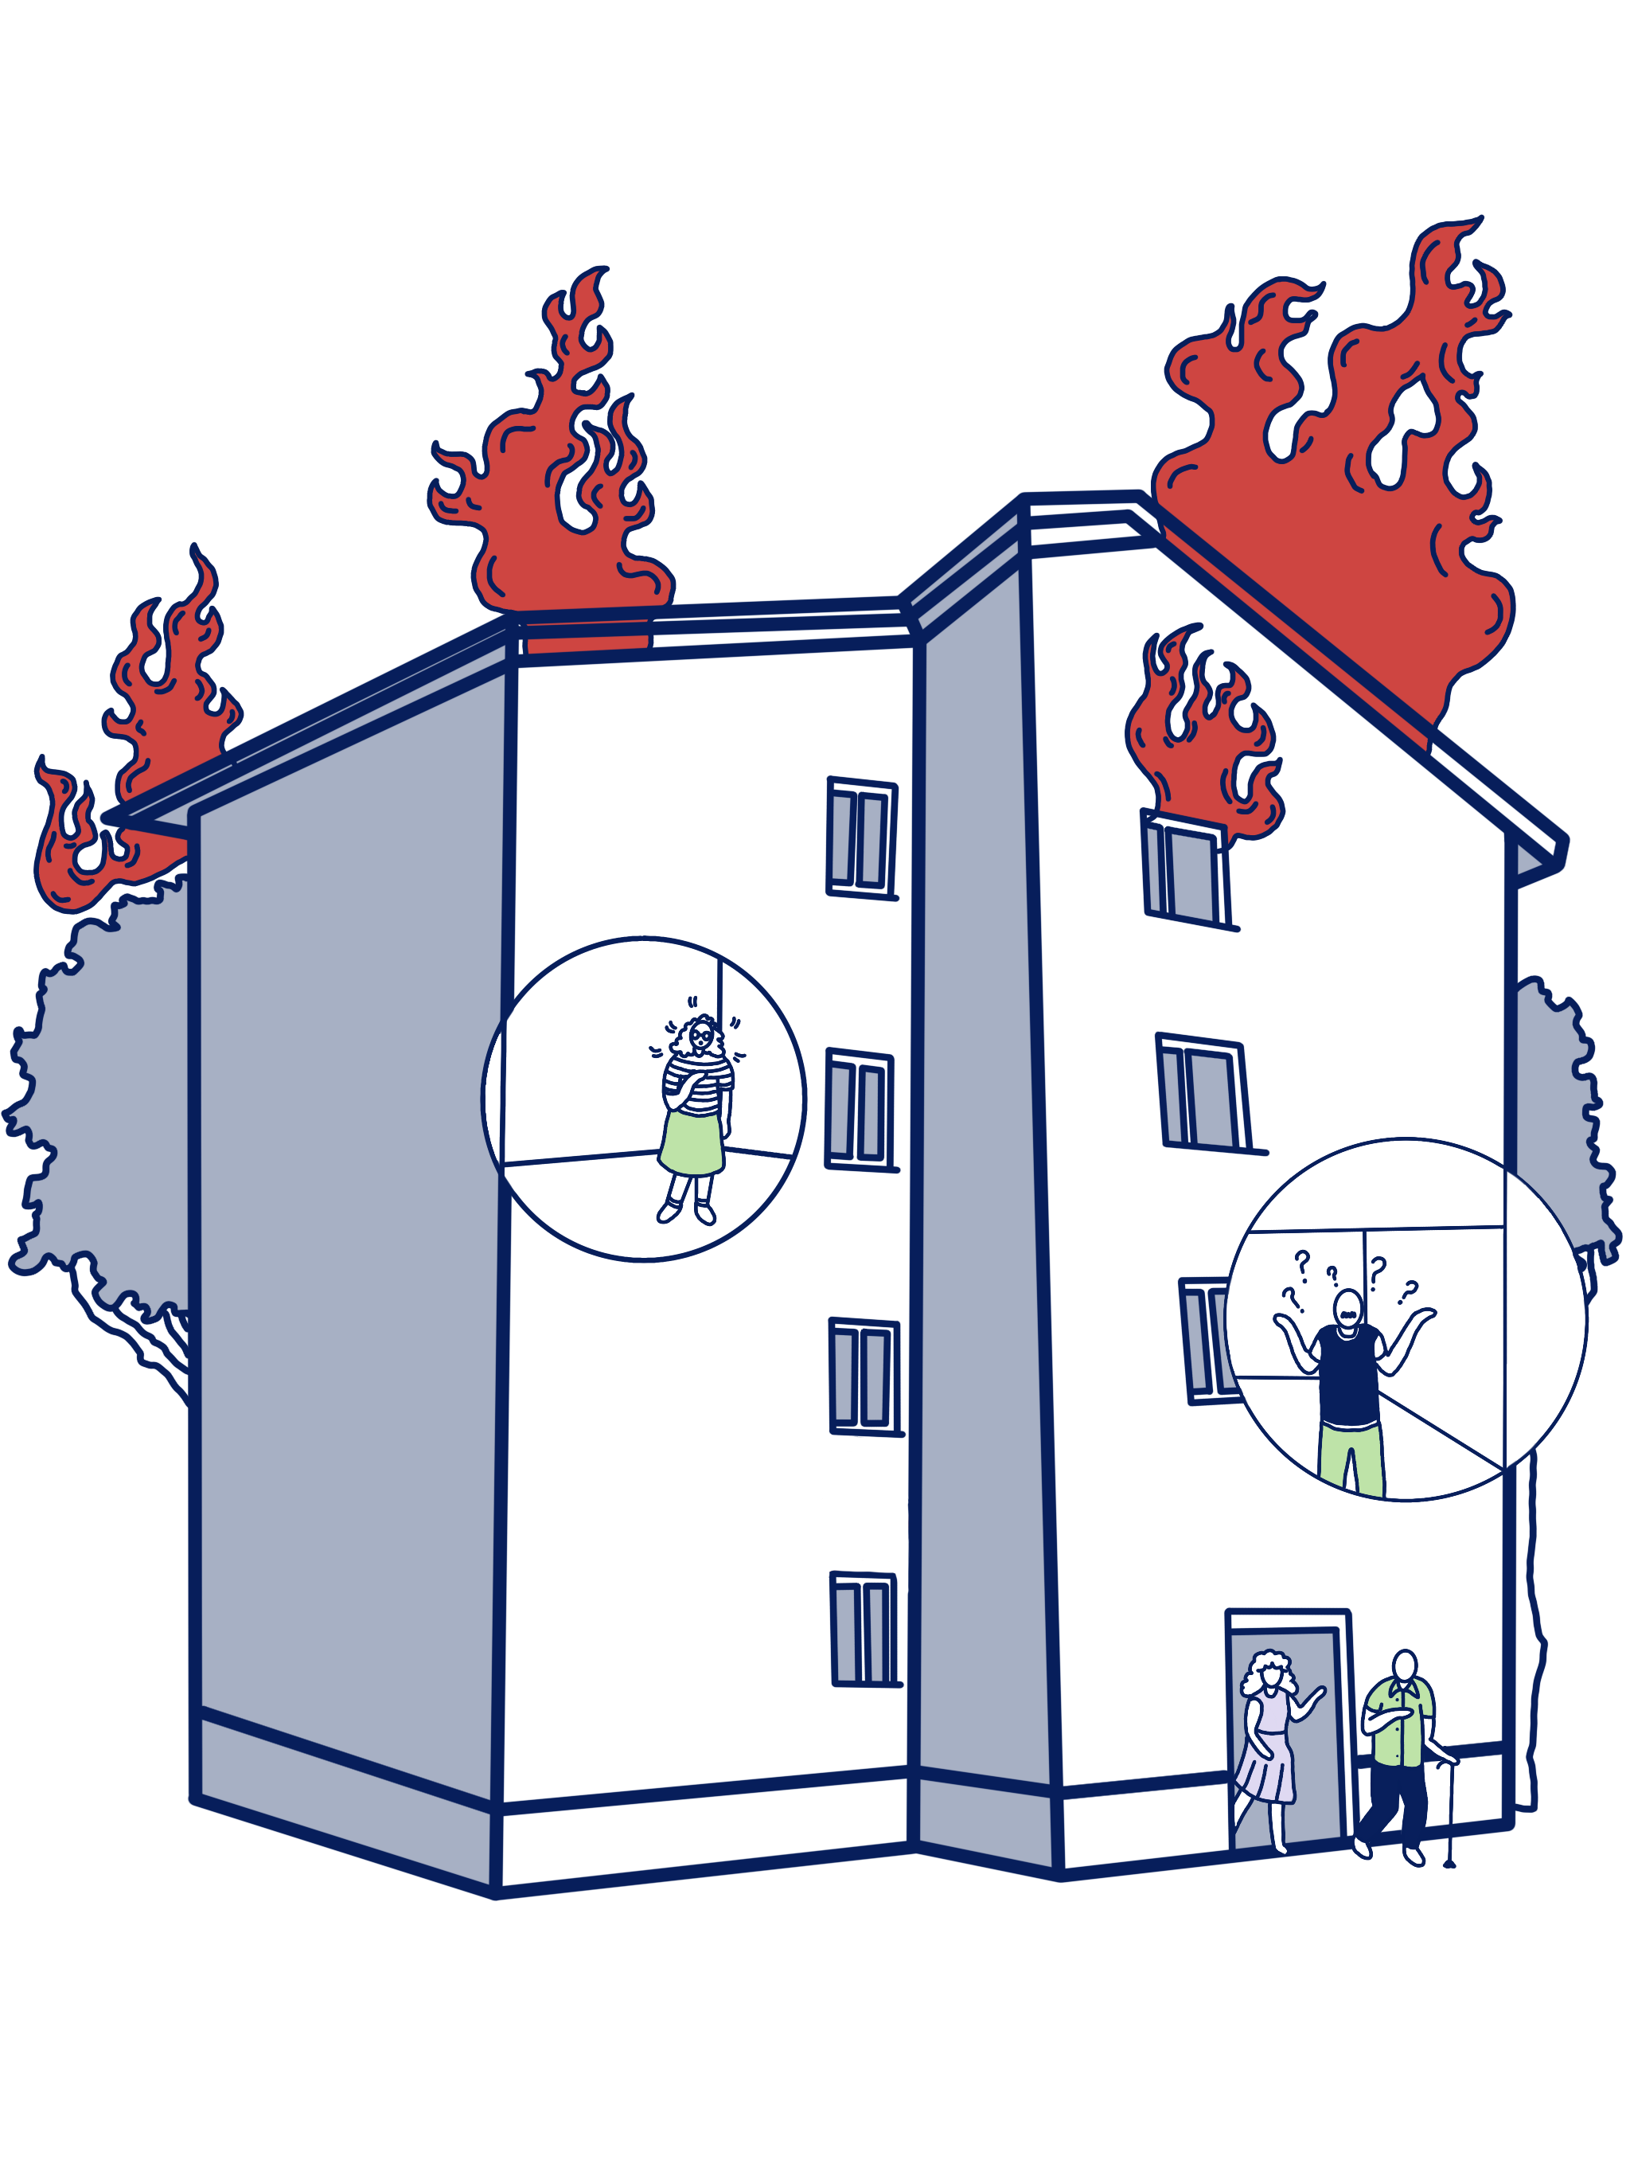
INTRODUCTION | OPTIMISM BIAS
Creative Commons CC BY 4.0 2026
Anna Hakola · Duc Chu · Fernanda Ordorica · Jutta Pihlamo · Kaitlin Safka · Tessa Lehmussaari
Design for Government course · Aalto University
3

Slide 6

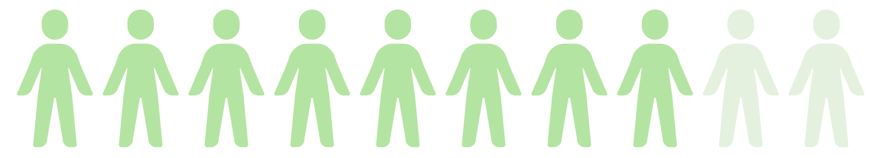

INTRODUCTION | OPTIMISM BIAS
80%
Creative Commons CC BY 4.0 2026
Anna Hakola · Duc Chu · Fernanda Ordorica · Jutta Pihlamo · Kaitlin Safka · Tessa Lehmussaari
Design for Government course · Aalto University
4

Slide 7

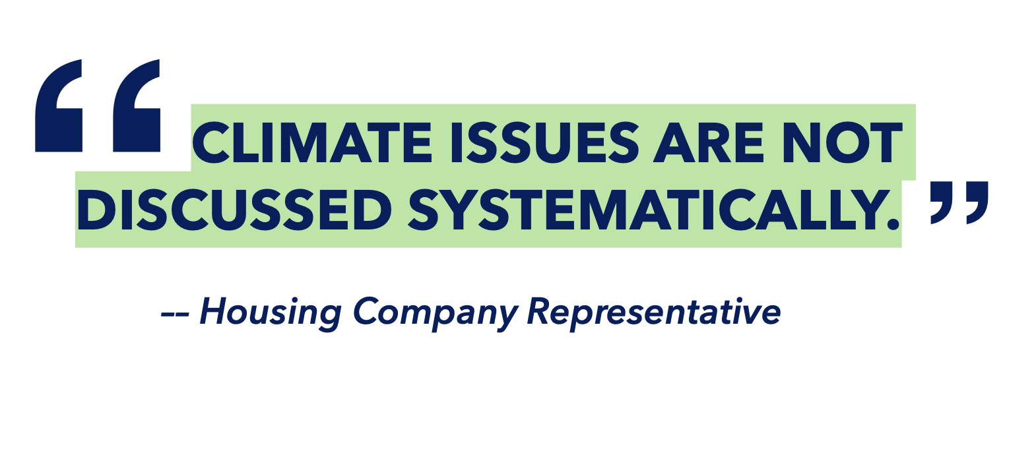
INTRODUCTION | OPTIMISM BIAS
80%
Creative Commons CC BY 4.0 2026
Anna Hakola · Duc Chu · Fernanda Ordorica · Jutta Pihlamo · Kaitlin Safka · Tessa Lehmussaari
Design for Government course · Aalto University
4

Slide 8
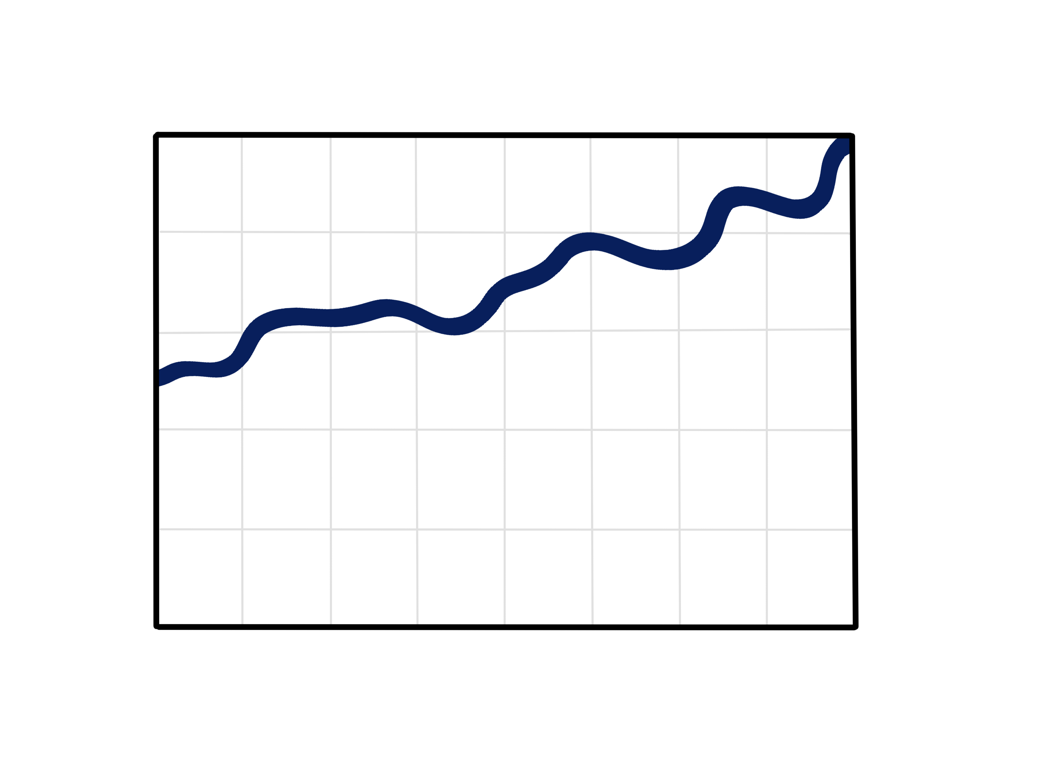
INTRODUCTION | OPTIMISM BIAS
perception
(Sharot, 2011)
Creative Commons CC BY 4.0 2026
Anna Hakola · Duc Chu · Fernanda Ordorica · Jutta Pihlamo · Kaitlin Safka · Tessa Lehmussaari
Design for Government course · Aalto University
5

Slide 9
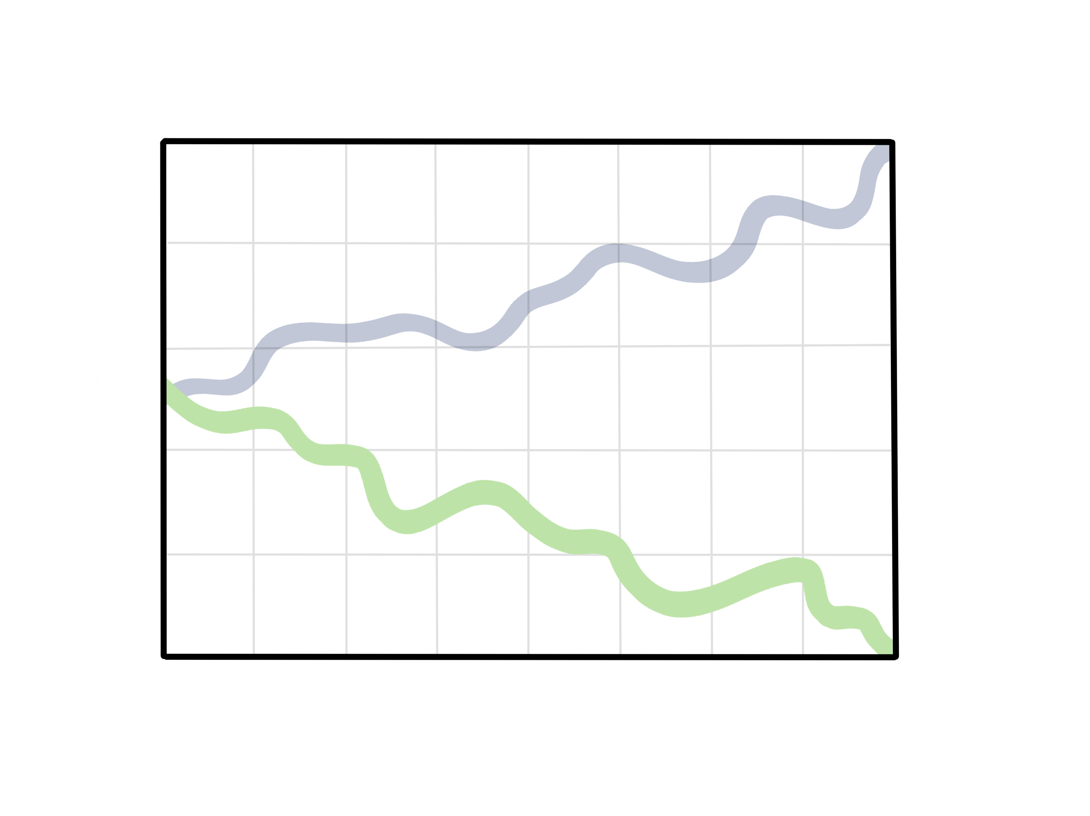
INTRODUCTION | OPTIMISM BIAS
perception
reality
(Sharot, 2011)
Creative Commons CC BY 4.0 2026
Anna Hakola · Duc Chu · Fernanda Ordorica · Jutta Pihlamo · Kaitlin Safka · Tessa Lehmussaari
Design for Government course · Aalto University
5

Slide 10

INTRODUCTION | OPTIMISM BIAS
Perceived
likelihood
(Sharot, 2011)
Creative Commons CC BY 4.0 2026
Anna Hakola · Duc Chu · Fernanda Ordorica · Jutta Pihlamo · Kaitlin Safka · Tessa Lehmussaari
Design for Government course · Aalto University
6

Slide 11
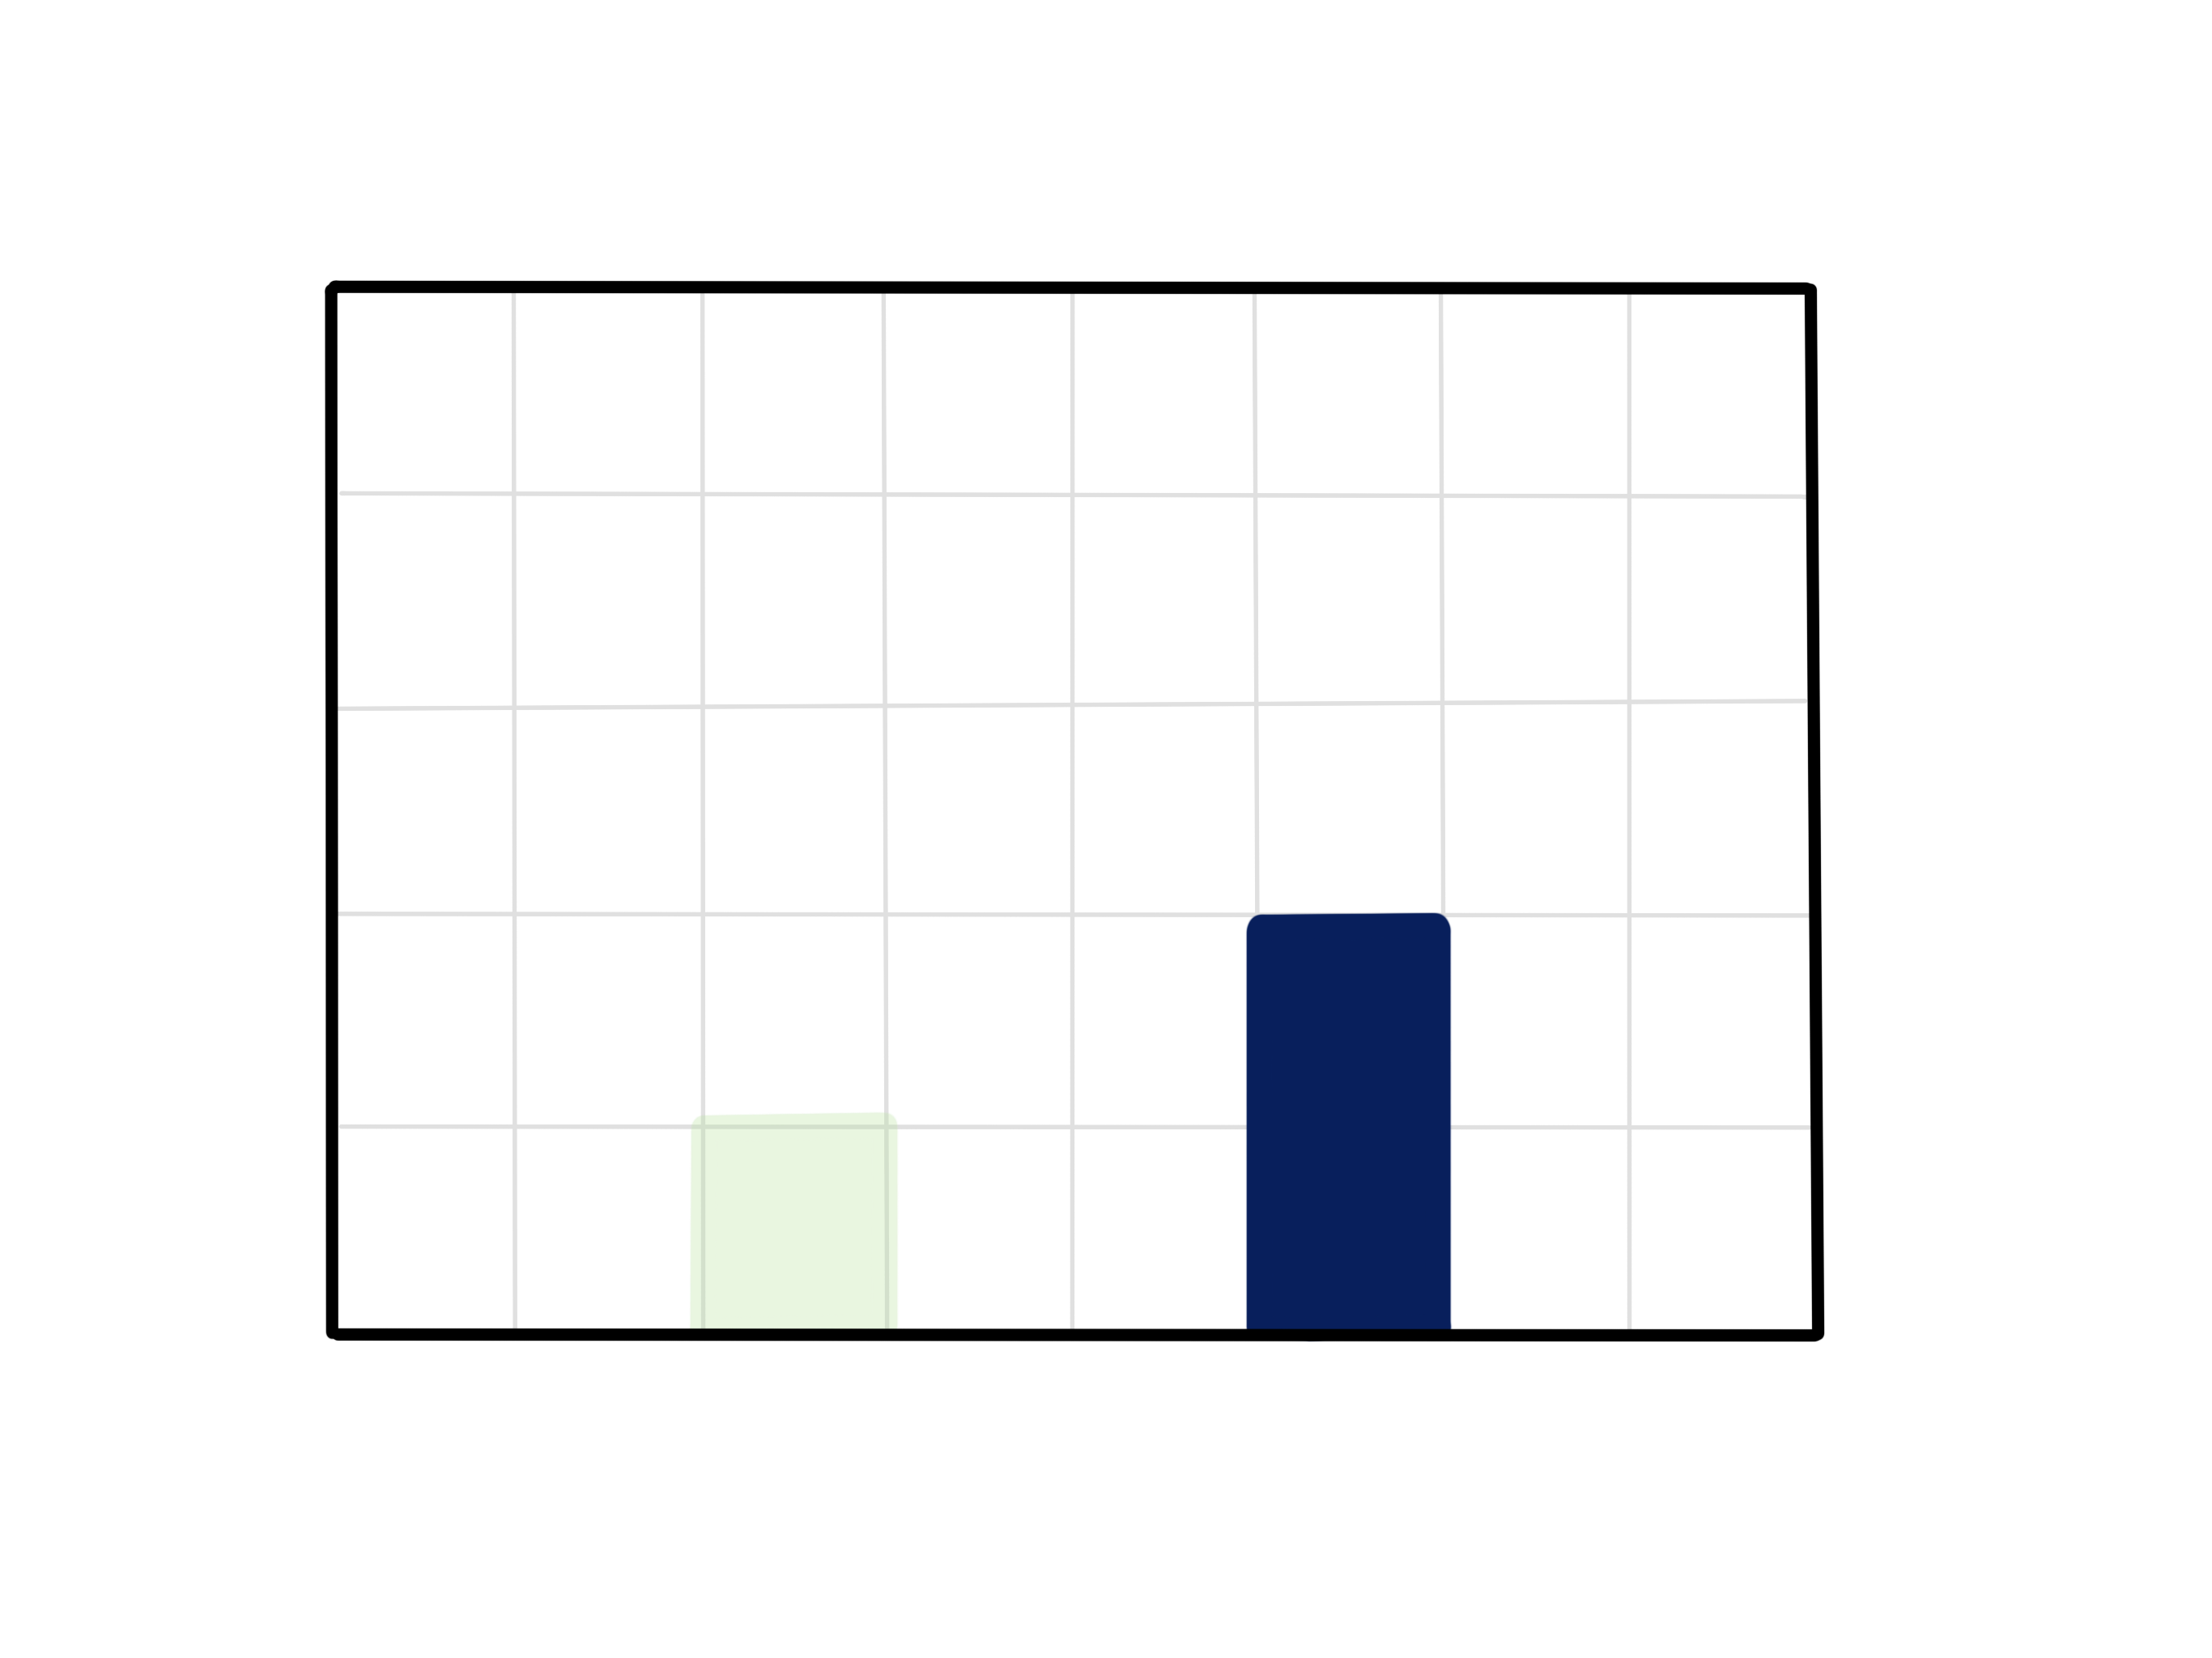
INTRODUCTION | OPTIMISM BIAS
Actual likelihood
Perceived
likelihood
(Sharot, 2011)
Creative Commons CC BY 4.0 2026
Anna Hakola · Duc Chu · Fernanda Ordorica · Jutta Pihlamo · Kaitlin Safka · Tessa Lehmussaari
Design for Government course · Aalto University
6

Slide 12
OPTIMISM BIAS
INTRODUCTION | OPTIMISM BIAS
”[…] the tendency to overestimate our likelihood of experiencing positive events and underestimate our likelihood of experiencing negative events.”
(Pilat & Krastev, 2021)
Creative Commons CC BY 4.0 2026
Anna Hakola · Duc Chu · Fernanda Ordorica · Jutta Pihlamo · Kaitlin Safka · Tessa Lehmussaari
Design for Government course · Aalto University
7

Slide 13
INTRODUCTION | OPTIMISM BIAS
"Overall, optimism seems to be negatively associated with an active response to environmental change."
(Pahl et al., 2014)
Creative Commons CC BY 4.0 2026
Anna Hakola · Duc Chu · Fernanda Ordorica · Jutta Pihlamo · Kaitlin Safka · Tessa Lehmussaari
Design for Government course · Aalto University
8

Slide 14
INTRODUCTION | OPTIMISM BIAS
They subconsciously assume that it will not happen to them
“
Some people say [flooding] is never going to happen.
— Housing Company Board Member
“
Creative Commons CC BY 4.0 2026
Anna Hakola · Duc Chu · Fernanda Ordorica · Jutta Pihlamo · Kaitlin Safka · Tessa Lehmussaari
Design for Government course · Aalto University
9

Slide 15
INTRODUCTION | OPTIMISM BIAS
They subconsciously assume that it will not happen to them
The feel they are powerless to make a difference
“
“
Some people say [flooding] is never going to happen.
— Housing Company Board Member
We don’t think about it, since nothing can be done.
— Housing Company Board Member
“
“
Creative Commons CC BY 4.0 2026
Anna Hakola · Duc Chu · Fernanda Ordorica · Jutta Pihlamo · Kaitlin Safka · Tessa Lehmussaari
Design for Government course · Aalto University
9

Slide 16
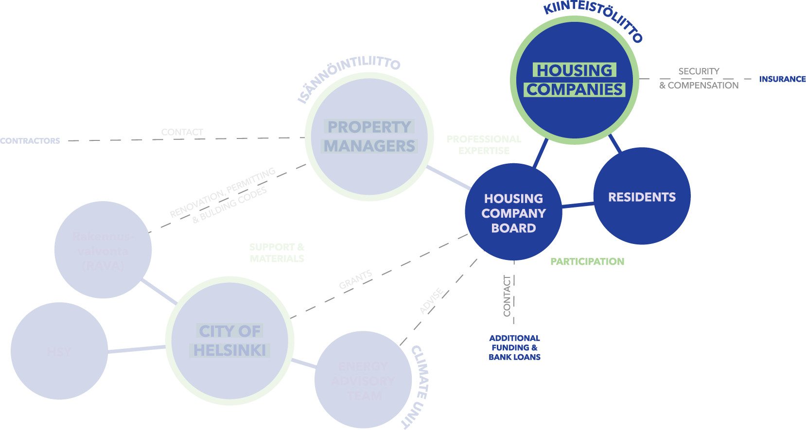
INTRODUCTION | STAKEHOLDERS
Creative Commons CC BY 4.0 2026
Anna Hakola · Duc Chu · Fernanda Ordorica · Jutta Pihlamo · Kaitlin Safka · Tessa Lehmussaari
Design for Government course · Aalto University
10

Slide 17

INTRODUCTION | STAKEHOLDERS
Creative Commons CC BY 4.0 2026
Anna Hakola · Duc Chu · Fernanda Ordorica · Jutta Pihlamo · Kaitlin Safka · Tessa Lehmussaari
Design for Government course · Aalto University
10

Slide 18
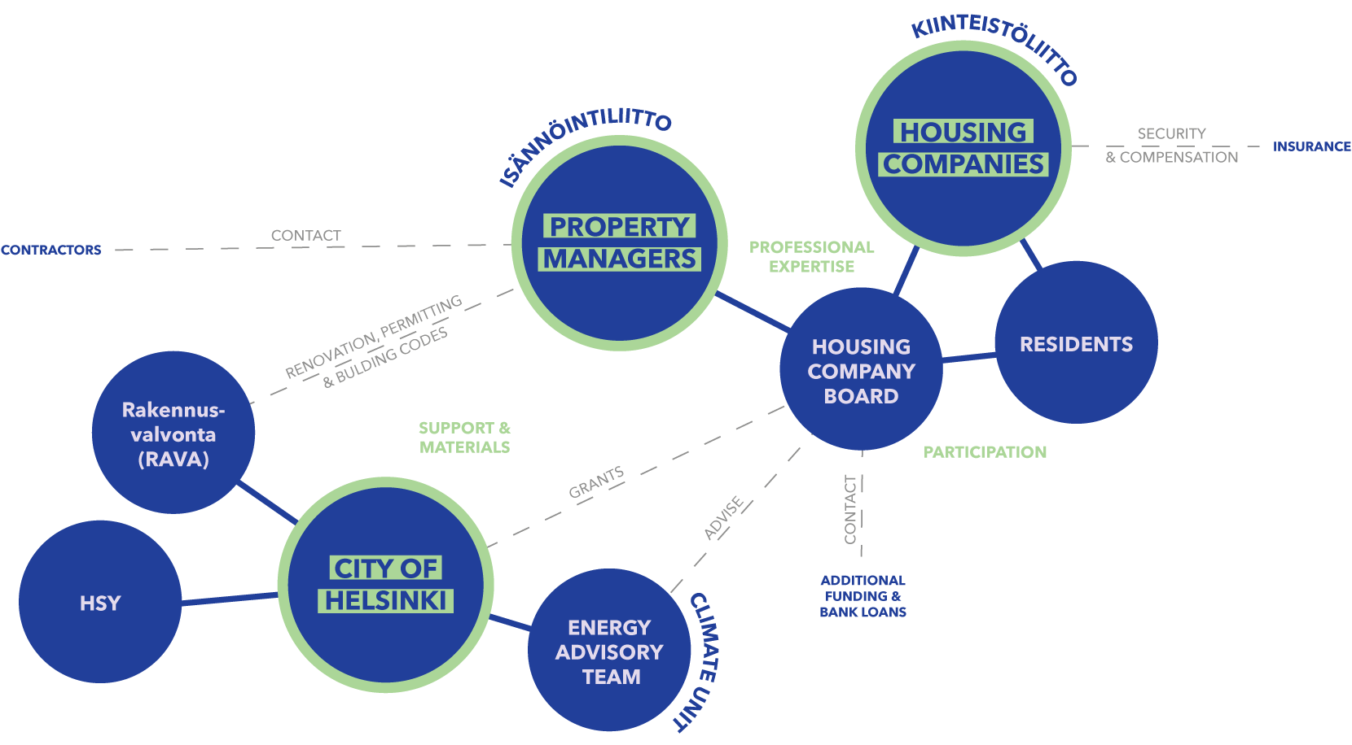
INTRODUCTION | STAKEHOLDERS
Creative Commons CC BY 4.0 2026
Anna Hakola · Duc Chu · Fernanda Ordorica · Jutta Pihlamo · Kaitlin Safka · Tessa Lehmussaari
Design for Government course · Aalto University
10

Slide 19

INTRODUCTION | STAKEHOLDERS
Creative Commons CC BY 4.0 2026
Anna Hakola · Duc Chu · Fernanda Ordorica · Jutta Pihlamo · Kaitlin Safka · Tessa Lehmussaari
Design for Government course · Aalto University
11

Slide 20
INTRODUCTION | STAKEHOLDERS
Creative Commons CC BY 4.0 2026
Anna Hakola · Duc Chu · Fernanda Ordorica · Jutta Pihlamo · Kaitlin Safka · Tessa Lehmussaari
Design for Government course · Aalto University
11

Slide 21
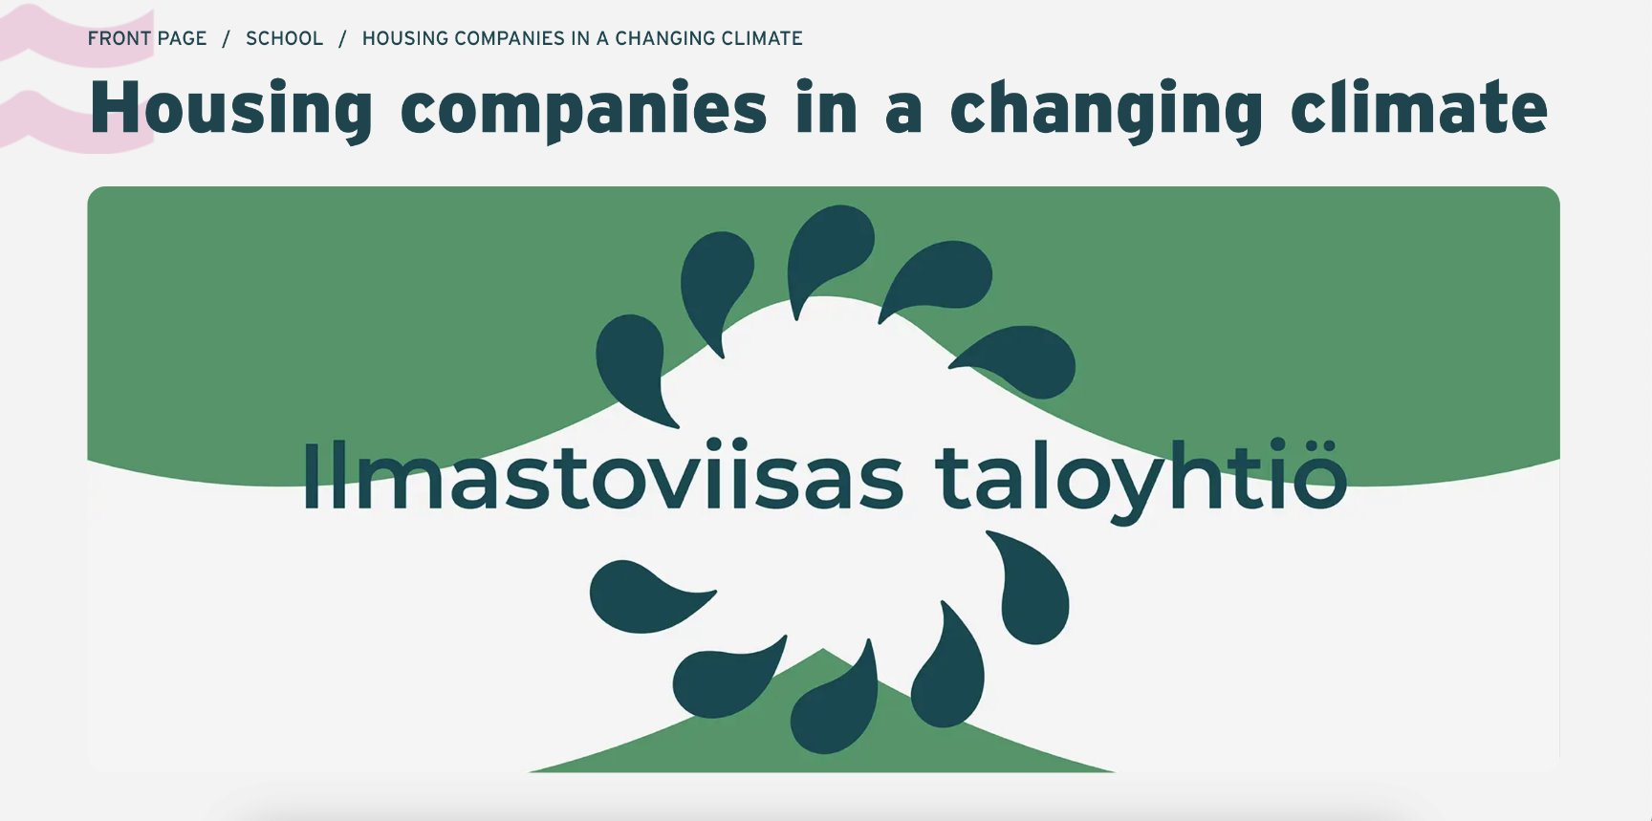
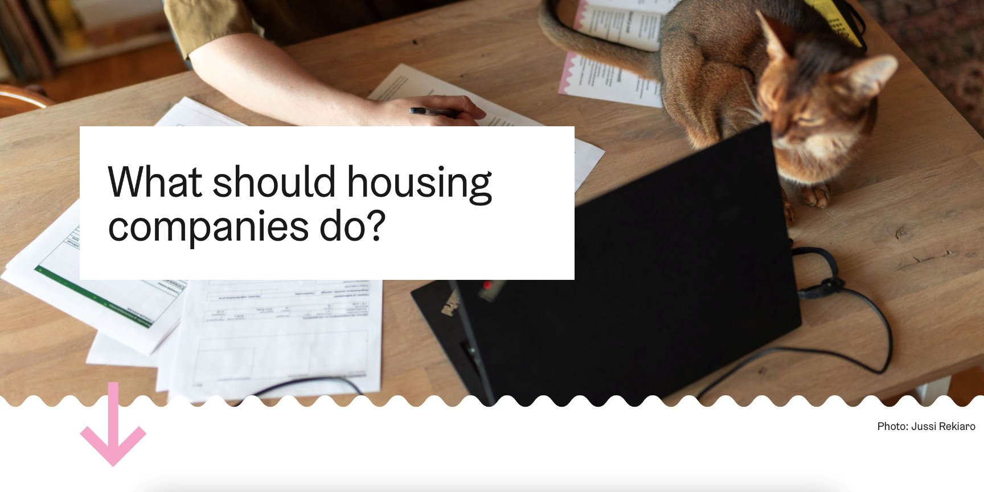
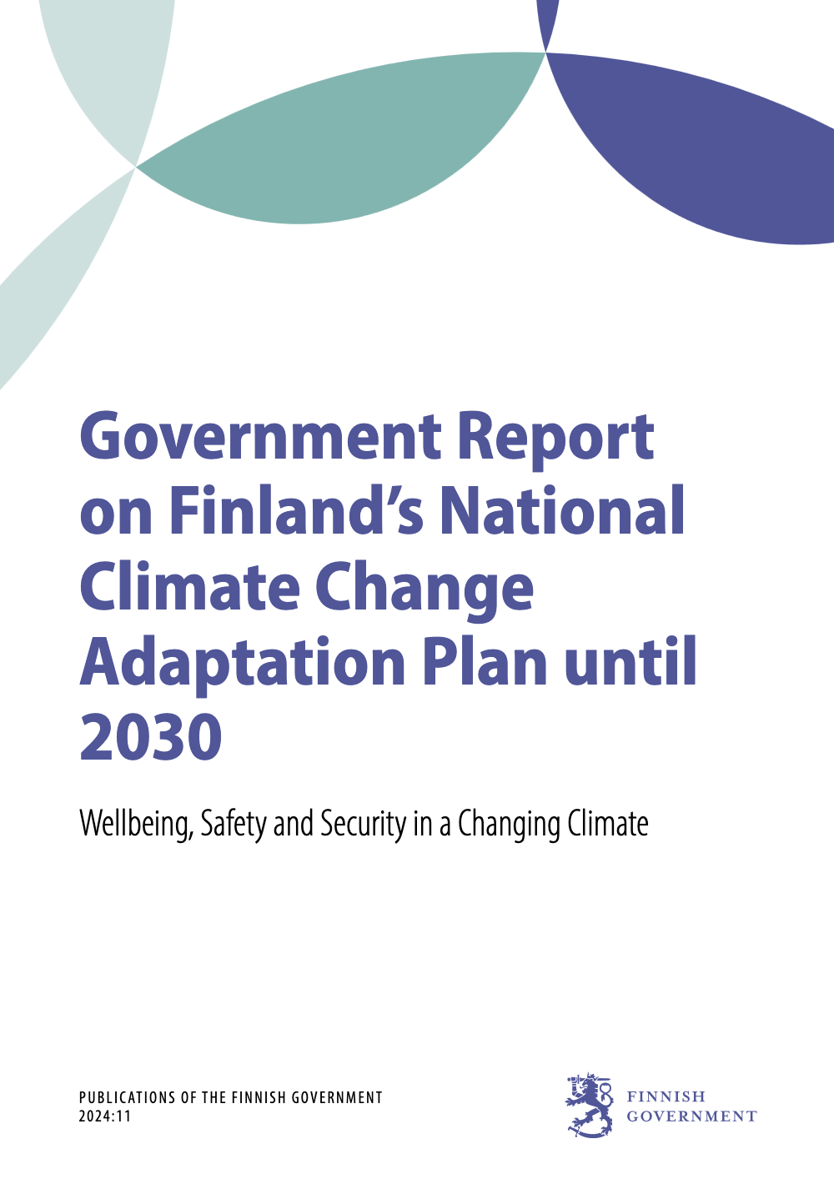
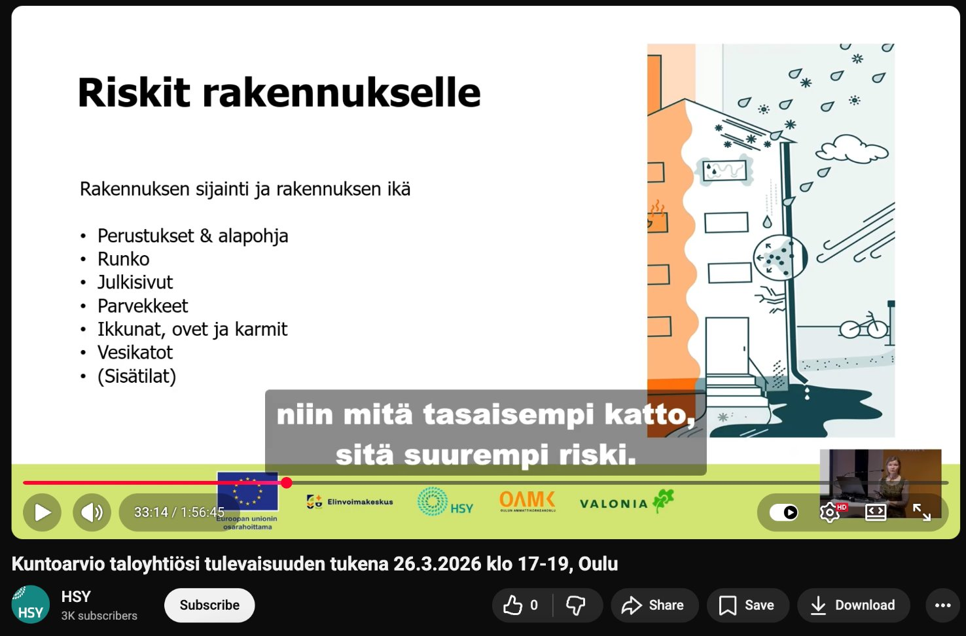
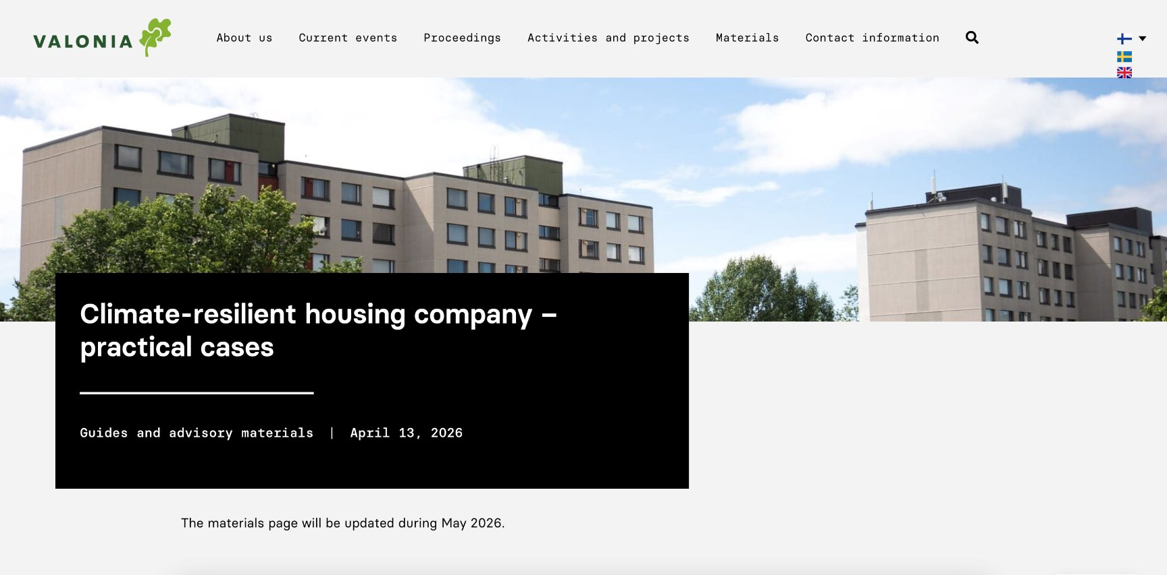
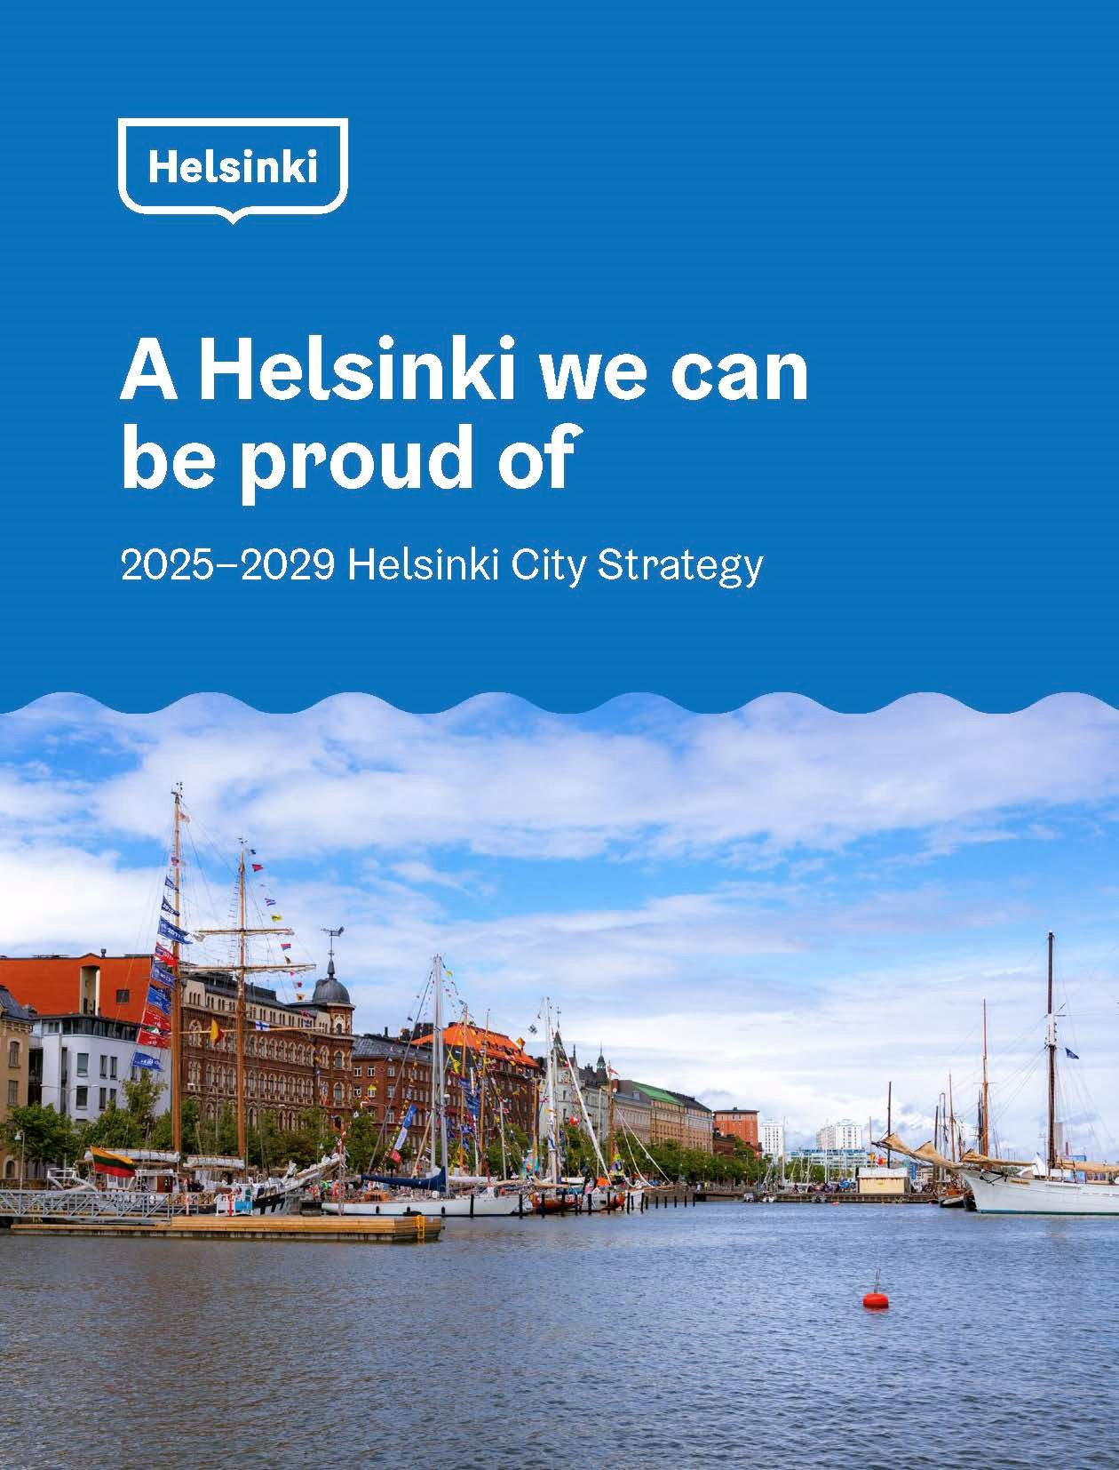
INTRODUCTION | CONTEXT
Creative Commons CC BY 4.0 2026
Anna Hakola · Duc Chu · Fernanda Ordorica · Jutta Pihlamo · Kaitlin Safka · Tessa Lehmussaari
Design for Government course · Aalto University
12

Slide 22
work with our biases, not against them
INTRODUCTION | CONCEPTUAL REFRAMING
Creative Commons CC BY 4.0 2026
Anna Hakola · Duc Chu · Fernanda Ordorica · Jutta Pihlamo · Kaitlin Safka · Tessa Lehmussaari
Design for Government course · Aalto University
13

Slide 23
tailored education that reaches its audience effectively.
INTRODUCTION | CONCEPTUAL REFRAMING
Creative Commons CC BY 4.0 2026
Anna Hakola · Duc Chu · Fernanda Ordorica · Jutta Pihlamo · Kaitlin Safka · Tessa Lehmussaari
Design for Government course · Aalto University
13

Slide 24
from “you do it tomorrow,” to “we do it today.”
INTRODUCTION | CONCEPTUAL REFRAMING
Creative Commons CC BY 4.0 2026
Anna Hakola · Duc Chu · Fernanda Ordorica · Jutta Pihlamo · Kaitlin Safka · Tessa Lehmussaari
Design for Government course · Aalto University
13

Slide 25
INTRODUCTION | CONCEPTUAL REFRAMING
But, why today?
Creative Commons CC BY 4.0 2026
Anna Hakola · Duc Chu · Fernanda Ordorica · Jutta Pihlamo · Kaitlin Safka · Tessa Lehmussaari
Design for Government course · Aalto University
13

Slide 26



INTRODUCTION | WHY NOW
CLIMATE IS ALREADY CHANGING
ADAPTATION TODAY IS AN INVESTMENT, NOT A COST
BIG RENOVATION CYCLE IS GOING TO HAPPEN SOON
(Finnish Meteorological Institute, 2025)
(Marttila-Tornio, 2024)
(Marttila-Tornio, 2024)
Creative Commons CC BY 4.0 2026
Anna Hakola · Duc Chu · Fernanda Ordorica · Jutta Pihlamo · Kaitlin Safka · Tessa Lehmussaari
Design for Government course · Aalto University
14

Slide 27
INTRODUCTION | WHY NOW
Because later is too late.
Creative Commons CC BY 4.0 2026
Anna Hakola · Duc Chu · Fernanda Ordorica · Jutta Pihlamo · Kaitlin Safka · Tessa Lehmussaari
Design for Government course · Aalto University
14

Slide 28
VISION | KNOWLEDGE IN ACTION
We envision a future-proof Helsinki where, through an ​ adaptive system of knowledge on our living spaces, we collaborate to ensure the safety and wellbeing of all inhabitants.​
Creative Commons CC BY 4.0 2026
Anna Hakola · Duc Chu · Fernanda Ordorica · Jutta Pihlamo · Kaitlin Safka · Tessa Lehmussaari
Design for Government course · Aalto University
15

Slide 29

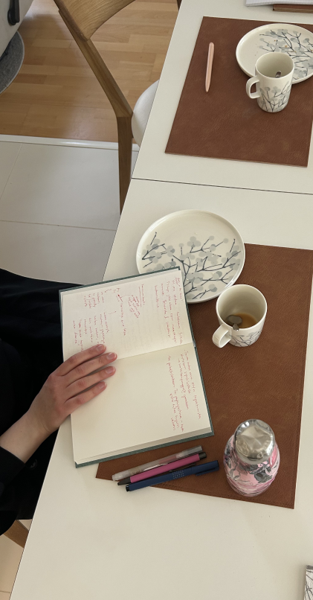
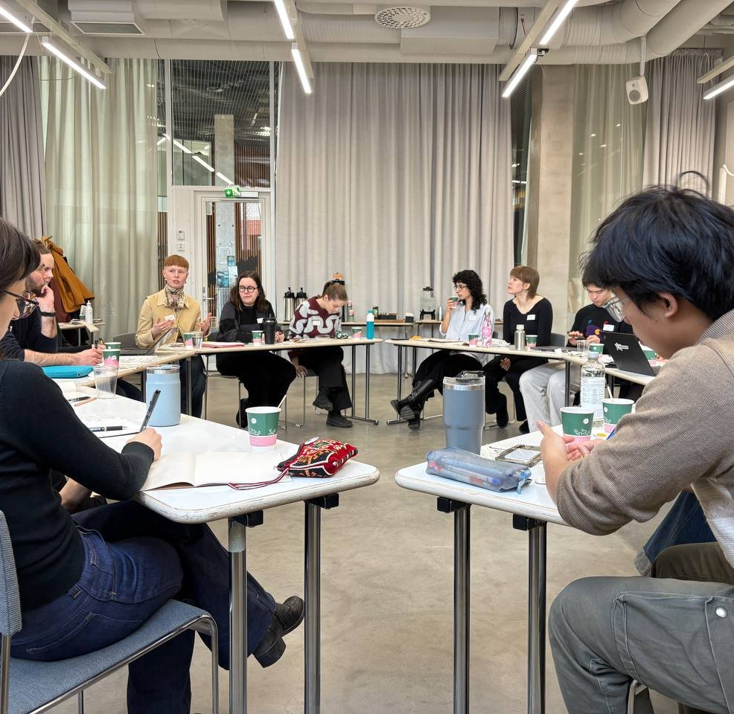
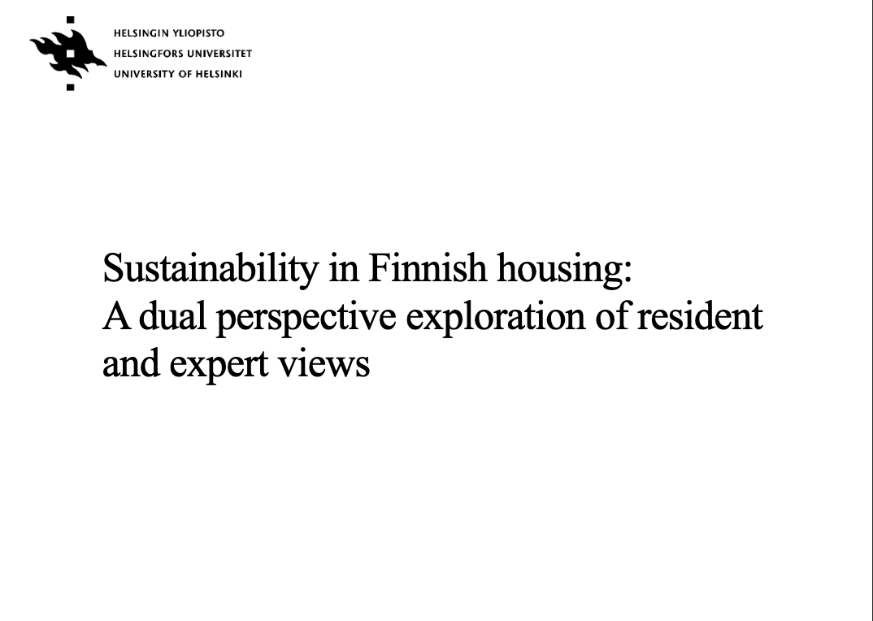

Creative Commons CC BY 4.0 2026
Anna Hakola · Jutta Pihlamo · Duc Chu · Fernanda Ordorica · Tessa Lehmussaari · Kaitlin Safka
Design for Government course · Aalto University
16

Slide 30
NUDGING STRATEGIES
PROPOSAL | STRATEGY
as a path to subtly alter the environment to guide people toward better decisions without restricting their freedom of choice.
Creative Commons CC BY 4.0 2026
Anna Hakola · Duc Chu · Fernanda Ordorica · Jutta Pihlamo · Kaitlin Safka · Tessa Lehmussaari
Design for Government course · Aalto University
17

Slide 31
THEN, WHERE DO WE START?
PROPOSAL | ENTRY POINTS
Creative Commons CC BY 4.0 2026
Anna Hakola · Duc Chu · Fernanda Ordorica · Jutta Pihlamo · Kaitlin Safka · Tessa Lehmussaari
Design for Government course · Aalto University
18

Slide 32
TAILORED EDUCATION
PROPOSAL | ENTRY POINT 1
ENTRY POINT 1
ENTRY POINT 2
ENTRY POINT 3
TAILORED EDUCATION
TAILORED EDUCATION
SHIFTING AGENCY
TAILORED EDUCATION
NETWORK BUILDING
An evaluation tool for
housing companies to assess the help they receive from property managers.
Provided by the City in collaboration with e.g. HSY and Kiinteistöliitto.
HOW:
simplified messaging, reframing, removing friction.
Creative Commons CC BY 4.0 2026
Anna Hakola · Duc Chu · Fernanda Ordorica · Jutta Pihlamo · Kaitlin Safka · Tessa Lehmussaari
Design for Government course · Aalto University
19

Slide 33
A PROPERTY MANAGER CAN “MAKE OR BREAK” A HOUSING COMPANY’S CLIMATE PREPAREDNESS
PROPOSAL | ENTRY POINT 1
Creative Commons CC BY 4.0 2026
Anna Hakola · Duc Chu · Fernanda Ordorica · Jutta Pihlamo · Kaitlin Safka · Tessa Lehmussaari
Design for Government course · Aalto University
20

Slide 34
A PROPERTY MANAGER CAN “MAKE OR BREAK” A HOUSING COMPANY’S CLIMATE PREPAREDNESS
PROPOSAL | ENTRY POINT 1
AN EVALUATION TOOL GIVES AGENCY TO HOUSING COMPANIES TO GET THE SUPPORT THEY NEED
Creative Commons CC BY 4.0 2026
Anna Hakola · Duc Chu · Fernanda Ordorica · Jutta Pihlamo · Kaitlin Safka · Tessa Lehmussaari
Design for Government course · Aalto University
20

Slide 35
PROPOSAL | ENTRY POINT 2
ENTRY POINT 1
ENTRY POINT 2
ENTRY POINT 3
SHIFTING AGENCY
TAILORED EDUCATION
SHIFTING AGENCY
NETWORK BUILDING
An evaluation tool for
housing companies to assess property managers.
Provided by the City of Helsinki in collaboration with e.g. HSY and Kiinteistöliitto.
HOW:
simplified messaging, reframing, removing friction.
Education material for residents on climate adaptation, but framed differently.
Offered to housing companies and interested residents by the City of Helsinki in collaboration with Työväenopisto.
HOW:
simplified messaging, reframing
Creative Commons CC BY 4.0 2026
Anna Hakola · Duc Chu · Fernanda Ordorica · Jutta Pihlamo · Kaitlin Safka · Tessa Lehmussaari
Design for Government course · Aalto University
21

Slide 36
HOW TO PREPARE FOR CLIMATE RISKS AND BUILD RESILIENCE?
PROPOSAL | ENTRY POINT 2
Creative Commons CC BY 4.0 2026
Anna Hakola · Duc Chu · Fernanda Ordorica · Jutta Pihlamo · Kaitlin Safka · Tessa Lehmussaari
Design for Government course · Aalto University
22

Slide 37
PROPOSAL | ENTRY POINT 2
HOW TO PREPARE FOR CLIMATE RISKS AND BUILD RESILIENCE?
HOW TO INCREASE PROPERTY VALUE THROUGH STRATEGIC RENOVATION?
Creative Commons CC BY 4.0 2026
Anna Hakola · Duc Chu · Fernanda Ordorica · Jutta Pihlamo · Kaitlin Safka · Tessa Lehmussaari
Design for Government course · Aalto University
22

Slide 38
TAILORED EDUCATION
PROPOSAL | ENTRY POINT 3
ENTRY POINT 1
ENTRY POINT 2
ENTRY POINT 3
SHIFTING AGENCY
TAILORED EDUCATION
SHIFTING AGENCY
NETWORK BUILDING
NETWORK BUILDING
An evaluation tool for
housing companies to assess property managers.
Provided by the City of Helsinki in collaboration with e.g. HSY and Kiinteistöliitto.
HOW:
simplified messaging, reframing, removing friction.
Education material for residents on climate adaptation, but framed differently.
Offered to housing companies and interested residents by the City of Helsinki in collaboration with työväenopisto.
HOW:
simplified messaging, reframing
Pooling renovations and establishing climate ambassadors to strengthen community networks.
Facilitated by the City of Helsinki e.g. Energy Advisory Team, with the help of Kiinteistöliitto and neighborhood organizations.
HOW:
social proof, social norms, activating social identities, reciprocity
Creative Commons CC BY 4.0 2026
Anna Hakola · Duc Chu · Fernanda Ordorica · Jutta Pihlamo · Kaitlin Safka · Tessa Lehmussaari
Design for Government course · Aalto University
23

Slide 39
SUPERSTARS ACT ALONE
PROPOSAL | ENTRY POINT 3
Creative Commons CC BY 4.0 2026
Anna Hakola · Duc Chu · Fernanda Ordorica · Jutta Pihlamo · Kaitlin Safka · Tessa Lehmussaari
Design for Government course · Aalto University
24

Slide 40
SUPERSTARS ACT ALONE
PROPOSAL | ENTRY POINT 3
WITH CLIMATE AMBASSADORS,
ACTION BECOMES THE NORM
“YOUR NEIGHBOURS ARE STARTING ENERGY RENOVATIONS. WOULD YOU LIKE TO JOIN?”
Creative Commons CC BY 4.0 2026
Anna Hakola · Duc Chu · Fernanda Ordorica · Jutta Pihlamo · Kaitlin Safka · Tessa Lehmussaari
Design for Government course · Aalto University
24

Slide 41
PROPOSAL | OVERVIEW
ENTRY POINT 1
ENTRY POINT 2
ENTRY POINT 3
SHIFTING AGENCY
TAILORED EDUCATION
NETWORK BUILDING
An evaluation tool for
housing companies to assess property managers.
Provided by the City of Helsinki in collaboration with e.g. HSY and Kiinteistöliitto.
HOW:
simplified messaging, reframing, removing friction.
Education material for residents on climate adaptation, but framed differently.
Offered to housing companies and interested residents by the City of Helsinki in collaboration with työväenopisto.
HOW:
simplified messaging, reframing.
Pooling renovations and establishing climate ambassadors to strengthen community networks.
Facilitated by the City of Helsinki e.g. Energy Advisory Team, with the help of Kiinteistöliitto and neighborhood organizations.
HOW:
social proof, social norms, activating social identities, reciprocity
Creative Commons CC BY 4.0 2026
Anna Hakola · Duc Chu · Fernanda Ordorica · Jutta Pihlamo · Kaitlin Safka · Tessa Lehmussaari
Design for Government course · Aalto University
25

Slide 42
LIMITATIONS | OVERVIEW
SHORT-TERM NUDGING & SOFT POWER
LONG-TERM
POLICY CHANGE & SUPPORT SYSTEM
as initiation strategy
before nudging loses effectiveness
ENTRY POINT 1:
SHIFTING AGENCY
ENTRY POINT 2:
TAILORED EDUCATION
ENTRY POINT 3:
NETWORK BUILDING
simplified messaging, reframing, removing friction
simplified messaging, reframing
social proof, social norms, activating social identities, reciprocity
OUR VISION
Creative Commons CC BY 4.0 2026
Anna Hakola · Duc Chu · Fernanda Ordorica · Jutta Pihlamo · Kaitlin Safka · Tessa Lehmussaari
Design for Government course · Aalto University
26

Slide 43
CLIMATE ADAPTATION
FUTURE OPPORTUNITIES | OVERVIEW
SAFETY
WELL-BEING
AN ADAPTIVE SYSTEM OF
KNOWLEDGE
RESILIENCE
INTERSECTIONAL
Creative Commons CC BY 4.0 2026
Anna Hakola · Duc Chu · Fernanda Ordorica · Jutta Pihlamo · Kaitlin Safka · Tessa Lehmussaari
Design for Government course · Aalto University
27

Slide 44
“
IF YOU WANT TO WALK TOMORROW, WALK TODAY.,,,
“
“
^{– Housing Company Board Member}
Creative Commons CC BY 4.0 2026
Anna Hakola · Duc Chu · Fernanda Ordorica · Jutta Pihlamo · Kaitlin Safka · Tessa Lehmussaari
Design for Government course · Aalto University
28

Slide 45
REFERENCES
1 Brandon, C., Kratzer, B., Aggarwal, A. & Heubaum, H. (2025). Strengthening the investment case for climate adaptation: A triple dividend approach. Working Paper. Washington, DC: World Resources Institute. Available online at doi.org/10.46830/wriwp.25.00019.
2 Finnish Meteorological Institute. (2024, November 13). Heavy rainfall events will become more severe in Finland as the climate warms. https://en.ilmatieteenlaitos.fi/press-release/2mV6FGVh8kkpwJG9DfKjTL
3 Laakkonen, T. (2025). The Roof Is on Fire - Housing Companies' Motivation for Adapting to Climate Change. Aalto University, Master's thesis.
4 Marttila-Tornio, M. (2024). TALVI-hankkeen alkukartoituskyselyn raportti. Accessed 18.5.2026 in https://www.hsy.fi/4ab27d/globalassets/hsy/projektisivustot-ja-hanke-esittelyt/tiedostot/talvi-hankkeen-alkukartoitusraportti.pdf
5 Pahl, S., Sheppard, S., Boomsma, C., & Groves, C. (2014). Perceptions of time in relation to climate change. WIREs Climate Change, 5(3), 375–388. https://doi.org/10.1002/wcc.272
6 Pilat, D., & Krastev, S. (2021). Optimism Bias. The Decision Lab. Retrieved May 20, 2026, from https://thedecisionlab.com/biases/optimism-bias
7 Thaler, R. H., & Sunstein, C. R. (2009). Nudge. Penguin.
8 Valonia. (2024). Ilmastosopeutuminen asuntoosakeyhtiöiden kuntoarvioinnissa ja korjausrakentamisessa – kartoitus nykytilasta ja kehitystarpeista. Accessed 18.5.2026 in https://valonia.fi/wp-content/uploads/2025/09/TP-3.2.-Raportti.pdf
9 Sharot, T. (2011). The optimism bias. Current biology, 21(23), R941-R945.
Creative Commons CC BY 4.0 2026
Anna Hakola · Duc Chu · Fernanda Ordorica · Jutta Pihlamo · Kaitlin Safka · Tessa Lehmussaari
Design for Government course · Aalto University
29

