Slide 1



CARE & CLIMATE IN AN AGE OF VULNERABILITY
HELSINKI CITY HALL
26TH MAY 2026
KNOWLEDGE IN ACTION
ACTIVATING CLIMATE ADAPTATION THROUGH TAILORED EDUCATION
· ANNA HAKOLA · DUC CHU · FERNANDA ORDORICA ·
· JUTTA PIHLAMO · KAITLIN SAFKA · TESSA LEHMUSSAARI ·
Creative Commons CC BY 4.0 2026
Anna Hakola · Duc Chu · Fernanda Ordorica · Jutta Pihlamo · Kaitlin Safka · Tessa Lehmussaari
Design for Government course · Aalto University

Slide 2
AGENDA
1 INTRODUCTION
2 VISION
3 PROPOSAL
4 LIMITATIONS
5 FUTURE OPPORTUNITIES
Creative Commons CC BY 4.0 2026
Anna Hakola · Duc Chu · Fernanda Ordorica · Jutta Pihlamo · Kaitlin Safka · Tessa Lehmussaari
Design for Government course · Aalto University

Slide 3

INTRODUCTION | OPTIMISM BIAS
Creative Commons CC BY 4.0 2026
Anna Hakola · Duc Chu · Fernanda Ordorica · Jutta Pihlamo · Kaitlin Safka · Tessa Lehmussaari
Design for Government course · Aalto University
3
Notes:
The dangers of climate change are much closer to home than we might think.

Slide 4
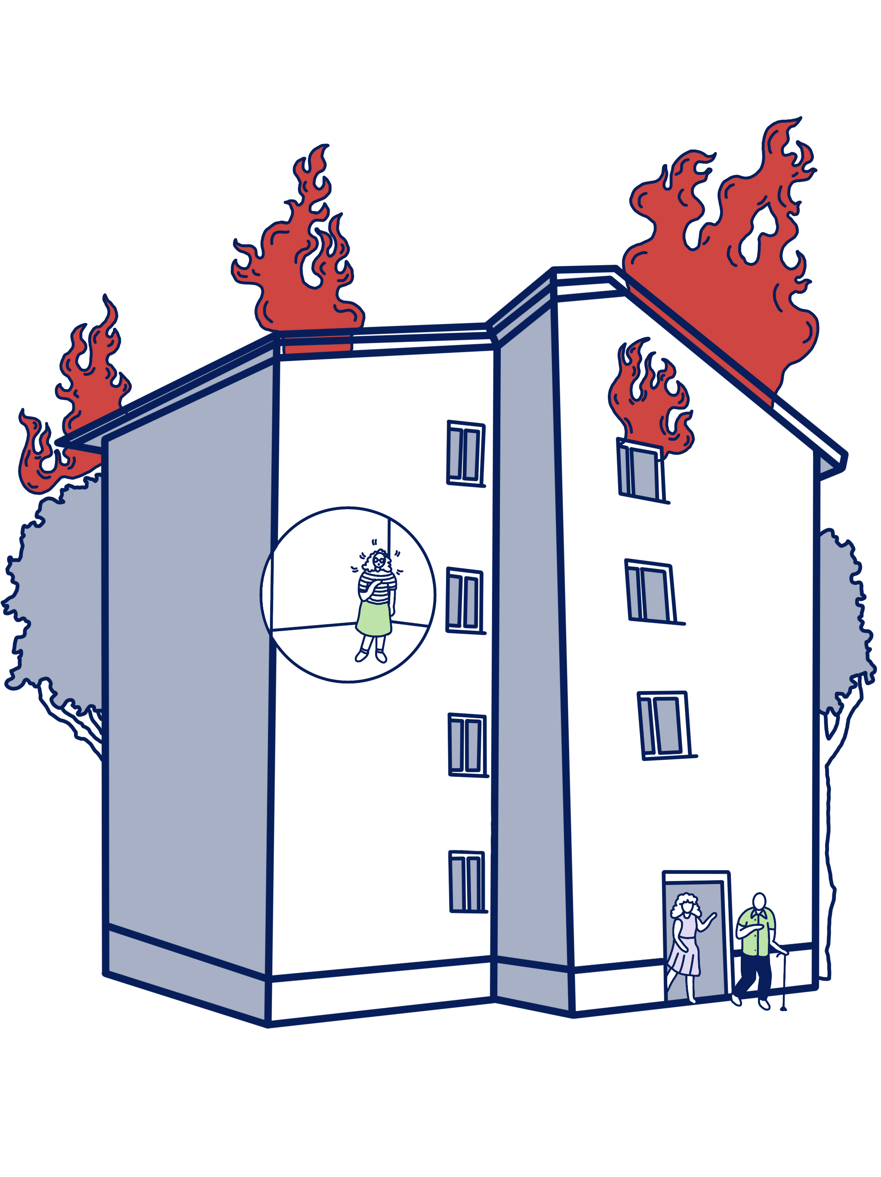
INTRODUCTION | OPTIMISM BIAS
Creative Commons CC BY 4.0 2026
Anna Hakola · Duc Chu · Fernanda Ordorica · Jutta Pihlamo · Kaitlin Safka · Tessa Lehmussaari
Design for Government course · Aalto University
3
Notes:
The dangers of climate change are much closer to home than we might think.

Slide 5
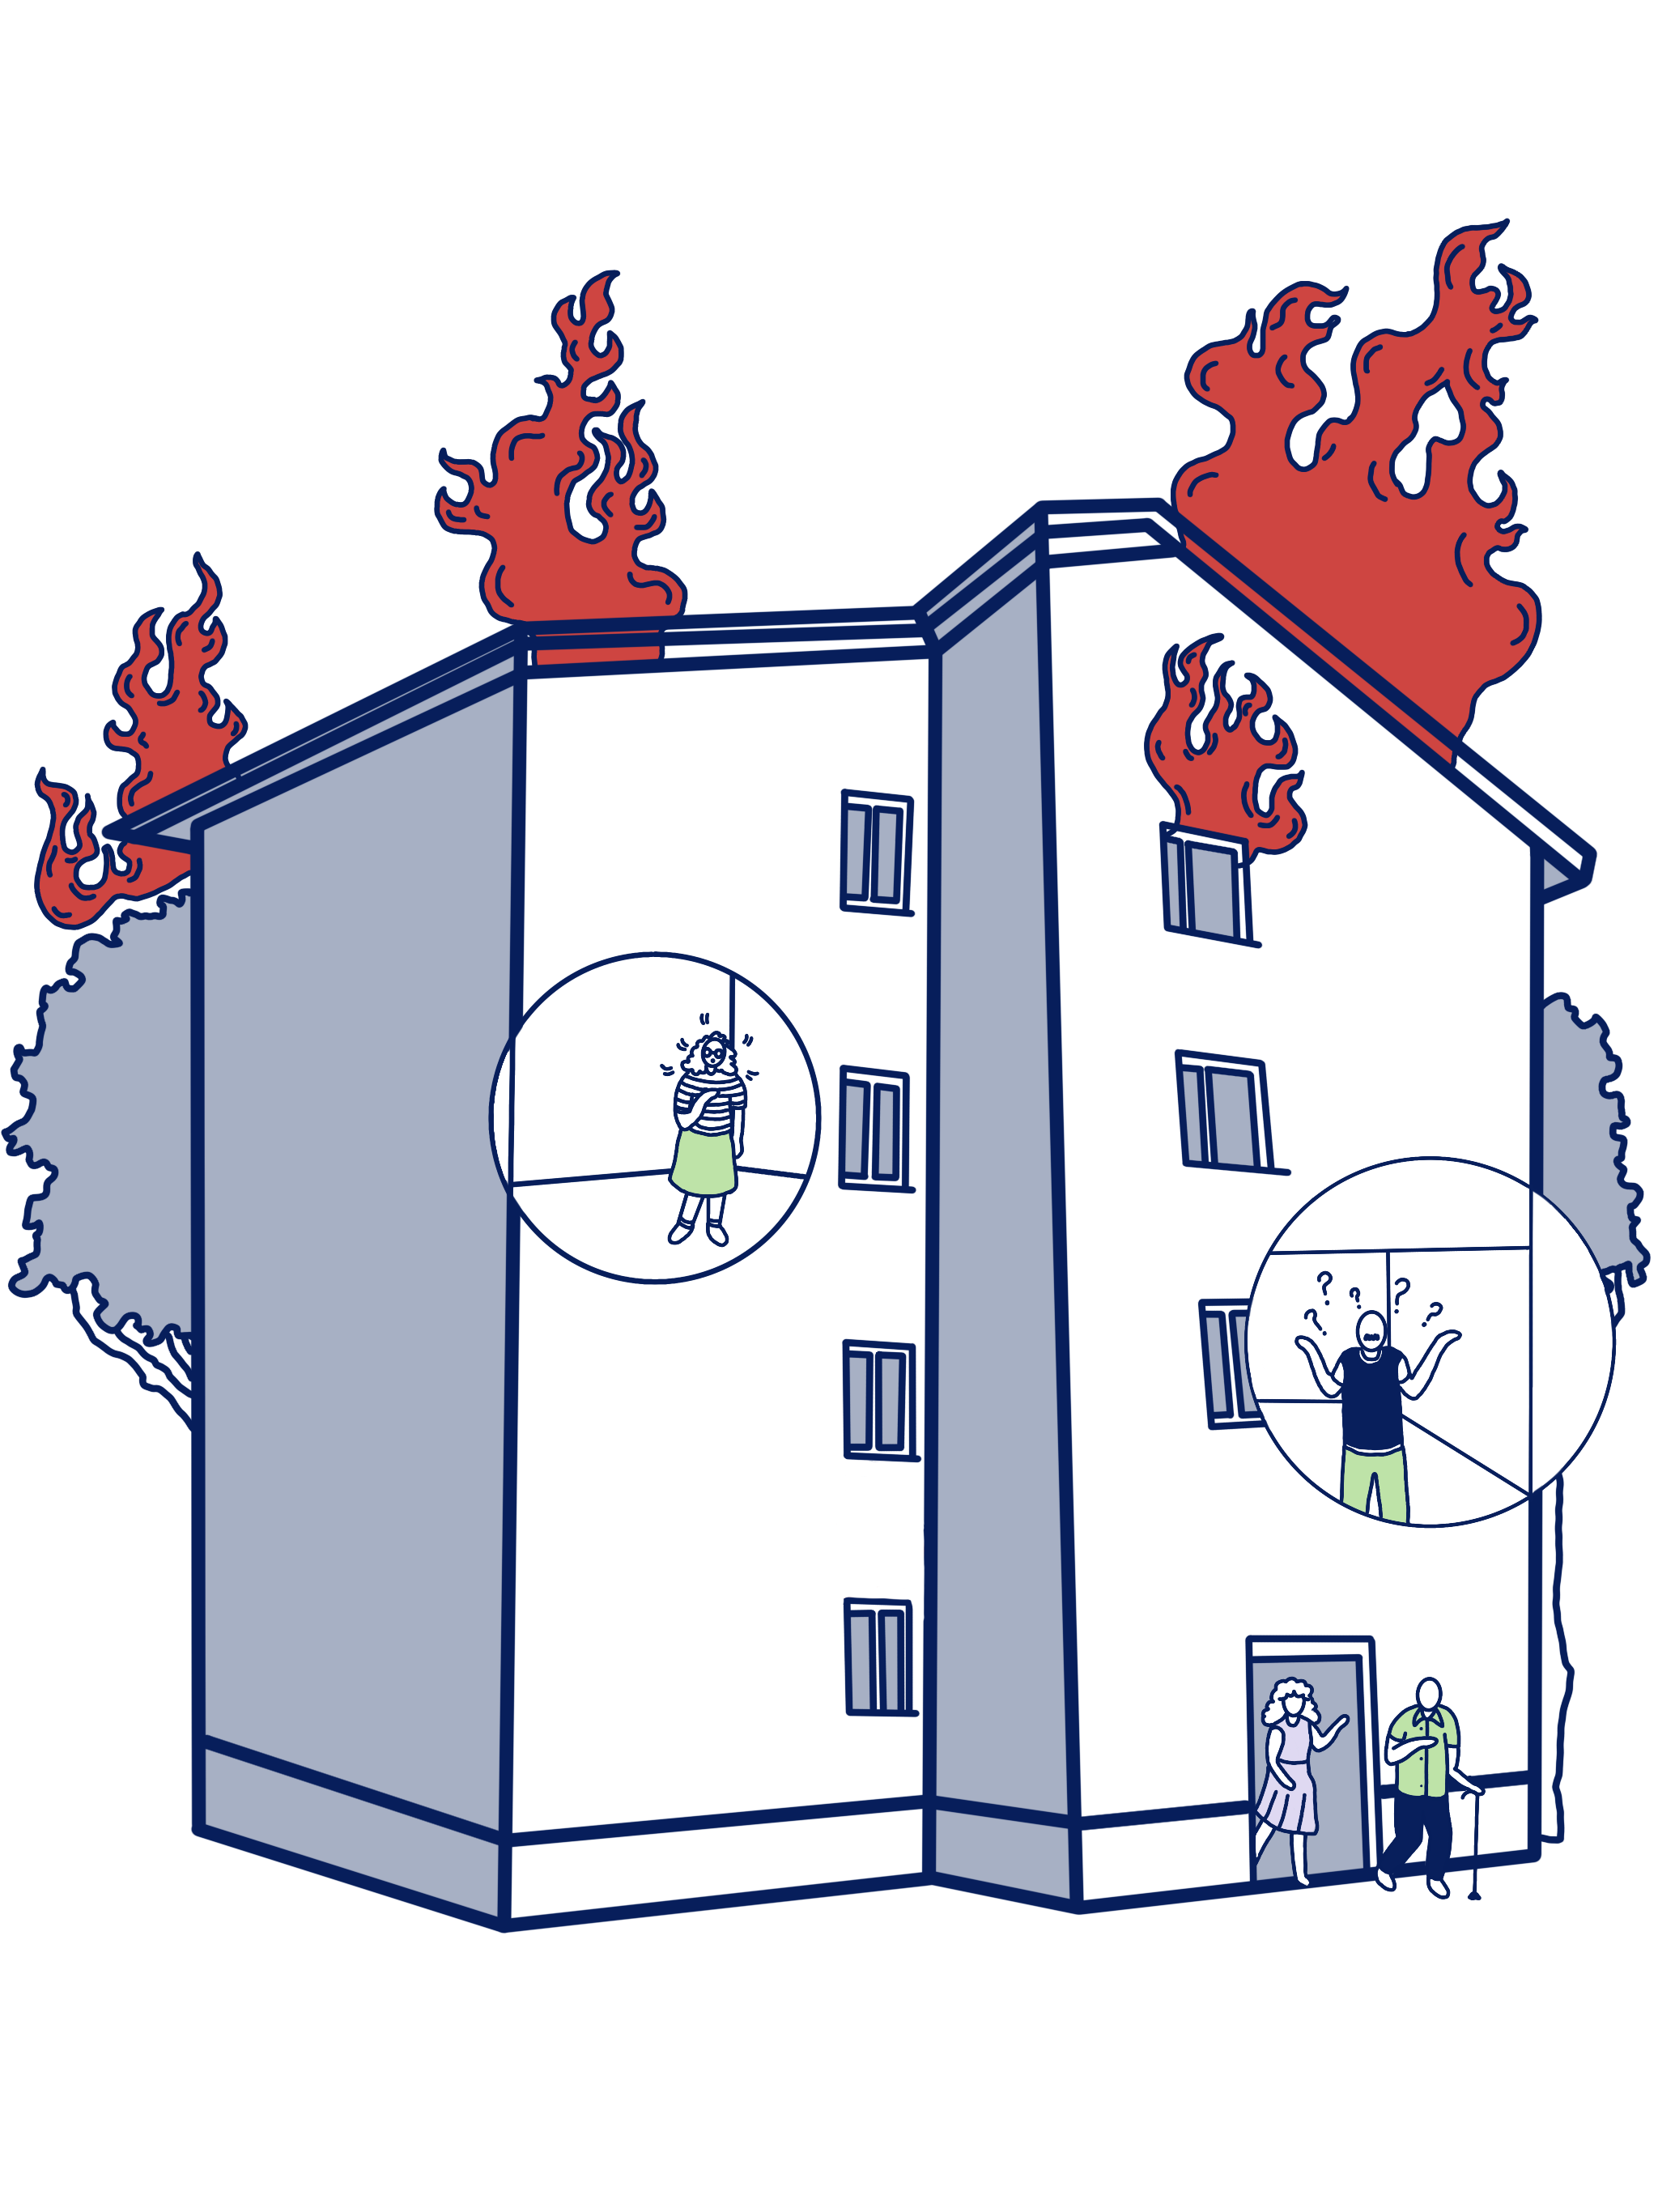
INTRODUCTION | OPTIMISM BIAS
Creative Commons CC BY 4.0 2026
Anna Hakola · Duc Chu · Fernanda Ordorica · Jutta Pihlamo · Kaitlin Safka · Tessa Lehmussaari
Design for Government course · Aalto University
3
Notes:
The dangers of climate change are much closer to home than we might think.

Slide 6


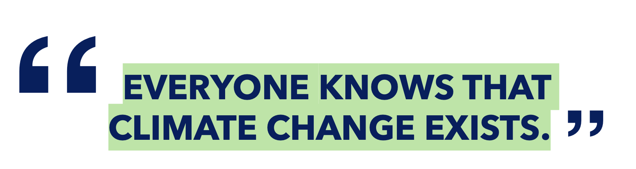
INTRODUCTION | OPTIMISM BIAS
80%
– Housing Company Board Member
Creative Commons CC BY 4.0 2026
Anna Hakola · Duc Chu · Fernanda Ordorica · Jutta Pihlamo · Kaitlin Safka · Tessa Lehmussaari
Design for Government course · Aalto University
4
Notes:
This story is not so uncommon. More than 80% of our housing board interviewees were aware of the extreme weather and health risks climate change poses in Finland. Yet, the same people stated that climate change was rarely, if ever, discussed in their board meetings. (quote on screen?)
This phenomena can be explained by behavioral science.

Slide 7

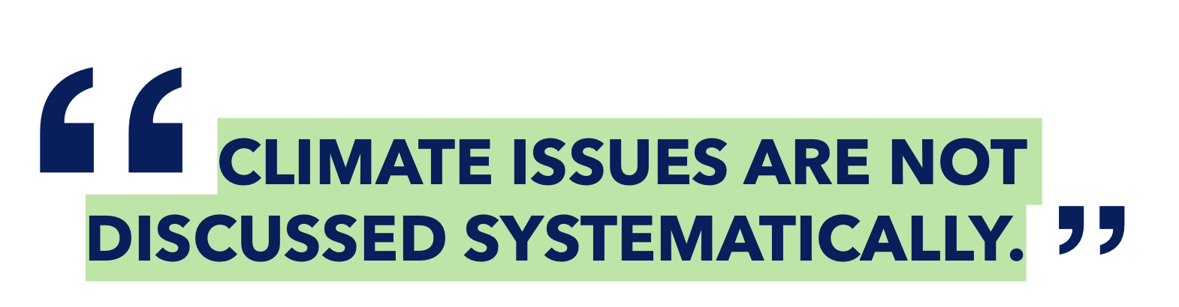
INTRODUCTION | OPTIMISM BIAS
80%
– Housing Company Board Member
Creative Commons CC BY 4.0 2026
Anna Hakola · Duc Chu · Fernanda Ordorica · Jutta Pihlamo · Kaitlin Safka · Tessa Lehmussaari
Design for Government course · Aalto University
4
Notes:
This story is not so uncommon. More than 80% of our housing board interviewees were aware of the extreme weather and health risks climate change poses in Finland. Yet, the same people stated that climate change was rarely, if ever, discussed in their board meetings. (quote on screen?)
This phenomena can be explained by behavioral science.

Slide 8
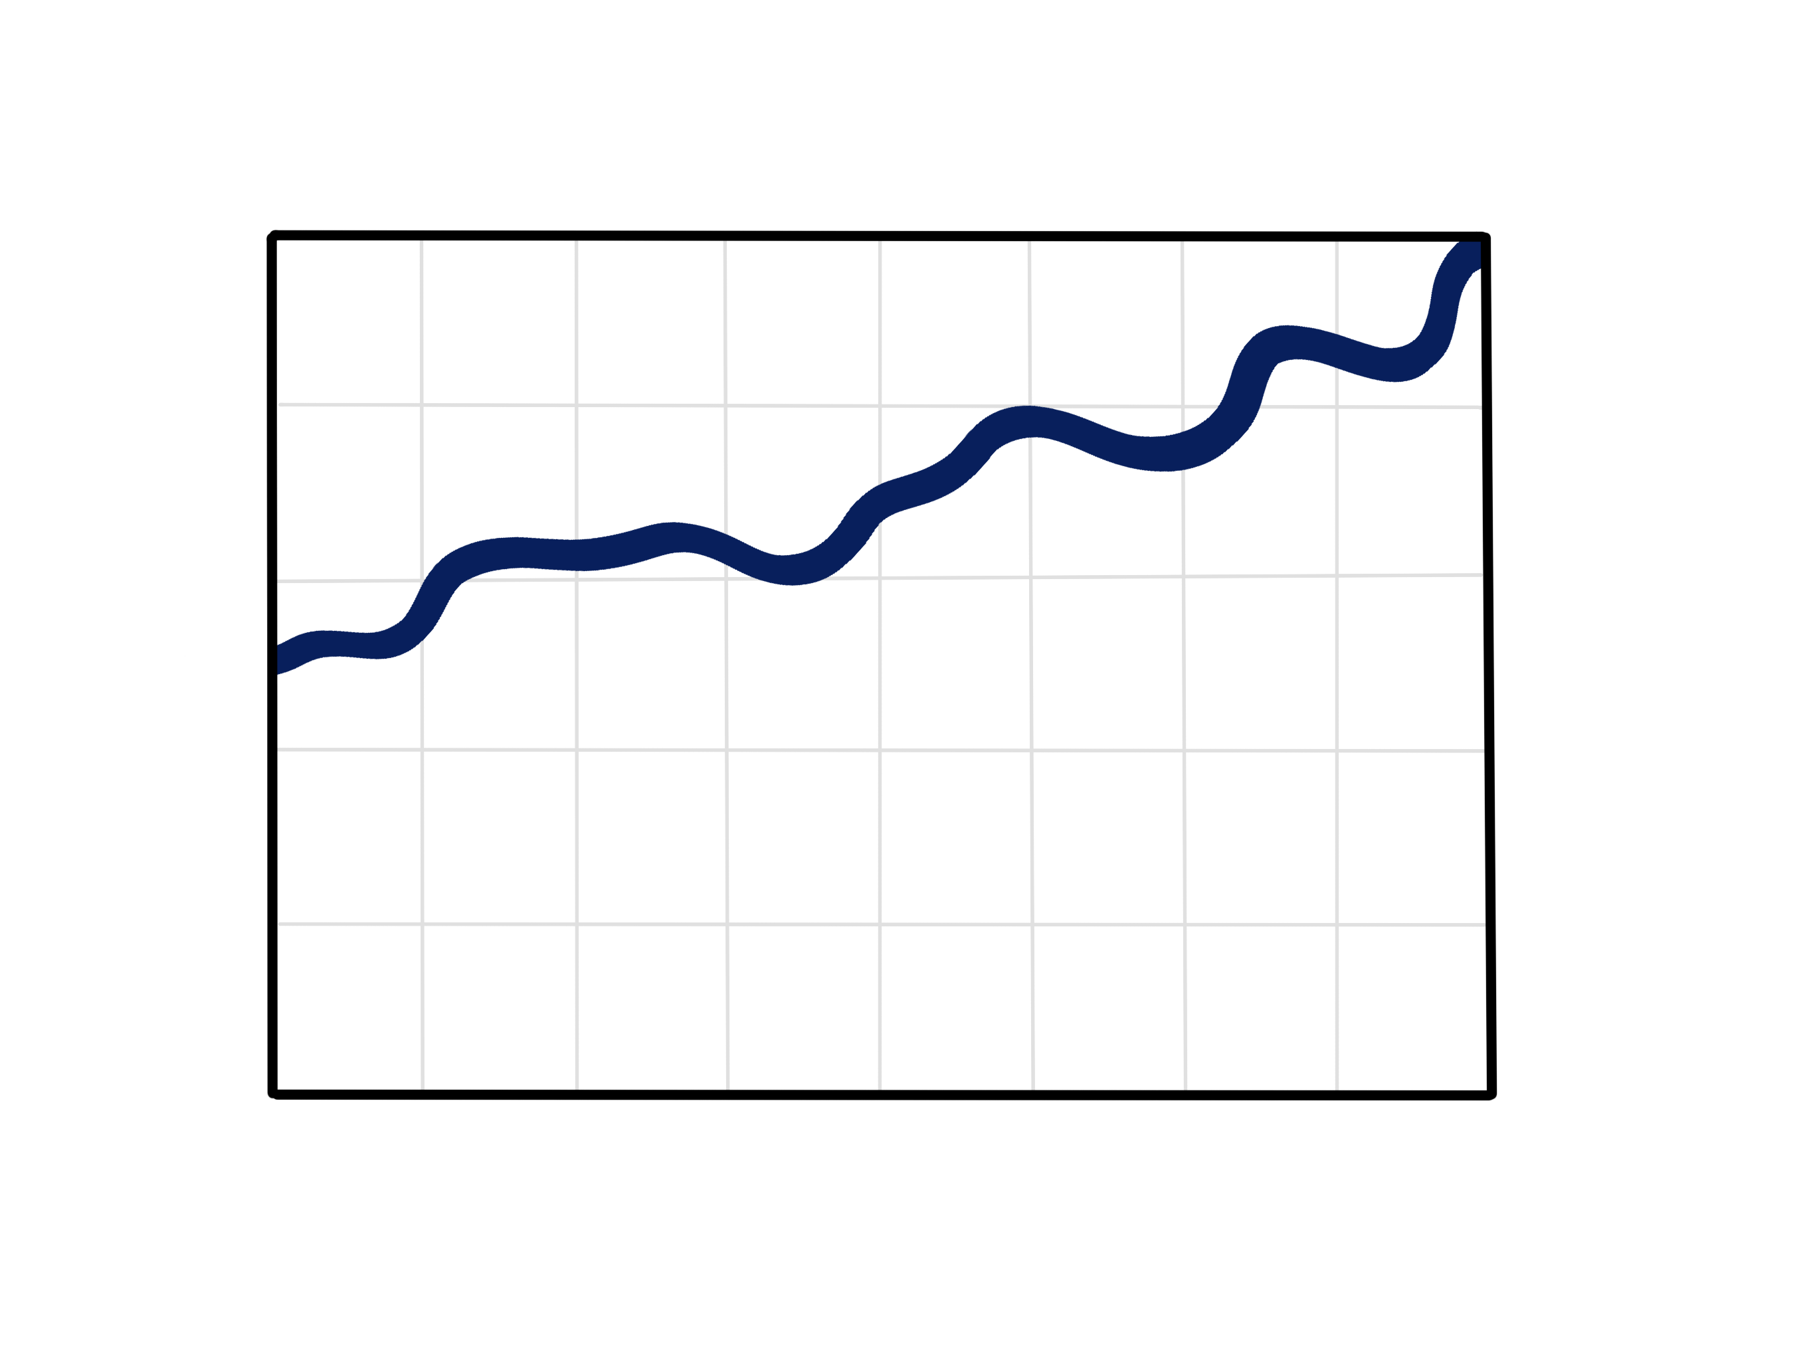
INTRODUCTION | OPTIMISM BIAS
perception
(Sharot, 2011)
Creative Commons CC BY 4.0 2026
Anna Hakola · Duc Chu · Fernanda Ordorica · Jutta Pihlamo · Kaitlin Safka · Tessa Lehmussaari
Design for Government course · Aalto University
5
Notes:
In Cognitive neuroscientist Tali Sharot’s book on the optimism bias, she describes a year in Great Britain when citizens were surveyed about their opinions on the future of their country. 83% said they believed violent crime was on the rise, when really it had been slowly decreasing in the past years. Meanwhile, Sharot conducted her own survey that asked British people to estimate their own likelihood of experiencing a crime. On average, participants estimated their likelihood as lower than the actual numbers from authorities.
Therefore, at the same time that citizens felt strongly about high crime rates in their country, they felt strongly that they wouldn’t be the ones to experience the negative effects.

Slide 9
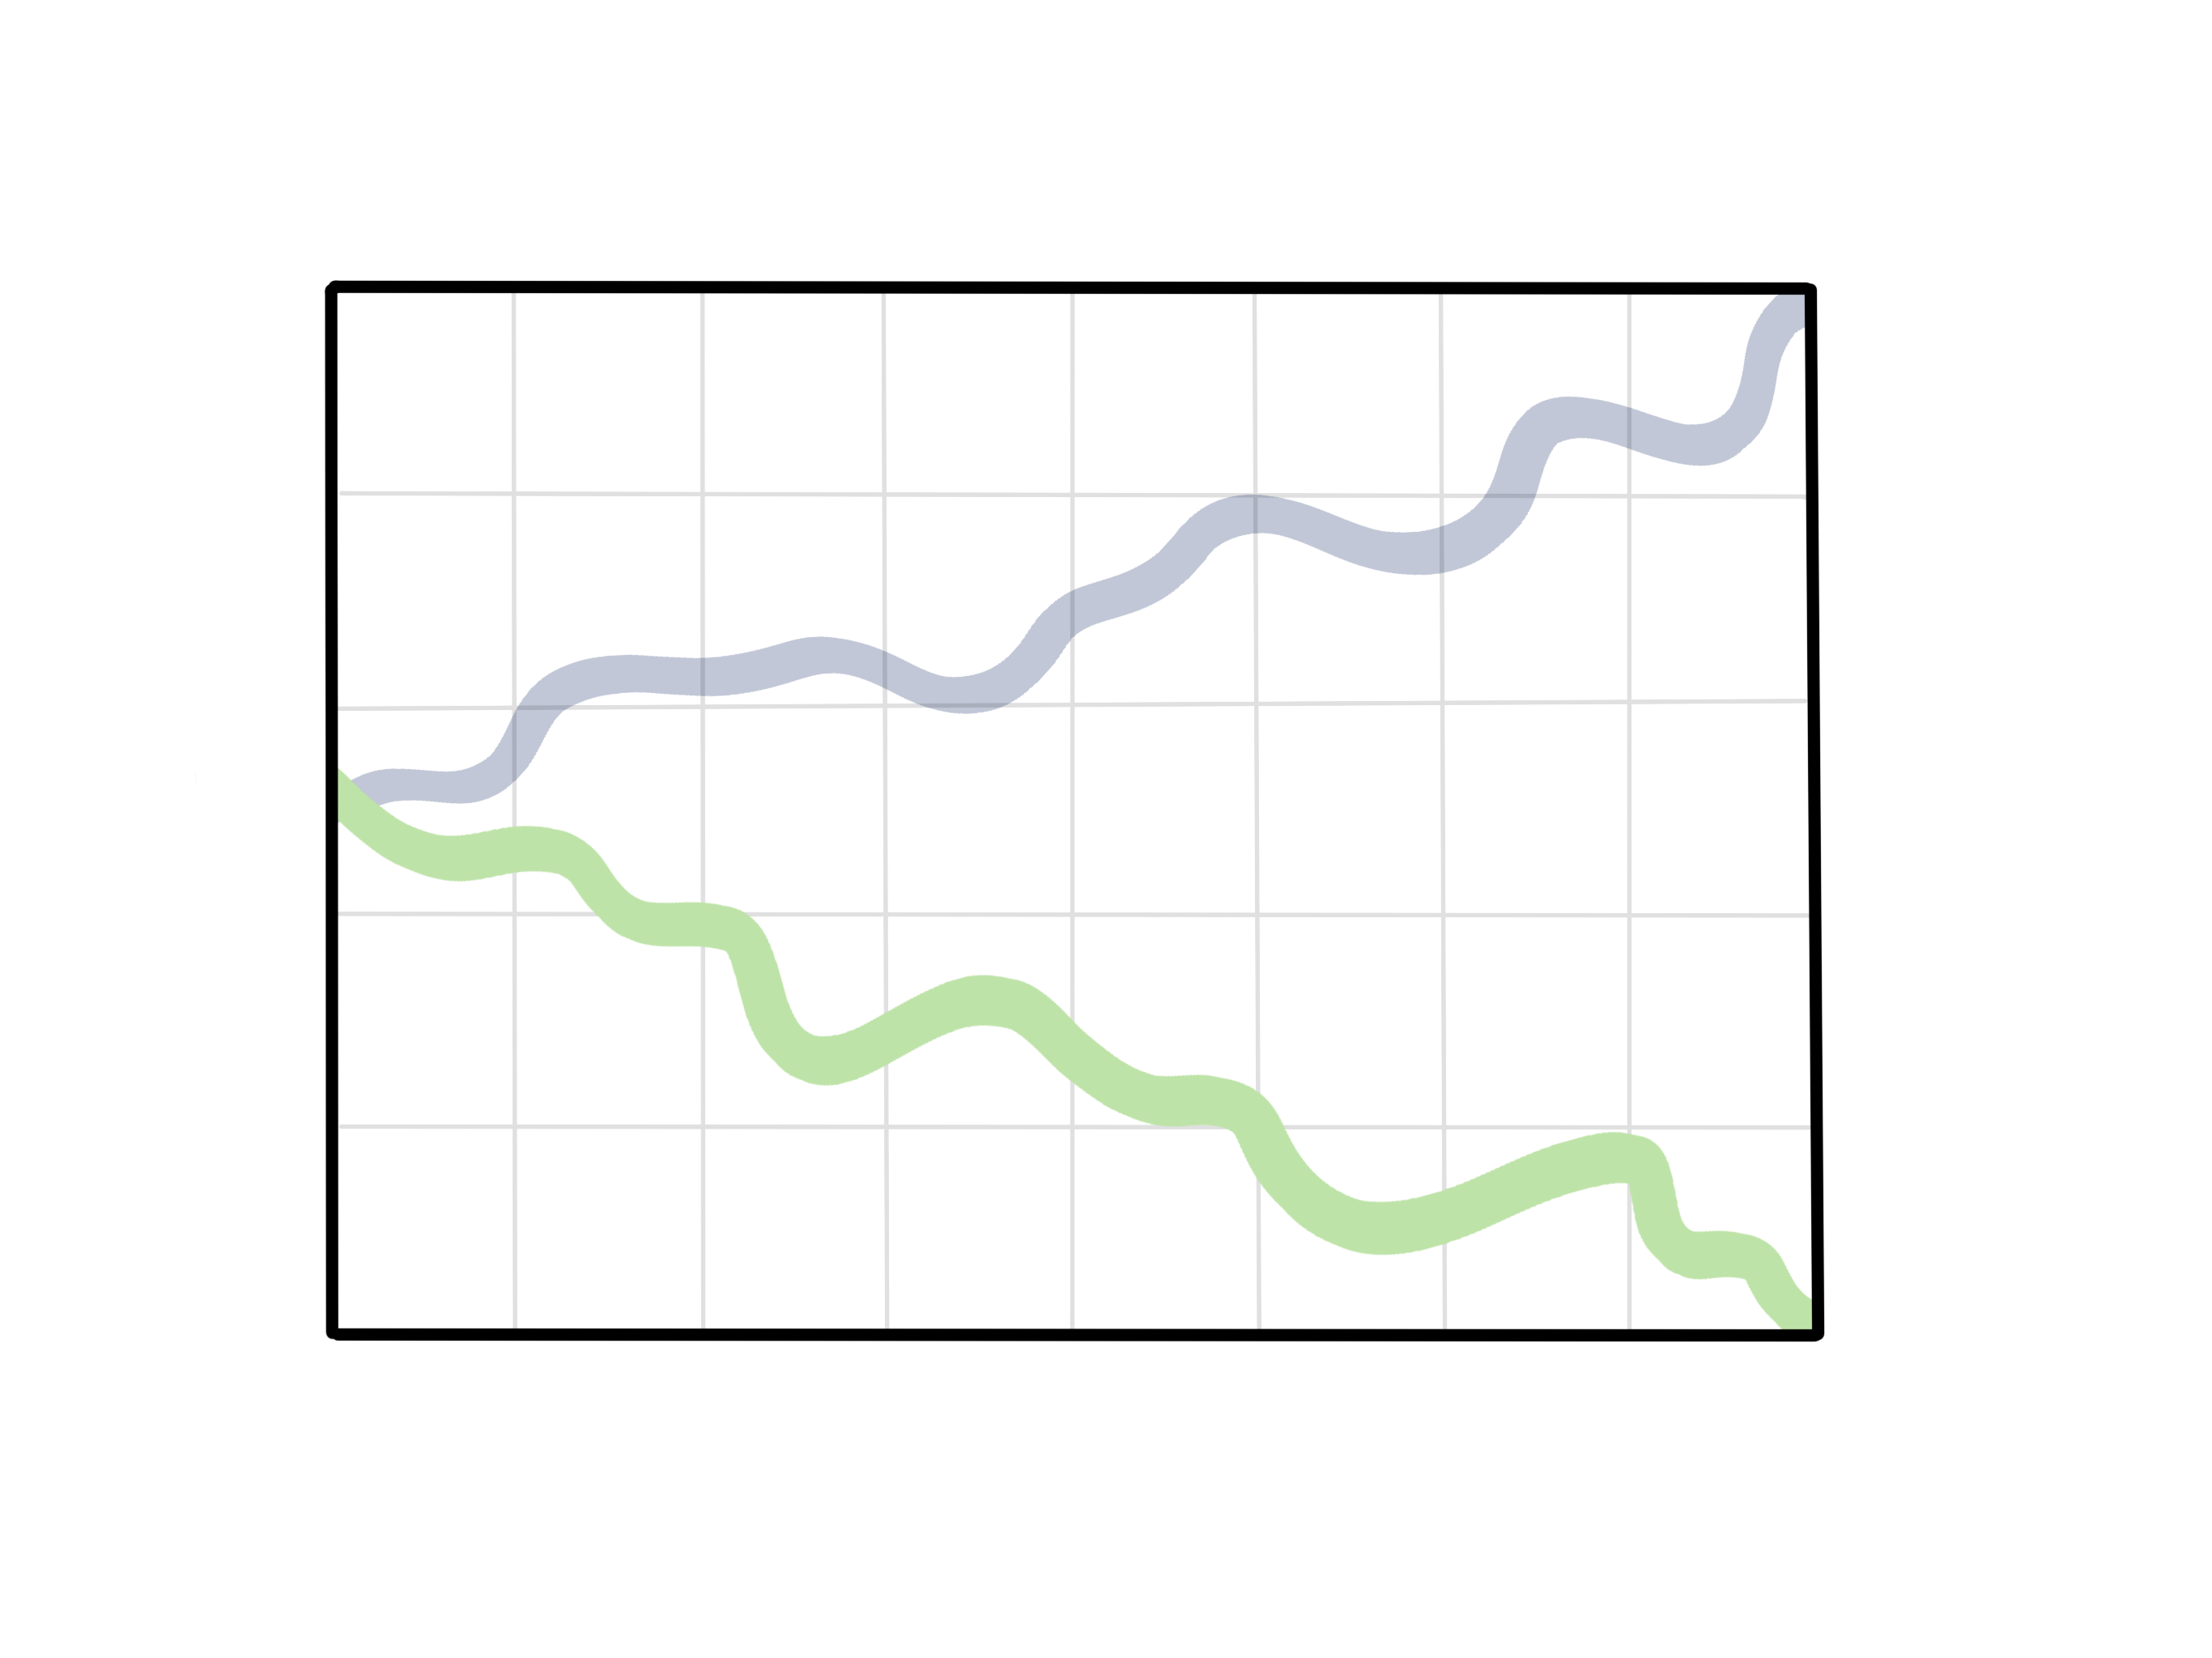
INTRODUCTION | OPTIMISM BIAS
perception
reality
(Sharot, 2011)
Creative Commons CC BY 4.0 2026
Anna Hakola · Duc Chu · Fernanda Ordorica · Jutta Pihlamo · Kaitlin Safka · Tessa Lehmussaari
Design for Government course · Aalto University
5
Notes:
In Cognitive neuroscientist Tali Sharot’s book on the optimism bias, she describes a year in Great Britain when citizens were surveyed about their opinions on the future of their country. 83% said they believed violent crime was on the rise, when really it had been slowly decreasing in the past years. Meanwhile, Sharot conducted her own survey that asked British people to estimate their own likelihood of experiencing a crime. On average, participants estimated their likelihood as lower than the actual numbers from authorities.
Therefore, at the same time that citizens felt strongly about high crime rates in their country, they felt strongly that they wouldn’t be the ones to experience the negative effects.

Slide 10

INTRODUCTION | OPTIMISM BIAS
Perceived
likelihood
(Sharot, 2011)
Creative Commons CC BY 4.0 2026
Anna Hakola · Duc Chu · Fernanda Ordorica · Jutta Pihlamo · Kaitlin Safka · Tessa Lehmussaari
Design for Government course · Aalto University
6
Notes:
In Cognitive neuroscientist Tali Sharot’s book on the optimism bias, she describes a year in Great Britain when citizens were surveyed about their opinions on the future of their country. 83% said they believed violent crime was on the rise, when really it had been slowly decreasing in the past years. Meanwhile, Sharot conducted her own survey that asked British people to estimate their own likelihood of experiencing a crime. On average, participants estimated their likelihood as lower than the actual numbers from authorities.
Therefore, at the same time that citizens felt strongly about high crime rates in their country, they felt strongly that they wouldn’t be the ones to experience the negative effects.

Slide 11
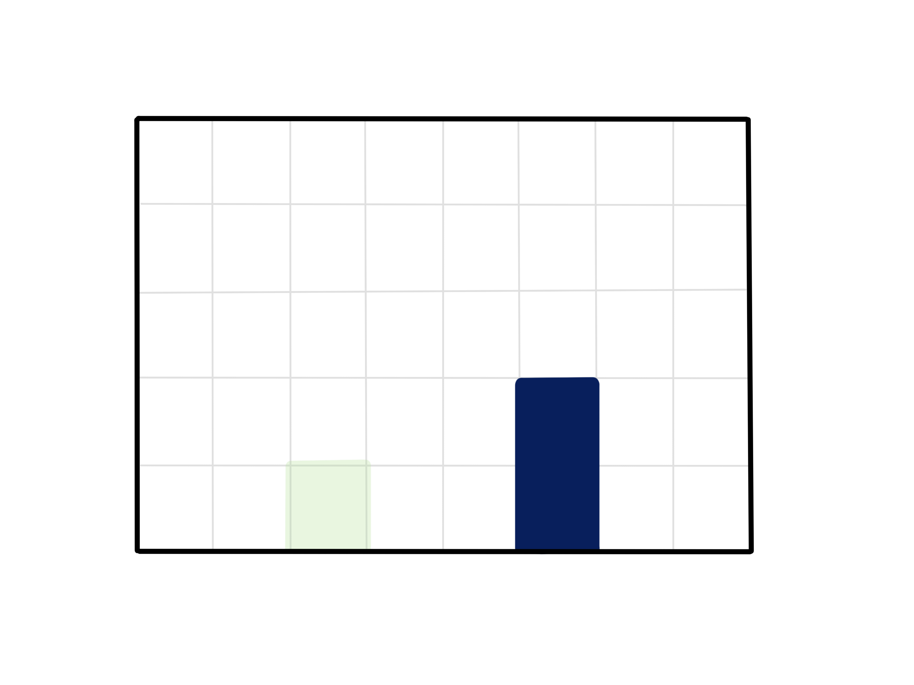
INTRODUCTION | OPTIMISM BIAS
Actual likelihood
Perceived
likelihood
(Sharot, 2011)
Creative Commons CC BY 4.0 2026
Anna Hakola · Duc Chu · Fernanda Ordorica · Jutta Pihlamo · Kaitlin Safka · Tessa Lehmussaari
Design for Government course · Aalto University
6
Notes:
In Cognitive neuroscientist Tali Sharot’s book on the optimism bias, she describes a year in Great Britain when citizens were surveyed about their opinions on the future of their country. 83% said they believed violent crime was on the rise, when really it had been slowly decreasing in the past years. Meanwhile, Sharot conducted her own survey that asked British people to estimate their own likelihood of experiencing a crime. On average, participants estimated their likelihood as lower than the actual numbers from authorities.
Therefore, at the same time that citizens felt strongly about high crime rates in their country, they felt strongly that they wouldn’t be the ones to experience the negative effects.

Slide 12
OPTIMISM BIAS
INTRODUCTION | OPTIMISM BIAS
”[…] the tendency to overestimate our likelihood of experiencing positive events and underestimate our likelihood of experiencing negative events.”
(Pilat & Krastev, 2021)
Creative Commons CC BY 4.0 2026
Anna Hakola · Duc Chu · Fernanda Ordorica · Jutta Pihlamo · Kaitlin Safka · Tessa Lehmussaari
Design for Government course · Aalto University
7

Slide 13
INTRODUCTION | OPTIMISM BIAS
"Overall, optimism seems to be negatively associated with an active response to environmental change."
(Pahl et al., 2014)
Creative Commons CC BY 4.0 2026
Anna Hakola · Duc Chu · Fernanda Ordorica · Jutta Pihlamo · Kaitlin Safka · Tessa Lehmussaari
Design for Government course · Aalto University
8

Slide 14
INTRODUCTION | OPTIMISM BIAS
They subconsciously assume that it will not happen to them
“
Some people say [flooding] is never going to happen.
— Housing Company Board Member
“
Creative Commons CC BY 4.0 2026
Anna Hakola · Duc Chu · Fernanda Ordorica · Jutta Pihlamo · Kaitlin Safka · Tessa Lehmussaari
Design for Government course · Aalto University
9
Notes:
The same natural optimism bias transfers to members of housing companies. They know the risks, but assume it will not effect them, or they believe they are powerless to make a difference. Both biases lead to inaction, and even more so in vulnerable groups, whose lack of time, money, and health only heightens their potential risk to the effects of climate change.

Slide 15
INTRODUCTION | OPTIMISM BIAS
They subconsciously assume that it will not happen to them
The feel they are powerless to make a difference
“
“
Some people say [flooding] is never going to happen.
— Housing Company Board Member
We don’t think about it, since nothing can be done.
— Housing Company Board Member
“
“
Creative Commons CC BY 4.0 2026
Anna Hakola · Duc Chu · Fernanda Ordorica · Jutta Pihlamo · Kaitlin Safka · Tessa Lehmussaari
Design for Government course · Aalto University
9
Notes:
The same natural optimism bias transfers to members of housing companies. They know the risks, but assume it will not effect them, or they believe they are powerless to make a difference. Both biases lead to inaction, and even more so in vulnerable groups, whose lack of time, money, and health only heightens their potential risk to the effects of climate change.

Slide 16
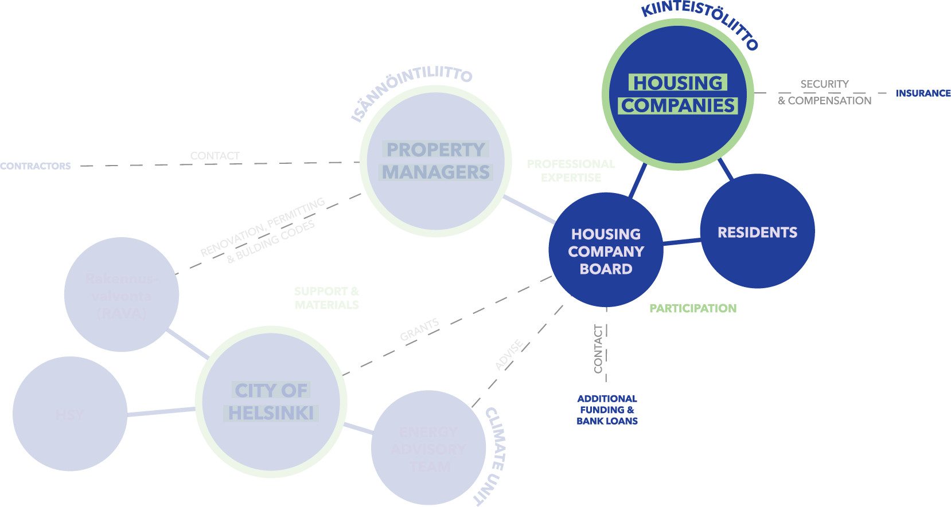
INTRODUCTION | STAKEHOLDERS
Creative Commons CC BY 4.0 2026
Anna Hakola · Duc Chu · Fernanda Ordorica · Jutta Pihlamo · Kaitlin Safka · Tessa Lehmussaari
Design for Government course · Aalto University
10
Notes:
The same natural optimism bias transfers to members of housing companies. They know the risks, but assume it will not effect them, or they believe they are powerless to make a difference. Both biases lead to inaction, and even more so in vulnerable groups, whose lack of time, money, and health only heightens their potential risk to the effects of climate change.

Slide 17

INTRODUCTION | STAKEHOLDERS
Creative Commons CC BY 4.0 2026
Anna Hakola · Duc Chu · Fernanda Ordorica · Jutta Pihlamo · Kaitlin Safka · Tessa Lehmussaari
Design for Government course · Aalto University
10
Notes:
The same natural optimism bias transfers to members of housing companies. They know the risks, but assume it will not effect them, or they believe they are powerless to make a difference. Both biases lead to inaction, and even more so in vulnerable groups, whose lack of time, money, and health only heightens their potential risk to the effects of climate change.

Slide 18
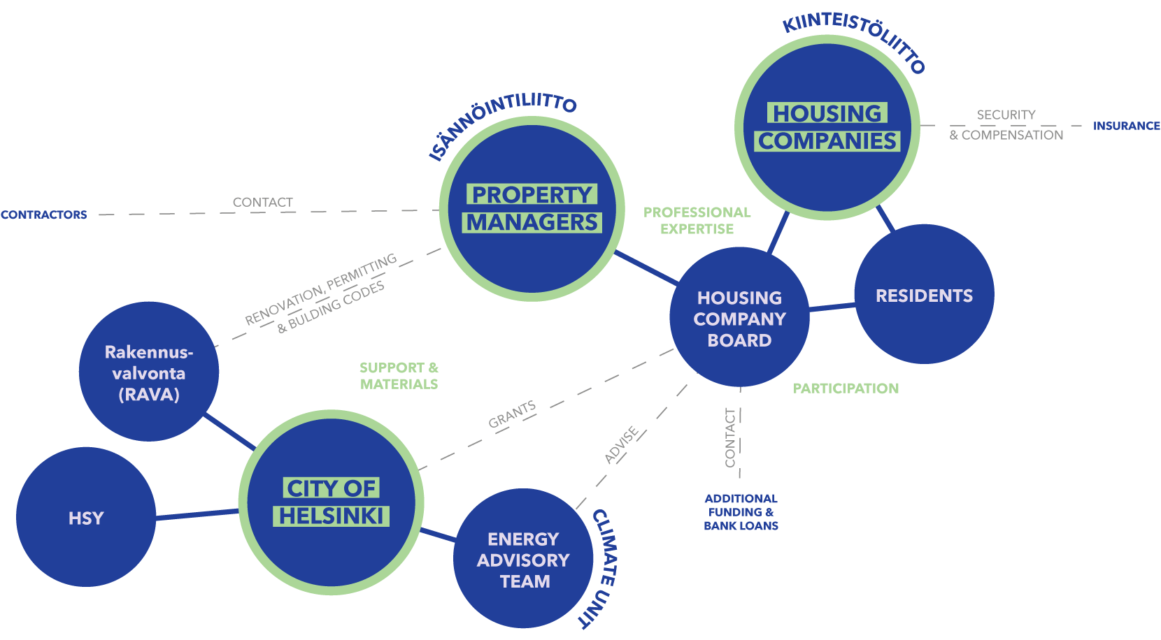
INTRODUCTION | STAKEHOLDERS
Creative Commons CC BY 4.0 2026
Anna Hakola · Duc Chu · Fernanda Ordorica · Jutta Pihlamo · Kaitlin Safka · Tessa Lehmussaari
Design for Government course · Aalto University
10
Notes:
The same natural optimism bias transfers to members of housing companies. They know the risks, but assume it will not effect them, or they believe they are powerless to make a difference. Both biases lead to inaction, and even more so in vulnerable groups, whose lack of time, money, and health only heightens their potential risk to the effects of climate change.

Slide 19

INTRODUCTION | STAKEHOLDERS
Creative Commons CC BY 4.0 2026
Anna Hakola · Duc Chu · Fernanda Ordorica · Jutta Pihlamo · Kaitlin Safka · Tessa Lehmussaari
Design for Government course · Aalto University
11
Notes:
These factors, coupled with unclear roles between housing companies, property managers, residents and the city, means the answer to the question “Who should start?” is always “They should.” The result is that action becomes a problem of the future, while climate risks are already faced now.
As we discovered more and more instances of the optimism bias at play with our interviewees, we started to look into other behavioral phenomena that could be contributing to people’s perception of the issue. What we found were multiple other cognitive patterns that influence our decision-making as humans.

Slide 20
INTRODUCTION | STAKEHOLDERS
Creative Commons CC BY 4.0 2026
Anna Hakola · Duc Chu · Fernanda Ordorica · Jutta Pihlamo · Kaitlin Safka · Tessa Lehmussaari
Design for Government course · Aalto University
11
Notes:
These factors, coupled with unclear roles between housing companies, property managers, residents and the city, means the answer to the question “Who should start?” is always “They should.” The result is that action becomes a problem of the future, while climate risks are already faced now.
As we discovered more and more instances of the optimism bias at play with our interviewees, we started to look into other behavioral phenomena that could be contributing to people’s perception of the issue. What we found were multiple other cognitive patterns that influence our decision-making as humans.

Slide 21
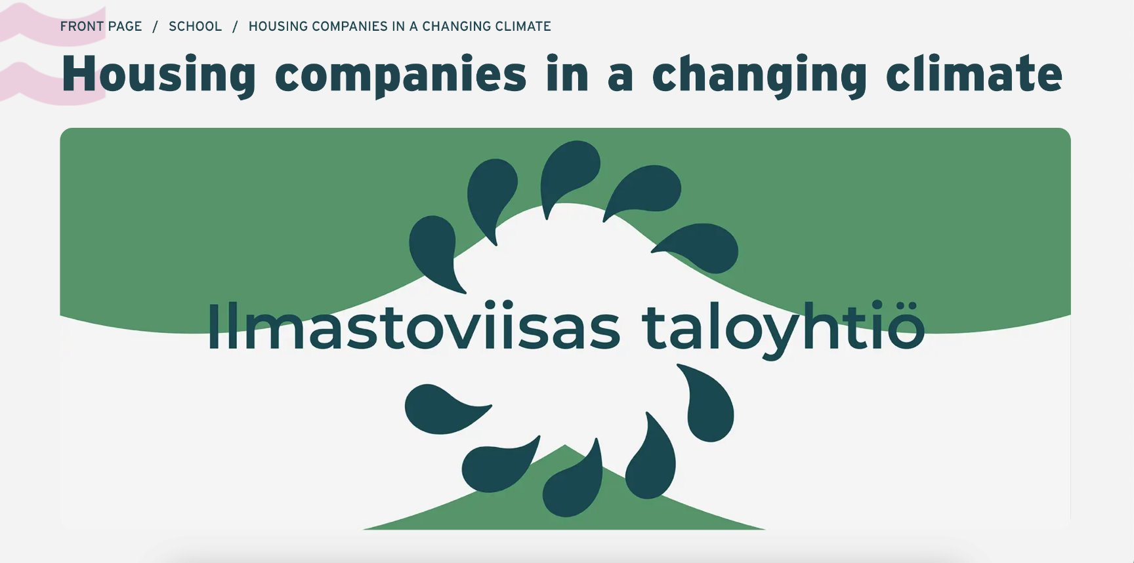

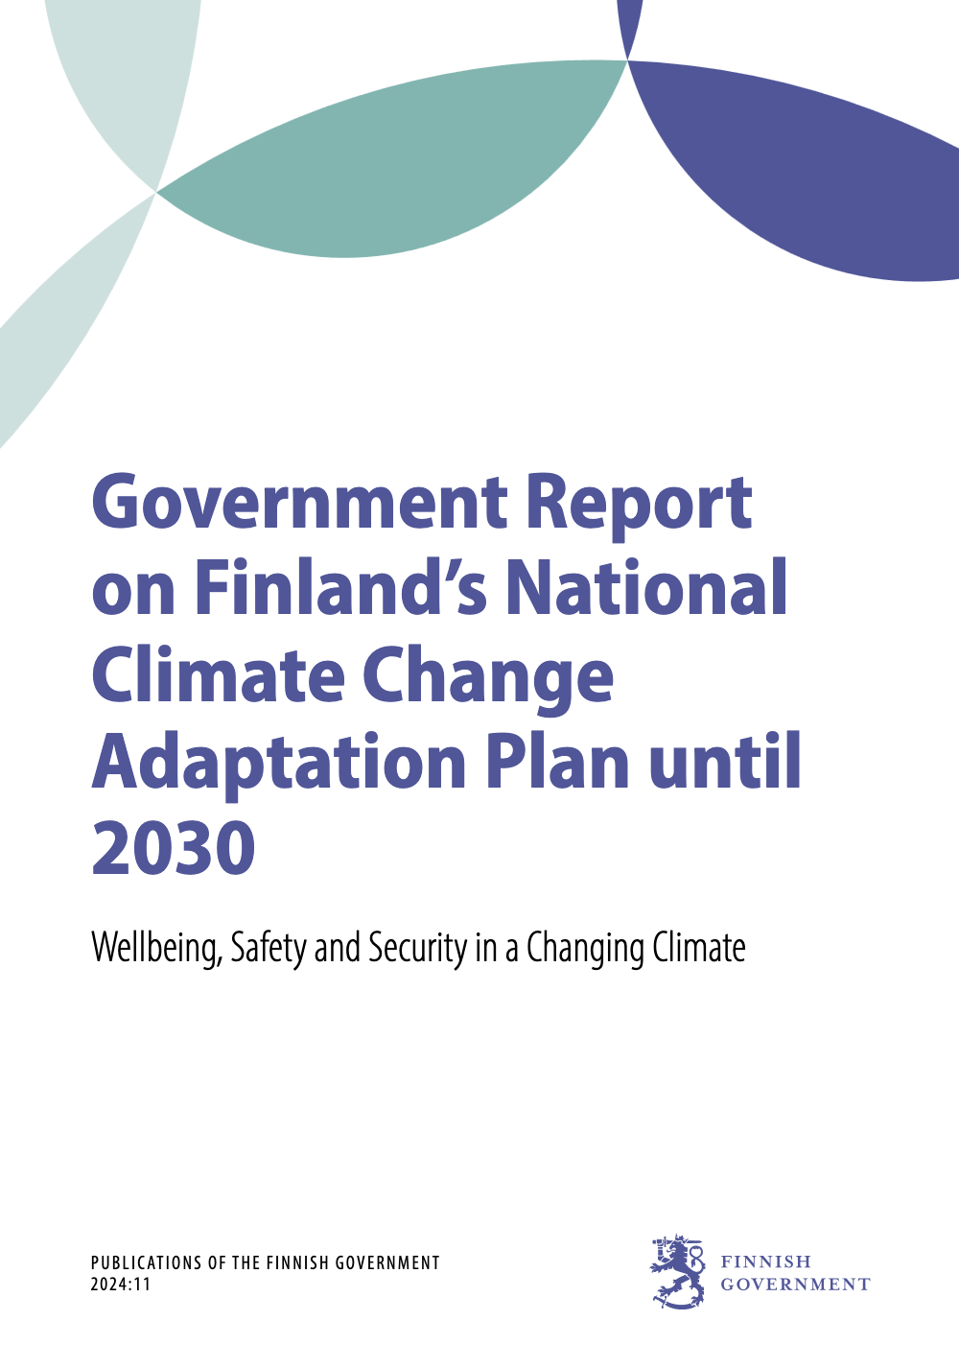
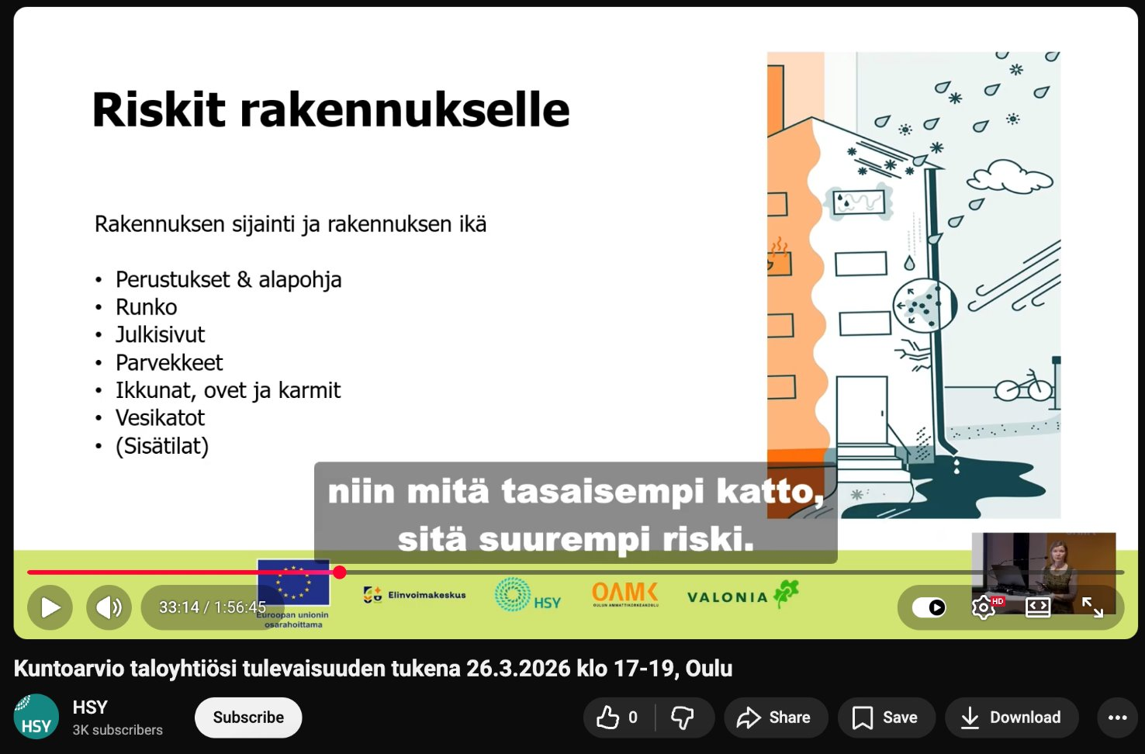
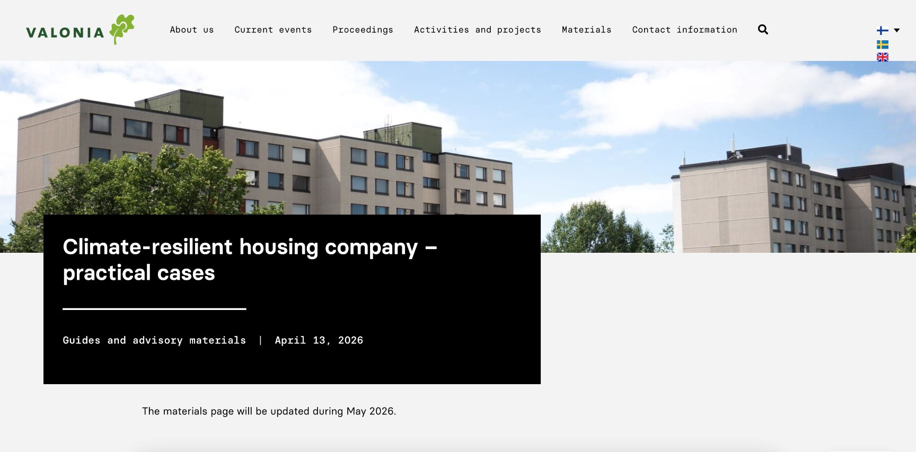
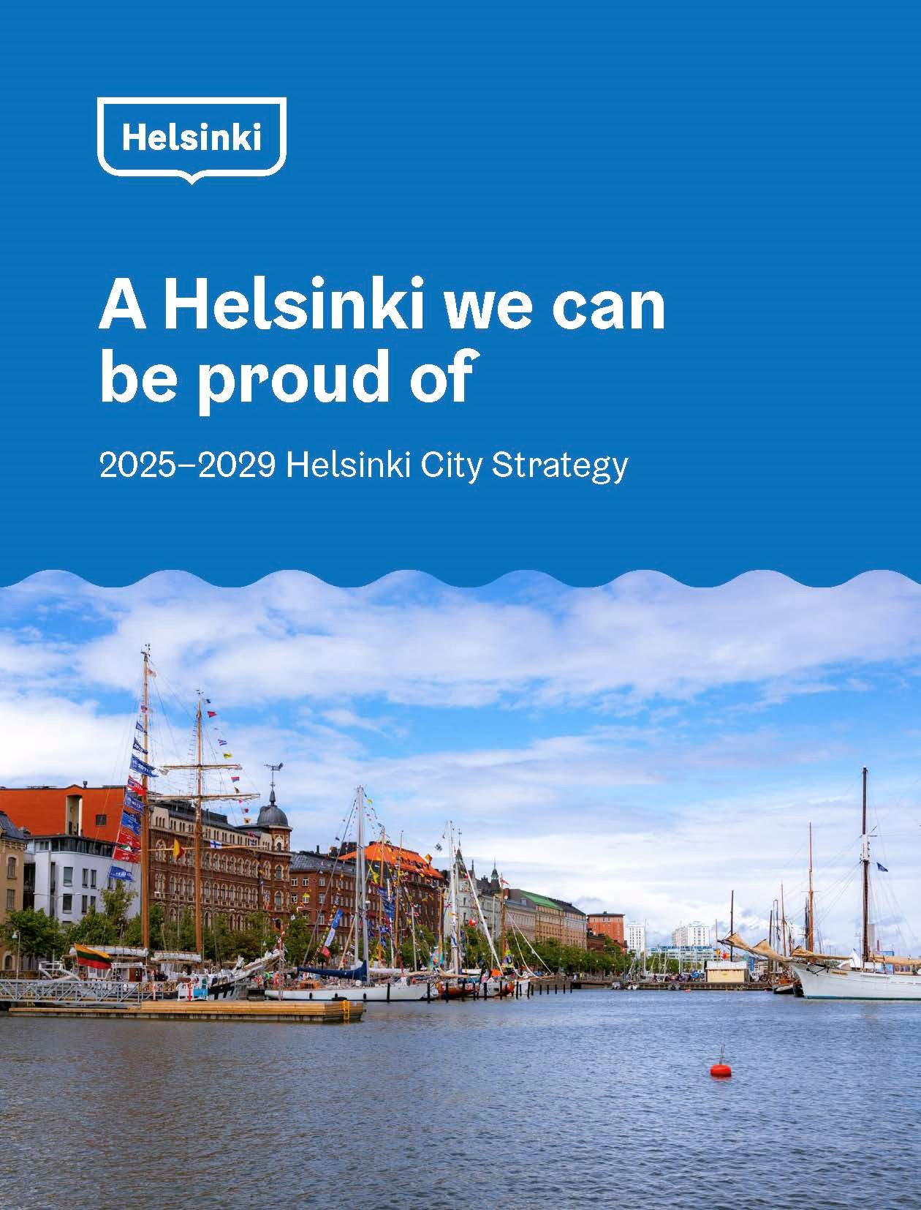
INTRODUCTION | CONTEXT
Creative Commons CC BY 4.0 2026
Anna Hakola · Duc Chu · Fernanda Ordorica · Jutta Pihlamo · Kaitlin Safka · Tessa Lehmussaari
Design for Government course · Aalto University
12
Notes:
This story is not so uncommon. More than 80% of our housing board interviewees were aware of the extreme weather and health risks climate change poses in Finland. Yet, the same people stated that climate change was rarely, if ever, discussed in their board meetings. (quote on screen?)
This phenomena can be explained by behavioral science.

Slide 22
work with our biases, not against them
INTRODUCTION | CONCEPTUAL REFRAMING
Creative Commons CC BY 4.0 2026
Anna Hakola · Duc Chu · Fernanda Ordorica · Jutta Pihlamo · Kaitlin Safka · Tessa Lehmussaari
Design for Government course · Aalto University
13
Notes:
But when we understand these biases, and how the systems around them operate, we have the unique opportunity to work with them, instead of against them,

Slide 23
tailored education that reaches its audience effectively.
INTRODUCTION | CONCEPTUAL REFRAMING
Creative Commons CC BY 4.0 2026
Anna Hakola · Duc Chu · Fernanda Ordorica · Jutta Pihlamo · Kaitlin Safka · Tessa Lehmussaari
Design for Government course · Aalto University
13
Notes:
to foster tailored education that reaches its audience effectively.

Slide 24
from “you do it tomorrow,” to “we do it today.”
INTRODUCTION | CONCEPTUAL REFRAMING
Creative Commons CC BY 4.0 2026
Anna Hakola · Duc Chu · Fernanda Ordorica · Jutta Pihlamo · Kaitlin Safka · Tessa Lehmussaari
Design for Government course · Aalto University
13
Notes:
With this awareness, we can create a shift in mindset: from “you do it tomorrow,” to “we do it today.”

Slide 25
INTRODUCTION | CONCEPTUAL REFRAMING
but, why today?
Creative Commons CC BY 4.0 2026
Anna Hakola · Duc Chu · Fernanda Ordorica · Jutta Pihlamo · Kaitlin Safka · Tessa Lehmussaari
Design for Government course · Aalto University
13
Notes:
Economic losses from weather and climate-related extremes in the EU reached over half a trillion eurosbetween 1980 and 2021. This signals an urgent need to speed up the implementation of adaptation measures (EEA 2025).

Slide 26



INTRODUCTION | WHY NOW
CLIMATE IS ALREADY CHANGING
ADAPTATION TODAY IS AN INVESTMENT, NOT A COST
BIG RENOVATION CYCLE IS GOING TO HAPPEN SOON
(Finnish Meteorological Institute, 2025)
(Marttila-Tornio, 2024)
(Marttila-Tornio, 2024)
Creative Commons CC BY 4.0 2026
Anna Hakola · Duc Chu · Fernanda Ordorica · Jutta Pihlamo · Kaitlin Safka · Tessa Lehmussaari
Design for Government course · Aalto University
14
Notes:
Economic losses from weather and climate-related extremes in the EU reached over half a trillion euros between 1980 and 2021. This signals an urgent need to speed up the implementation of adaptation measures (EEA 2025).

Slide 27
INTRODUCTION | WHY NOW
because later is too late.
Creative Commons CC BY 4.0 2026
Anna Hakola · Duc Chu · Fernanda Ordorica · Jutta Pihlamo · Kaitlin Safka · Tessa Lehmussaari
Design for Government course · Aalto University
14

Slide 28
VISION | KNOWLEDGE IN ACTION
We envision a future-proof Helsinki where, through an​ adaptive system of knowledge on our living spaces, we collaborate to ensure the safety and wellbeing of all inhabitants.​
Creative Commons CC BY 4.0 2026
Anna Hakola · Duc Chu · Fernanda Ordorica · Jutta Pihlamo · Kaitlin Safka · Tessa Lehmussaari
Design for Government course · Aalto University
15
Notes:
In Cognitive neuroscientist Tali Sharot’s book on the optimism bias, she describes a year in Great Britain when citizens were surveyed about their opinions on the future of their country. 83% said they believed violent crime was on the rise, when really it had been slowly decreasing in the past years. Meanwhile, Sharot conducted her own survey that asked British people to estimate their own likelihood of experiencing a crime. On average, participants estimated their likelihood as lower than the actual numbers from authorities.
Therefore, at the same time that citizens felt strongly about high crime rates in their country, they felt strongly that they wouldn’t be the ones to experience the negative effects.

Slide 29

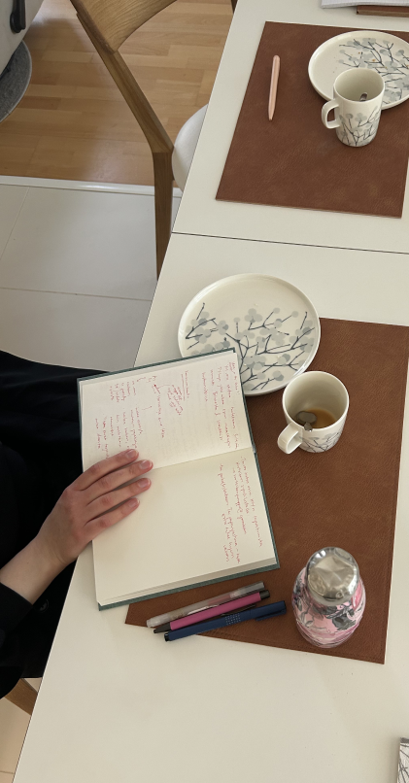

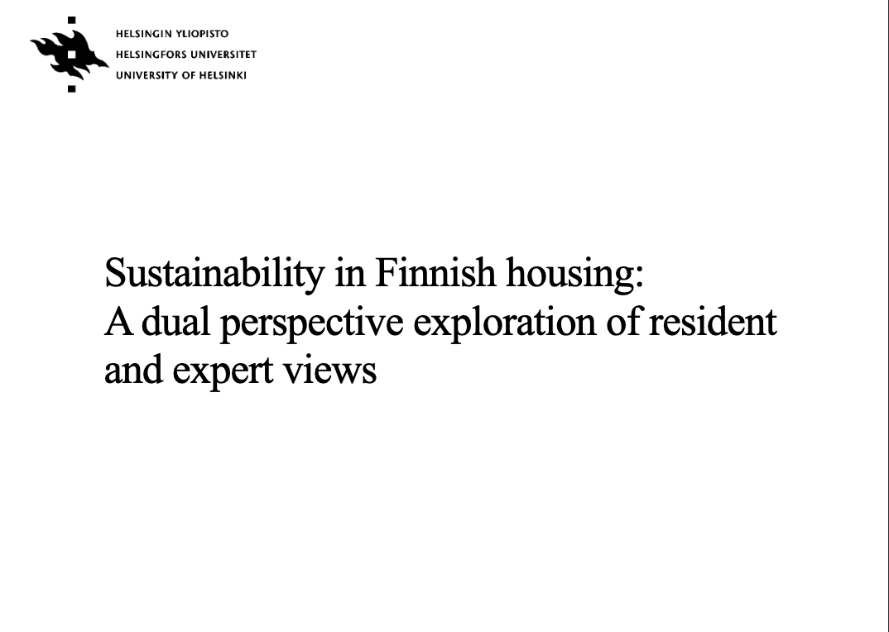

Creative Commons CC BY 4.0 2026
Anna Hakola · Jutta Pihlamo · Duc Chu · Fernanda Ordorica · Tessa Lehmussaari · Kaitlin Safka
Design for Government course · Aalto University
16

Slide 30
NUDGING STRATEGIES
PROPOSAL | STRATEGY
as a path to subtly alter the environment to guide people toward better decisions without restricting their freedom of choice.
(Thaler & Sunstein, 2009)
Creative Commons CC BY 4.0 2026
Anna Hakola · Duc Chu · Fernanda Ordorica · Jutta Pihlamo · Kaitlin Safka · Tessa Lehmussaari
Design for Government course · Aalto University
17
Notes:
- Anna will finalize slides for entrypoints

Slide 31
THEN, WHERE DO WE START?
PROPOSAL | ENTRY POINTS
Creative Commons CC BY 4.0 2026
Anna Hakola · Duc Chu · Fernanda Ordorica · Jutta Pihlamo · Kaitlin Safka · Tessa Lehmussaari
Design for Government course · Aalto University
18
Notes:
So, where to start?
In this section we will introduce our proposal with three entry points that rely on education and knowledge sharing.
We have also identified nudges that can be used in each entry point.

Slide 32
TAILORED EDUCATION
PROPOSAL | ENTRY POINT 1
ENTRY POINT 1
ENTRY POINT 2
ENTRY POINT 3
TAILORED EDUCATION
TAILORED EDUCATION
SHIFTING AGENCY
TAILORED EDUCATION
NETWORK BUILDING
An evaluation tool for
housing companies to assess the help they receive from property managers.
Provided by the City of Helsinki in collaboration with e.g. HSY and Kiinteistöliitto.
HOW:
simplified messaging, reframing, removing friction.
Creative Commons CC BY 4.0 2026
Anna Hakola · Duc Chu · Fernanda Ordorica · Jutta Pihlamo · Kaitlin Safka · Tessa Lehmussaari
Design for Government course · Aalto University
19
Notes:
Our first entry point is Shifting Agency.
Currently, housing companies often relying entirely on the skills of their property manager for technical advice on maintenance and renovation as well as climate adaptation. This gives the property manager a key role in housing company operations.
We propose flipping this dynamic. By introducing a simple evaluation tool, and with it we shift agency to the housing companies. This tool would allow boards to clearly define expectations and assess whether their property manager is delivering the support they need.

Slide 33
A PROPERTY MANAGER CAN MAKE OR BREAK A HOUSING COMPANY’S CLIMATE PREPAREDNESS
PROPOSAL | ENTRY POINT 1
Creative Commons CC BY 4.0 2026
Anna Hakola · Duc Chu · Fernanda Ordorica · Jutta Pihlamo · Kaitlin Safka · Tessa Lehmussaari
Design for Government course · Aalto University
20
Notes:
In our interviews, we discovered that a property manager can make or break a housing company’s climate prepardness as a skilled manager can drive a housing company's progressive plans forward, but less skilled one can stall them.
Currently, the success of a housing company's climate adaptation depends almost entirely on the luck of who they hired. This creates an uneven playing field where preparedness is a gamble, not a guarantee.

Slide 34
A PROPERTY MANAGER CAN MAKE OR BREAK A HOUSING COMPANY’S CLIMATE PREPAREDNESS
PROPOSAL | ENTRY POINT 1
AN EVALUATION TOOL GIVES AGENCY TO HOUSING COMPANIES TO GET THE SUPPORT THEY NEED
Creative Commons CC BY 4.0 2026
Anna Hakola · Duc Chu · Fernanda Ordorica · Jutta Pihlamo · Kaitlin Safka · Tessa Lehmussaari
Design for Government course · Aalto University
20
Notes:
Instead of hoping for the best, housing companies could hold property managers accountable. This levels the playing field, ensuring that climate readiness is driven by the housing company's standards, not just the manager's individual skill.
The evaluation tool could be a simple, quiz-like online test which ensures that it is easy to use and to understand by the housing company boards. For example it could look something like the SITRA Lifestyle test where you get tailored feedback based on what boxes you check.

Slide 35
PROPOSAL | ENTRY POINT 2
ENTRY POINT 1
ENTRY POINT 2
ENTRY POINT 3
SHIFTING AGENCY
TAILORED EDUCATION
SHIFTING AGENCY
NETWORK BUILDING
An evaluation tool for
housing companies to assess property managers.
Provided by the City of Helsinki in collaboration with e.g. HSY and Kiinteistöliitto.
HOW:
simplified messaging, reframing, removing friction.
Education material for residents on climate adaptation, but framed differently.
Offered to housing companies and interested residents by the City of Helsinki in collaboration with Työväenopisto.
HOW:
simplified messaging, reframing
Creative Commons CC BY 4.0 2026
Anna Hakola · Duc Chu · Fernanda Ordorica · Jutta Pihlamo · Kaitlin Safka · Tessa Lehmussaari
Design for Government course · Aalto University
21
Notes:
Our second entry point is Tailored Education.
Our interviews with housing company board members revealed that many of them simply don't know what to do about climate adaptation, and some struggle even with basic organization skills within the board.
That's why we propose that the City of Helsinki, perhaps alongside Työväenopisto, could offer education that is tailored to housing companies’ specific needs—whether that's board governance, maintenance, or long-term planning. Additionally, we propose a reframe for conversations on climate change to make it immediately relevant, and actionable for everyone involved.

Slide 36
HOW TO PREPARE FOR CLIMATE RISKS AND BUILD RESILIENCE?
PROPOSAL | ENTRY POINT 2
Creative Commons CC BY 4.0 2026
Anna Hakola · Duc Chu · Fernanda Ordorica · Jutta Pihlamo · Kaitlin Safka · Tessa Lehmussaari
Design for Government course · Aalto University
22
Notes:
So, how could this look in practice?
We know that people are generally aware of climate change, yet they are often not acting on it. Perhaps the barriers is that when educational materials focus solely on 'climate change' the message can feel abstract or distant to a housing company board.

Slide 37
HOW TO PREPARE FOR CLIMATE RISKS AND BUILD RESILIENCE?
PROPOSAL | ENTRY POINT 2
HOW TO INCREASE PROPERTY VALUE THROUGH STRATEGIC RENOVATION?
Creative Commons CC BY 4.0 2026
Anna Hakola · Duc Chu · Fernanda Ordorica · Jutta Pihlamo · Kaitlin Safka · Tessa Lehmussaari
Design for Government course · Aalto University
22
Notes:
This is where reframing comes in. Instead of talking about 'climate change,' we talk about for example increasing property value through strategic renovation. Suddenly, the topic shifts from an abstract global crisis to a concrete financial opportunity.
By framing these actions as ways to save money, or increase safety, we could spark the interest of housing companies

Slide 38
TAILORED EDUCATION
PROPOSAL | ENTRY POINT 3
ENTRY POINT 1
ENTRY POINT 2
ENTRY POINT 3
SHIFTING AGENCY
TAILORED EDUCATION
SHIFTING AGENCY
NETWORK BUILDING
NETWORK BUILDING
An evaluation tool for
housing companies to assess property managers.
Provided by the ER Team in collaboration with e.g. HSY and Kiinteistöliitto.
HOW:
simplified messaging, reframing, removing friction.
Education material for residents on climate adaptation, but framed differently.
Offered to housing companies and interested residents by the City of Helsinki e.g. in collaboration with työväenopisto.
HOW:
simplified messaging, reframing
Pooling renovations and establishing climate ambassadors to strengthen community networks.
Facilitated by the City of Helsinki e.g. Energy Advisory Team, with the help of Kiinteistöliitto and neighborhood organizations.
HOW:
social proof, social norms, activating social identities, reciprocity
Creative Commons CC BY 4.0 2026
Anna Hakola · Duc Chu · Fernanda Ordorica · Jutta Pihlamo · Kaitlin Safka · Tessa Lehmussaari
Design for Government course · Aalto University
23
Notes:
Moving on to the last entry point: Network building.
Our research revealed that many housing companies are tackling maintenance and climate adaptation alone.
To solve this, we propose leveraging social pressure and community networks to make climate adaptation feel like a sensible, common standard.
For network building we propose a system where housing companies pool demand for area-based joint renovations to save costs, supported by 'Climate Ambassadors.' These volunteers from housing companies would act as peer mentors and bridges between the City and residents.

Slide 39
SUPERSTARS ACT ALONE
PROPOSAL | ENTRY POINT 3
Creative Commons CC BY 4.0 2026
Anna Hakola · Duc Chu · Fernanda Ordorica · Jutta Pihlamo · Kaitlin Safka · Tessa Lehmussaari
Design for Government course · Aalto University
24
Notes:
SO, currently the housing companies were working in isolation and furthermore, we found out that there is also a disruption in the information flow between the city and the housing company which can increase the feeling of being left alone
When housing companies act alone knowledge stays siloed within a few boards, creating a fragmented landscape where climate action is the exception, not the rule.

Slide 40
SUPERSTARS ACT ALONE
PROPOSAL | ENTRY POINT 3
WITH CLIMATE AMBASSADORS,
ACTION BECOMES THE NORM
“YOUR NEIGHBOURS ARE STARTING ENERGY RENOVATIONS. WOULD YOU LIKE TO JOIN?”
Creative Commons CC BY 4.0 2026
Anna Hakola · Duc Chu · Fernanda Ordorica · Jutta Pihlamo · Kaitlin Safka · Tessa Lehmussaari
Design for Government course · Aalto University
24
Notes:
In this last entry point we propose building a collaborative community.
This approach leverages for instance social proof and social norms. When residents see neighbors doing adaptation measures, they feel a positive pressure to 'fit in' with the new standard. Furthermore, networks allow housing companies to learn directly from the real-world successes and failures of others, accelerating the adoption of sustainable practices.

Slide 41
PROPOSAL | OVERVIEW
ENTRY POINT 1
ENTRY POINT 2
ENTRY POINT 3
SHIFTING AGENCY
TAILORED EDUCATION
NETWORK BUILDING
An evaluation tool for
housing companies to assess property managers.
Provided by the City of Helsinki in collaboration with e.g. HSY and Kiinteistöliitto.
HOW:
simplified messaging, reframing, removing friction.
Education material for residents on climate adaptation, but framed differently.
Offered to housing companies and interested residents by the City of Helsinki in collaboration with työväenopisto.
HOW:
simplified messaging, reframing.
Pooling renovations and establishing climate ambassadors to strengthen community networks.
Facilitated by the City of Helsinki e.g. Energy Advisory Team, with the help of Kiinteistöliitto and neighborhood organizations.
HOW:
social proof, social norms, activating social identities, reciprocity
Creative Commons CC BY 4.0 2026
Anna Hakola · Duc Chu · Fernanda Ordorica · Jutta Pihlamo · Kaitlin Safka · Tessa Lehmussaari
Design for Government course · Aalto University
25
Notes:
In summary, we propose three entry points for climate adaptation that can build on each other
First, we move beyond relying solely on individual property managers by introducing evaluation tools that give housing companies the agency to set clear standards.
Second, we reframe climate adaptaion actions with tailored education focused on safety and practical maintenance, making adaptation accessible to every board.
And finally, we break isolation by building networks that leverage social proof and shared resources, turning individual efforts into a collective movement.

Slide 42
LIMITATIONS | OVERVIEW
SHORT-TERM NUDGING & SOFT POWER
LONG-TERM
POLICY CHANGE & SUPPORT SYSTEM
as initiation strategy
before nudging loses effectiveness
ENTRY POINT 1:
SHIFTING AGENCY
ENTRY POINT 2:
TAILORED EDUCATION
ENTRY POINT 3:
NETWORK BUILDING
simplified messaging, reframing, removing friction
simplified messaging, reframing
social proof, social norms, activating social identities, reciprocity
OUR VISION
Creative Commons CC BY 4.0 2026
Anna Hakola · Duc Chu · Fernanda Ordorica · Jutta Pihlamo · Kaitlin Safka · Tessa Lehmussaari
Design for Government course · Aalto University
26

Slide 43
CLIMATE ADAPTATION
FUTURE OPPORTUNITIES | OVERVIEW
SAFETY
WELL-BEING
AN ADAPTIVE SYSTEM OF
KNOWLEDGE
RESILIENCE
INTERSECTIONAL
Creative Commons CC BY 4.0 2026
Anna Hakola · Duc Chu · Fernanda Ordorica · Jutta Pihlamo · Kaitlin Safka · Tessa Lehmussaari
Design for Government course · Aalto University
27

Slide 44
“
IF YOU WANT TO WALK TOMORROW, WALK TODAY.,,,
“
“
^{- Housing Company Board Member}
Creative Commons CC BY 4.0 2026
Anna Hakola · Duc Chu · Fernanda Ordorica · Jutta Pihlamo · Kaitlin Safka · Tessa Lehmussaari
Design for Government course · Aalto University
28
Notes:
This story is not so uncommon. More than 80% of our housing board interviewees were aware of the extreme weather and health risks climate change poses in Finland. Yet, the same people stated that climate change was rarely, if ever, discussed in their board meetings. (quote on screen?)
This phenomena can be explained by behavioral science.

Slide 45
REFERENCES
Brandon, C., Kratzer, B., Aggarwal, A. & Heubaum, H. (2025). Strengthening the investment case for climate adaptation: A triple dividend approach. Working Paper. Washington, DC: World Resources Institute. Available online at doi.org/10.46830/wriwp.25.00019.
Finnish Meteorological Institute. (2024, November 13). Heavy rainfall events will become more severe in Finland as the climate warms. https://en.ilmatieteenlaitos.fi/press-release/2mV6FGVh8kkpwJG9DfKjTL
Laakkonen, T. (2025). The Roof Is on Fire - Housing Companies' Motivation for Adapting to Climate Change. Aalto University, Master's thesis.
Marttila-Tornio, M. (2024). TALVI-hankkeen alkukartoituskyselyn raportti. Accessed 18.5.2026 in https://www.hsy.fi/4ab27d/globalassets/hsy/projektisivustot-ja-hanke-esittelyt/tiedostot/talvi-hankkeen-alkukartoitusraportti.pdf
Pahl, S., Sheppard, S., Boomsma, C., & Groves, C. (2014). Perceptions of time in relation to climate change. WIREs Climate Change, 5(3), 375–388. https://doi.org/10.1002/wcc.272
Pilat, D., & Krastev, S. (2021). Optimism Bias. The Decision Lab. Retrieved May 20, 2026, from https://thedecisionlab.com/biases/optimism-bias
Sharot, T. (2011). The optimism bias. Current biology, 21(23), R941-R945.
Thaler, R. H., & Sunstein, C. R. (2009). Nudge. Penguin.
Valonia. (2024). Ilmastosopeutuminen asuntoosakeyhtiöiden kuntoarvioinnissa ja korjausrakentamisessa – kartoitus nykytilasta ja kehitystarpeista. Accessed 18.5.2026 in https://valonia.fi/wp-content/uploads/2025/09/TP-3.2.-Raportti.pdf
Creative Commons CC BY 4.0 2026
Anna Hakola · Duc Chu · Fernanda Ordorica · Jutta Pihlamo · Kaitlin Safka · Tessa Lehmussaari
Design for Government course · Aalto University
29
Notes:
Simplifying messages: When information is complex, dense, or hard to find, people tend to procrastinate, default to the status quo, or make errors. Simplification reduces the "friction" or mental effort required to act.
Framing: The same objective information can lead to different decisions depending on how it is presented (the "frame"). People react differently to a loss than to a gain, or to a percentage versus a raw number.

