Slide 1

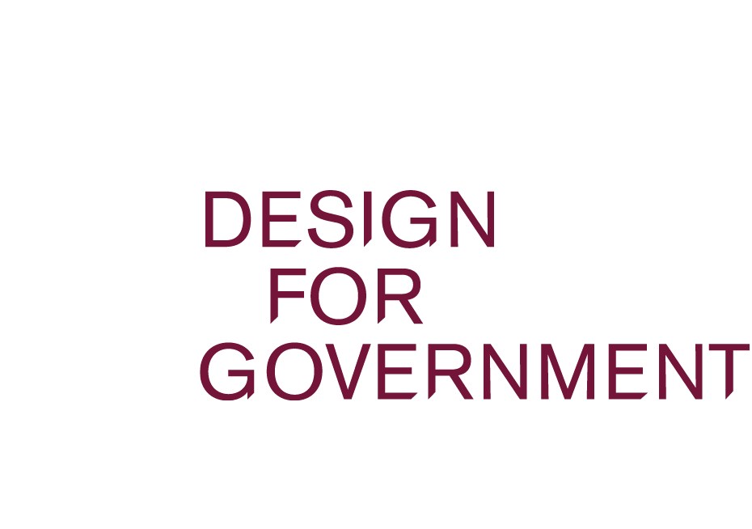
Care as a shared practice
Exploring how healthcare systems can move from fragmentation toward unified understanding
Creative Commons CC BY 4.0 2026 Clara Wahrenberg · Chiara Paolillo · Emma Hämäläinen · Hesamoddin Jalali · Sara Maukonen Design for Government course · Aalto University
Notes:
Patients often must navigate care systems that feel fragmented, confusing, and difficult to access – especially in vulnerable moments. This proposal explores how healthcare systems can move from fragmented experiences of information and interpretation toward an approach to care grounded in shared, collaborative practice, unifying understanding and delivery across organisational and professional boundaries.

Slide 2

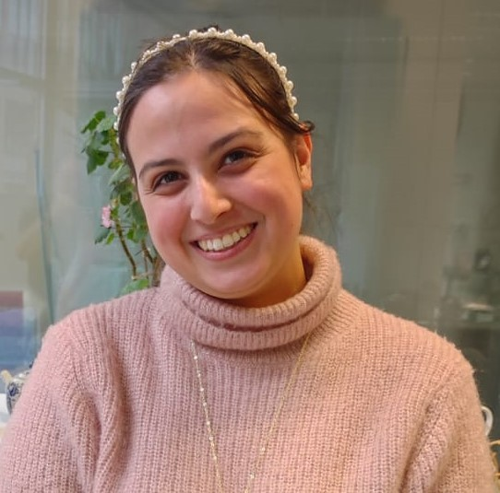
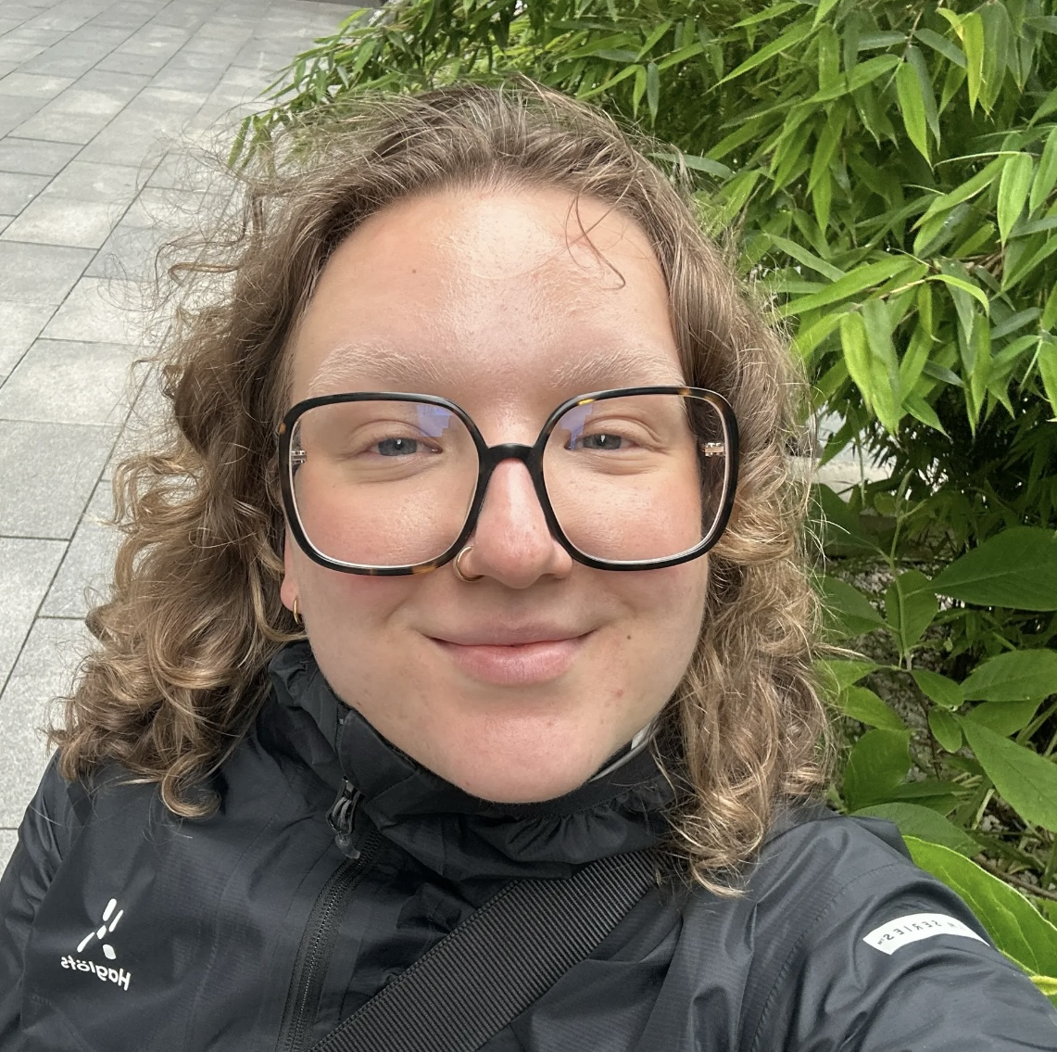
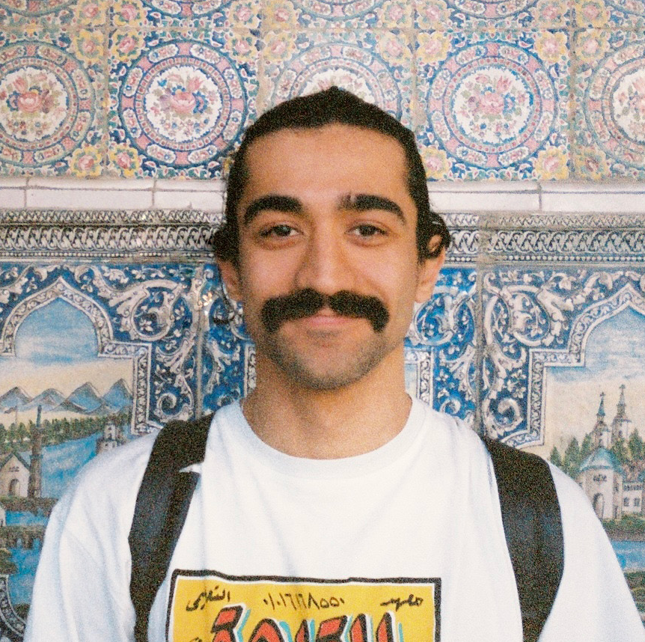





Introduction
Clara Wahrenberg
Chiara Paolillo
Emma Hämäläinen
Hesamoddin Jalali
Sara Maukonen
Creative Sustainability ARTS
Industrial Engineering and Management
Creative Sustainability ARTS
Creative Sustainability ARTS
Creative Sustainability CHEM
Creative Commons CC BY 4.0 2026 Clara Wahrenberg · Chiara Paolillo · Emma Hämäläinen · Hesamoddin Jalali · Sara Maukonen Design for Government course · Aalto University
Notes:
This was a 3 month project during which we partnered with Hus, Kela, Itä-Uusimaa Wellbeing Services County, and Länsi-Uusimaa Wellbeing Services County.

Slide 3
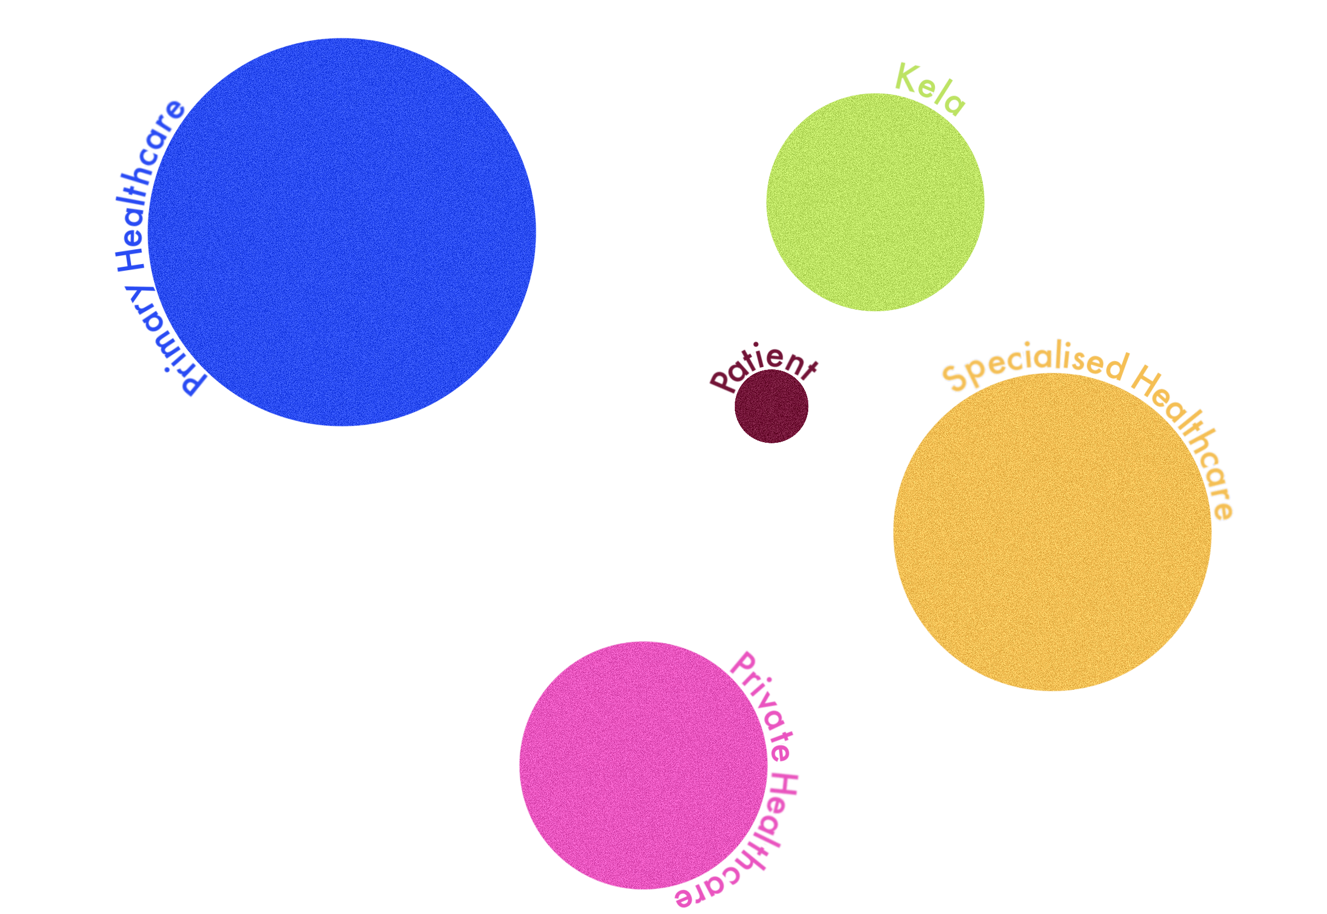
DRAMATIC ENTRANCE
Introduction
Vulnerable patient = a person suffering from long term mental health and substance abuse problems
Patients find themselves navigating fragmented medical pathways while vulnerable patients are the first to be impacted by the discontinuity of a healthcare system that no one fully owns.
Action = fragmented system
Consequence = patient not receiving the care that they need
Vulnerable patient = a person suffering from long-term mental
health and substance abuse problems
Creative Commons CC BY 4.0 2026 Clara Wahrenberg · Chiara Paolillo · Emma Hämäläinen · Hesamoddin Jalali · Sara Maukonen Design for Government course · Aalto University
Notes:
In Finland, there are many vulnerable patients who need extra help, but are left alone to navigating the fragmented healthcare system due to inconsistent information flow and uncertainty as to who is responsible for the patients’ overarching care paths. In this context, vulnerable patients refer to people who are suffering from long term mental health and substance abuse problems.
We talked about care paths, but what do we mean when we say care

Slide 4
Definition of care:
Introduction
“The process of protecting someone or something and providing what that person or thing needs.”
Synonym = responsibility, guidance
(Cambridge Dictionary)
Creative Commons CC BY 4.0 2026 Clara Wahrenberg · Chiara Paolillo · Emma Hämäläinen · Hesamoddin Jalali · Sara Maukonen Design for Government course · Aalto University
Notes:
When we look at the definition of care, we can see that it is about protecting someone and providing the help they need. Care can also be understood through ideas such as responsibility and guidance.
With this in mind, let’s return to those moments of vulnerability.

Slide 5
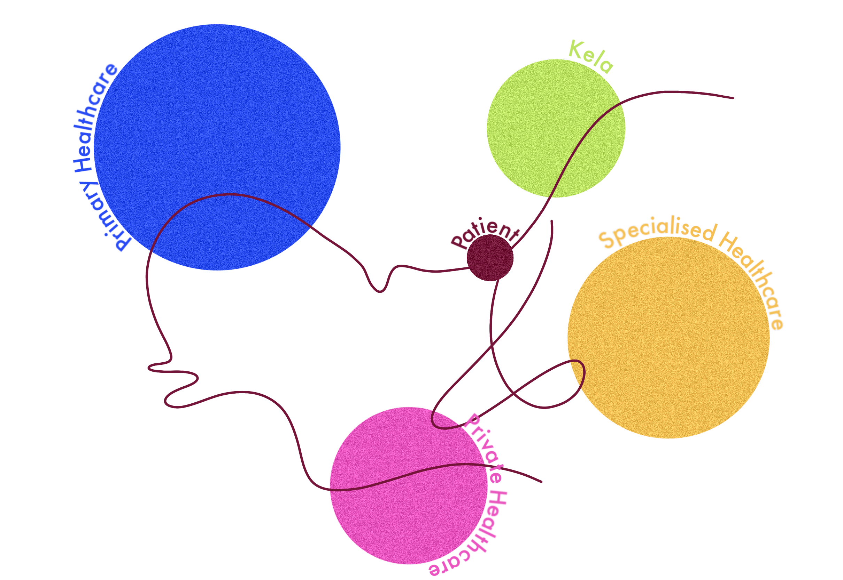
Introduction
Current issue:
Creative Commons CC BY 4.0 2026 Clara Wahrenberg · Chiara Paolillo · Emma Hämäläinen · Hesamoddin Jalali · Sara Maukonen Design for Government course · Aalto University
Notes:
In reality, care pathways often extend across multiple institutions, professionals, and systems. Yet the understanding needed to support continuity of care does not always carry over between them.
The Sote reform in 2023 was created to unify healthcare services and reduce inequalities in care. At the same time, it has created strong momentum for system-wide structural change. ->

Slide 6
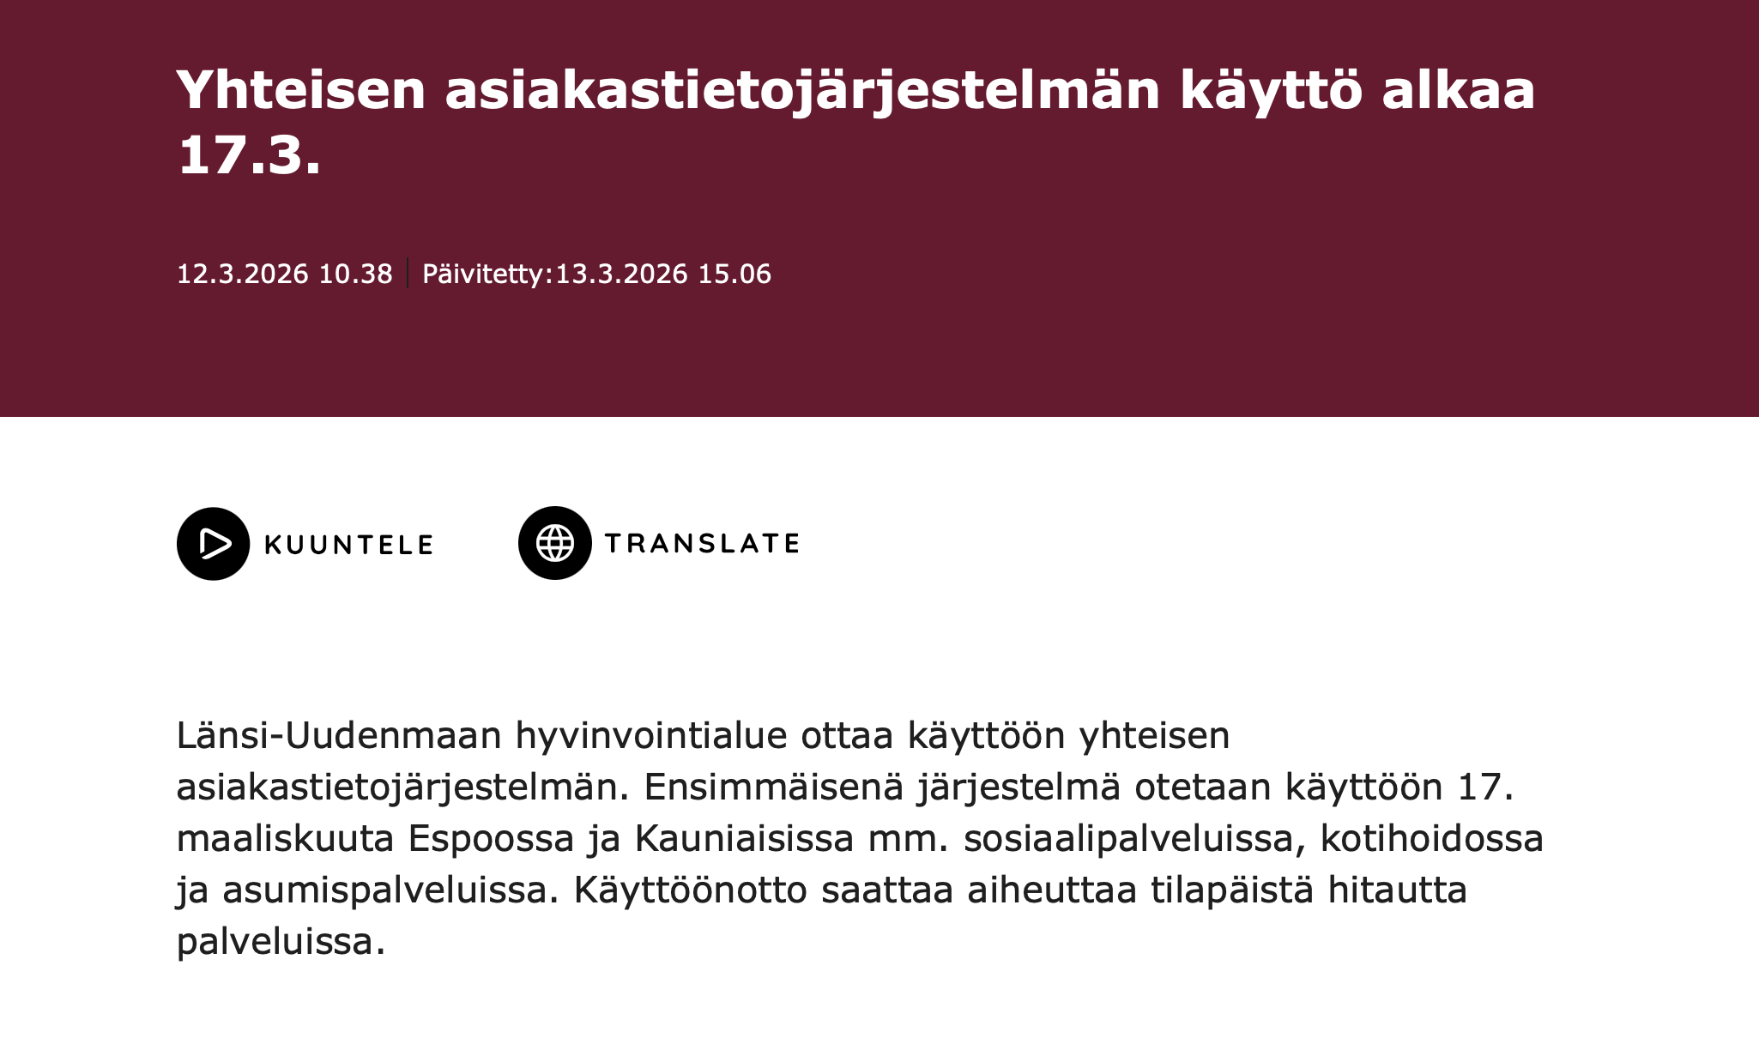
Introduction
“The Western Uusimaa Wellbeing Services County will gradually transition to using the Lifecare Client and Patient Information Systems by the end of May 2026.”
(Länsi-Uudenmaan hyvinvointialue, 2026)
Creative Commons CC BY 4.0 2026 Clara Wahrenberg · Chiara Paolillo · Emma Hämäläinen · Hesamoddin Jalali · Sara Maukonen Design for Government course · Aalto University
Notes:
The Sote reform in 2023 was created to unify healthcare services and reduce inequalities in care. At the same time, it has created strong momentum for system-wide structural change.
Wellbeing Services Counties are currently developing new practices within their own organizations, for example, by shifting toward the use of a single patient information system. However, these efforts often remain disconnected from other healthcare institutions.

Slide 7
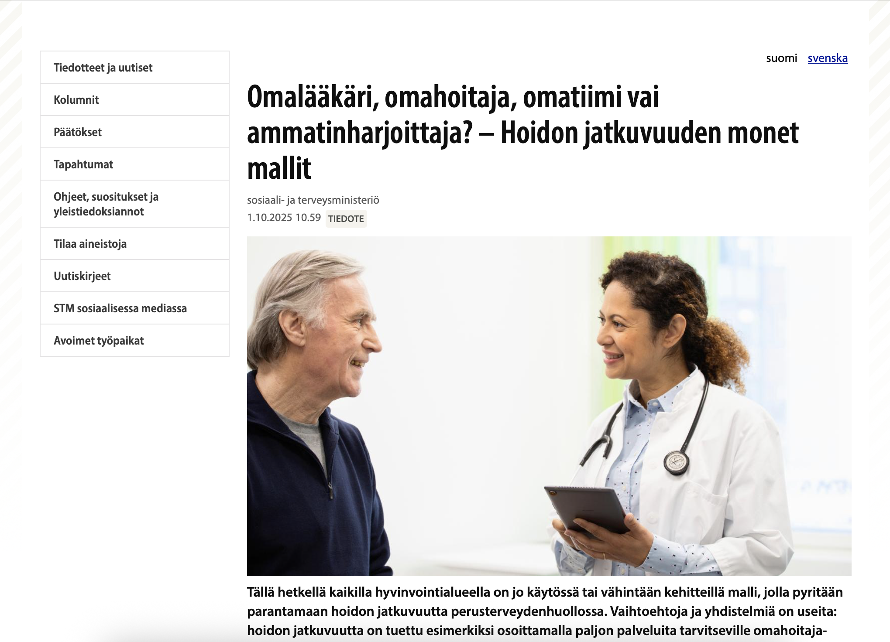
Introduction
“At the moment, all Wellbeing Services Counties either already have in use, or are at least developing, a model aimed at improving continuity of care in primary healthcare. […] The purpose of the “omalääkäri” programme launched in spring 2025 is to encourage wellbeing services counties to develop and implement models that meet regional needs.”
(Ministry of Social Affairs and Health, 2025)
Creative Commons CC BY 4.0 2026 Clara Wahrenberg · Chiara Paolillo · Emma Hämäläinen · Hesamoddin Jalali · Sara Maukonen Design for Government course · Aalto University
Notes:
At the same time, healthcare systems and workflows are being restructured across organizations. New programs are also changing how healthcare is delivered, such as the omalääkäri programme launched in spring 2025.

Slide 8
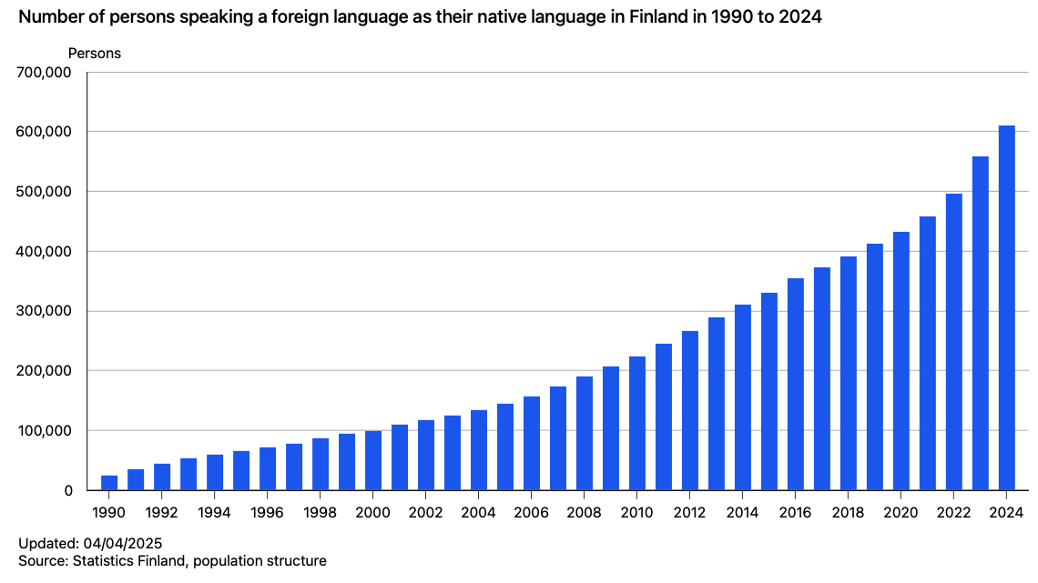
Introduction
Increasing linguistic diversity in Finland is exposing gaps in communication
Increasing linguistic diversity exposes gaps in communication and coordination in health care
”The number of foreign-language speakers exceeded 600,000 during 2024.”
(Statistics Finland, 2025a)
Creative Commons CC BY 4.0 2026 Clara Wahrenberg · Chiara Paolillo · Emma Hämäläinen · Hesamoddin Jalali · Sara Maukonen Design for Government course · Aalto University
Notes:
Alongside these structural changes, increasing linguistic diversity in Finland is exposing gaps in communication and coordination across care pathways. As we can see, the number of people in Finland who speak a foreign language as their native language increased by 600,000 by 2024.

Slide 9

Introduction
One in six people in Finland speak another native language than Finnish
(Statistics Finland, 2025b)
Creative Commons CC BY 4.0 2026 Clara Wahrenberg · Chiara Paolillo · Emma Hämäläinen · Hesamoddin Jalali · Sara Maukonen Design for Government course · Aalto University
Notes:
Today, one in six people in Finland speaks a native language other than Finnish.
Together, these changes are creating a critical window of opportunity to strengthen collaboration and establish shared practices before new structures become fixed.

Slide 10

Research and findings
Creative Commons CC BY 4.0 2026 Clara Wahrenberg · Chiara Paolillo · Emma Hämäläinen · Hesamoddin Jalali · Sara Maukonen Design for Government course · Aalto University
Notes:
In this project, we began by immersing ourselves in the Finnish healthcare system through research.

Slide 11

Research
Understand internal languages of care institutions
Continuity of Understanding
2026
better care for all
Continuity of Knowledge
2025
Continuity of Care
2024
Creative Commons CC BY 4.0 2026 Clara Wahrenberg · Chiara Paolillo · Emma Hämäläinen · Hesamoddin Jalali · Sara Maukonen Design for Government course · Aalto University
Notes:
In this course, the theme of care has been explored over the past few years, and this year our focus has been on continuity of understanding. Before concentrating specifically on improving Swedish-language services, it is important to first understand the different internal languages and ways of communication within care institutions. Strengthening continuity of understanding across these systems can lead to better care for everyone, especially for vulnerable patients in Swedish-speaking areas.

Slide 12
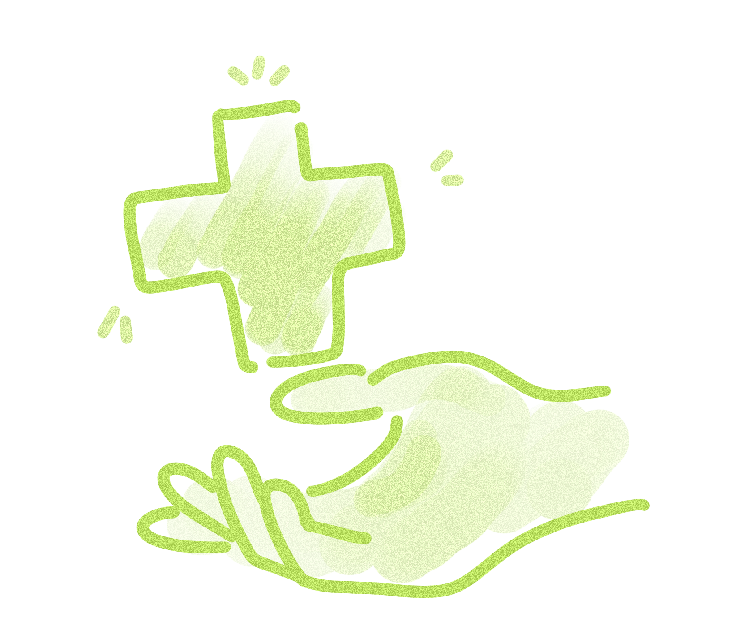

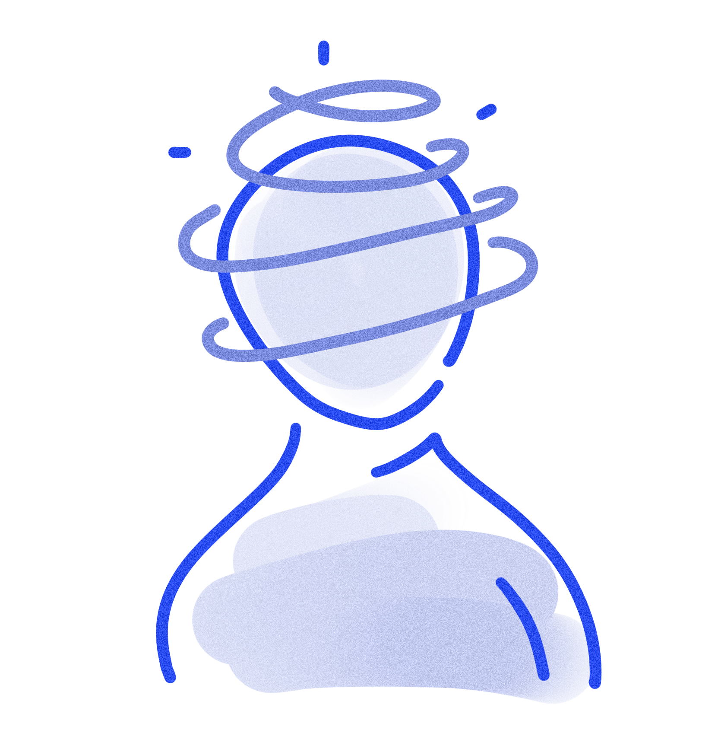
Research
Desktop research: Three different perspectives
Provider
Patient
Administrative
Creative Commons CC BY 4.0 2026 Clara Wahrenberg · Chiara Paolillo · Emma Hämäläinen · Hesamoddin Jalali · Sara Maukonen Design for Government course · Aalto University
Notes:
We started with desktop research from three perspectives, patient, provider, and administrative, to better understand the challenges vulnerable patients face within Finnish healthcare.

Slide 13
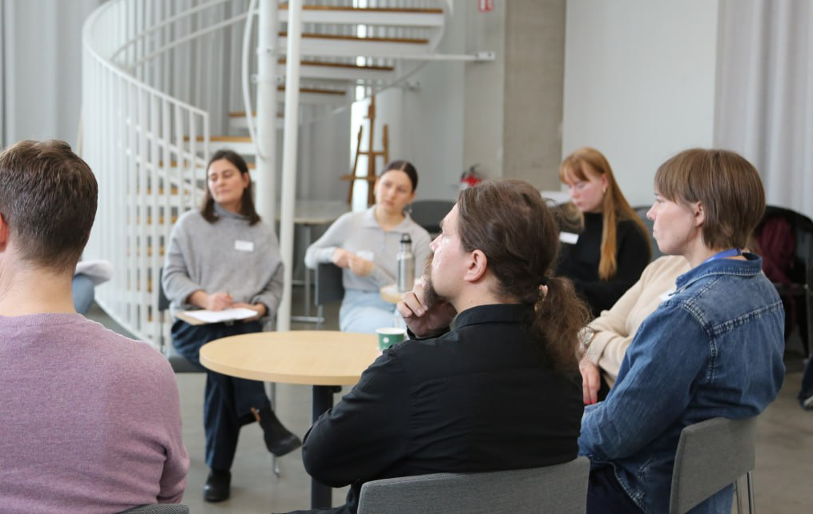
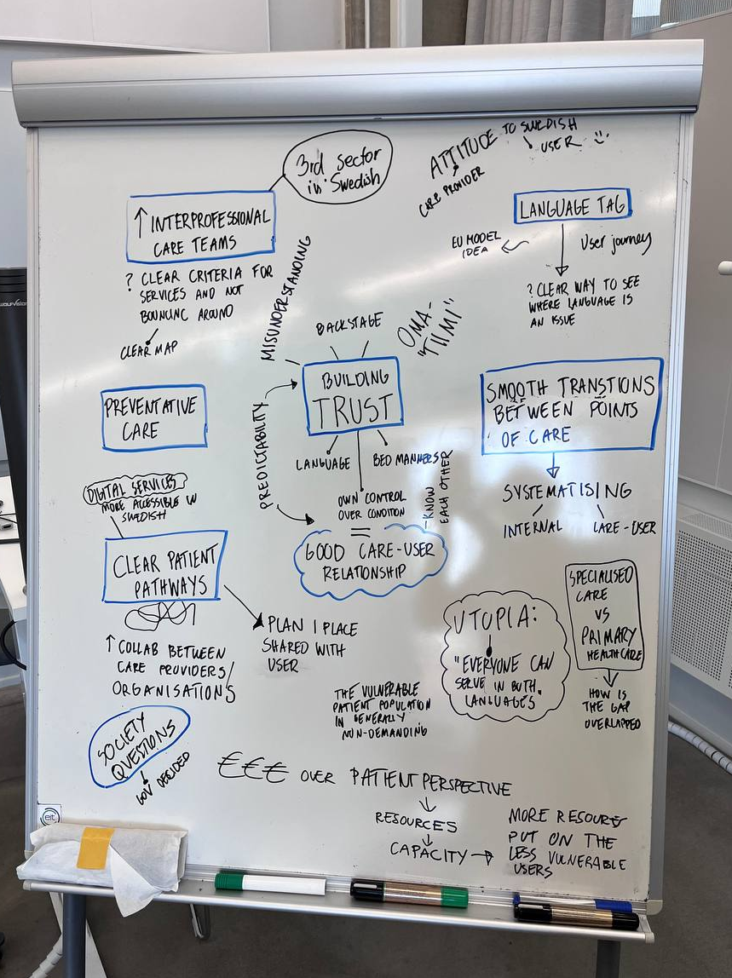

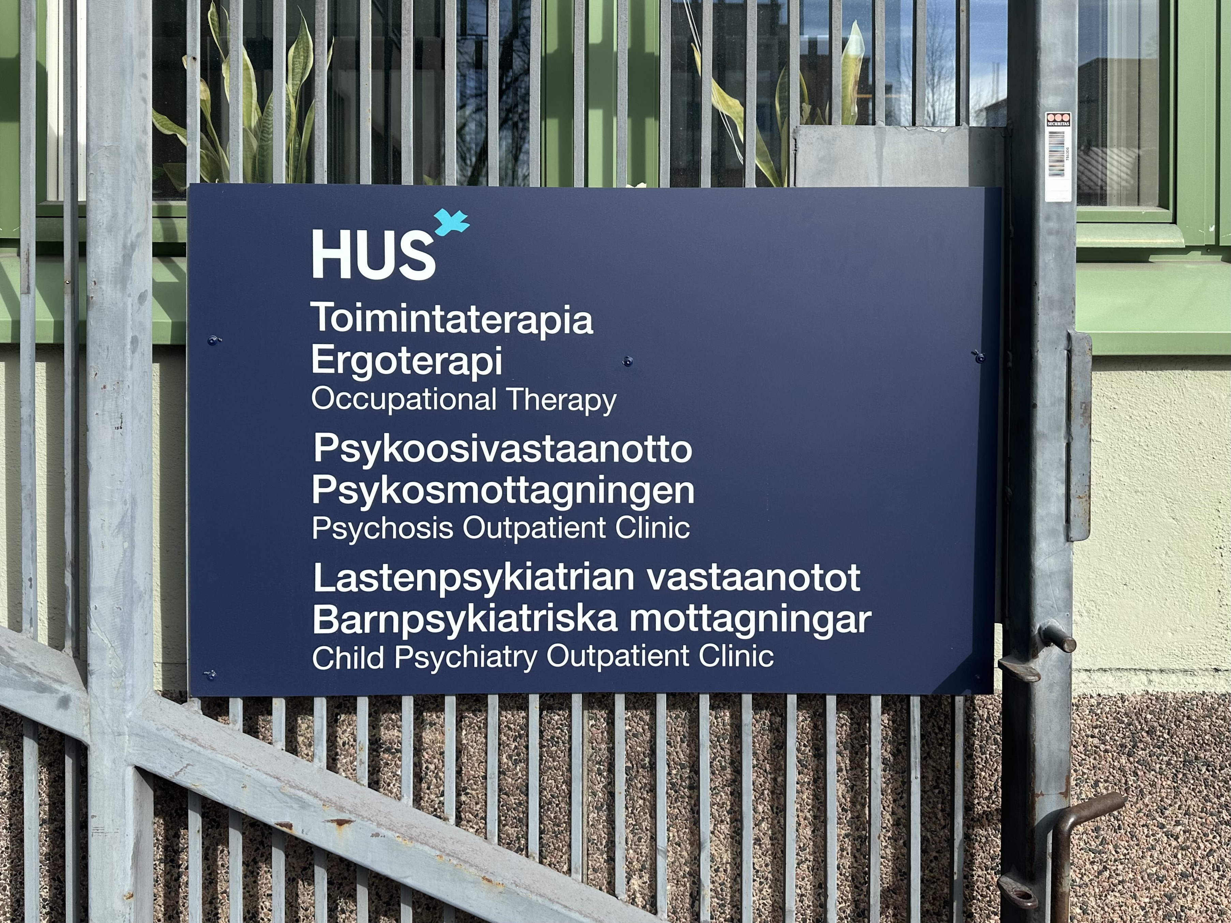
Research
Collaborative work with partners
Interviews and fieldwork
Round Table Discussions
5 professionals from Kela, HUS, and the Uusimaa Wellbeing Services Counties
Mid-Term Presentation
Presenting interim findings and meeting project partners
Ideation Session
8 participants from Kela, HUS, and the Uusimaa Wellbeing Services Counties
Early conversations
10 meetings with healthcare professionals and representatives from Kela
Semi-Structured Interviews & Fieldwork
9 interviews with healthcare professionals, experience experts, clients, and foundations
Creative Commons CC BY 4.0 2026 Clara Wahrenberg · Chiara Paolillo · Emma Hämäläinen · Hesamoddin Jalali · Sara Maukonen Design for Government course · Aalto University
Notes:
Early in the process, we also collaborated closely with our partners through meetings that helped us gain a deeper understanding of the current situation. Throughout the project, we met with healthcare professionals as well as people with lived experiences, which helped us better understand the patient perspective.
During our interviews and fieldwork, we focused especially on communication, collaboration, and patient care pathways.

Slide 14
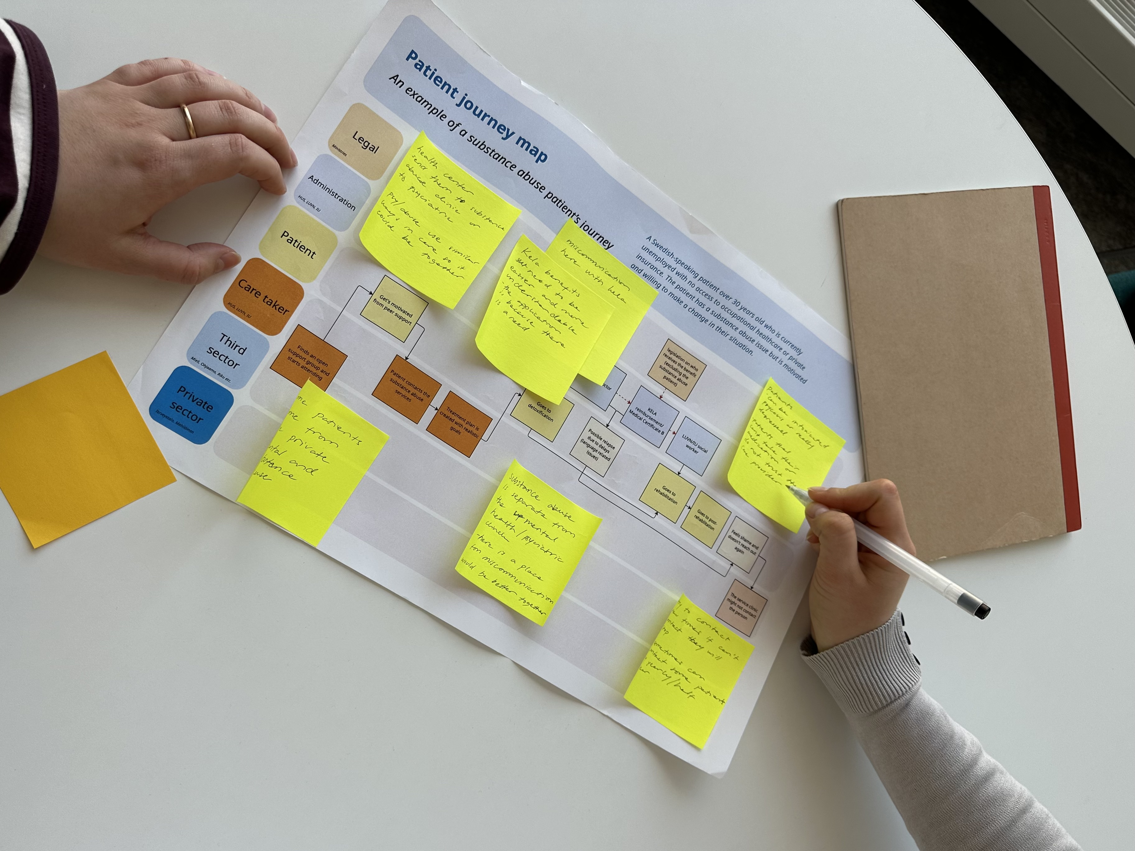
Research
Mapping patient journeys with professionals
Creative Commons CC BY 4.0 2026 Clara Wahrenberg · Chiara Paolillo · Emma Hämäläinen · Hesamoddin Jalali · Sara Maukonen Design for Government course · Aalto University
Notes:
Together with healthcare professionals, we mapped the journeys of substance abuse and mental health patients in order to identify bottlenecks and disconnections within their care paths. This helped us understand both the patient experience and the provider perspective.

Slide 15
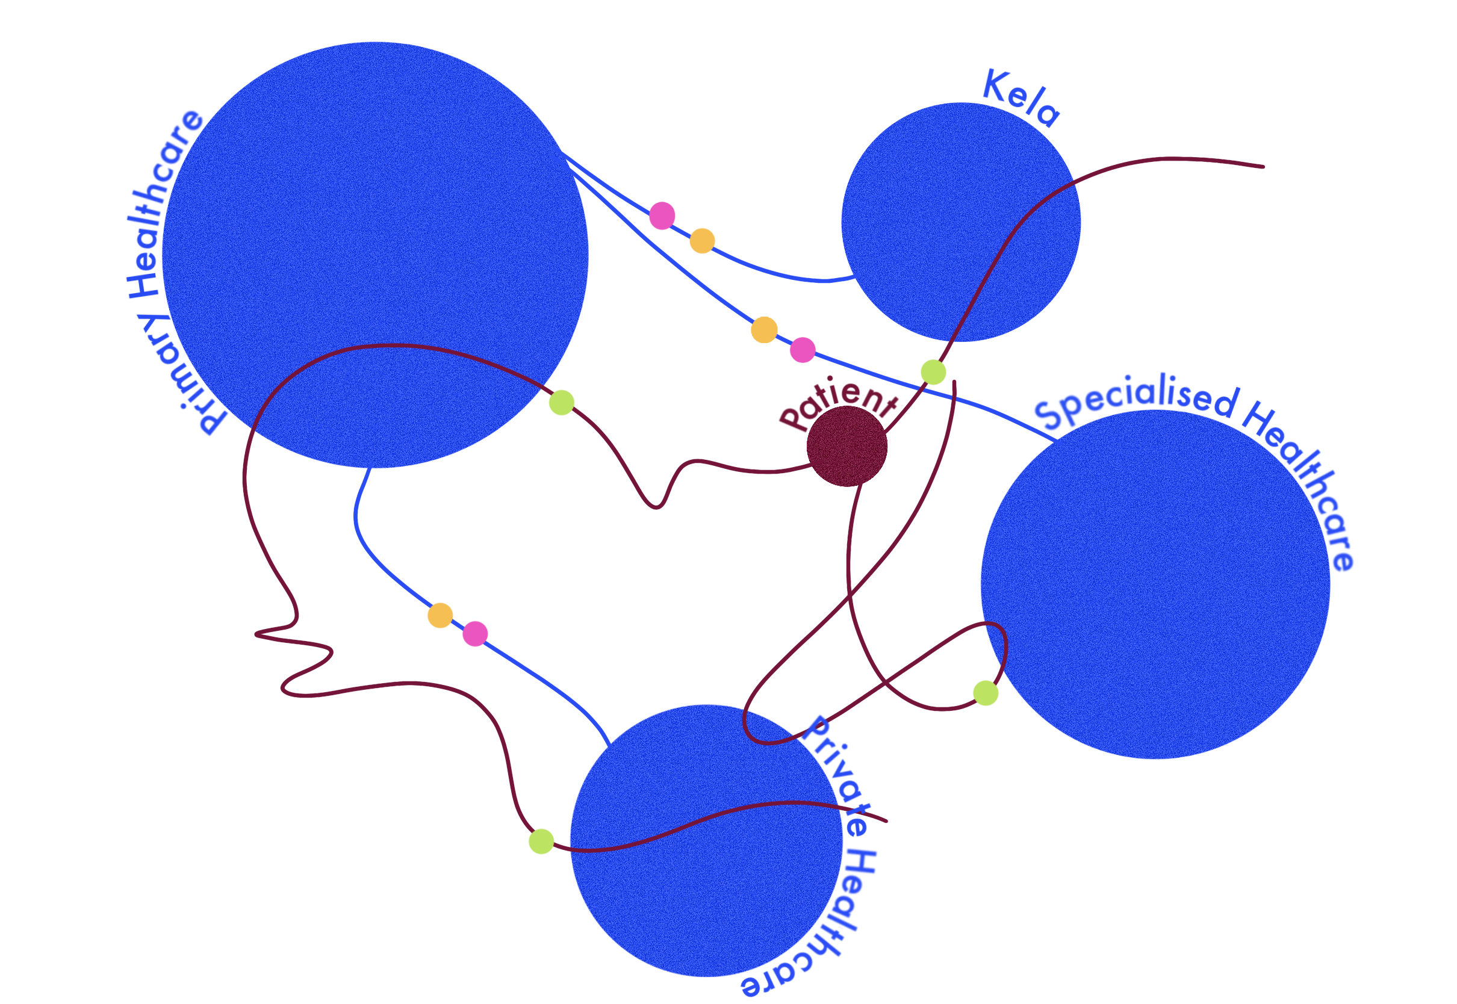
Research - Findings
Bottlenecks
Multiple Systems
Documentation Style
Assessment Criteria
Creative Commons CC BY 4.0 2026 Clara Wahrenberg · Chiara Paolillo · Emma Hämäläinen · Hesamoddin Jalali · Sara Maukonen Design for Government course · Aalto University
Notes:
Through our research and multiple interviews with our partners, we identified several key bottlenecks where discontinuity of understanding is reinforced across the care system. During the initial phase of the project, we found that the lack of a unified care system, fragmented communication practices between healthcare providers, and inconsistent digital services all contribute to this discontinuity. These gaps become especially visible when working with vulnerable groups. In such cases, discontinuity of understanding is further compounded by barriers such as language accessibility, fragmented patient information flow across institutions, the absence of a holistic view of the patient’s care pathway, and the expectation that patients must navigate complex systems independently. Overcoming these barriers, therefore requires strengthening continuity of understanding both between care institutions and within them.

Slide 16
Research - Findings
Insights from fieldwork
1. Multiple Information Systems:
Healthcare still uses many separate data systems due to its previously decentralized structure. Even after the creation of Wellbeing Service Counties this fragmentation remains and makes it harder to access patient information.
2. Different Ways of Communicating:
Miscommunications arise when patients receive care in multiple services because institutions have individual understandings of care and their own way of communicating with patients and other institutions.
3. Inconsistent Digital Services:
Digital services are working well in Finnish, but are still underdeveloped in other languages. This highlights how Swedish speakers have a clear disadvantage when seeking information.
Creative Commons CC BY 4.0 2026 Clara Wahrenberg · Chiara Paolillo · Emma Hämäläinen · Hesamoddin Jalali · Sara Maukonen Design for Government course · Aalto University
Notes:
From our fieldwork, we gathered a variety of insights. In the following, we want to highlight three of them, which highlight a broader problem of fragmented continuity across information, interpretation, and access. Those insights describe situations in which healthcare actors hold incomplete or incompatible understandings, continuity breaks when responsibility shifts among actors, and patients must compensate for system fragmentation themselves. Before the reform, healthcare actors were supposed to self-manage everything, which can now cause problems due to a lack of standardisation, resulting in a variety of ways in which healthcare is implemented. On the other hand, this micro-level action demonstrates a level of engagement and agency to build on for future change.

Slide 17



Research - Findings
Uncovering underlying fragmentation…
Multiple information systems | Fragmented informational continuity
Different ways of communicating | Fragmented interpretive continuity
Inconsistent digital services | Fragmented accessibility continuity
Creative Commons CC BY 4.0 2026 Clara Wahrenberg · Chiara Paolillo · Emma Hämäläinen · Hesamoddin Jalali · Sara Maukonen Design for Government course · Aalto University
Notes:
Through our insights, we discovered underlying fragmentations, so the first insight shows how information continuity is disrupted. The second insight shows how, inside and across institutions, the way of interpreting is fragmented, and the inconsistent digital services illustrate how accessibility is fragmented.

Slide 18
Our proposal
Creative Commons CC BY 4.0 2026 Clara Wahrenberg · Chiara Paolillo · Emma Hämäläinen · Hesamoddin Jalali · Sara Maukonen Design for Government course · Aalto University
Notes:
After conducting research and evaluating our findings, we began envisioning the changes we would like to see in the healthcare system.

Slide 19
Our proposal
Finland is striving towards "a sustainable and safe welfare society where everyone can have faith in the future."
(Ministry of Social Affairs and Health, 2026)
Creative Commons CC BY 4.0 2026 Clara Wahrenberg · Chiara Paolillo · Emma Hämäläinen · Hesamoddin Jalali · Sara Maukonen Design for Government course · Aalto University
Notes:
According to the Ministry of Social Affairs and Health , Finnland is striving towards "a sustainable and safe welfare society where everyone can have faith in the future."
We defined what we envision for the future of care in Finland. → read statement
Finland is striving towards an equitable society.
Achieving this requires a healthcare system that emphasises understanding across institutions through accessible patient information, collaborative practices, and continuous learning.
These practices build a culture of care-giving grounded in shared responsibility and holistic support for every patient

Slide 20
Our proposal - vision
Finland is striving toward an equitable society based on trust.
Achieving this requires a healthcare system that emphasizes seamless communication across institutions through standardized patient care summaries, transparent patient assessment criteria, and inter-institutional collaborations.
Together, these practices foster a culture of care grounded in shared responsibility and holistic support for every patient.
Creative Commons CC BY 4.0 2026 Clara Wahrenberg · Chiara Paolillo · Emma Hämäläinen · Hesamoddin Jalali · Sara Maukonen Design for Government course · Aalto University
Notes:
We defined what we envision for the future of care in Finland. → read statement
Finland is striving towards an equitable society.
Achieving this requires a healthcare system that emphasises understanding across institutions through accessible patient information, collaborative practices, and continuous learning.
These practices build a culture of care-giving grounded in shared responsibility and holistic support for every patient

Slide 21
Our proposal
Intervention points
Creative Commons CC BY 4.0 2026 Clara Wahrenberg · Chiara Paolillo · Emma Hämäläinen · Hesamoddin Jalali · Sara Maukonen Design for Government course · Aalto University
Notes:
So let’s have a look at where we can initiate the changes we want to see.
Aim of the intervention points
What is the underlying aim to achieve our vision? All three proposed starting points that we are going to look into next, reduce fragmentation by helping different actors form a coherent and continuous understanding of the patient, the care pathways and each other’s roles.

Slide 22
Our proposal – Intervention point
Standardization
“Patients feel that they often need to repeat themselves during the process”
(Social worker at primary healthcare - 2026)
Creative Commons CC BY 4.0 2026 Clara Wahrenberg · Chiara Paolillo · Emma Hämäläinen · Hesamoddin Jalali · Sara Maukonen Design for Government course · Aalto University
Notes:
In order for a meaningful change to happen within the care path, we believed that listening to people who are at the core of the process is crucial. Therefore we looked into what professionals who work for healthcare institutions and patients who’s health dependant on these institutions experienced.
An expert from a wellbeing provider expressed how throughout care path patients feel the need to repeat themselves multiple times (either when moving within their own wellbeing county or being sent to specialised care).
Or an experience expert revealed that a lack of shared responsibility across the whole patients’ care path have forced them to get bounced around across healthcare institutions and being said “you cannot be here”
Such examples lead us to believe that a unified patient information accessible to professionals would be beneficial to expand the holistic understanding and looking into holistic patient’s care path. We decided to take leverage of the exisitng momentum. Oma–lääkäri is an approach that ensures a patient recieves care with a long-term designated to a particular healthcare institution and is being piloted in healthcare institutions. While this approach is patient centric, we thought it’s perhaps about the healthcare insitution-centric approach would fix this problem issue. Oma-potilas is a concept where healthcare institutions share responsibility of patients regardless of their present or future posistion in care path. A proposed approach to reinforce this idea would be designating a standardised patient information summary where patient’s health is looked into more holistically with shared responsibility across all healthcare institututions.

Slide 23
Our proposal – Intervention point
Standardization
“I get bounced around between healthcare providers,
and I am told you cannot be here”
(Experience expert - 2026)
Creative Commons CC BY 4.0 2026 Clara Wahrenberg · Chiara Paolillo · Emma Hämäläinen · Hesamoddin Jalali · Sara Maukonen Design for Government course · Aalto University
Notes:
Reference:
Interview with experience expert Sipoo. 29.4.2026

Slide 24

Our proposal – Intervention point
Standardization
Unified patient information
Enabling more responsible and continuous care through a shared patient history overview.
Creative Commons CC BY 4.0 2026 Clara Wahrenberg · Chiara Paolillo · Emma Hämäläinen · Hesamoddin Jalali · Sara Maukonen Design for Government course · Aalto University

Slide 25

Our proposal – Intervention point
Standardization
Omalääkäri [personal doctor]
Patient has a designated personal doctor from local healthcare service
Provides long-term and holistic care
(Ministry of Social Affairs and Health, 2025)
Creative Commons CC BY 4.0 2026 Clara Wahrenberg · Chiara Paolillo · Emma Hämäläinen · Hesamoddin Jalali · Sara Maukonen Design for Government course · Aalto University
Notes:
An approach in healthcare providers where a patient is designated with a personal doctor from their local healthcare service. This approach provides patient to receive a long-term and holistic care.

Slide 26
Our proposal – Intervention point
Standardization
Omalääkäri [personal doctor]
Omapotilas [personal patient]
Patient has a designated personal doctor from local healthcare service
Provides long-term and holistic care
Healthcare providers share responsibility across care path with a long-term vision of patient’s history
(Ministry of Social Affairs and Health, 2025)
Creative Commons CC BY 4.0 2026 Clara Wahrenberg · Chiara Paolillo · Emma Hämäläinen · Hesamoddin Jalali · Sara Maukonen Design for Government course · Aalto University
Notes:
An approach in healthcare providers where a patient is designated with a personal doctor from their local healthcare service. This approach provides patient to receive a long-term and holistic care.

Slide 27
Our proposal – Intervention point
Standardization
Name:
Social security:
Social:
Tests:
Standard patient information summary
Housing status
Employment status
Current care pathway:
Diagnosis:
On-going treatments
Doctors note:
Up-coming transition
Last appointment:
Active institutions involved:
HUS
IU
LUVN
KELA
Creative Commons CC BY 4.0 2026 Clara Wahrenberg · Chiara Paolillo · Emma Hämäläinen · Hesamoddin Jalali · Sara Maukonen Design for Government course · Aalto University

Slide 28
Our proposal – Intervention point
Integration
“We don’t know based on what criteria other institutions make certain decisions for patients”
(Expert at a healthcare institution - 2026)
Creative Commons CC BY 4.0 2026 Clara Wahrenberg · Chiara Paolillo · Emma Hämäläinen · Hesamoddin Jalali · Sara Maukonen Design for Government course · Aalto University
Notes:
Another possible intervention point would be at how new employees are integrated into their new role.
Some experts expressed that they often lack understanding why other institutions make certain decisions for patients. While others expressed that, due to lack of resources new employees are often thrown into work without receiving training on critial assessment criteria which is necessary to understand patient’s carepath. Analysing such views convinced us to believe that creating onboarding frameworks for new employees is necessary. Such onboarding could include patient’s care path in long-term, patient’s critical information and assessment criteria for patients would lead to employees expand their understanding of patient’s needs while understanding their abilities to assist patient holistically.

Slide 29
Our proposal – Intervention point
Integration
“We do not get trainings for the patient assessment criteria. New employees are often thrown into work immediately”
(Senior expert at primary healthcare– 2026)
Creative Commons CC BY 4.0 2026 Clara Wahrenberg · Chiara Paolillo · Emma Hämäläinen · Hesamoddin Jalali · Sara Maukonen Design for Government course · Aalto University
Notes:
Reference: Ideation session with experts (5.5.2026)

Slide 30

Our proposal – Intervention point
Integration
Onboarding frameworks
Establishing frameworks that familiarize new employees with care pathways and assessment criteria that affect patients’ long-term care.
Creative Commons CC BY 4.0 2026 Clara Wahrenberg · Chiara Paolillo · Emma Hämäläinen · Hesamoddin Jalali · Sara Maukonen Design for Government course · Aalto University

Slide 31
Our proposal – Intervention point
Integration
Critical information training programs for new employees
Creative Commons CC BY 4.0 2026 Clara Wahrenberg · Chiara Paolillo · Emma Hämäläinen · Hesamoddin Jalali · Sara Maukonen Design for Government course · Aalto University
Notes:
Referral information; prelimmenary diagnosis symptoms.
Core medical history; laboratory results.
Care plans and assessment; rehabilitation plans
Critical saftey information: suicide risks
What’s not included:
Holistic patient understanding
Informal/professional knowledge
Social service context
Patient narrative continuity

Slide 32
Our proposal – Intervention point
Exchanging perspectives
“I work with the other care institution the best because
I understand their criteria the most.”
(Social worker at primary healthcare – 2026)
Creative Commons CC BY 4.0 2026 Clara Wahrenberg · Chiara Paolillo · Emma Hämäläinen · Hesamoddin Jalali · Sara Maukonen Design for Government course · Aalto University
Notes:
Reference: Ideation session with experts (5.5.2026)

Slide 33
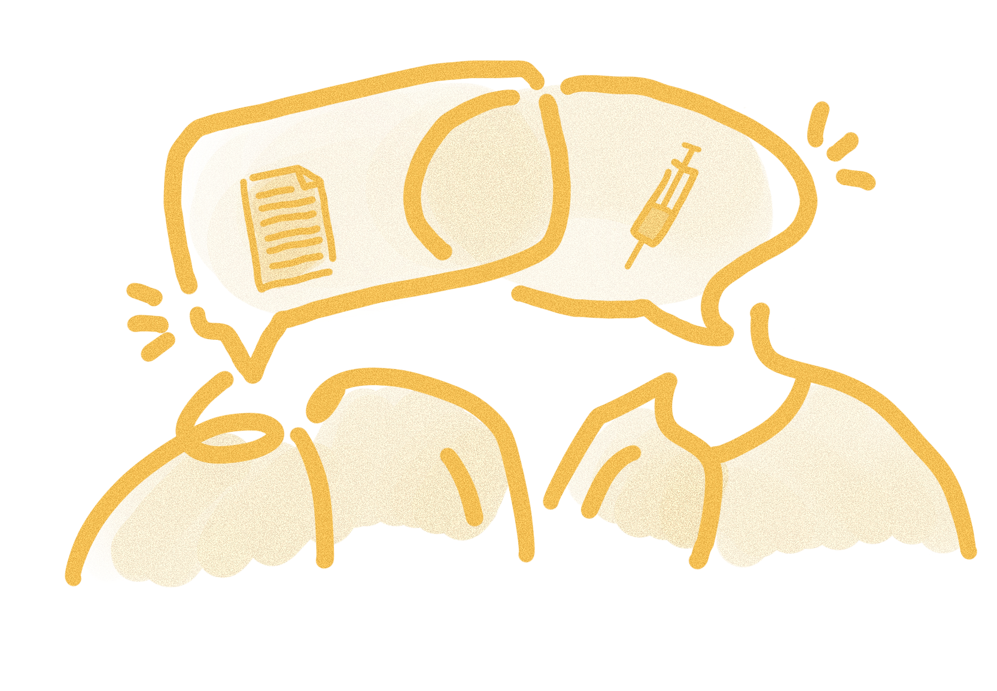
Our proposal – Intervention point
Exchanging perspectives
Knowledge sharing practices
Bridge institutional silos at the employee level through collaborative knowledge-sharing practices.
Creative Commons CC BY 4.0 2026 Clara Wahrenberg · Chiara Paolillo · Emma Hämäläinen · Hesamoddin Jalali · Sara Maukonen Design for Government course · Aalto University

Slide 34
Our proposal – Intervention point
Exchanging perspectives
Exchange programmes such as shadowing or workshops across healthcare institutions.
Creative Commons CC BY 4.0 2026 Clara Wahrenberg · Chiara Paolillo · Emma Hämäläinen · Hesamoddin Jalali · Sara Maukonen Design for Government course · Aalto University

Slide 35
Our proposal
Opportunities
Creative Commons CC BY 4.0 2026 Clara Wahrenberg · Chiara Paolillo · Emma Hämäläinen · Hesamoddin Jalali · Sara Maukonen Design for Government course · Aalto University
Notes:
4 minutes ->
(New notes from Chiara):
These opportunities are not abstract ideals—they are futures that the healthcare system can realistically move toward. They are possible, plausible, and in many ways already emerging in parts of the system today.
Because of that, our vision is not about introducing something entirely new, but about shifting how we understand care, accountability, and wellbeing. It asks us to move from fragmented responsibility to shared responsibility, and from isolated actions to continuous, connected care.
In other words, the real change is not only structural or digital—it is a mindset shift in how the whole system sees its role in supporting patients.

Slide 36

Our proposal – Opportunities
Shared responsibility
From individual responsibility to shared responsibility
No one should continue to carry the burden of connecting fragmented systems alone.
Care is seen as collective responsibility shared across professionals, providers, and systems.
This ensures the holistic wellbeing of the patients.
Unified patient information
Earlier support instead of waiting for problems to escalate
Quicker recognition of patients who may be at risk
Reduced repetition of assessments and administrative work
Greater shared accountability in institutions, leading to consideration of holistic wellbeing
Creative Commons CC BY 4.0 2026 Clara Wahrenberg · Chiara Paolillo · Emma Hämäläinen · Hesamoddin Jalali · Sara Maukonen Design for Government course · Aalto University
Notes:
New notes (from Chiara):
With unified patient information, we move from fragmented views of the patient to a shared, real-time understanding across institutions.
This enables earlier support, instead of waiting for problems to escalate, and helps professionals recognize vulnerable patients much faster.
It also reduces unnecessary repetition of assessments and administrative work, which currently often falls both on staff and patients.
Most importantly, when everyone is working from the same information, responsibility naturally becomes more shared—supporting a shift toward more coordinated and holistic care across the system.
OLD (ignore):
Rough outline of the speech (Sara): Once the unified patient information systems are in use, we can build a care providing culture that supports holistic wellbeing of patients. This can be achieved through emhasizing that care should be more about prevention, and less about reacting to situations after they have already escalated. This is also about strengthening the continuity of care during crises and transitions. The aim is to recognise patient vulnerability fast, while avoiding inconsistent and overlapping care, and building a greater accountability across institutions.
We want to ensure the holistic wellbeing of the patients by making sure that care professionals better understand what their contribution to the patient journey is and how it helps the patient to navigate the process. This would ensure that the patient no longer needs to navigate the complex healthcare systems alone, but can trust the care providers to understand who is responsible for the patient when they move forwards on their carepath through the system and towards holistic wellbeing. Care will be seen as collective responsibility across professionals, provides, and systems.

Slide 37


Our proposal – Opportunities
Shared understanding
From isolated expertise to collaborative understanding
Professionals recognize through training and right from onboarding that high-quality care depends not only on their own field-related skills, but on their opportunities to coordinate with others.
Professionals gain a vision of their career development rooted into shared understanding.
Onboarding frameworks
Professionals are trained to understand different care systems from onboarding
More complete understanding of patient pathways across time and place
Greater understanding of each other’s roles for the patient
Reduced misunderstandings about assessment criteria
Creative Commons CC BY 4.0 2026 Clara Wahrenberg · Chiara Paolillo · Emma Hämäläinen · Hesamoddin Jalali · Sara Maukonen Design for Government course · Aalto University
Notes:
Notes on what to say here (from Chiara):
Onboarding frameworks help us build shared understanding of different care systems right from the start. Instead of professionals learning their role in isolation, they begin to understand care together as a connected system.
This leads to a more complete picture of the patient journey across different services and timeframes, not just within one institution.
It also helps people better understand each other’s roles in the care process, and how their work contributes to the overall patient pathway.
At the same time, it reduces confusion around assessment criteria and decision-making, which are often sources of misalignment today.
Overall, it creates a stronger shared foundation for more coordinated and consistent care across the entire system.
OLD (ignore):
Rough outline of the speech (Sara): After we’ve established solid onboarding frameworks, we can move towards healthcare professionals envisioning their careers through shared understanding of care. This can be achieved through establishing more consistent care practices and understanding collaborative care pathways, as well as through faster employee integration and reduced misunderstandings regarding assessment criteria.
Healthcare moves towards improved continous learning. This means moving on from compartmentalised institutional knowledge and building on it by learning from other providers and institutions’ professionals. These experts will recognise the value of growing their knowledge and increasing their ability to coordinate with others for the benefit of the patient.

Slide 38
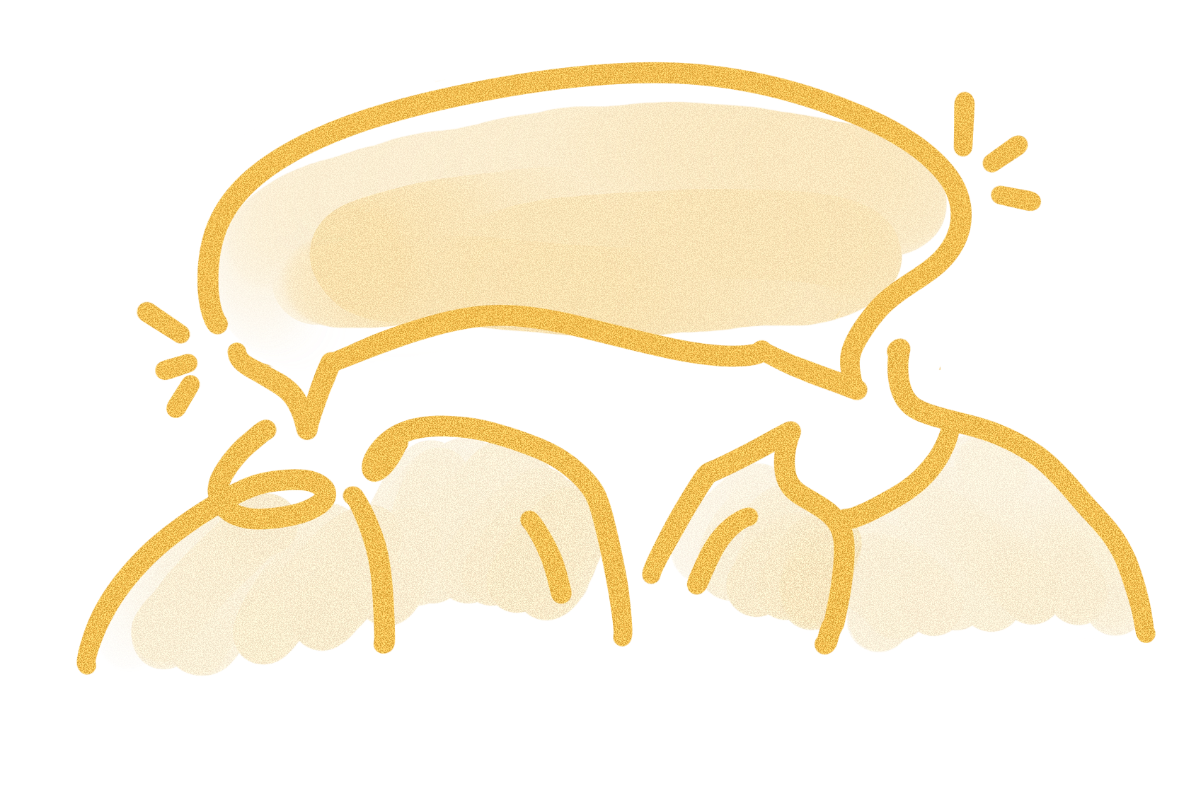

Our proposal – Opportunities
Continuous learning
From symptomatic treatment to supporting continuous wellbeing
Healthcare institutions understands each others shared language and practices.
Rather than considering only isolated medical events, healthcare becomes planned around long-term continuity, prevention and continuous learning.
Care pathways are conceived as ongoing human experiences rather than disconnected practices of care.
Knowledge sharing practices
Continuous learning through open conversation and reflection
Stronger empathy between professionals
Knowledge sharing helps professionals learn from each other
Creation of a health culture based on listening and growing together
Creative Commons CC BY 4.0 2026 Clara Wahrenberg · Chiara Paolillo · Emma Hämäläinen · Hesamoddin Jalali · Sara Maukonen Design for Government course · Aalto University
Notes:
Notes what to say here (from Chiara):
Knowledge sharing practices create space for continuous learning through open conversation and reflection across institutions.
They help professionals better understand each other’s realities, which builds stronger empathy and trust between different roles in the healthcare system.
Through this exchange, professionals don’t just share information, they learn from each other’s everyday experiences and challenges.
Over time, this supports a culture where healthcare grows through listening, collaboration, and continuous improvement together.
OLD (ignore):
Rough outline of the speech (Sara): When we have established knowledge sharing practices, we can move towards a system, where long term continuity can flourish, by strengthening collaboration and increasing empathy and trust between professionals. When care practices are aligned, care pathways become more about human experiences rather than diconnected practices of care.
Shared understanding between institutional practices and requirements helps to build a coherent group of professionals, who can use their enhanced knowledge to better supports vulnerable patients. This helps to end discountinuity of care by providing a safe environment for the patient through faster and more efficient patient journey. This means less delays in the system, which ensures that the patient can get the care they need as soon as they need it.

Slide 39
Conclusion
Creative Commons CC BY 4.0 2026 Clara Wahrenberg · Chiara Paolillo · Emma Hämäläinen · Hesamoddin Jalali · Sara Maukonen Design for Government course · Aalto University
Notes:
Improving healthcare requires building shared awareness across the entire care landscape so that professionals, institutions, and patients can act with a common understanding of care, responsibility, and wellbeing.

Slide 40
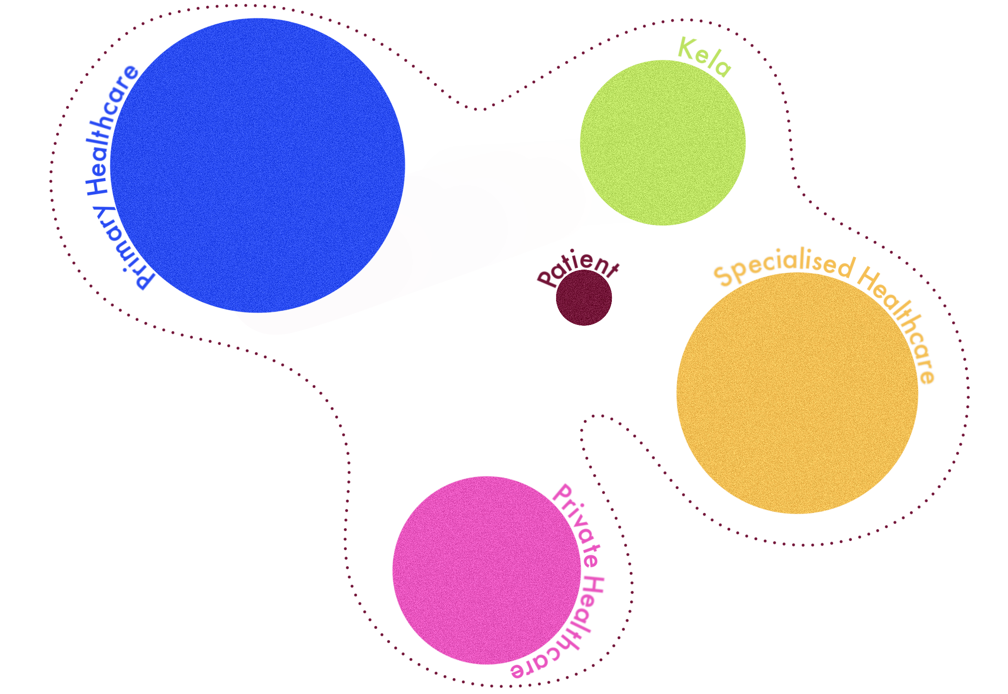
Conclusion
When understanding is continuous, care can be continuous as well.
Creative Commons CC BY 4.0 2026 Clara Wahrenberg · Chiara Paolillo · Emma Hämäläinen · Hesamoddin Jalali · Sara Maukonen Design for Government course · Aalto University
Notes:
When we nurture this atmosphere of understanding, it will not only help us provide care for everyone, but especially those who are in vulnerable positions in the society.
When understanding is continous, care can be continous as well.

Slide 41
Thank you!
Kiitos!
Tack!
Creative Commons CC BY 4.0 2026 Clara Wahrenberg · Chiara Paolillo · Emma Hämäläinen · Hesamoddin Jalali · Sara Maukonen Design for Government course · Aalto University

Slide 42
References
Cambridge Dictionary. (2026). Care definition. [Website]. Retrieved 18.5.2026 from https://dictionary.cambridge.org/dictionary/english/care
Interview with a social worker. (2026, April 20).
Interview with experience expert. (2026, April 29).
Ideation session with experts. (2026, May 5).
Länsi-Uudenmaan hyvinvointialue. (2026, March 12). Yhteisen asiakastietojärjestelmän käyttö alkaa 17.3. https://www.luvn.fi/fi/uutiset/2026/03/yhteisen-asiakastietojarjestelman-kaytto-alkaa-173
Ministry of Social Affairs and Health. (2025). Personal physician, personal nurse, care team or independent practitioner? The many models of continuity of care. STM
Ministry of Social Affairs and Health. (2026, May 21). Strategy. [Website] Retrieved 25.5.2026 from https://stm.fi/en/strategy.
Statistics Finland. (2025a, April 4th). Number of foreign-language speakers exceeded 600,000 during 2024. [Website]. Retrieved 20.5.2026 from https://stat.fi/en/publication/cm1jg8tr20lco07vwvoif9s6i
Statistics Finland. (2025b). Väestö ja yhteiskunta: Väestötietoja 2021–2025. Statistics Finland. https://stat.fi/fi/tilastot/tietoa-teemoittain/suomi-lukuina/vaesto-ja-yhteiskunta

