Slide 1


CARE THROUGH
CONNECTION
Continuity of Understanding: Supporting Bilingual, Inter-professional Care Pathways
Notes:
Connecting needs of people with h
Do not present the original project brief. Tutors will introduce it.
Refer to the Narrative for Change lecture to help you create a story to communicate your proposal and structure your presentation
Give your proposal a title
The focus should be on communicating the proposal: narrative for change, vision, and concrete examples as entry points for how change could start.
The presentation should last no longer than 15 min.
It is up to the group to decide who and how many team members present
Use your research evidence to substantiate the proposal. Visualisations should be utilised to communicate your understanding and make the argumentation and interpretations more transparent, for example, by showing where conflicts, perspectives, and leverage points are in the system.
What needs to change? Why now?
Further considerations and reflections: What are the next steps to make the suggested change happen? What are the potential barriers? How do you suggest mitigating them?
Words, phrasing, and imagery included in your public materials can be used according to the terms of the copyright, therefore, also by your ministry. Do not include confidential information. Remember that you cannot use materials copyrighted by others and give citations for any quotes or images from others.
Remember, this is your moment to be as clear as possible, and as engaging as possible. Take this into consideration for structuring and delivering the presentation itself. How can I tell a story? How do I communicate all the work done in a simple, effective and compelling way

Slide 2
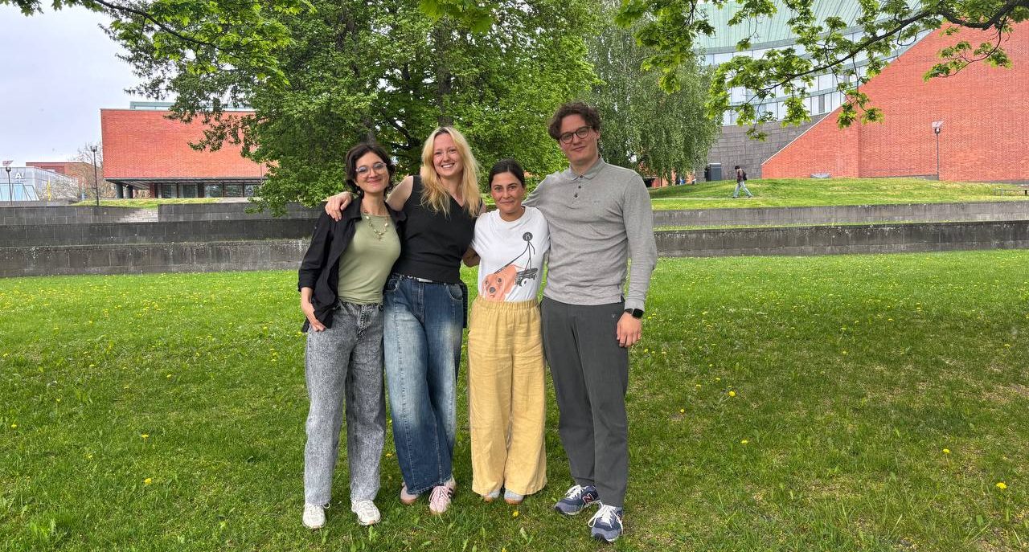
Care 2 Team
Jasmin Joshi
Vivian Katajainen
Caroline Sjöström
Otso Koiso-Kanttila
Collaborative and
Industrial Design
Creative Sustainability
Collaborative and Industrial Design
Strategy & Organizational Design
Creative Commons CC BY 4.0 2026 Jasmin Joshi, Vivian Katajainen, Otso Koiso-Kanttila, Caroline Sjöström, and Design for Government course at Aalto University

Slide 3
INTRODUCTION | expert quote
“Oh, there is so much more that I'd like to do, but I can't.”
-Social worker
Creative Commons CC BY 4.0 2026 Jasmin Joshi, Vivian Katajainen, Otso Koiso-Kanttila, Caroline Sjöström, and Design for Government course at Aalto University

Slide 4
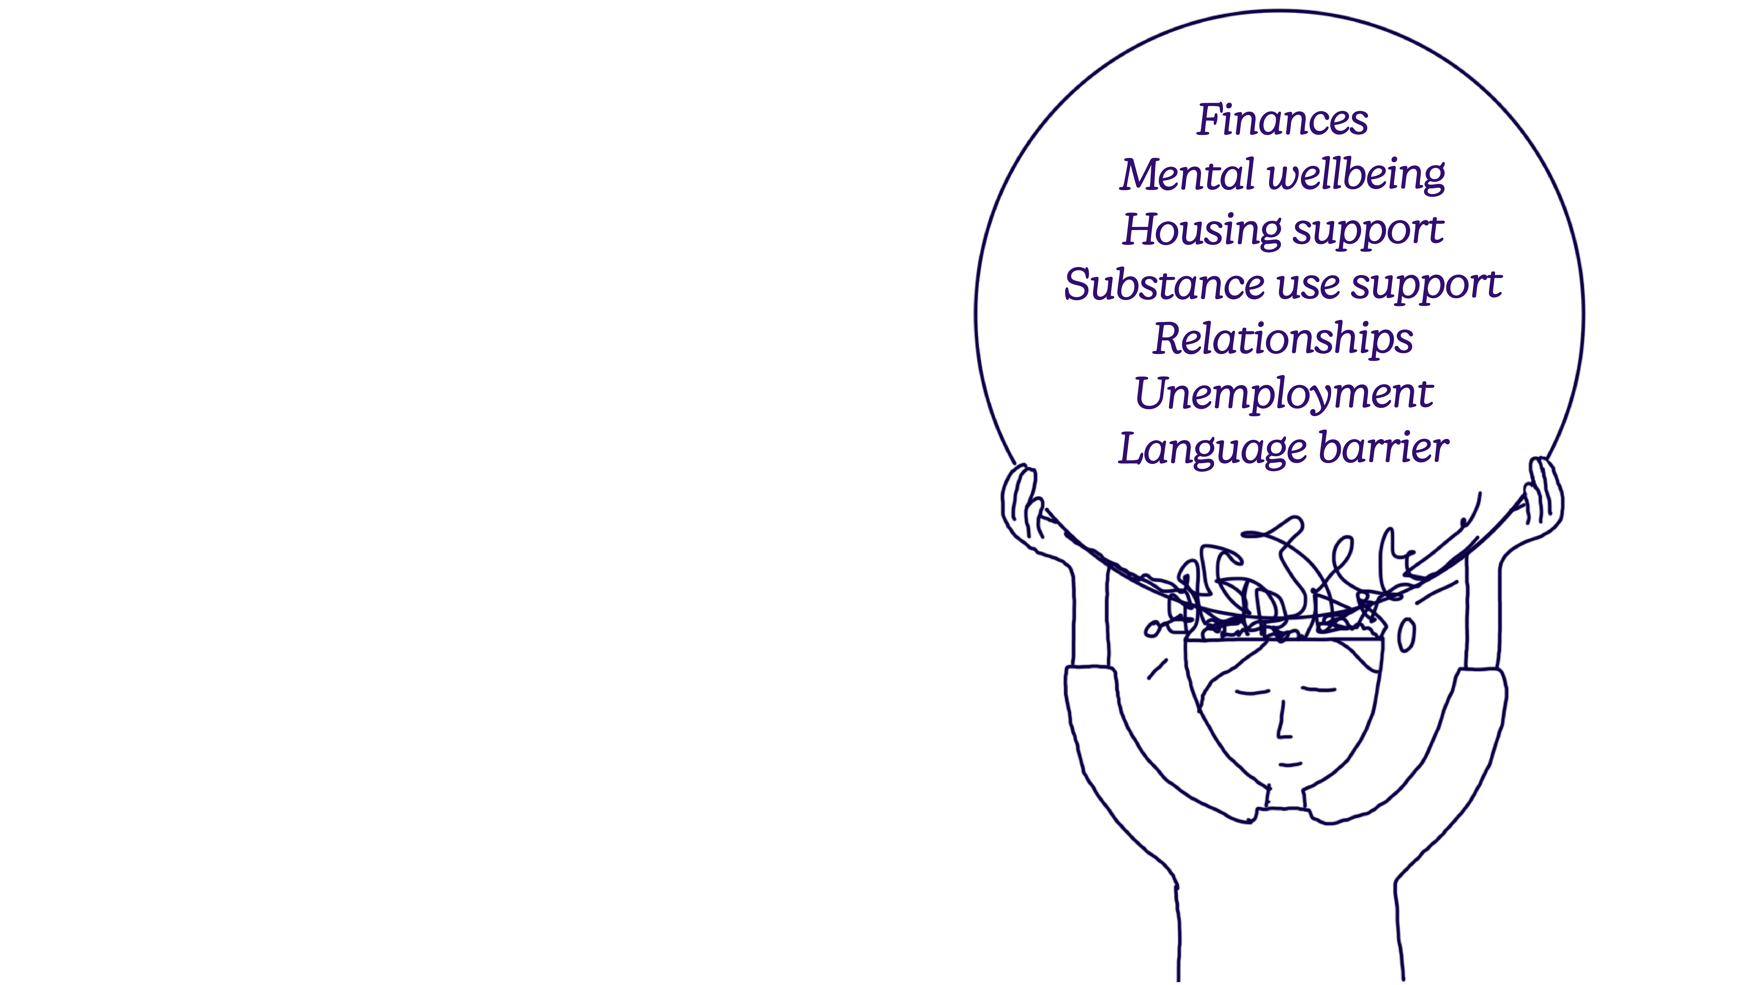
INTRODUCTION | internal challenges
Vulnerable groups face many problems where help is needed
Creative Commons CC BY 4.0 2026 Jasmin Joshi, Vivian Katajainen, Otso Koiso-Kanttila, Caroline Sjöström, and Design for Government course at Aalto University
Notes:
With the crash Erik subsequently suffered from cognitive issues which has left him partly unable to work. This further has impacted his mental health and social life.
Velat, diilin menettämis masennus, päihteiden käyttö. Erik goes down a really rough path.
Overlapping needs
Financial stress, substance use, social isolatio, anxiety, housing worries, mental health struggles etc. Starting by telling about Erik’s problems
Cognitive overload
Visuaali: Orgaaninen yhteys toisiinsa, koska kaikki kytköksissä toisiinsa

Slide 5
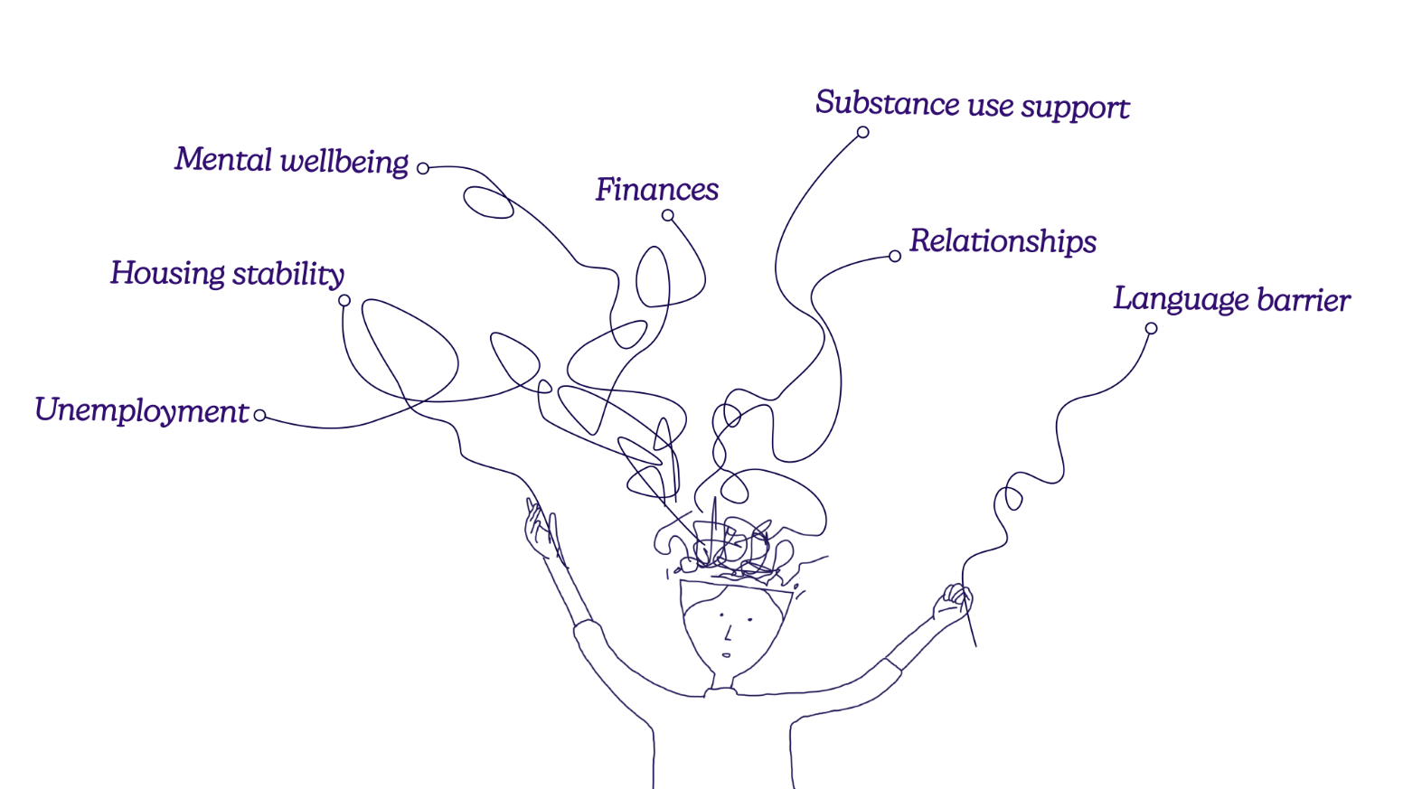
Help exists, but all problems do not fit under one service
INTRODUCTION | connected challenges
Creative Commons CC BY 4.0 2026 Jasmin Joshi, Vivian Katajainen, Otso Koiso-Kanttila, Caroline Sjöström, and Design for Government course at Aalto University
Notes:
Sori se beige hue muistuttaa jalkaproteesia

Slide 6
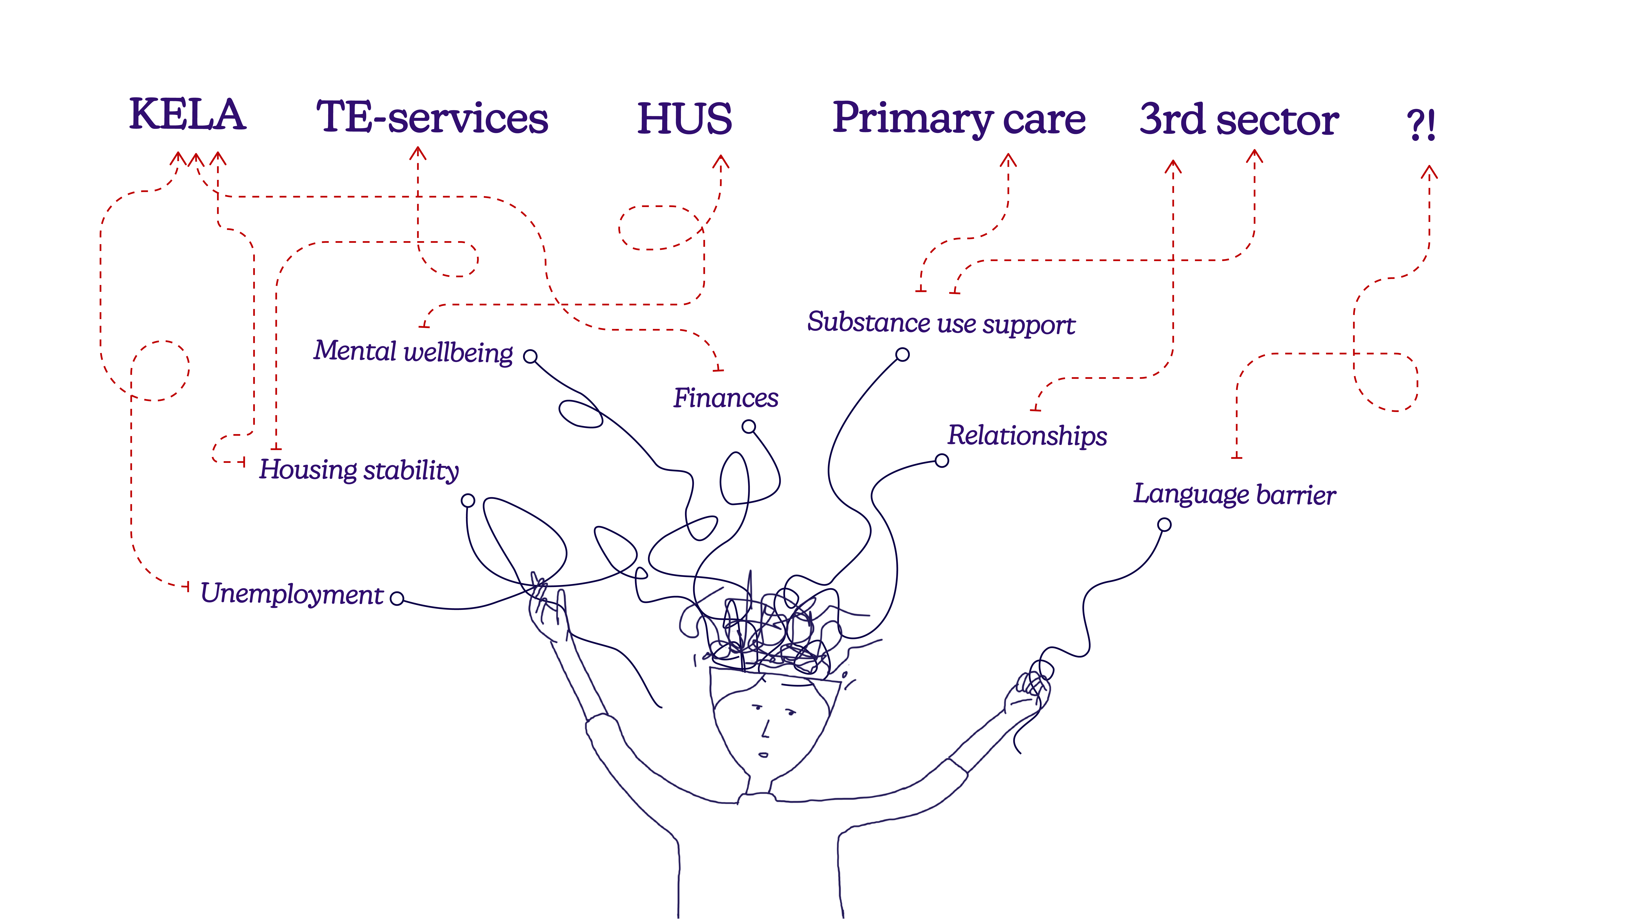
INTRODUCTION | fragmented support
Creative Commons CC BY 4.0 2026 Jasmin Joshi, Vivian Katajainen, Otso Koiso-Kanttila, Caroline Sjöström, and Design for Government course at Aalto University
Notes:
With the crash Erik subsequently suffered from cognitive issues which has left him partly unable to work. This further has impacted his mental health and social life.
Velat, diilin menettämis masennus, päihteiden käyttö. Erik goes down a really rough path.
Visuaali: Palvelut koskettaa yhtä tai toista palvelua
-insert different overlapping services visually-
- Fragmented support
Each of those services sees only part of Erik’s situation. Erik experiences all of it by himself, at once. Yksittäisten ongelmien hoitaminen on vaikeaa, mutta vaikeus kasvaa ekponentiaalisesti kun ongelmia tulee useita hoidettaviksi.

Slide 7
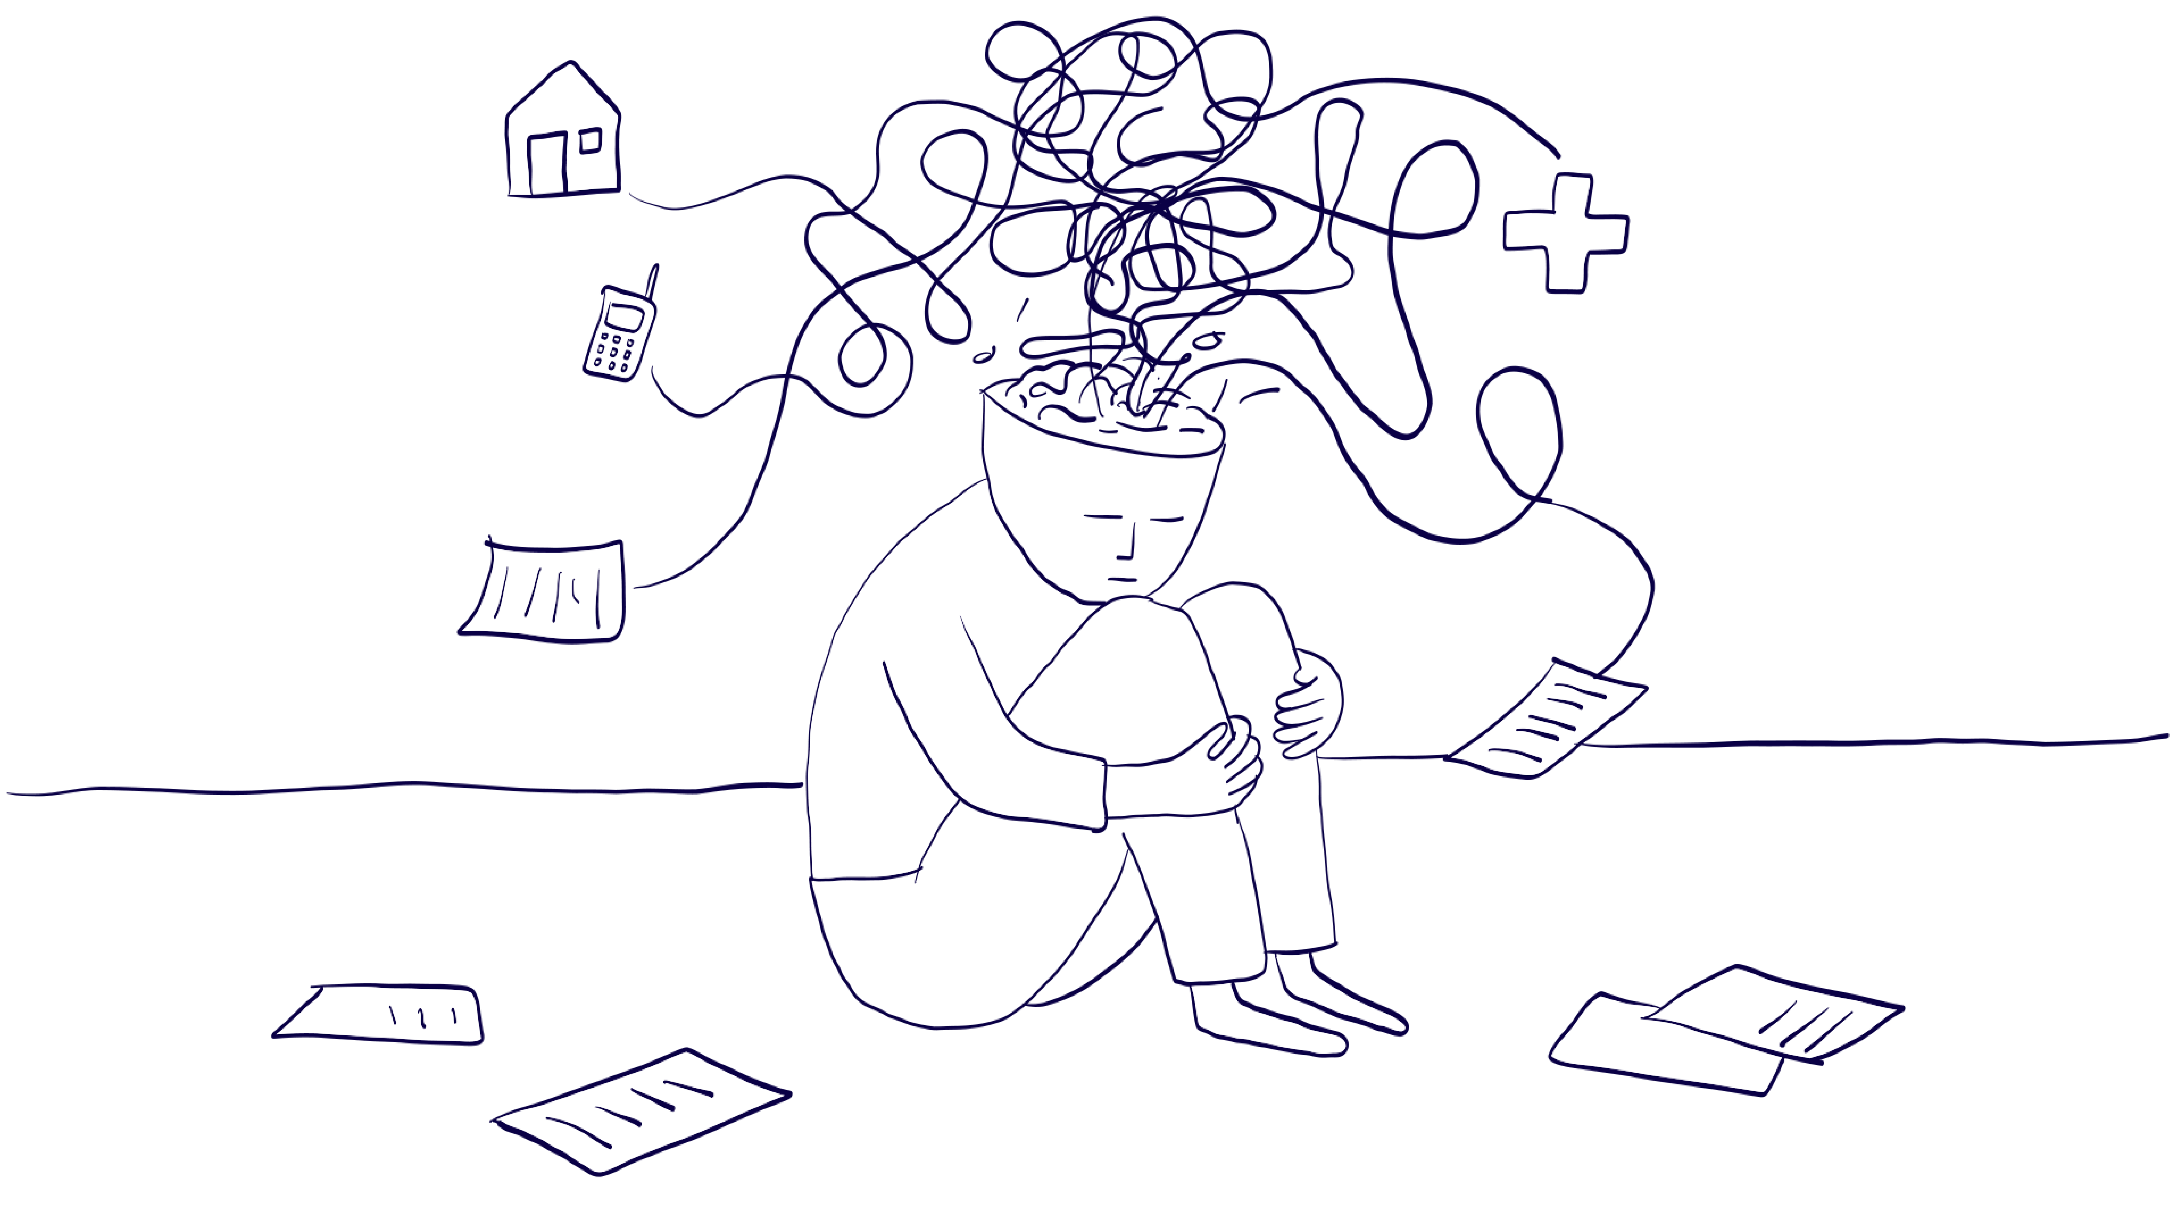
Navigating and advocating for oneself is hard especially for vulnerable groups
INTRODUCTION | cognitive overload
There are many steps in the care pathway
-3rd sector service user
I'm waiting to meet my social worker to look over my benefits, but she's probably very busy​
-3rd sector service user​
​
Creative Commons CC BY 4.0 2026 Jasmin Joshi, Vivian Katajainen, Otso Koiso-Kanttila, Caroline Sjöström, and Design for Government course at Aalto University
Notes:
.

Slide 8
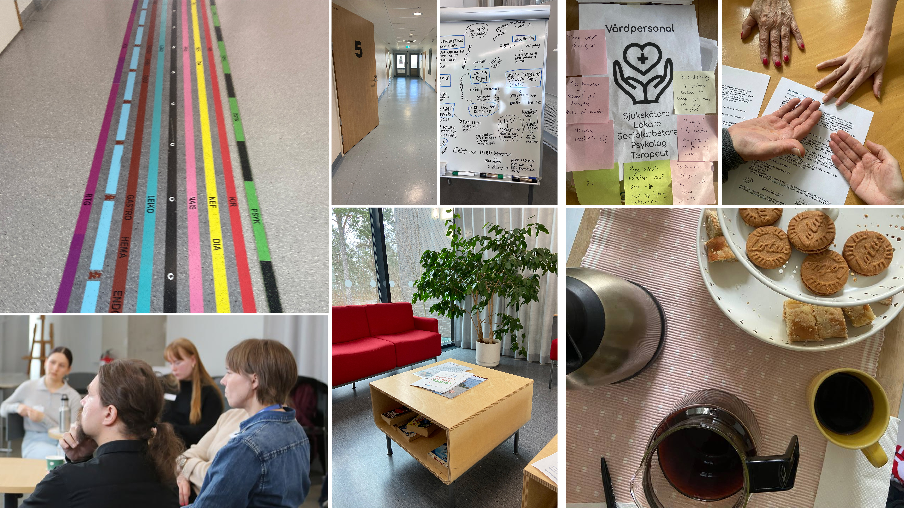
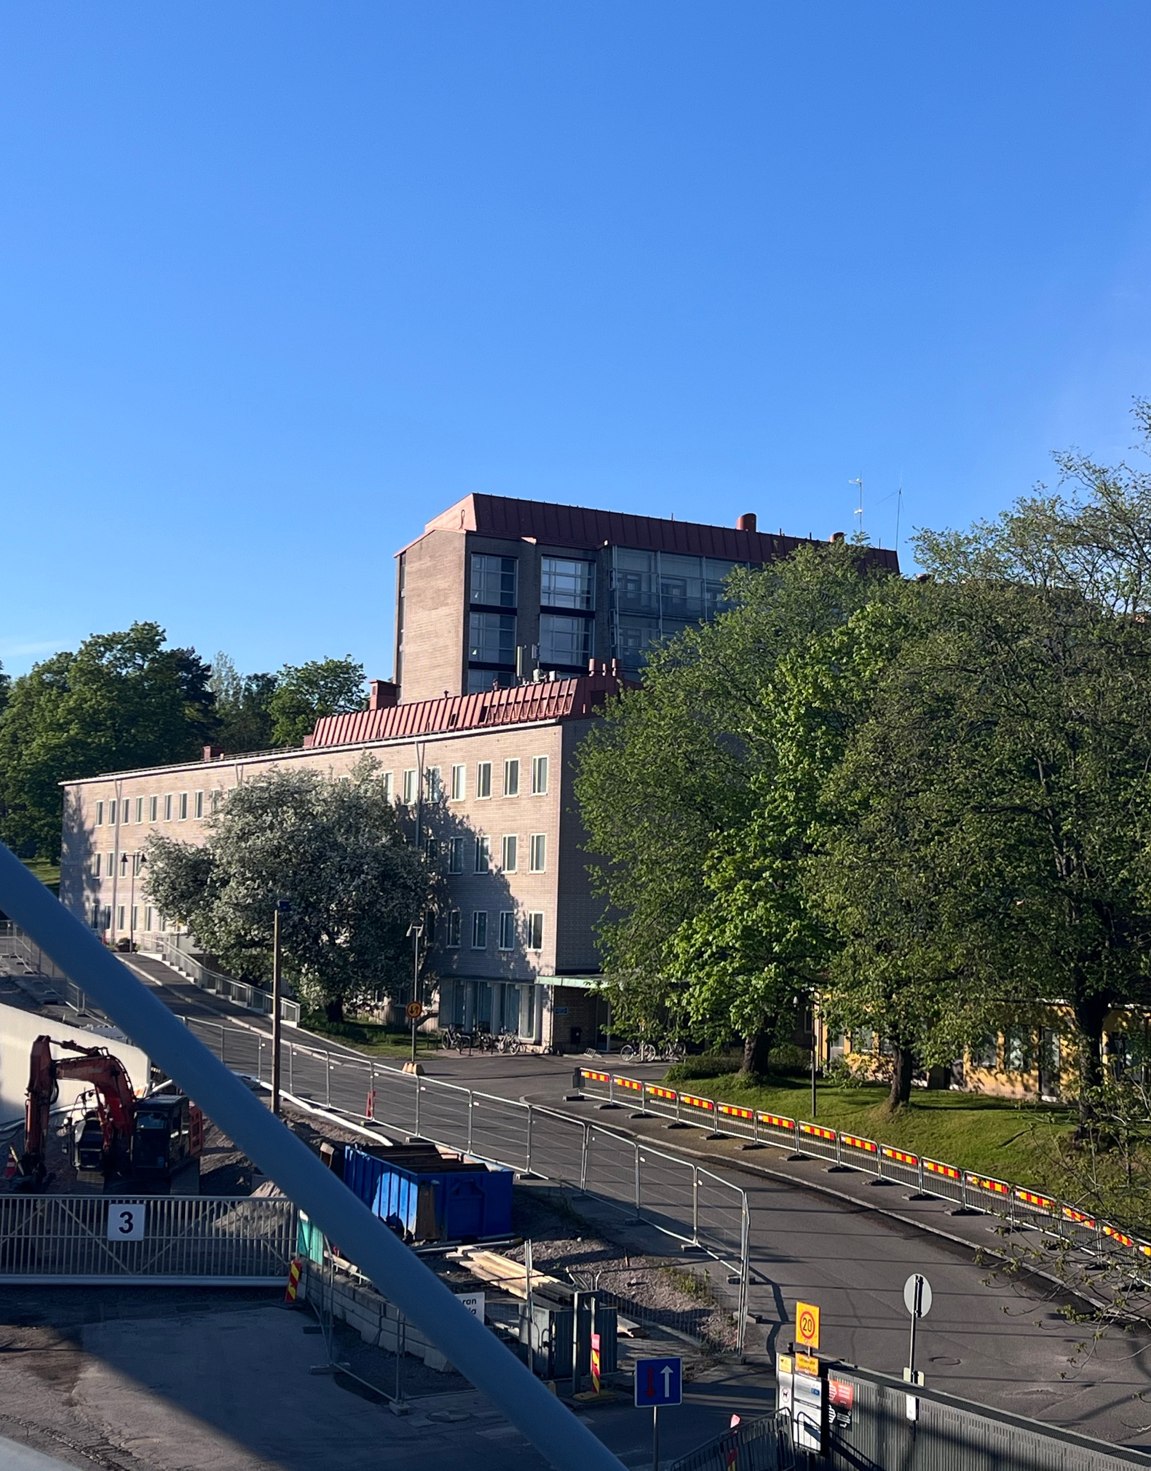
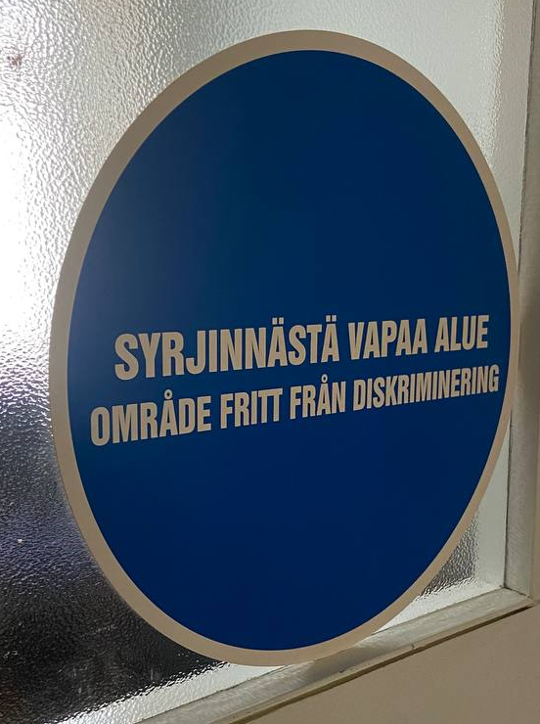





These are snapshots of the challenges a vulnerable person might face in their care pathway
Creative Commons CC BY 4.0 2026 Jasmin Joshi, Vivian Katajainen, Otso Koiso-Kanttila, Caroline Sjöström, and Design for Government course at Aalto University
Notes:
Intro to research. ” nää tyypit kerto meille keitä vulnerable target oli” social workers, mental health specialist jne…

Slide 9
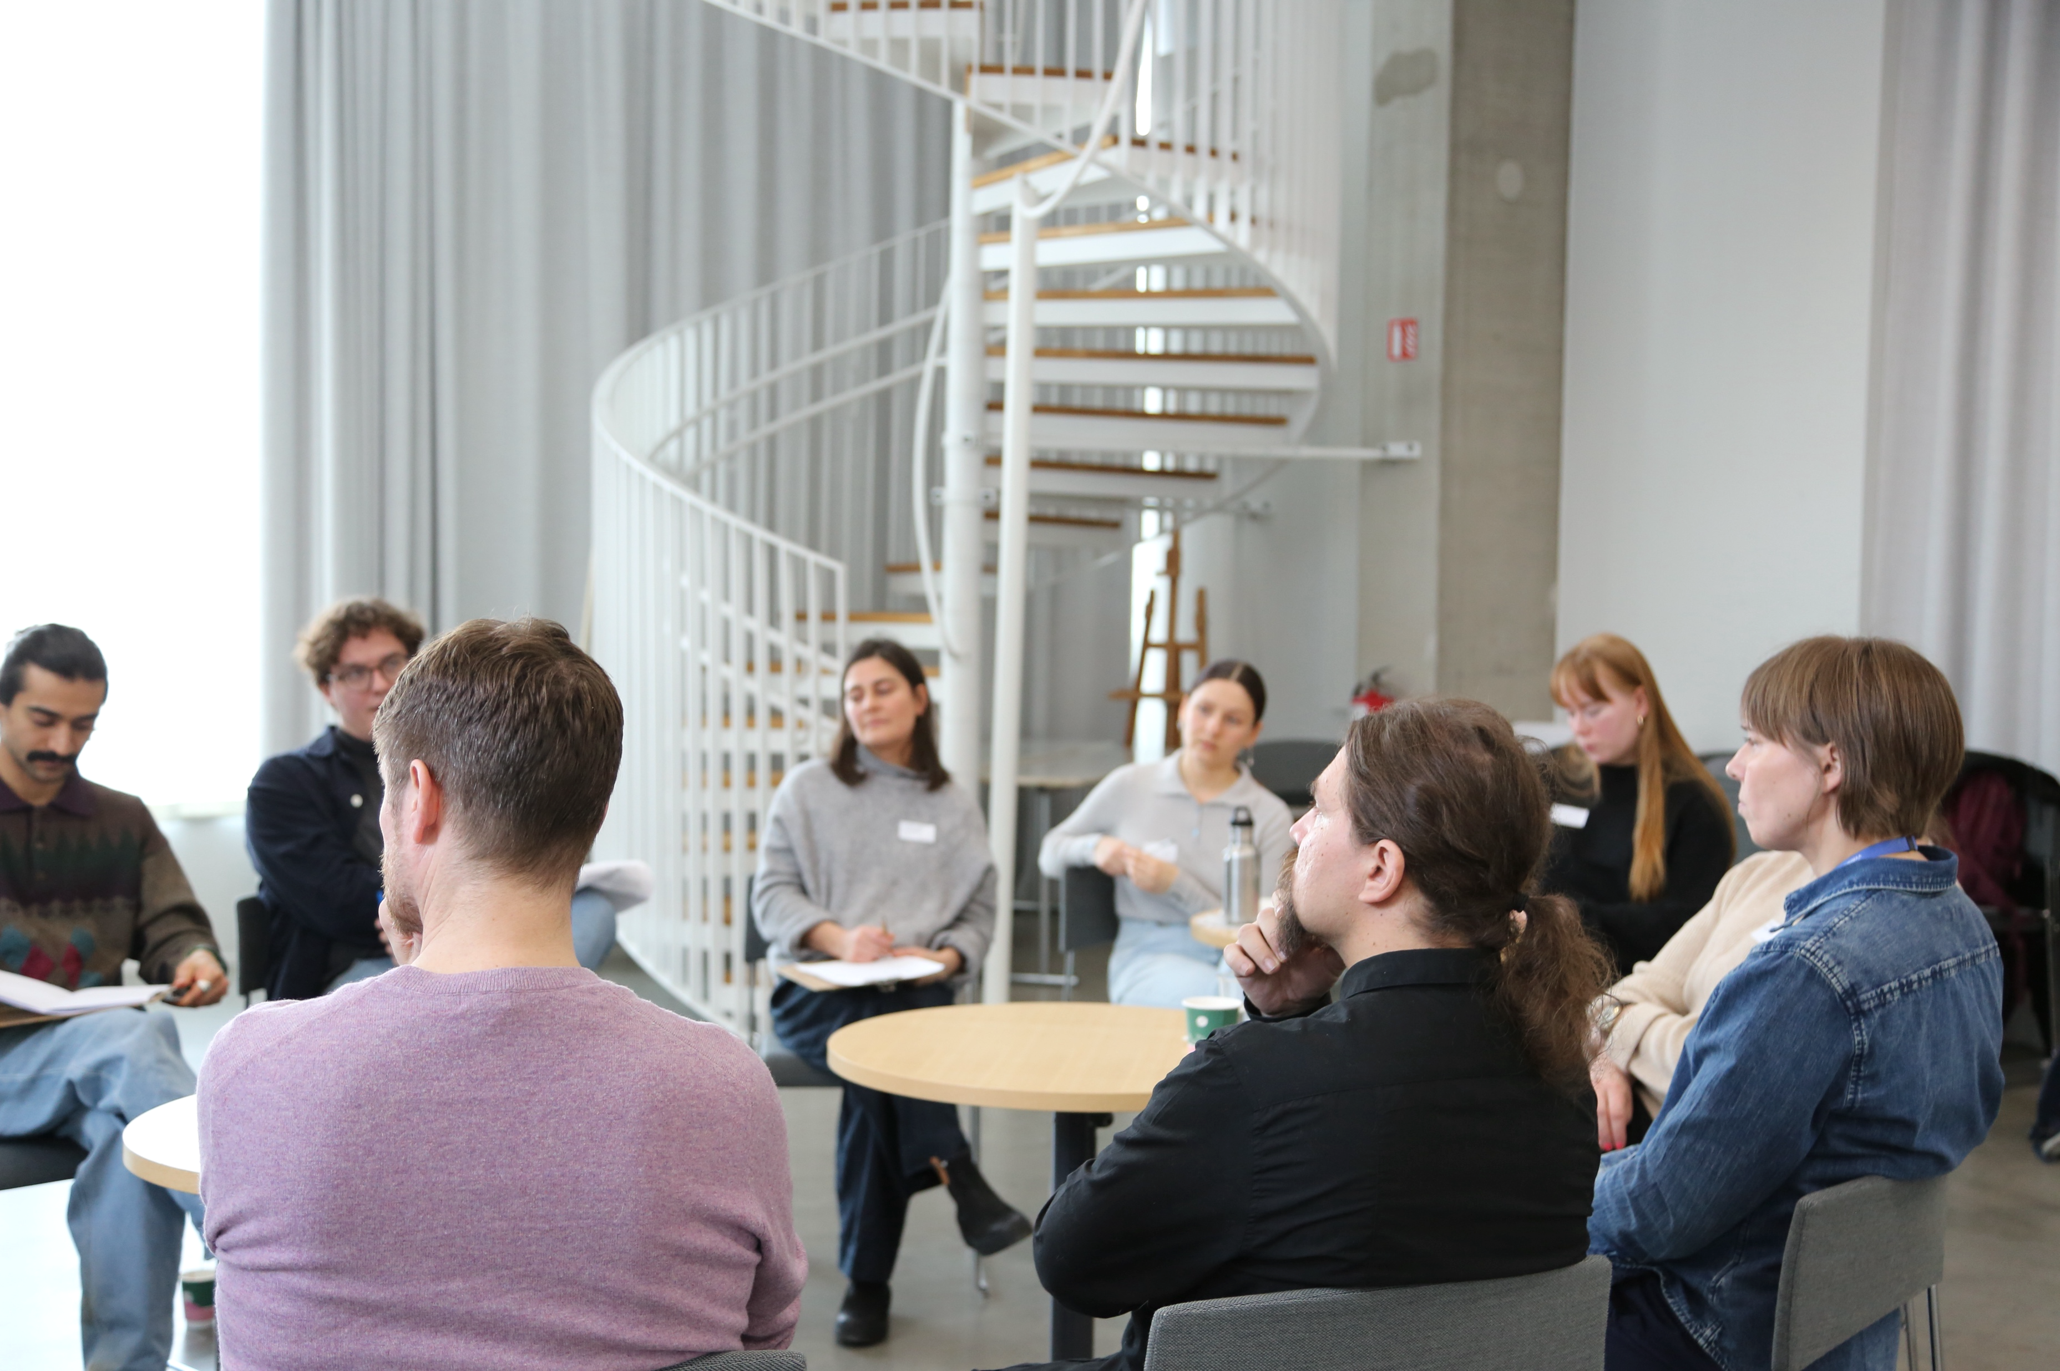

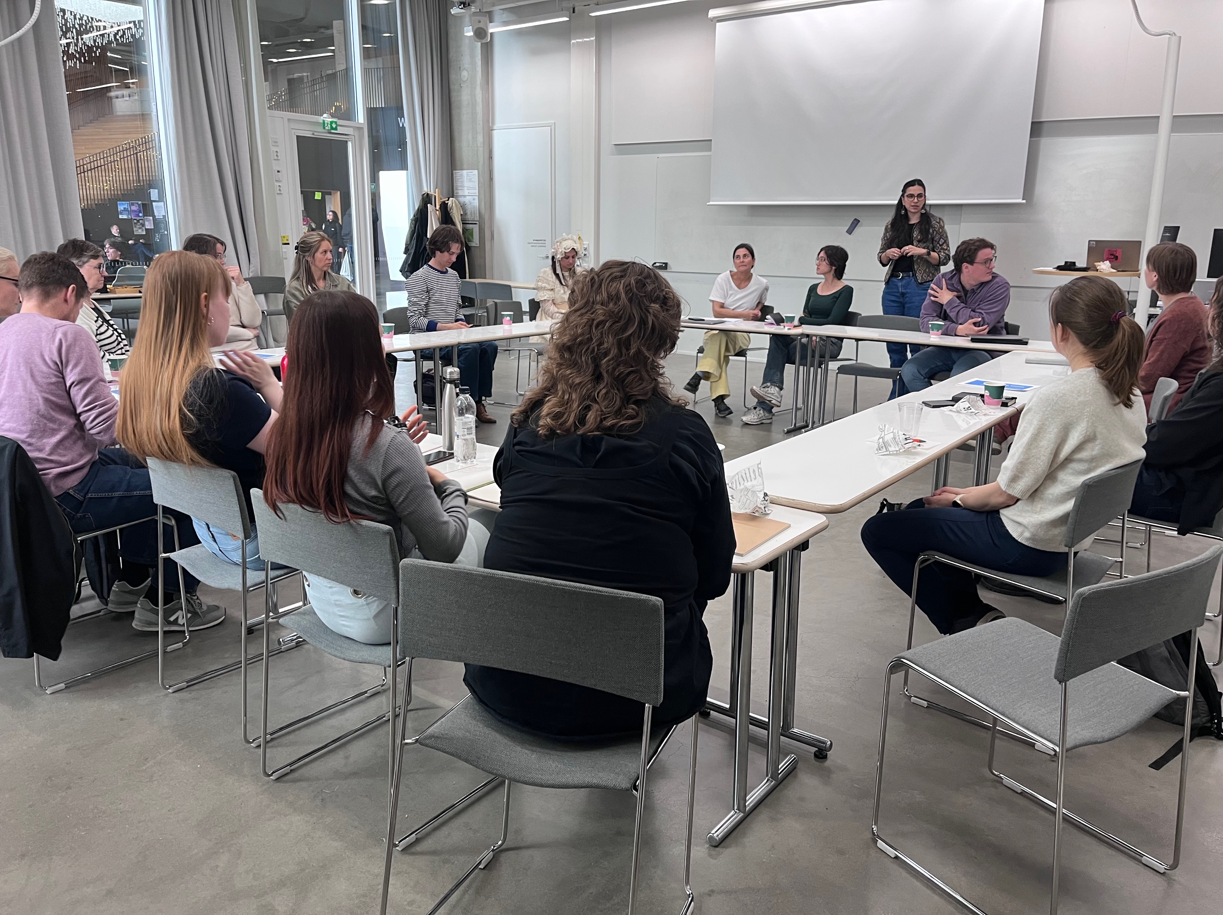
INTRODUCTION | research
Desk research
Interviews from
Bringing all insights together
HUS
Länsi-Uudenmaan hyinvointialue (LUVN)
Itä-Uudenmaan hyvinvointialue (IU)
Kela
3rd sector support groups
Erätauko
Meetings
Mapping discoveries from our research to suggest entry points — the first simple, yet concrete, point of engagement (Steinberg, 2026)
Discussions with a variety of organizations and sectors to better understand the target group and the current system
From three initial perspectives:
Patient
Provider
Administrative
to one coherent understanding
Field work
Foundation work
Ideation
Round-table discussion
Focus group
Partner discussion
Collaborative meeting with partners for sharing perspectives
X4 Service user participants
X1 3rd sector organiser
Collaborative meeting with partners for sharing ideas
Creative Commons CC BY 4.0 2026 Jasmin Joshi, Vivian Katajainen, Otso Koiso-Kanttila, Caroline Sjöström, and Design for Government course at Aalto University
Expert interviews
X
X
X
Notes:
“ja täällä käytiin toteuttamassa haastattelua jne…
Vivian
Expert interviews
X1 Project leader, HUS (Carola)
X2 Mental health nurses LUVN (Pamela o Linda)
X1 Psychiatrist, HUS (Annika)
X1 Experience expert, 3rd sector (Maria)
X1 Topic expert (Jonna)
X1 joku lohjassa (Ohjaamo)
Focus group, 3rd sector
X4 service user participants
X1 organiser
HUONO set up. Teen uudestaan!
**Selitetään mikä 3rd sector on tässä

Slide 10
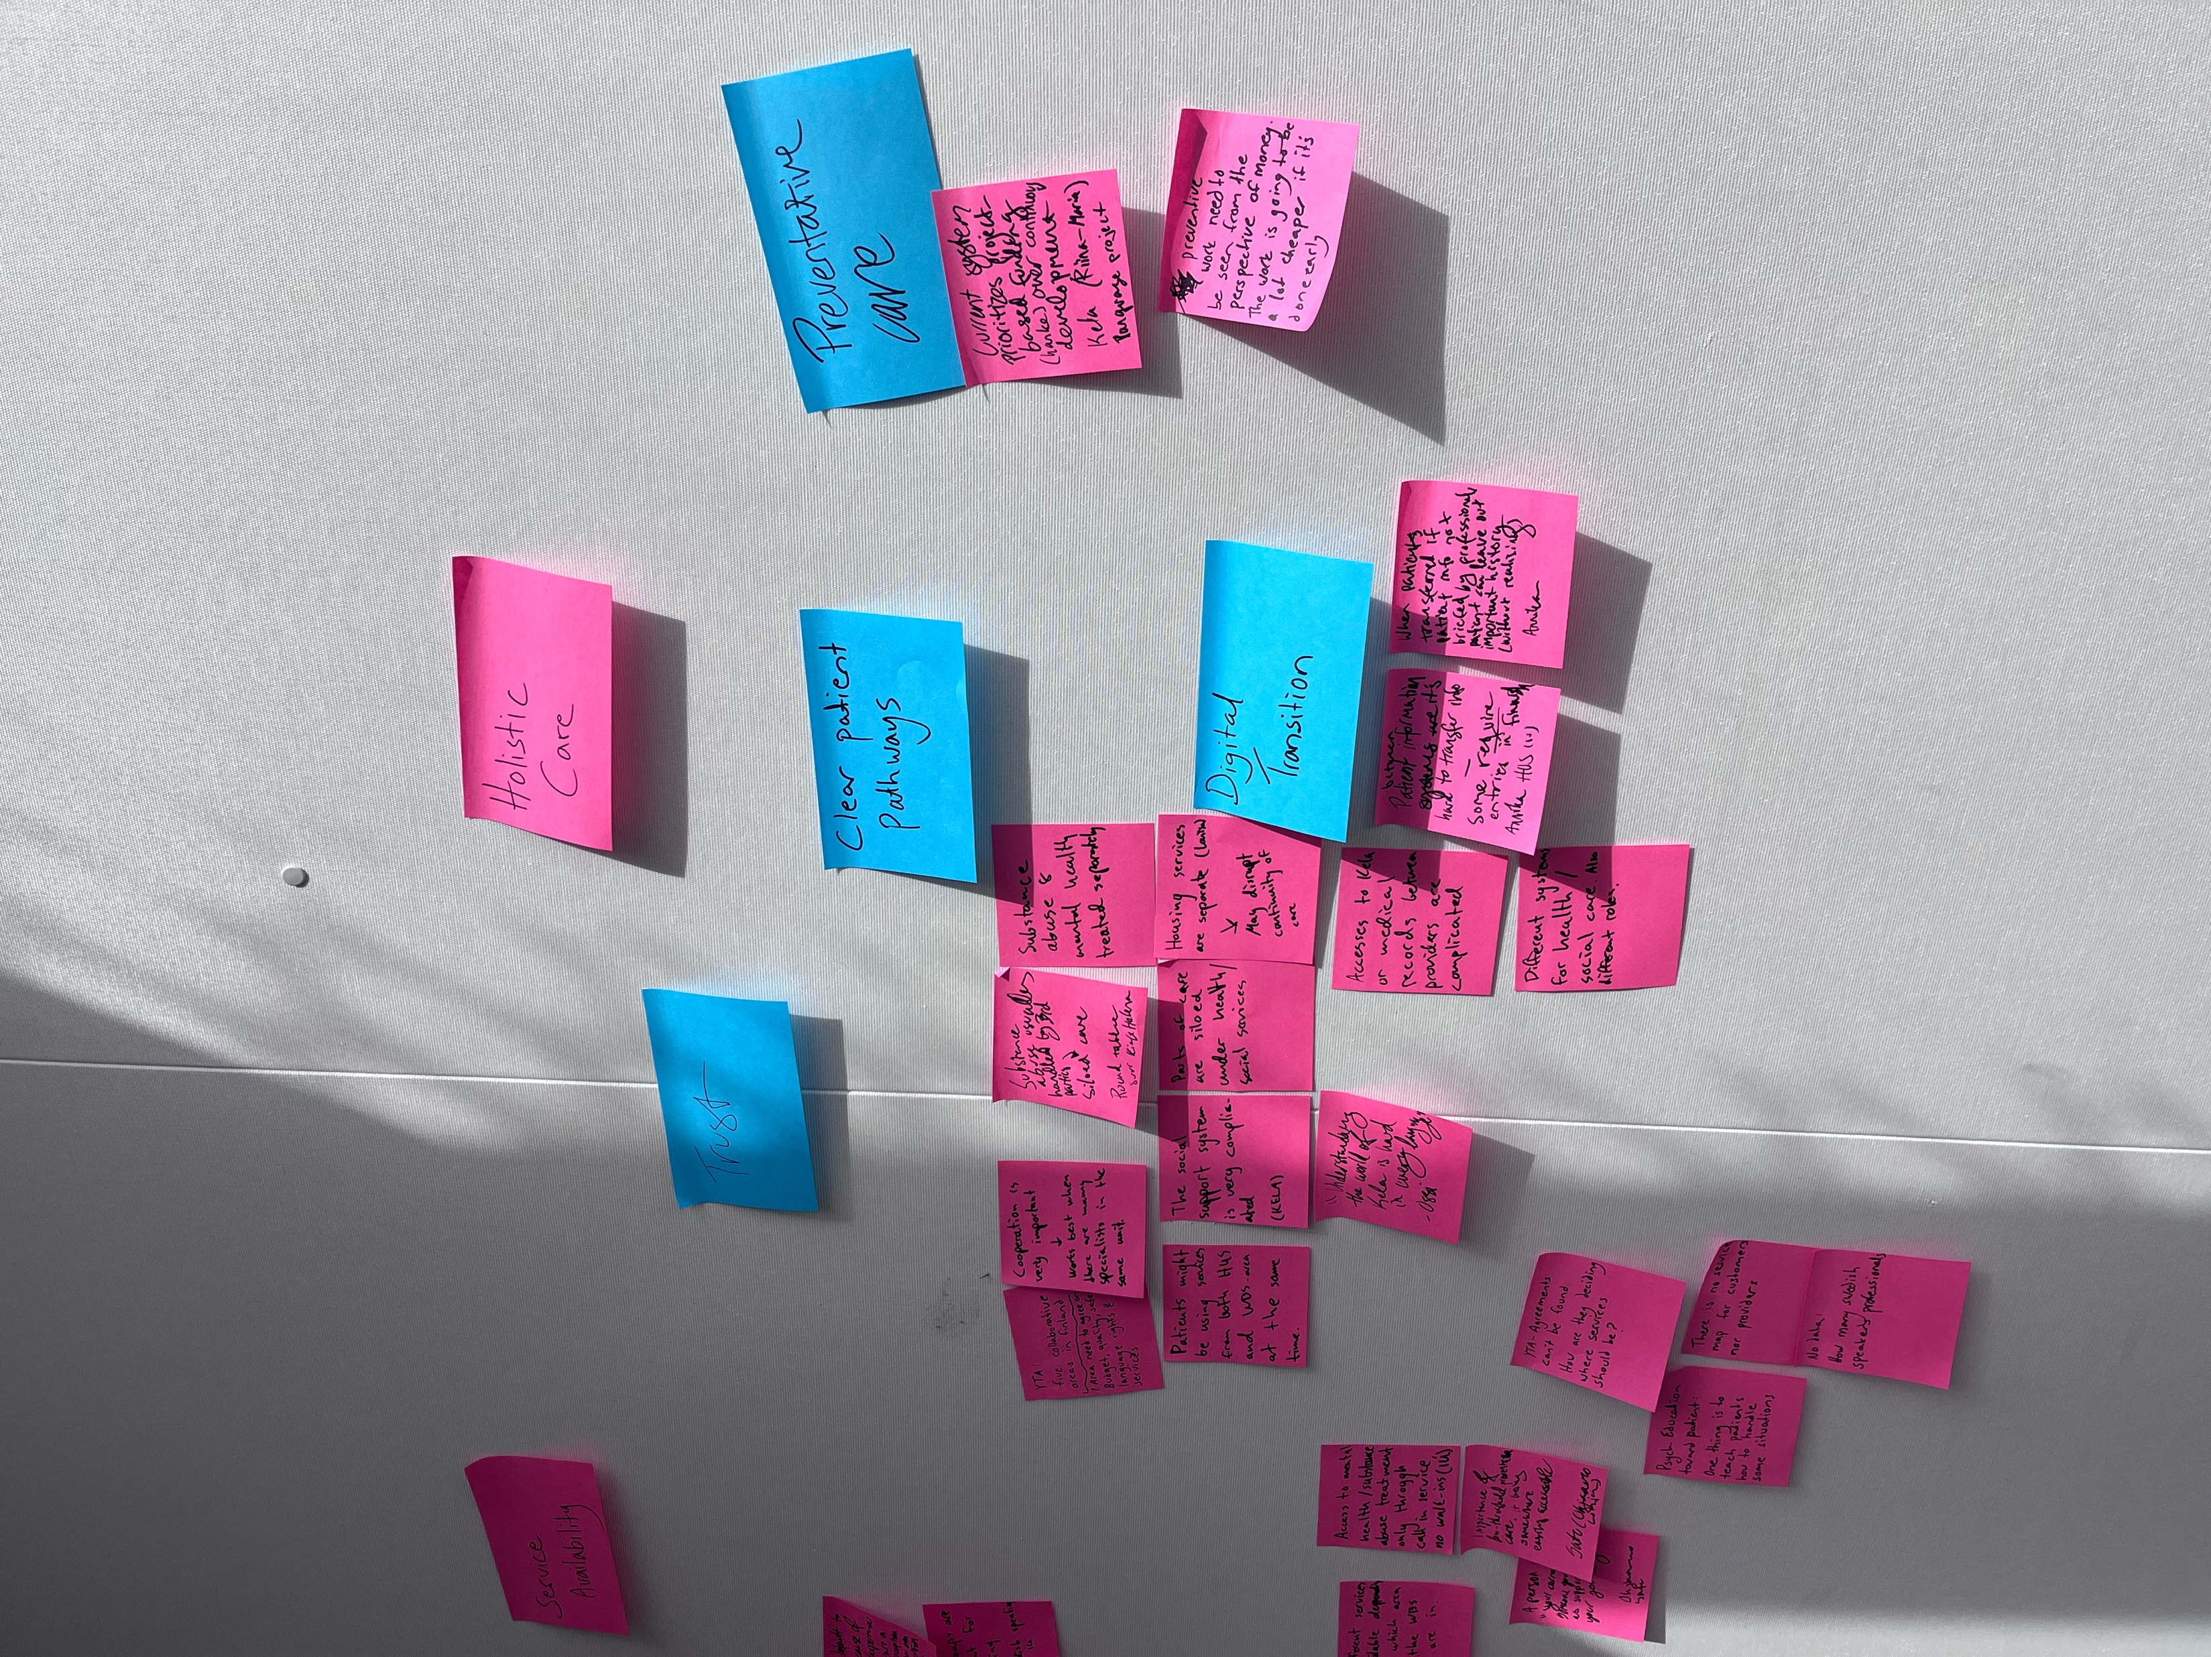
Key findings
Insights from our 12-week research
Creative Commons CC BY 4.0 2026 Jasmin Joshi, Vivian Katajainen, Otso Koiso-Kanttila, Caroline Sjöström, and Design for Government course at Aalto University
Notes:
observations during our 12 week jne… concrete aika!

Slide 11
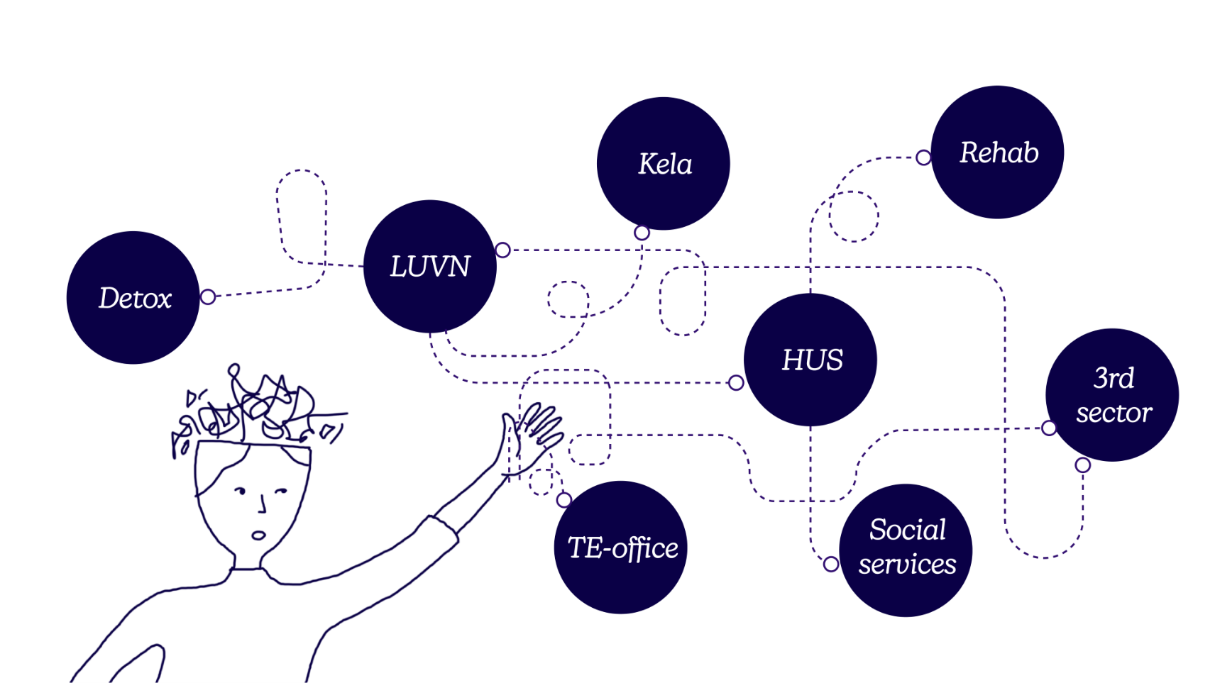
INTRODUCTION | insight 1
Vulnerable patients face the most complex care paths
Creative Commons CC BY 4.0 2026 Jasmin Joshi, Vivian Katajainen, Otso Koiso-Kanttila, Caroline Sjöström, and Design for Government course at Aalto University

Slide 12
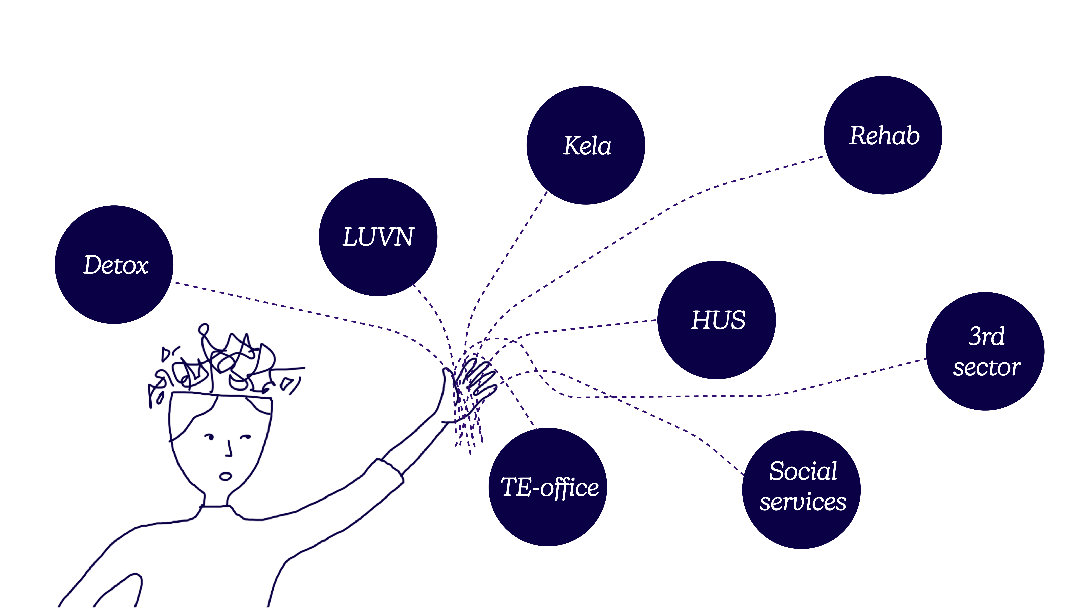
INTRODUCTION | insight 1
For the individual, many of these interconnected issues are treated under separate points of care
Creative Commons CC BY 4.0 2026 Jasmin Joshi, Vivian Katajainen, Otso Koiso-Kanttila, Caroline Sjöström, and Design for Government course at Aalto University
Notes:
For the individual, these problems are interconnected but the system treats them as separate issues / All problems don't fit under one service

Slide 13
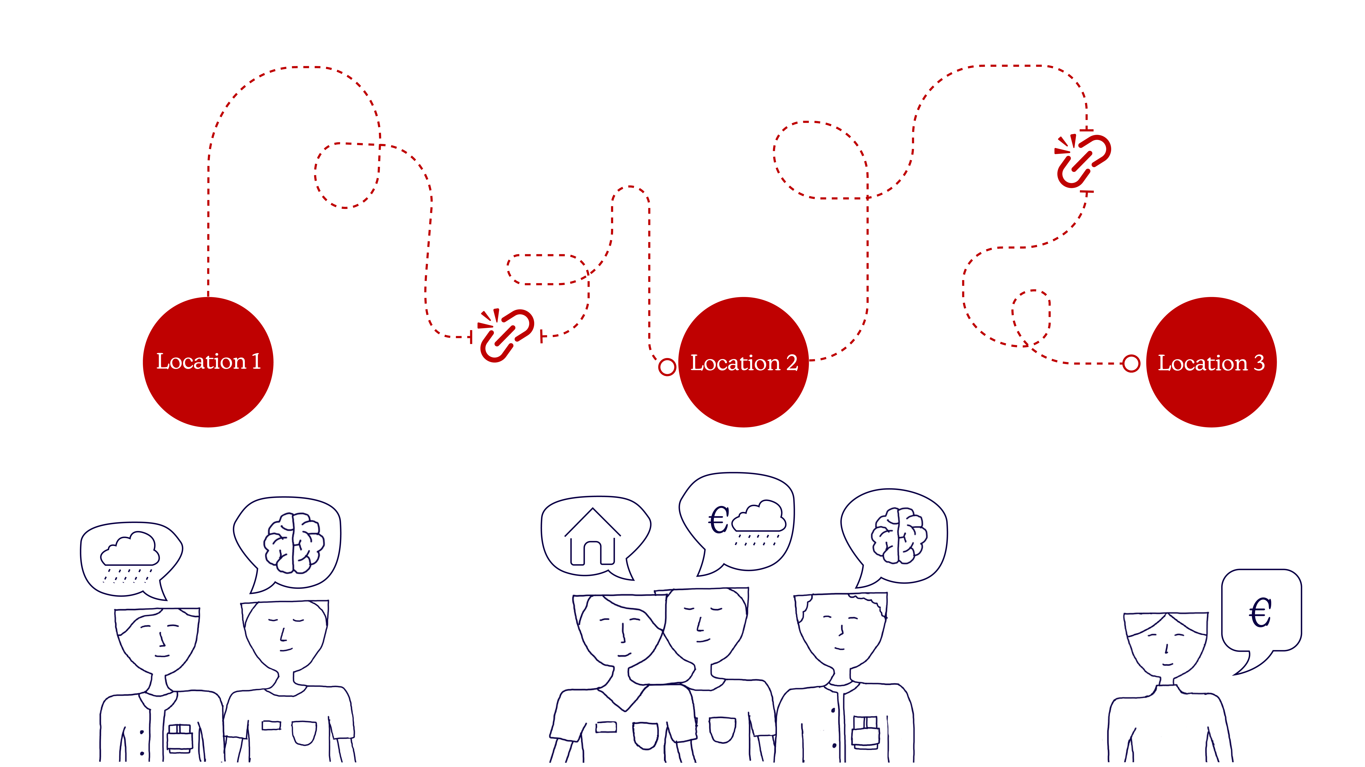
INTRODUCTION | insight 2
Understanding breaks down in transitions between and within systems
Creative Commons CC BY 4.0 2026 Jasmin Joshi, Vivian Katajainen, Otso Koiso-Kanttila, Caroline Sjöström, and Design for Government course at Aalto University
Notes:
Mikä on YMMÄRRYS (Understanding) ja mikä on TRANSITION, ei voi tietää kun ekaa kertaa mainitaan nämä asiat, joten elaborate
Teen visun uudestaan et se mätchää. Vähän sekava nyt.

Slide 14
“We don't really cooperate so well. My wish is that we would.
…
They often send patients back and say: did you try this?”
INTRODUCTION | insight 2
-Social worker about sharing information with the healthcare system
Creative Commons CC BY 4.0 2026 Jasmin Joshi, Vivian Katajainen, Otso Koiso-Kanttila, Caroline Sjöström, and Design for Government course at Aalto University
Notes:
OR ”Trust our professional more. The system is the one with the gaps, but professionals know what is going on and how to handle things.” – Kia
Symbolic and literal represetantion of how we envision this
Ossi + Suvi: Social workers guide patients forward effectively if they get that far in the system. The social workers are not the first point of contact to the patient, and neither is KELA.
Helena: Having monolingual healthcare centres could increase the feeling of inequality in patients, this is why we need more bilingual services. In Porvoo, we are developing a bilingual healthcare centre.
Kia: We need to guide the patient right. Focus should be on the pathways, how the information is shared between organisations, resource use…
Ossi: Money, politics, desire to be independent, and upkeep all factors that prevent the use of one system only.
What needs to change and how to provide a continuity of understanding?
Helena: There should be no gaps. No one should fall out of the system.
Suvi: The system should be thought about from the patient perspective, and how to make the system flow better and easier. The patient doesn’t necessarily understand the medical language from OmaKanta.
Kia: There needs to be one person to guide the patient. Ideally, there would only be one healthcare system for the entire country, because that would save a lot of money and
make communication easier.

Slide 15
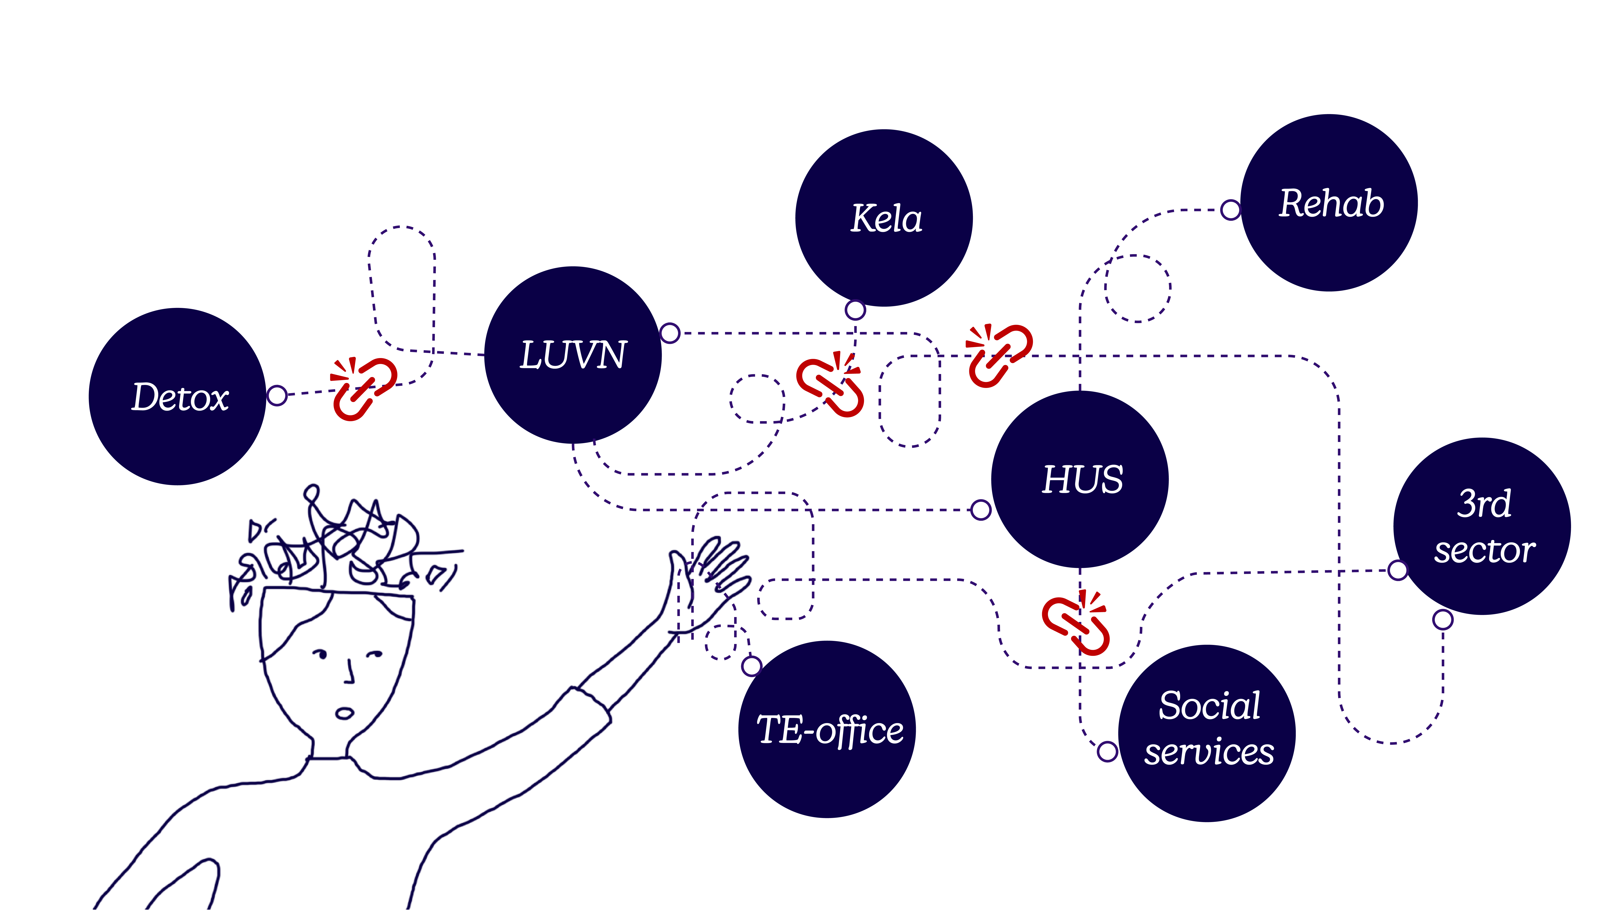
It is during these transitions that understanding can break down
INTRODUCTION | insight 2
Creative Commons CC BY 4.0 2026 Jasmin Joshi, Vivian Katajainen, Otso Koiso-Kanttila, Caroline Sjöström, and Design for Government course at Aalto University
Notes:
Visuaali: Palvelut koskettaa yhtä tai toista palvelua
-insert different overlapping services visually-
- Fragmented support
Each of those services sees only part of Erik’s situation. Erik experiences all of it by himself, at once. Yksittäisten ongelmien hoitaminen on vaikeaa, mutta vaikeus kasvaa ekponentiaalisesti kun ongelmia tulee useita hoidettaviksi.

Slide 16
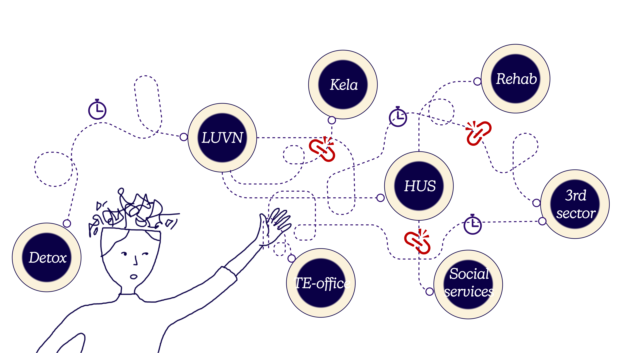
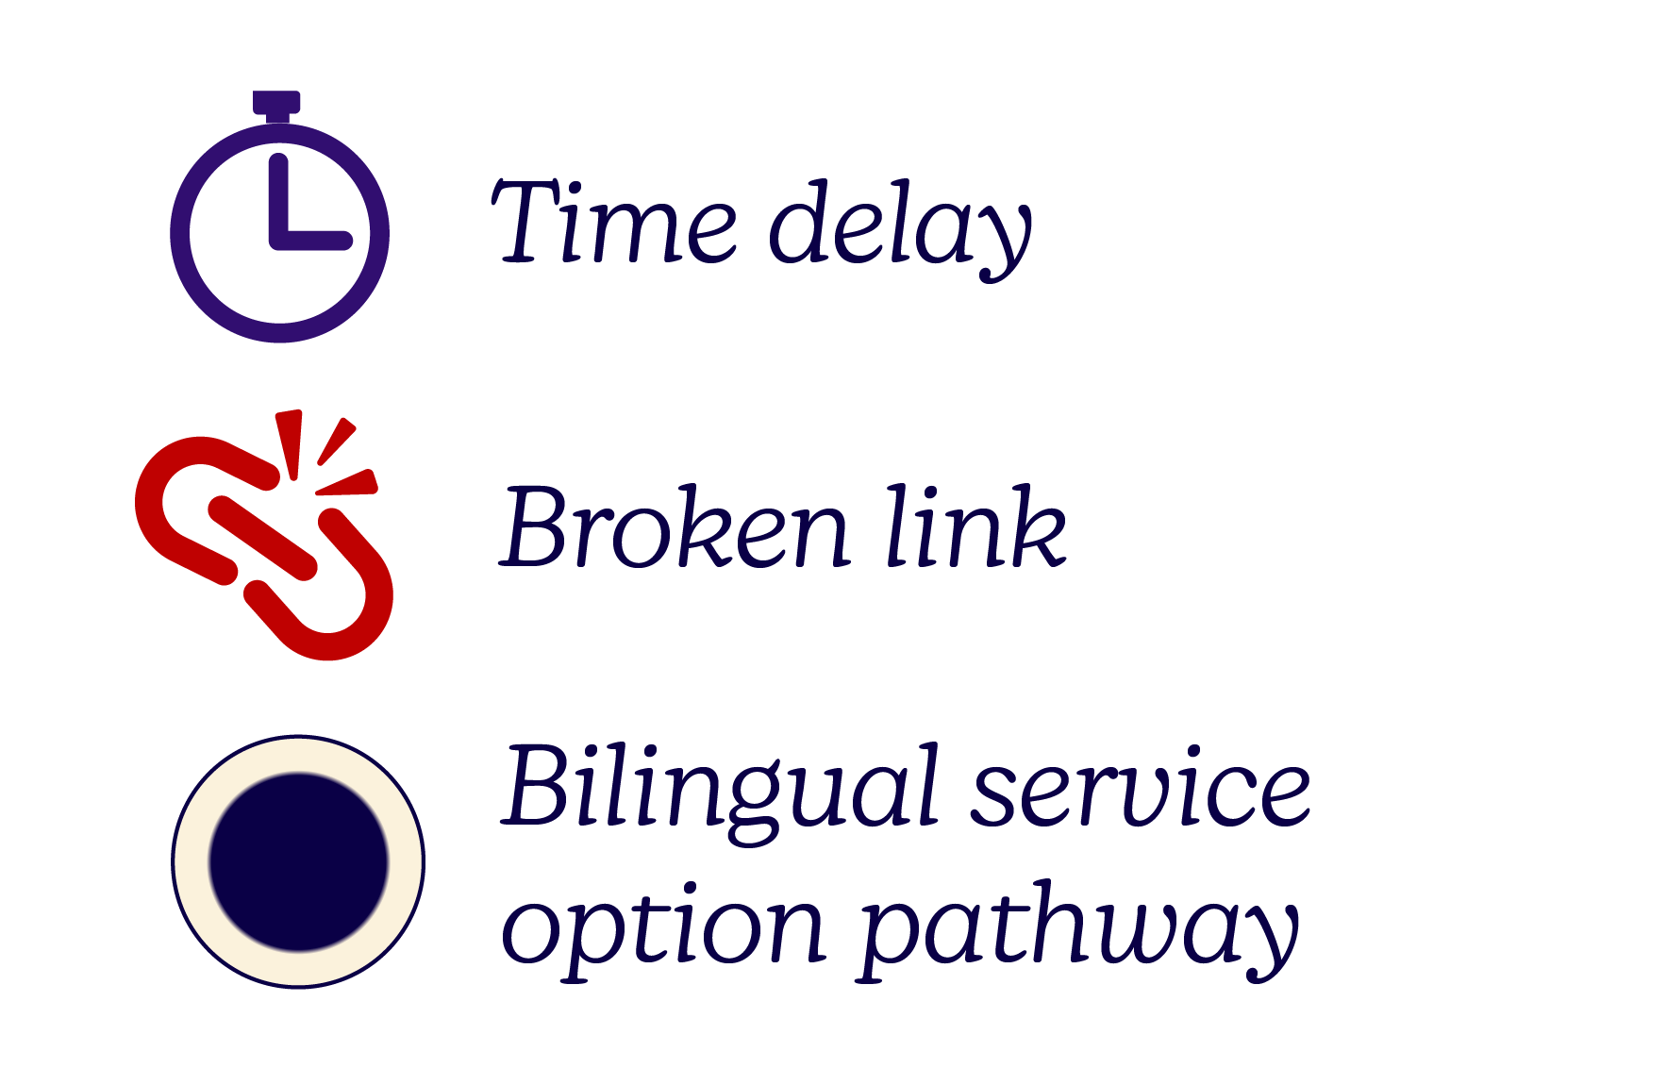
INTRODUCTION | insight 3
Vulnerability compounds and language is part of it
Swedish-speakers easily default to Finnish for convenience
Patient records written in Finnish
Using translators in Finnish or Swedish is considered breaking the law
Unclear what services are available and where
Creative Commons CC BY 4.0 2026 Jasmin Joshi, Vivian Katajainen, Otso Koiso-Kanttila, Caroline Sjöström, and Design for Government course at Aalto University
Notes:
Väritetään pallot ”kielien” mukaan. Puolikas väritys: voi Saada suomeksi ja ruotsiksi. Koko väritys: täysin yksikielinen palvelu

Slide 17
Why act now?
The state of Finnish care & economy
Creative Commons CC BY 4.0 2026 Jasmin Joshi, Vivian Katajainen, Otso Koiso-Kanttila, Caroline Sjöström, and Design for Government course at Aalto University

Slide 18
Trust in the Finnish care system is declining
WHY NOW | trust
76%
54%
Trust in the healthcare system
(THL, 2025)
60%
42%
Trust in the social care system
(THL, 2025)
in 2020
in 2024
Creative Commons CC BY 4.0 2026 Jasmin Joshi, Vivian Katajainen, Otso Koiso-Kanttila, Caroline Sjöström, and Design for Government course at Aalto University
in 2020
in 2024

Slide 19
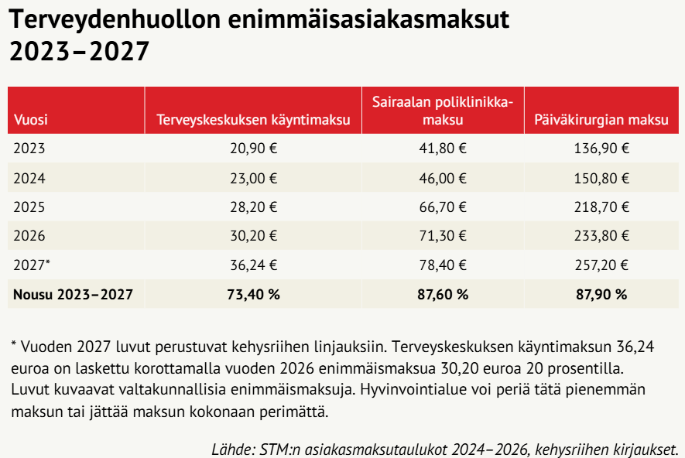
The Finnish public sector is facing cost pressures
WHY NOW | resources
240million €
73% rise
Planned cuts to healthcare in 2027
(Valtioneuvosto, 2026)
Health center visit fees
between 2023-2027
(Sosiaali ja terveysministeriö, 2024-2026)
Creative Commons CC BY 4.0 2026 Jasmin Joshi, Vivian Katajainen, Otso Koiso-Kanttila, Caroline Sjöström, and Design for Government course at Aalto University
Notes:
Most vulnerable kärsii fees
87,60% rise
in XXservice fees
Healthcare service fees are planned to rise steeply, and most affected will be the vulnerable and people needing complex care
(YLE, 2026)

Slide 20
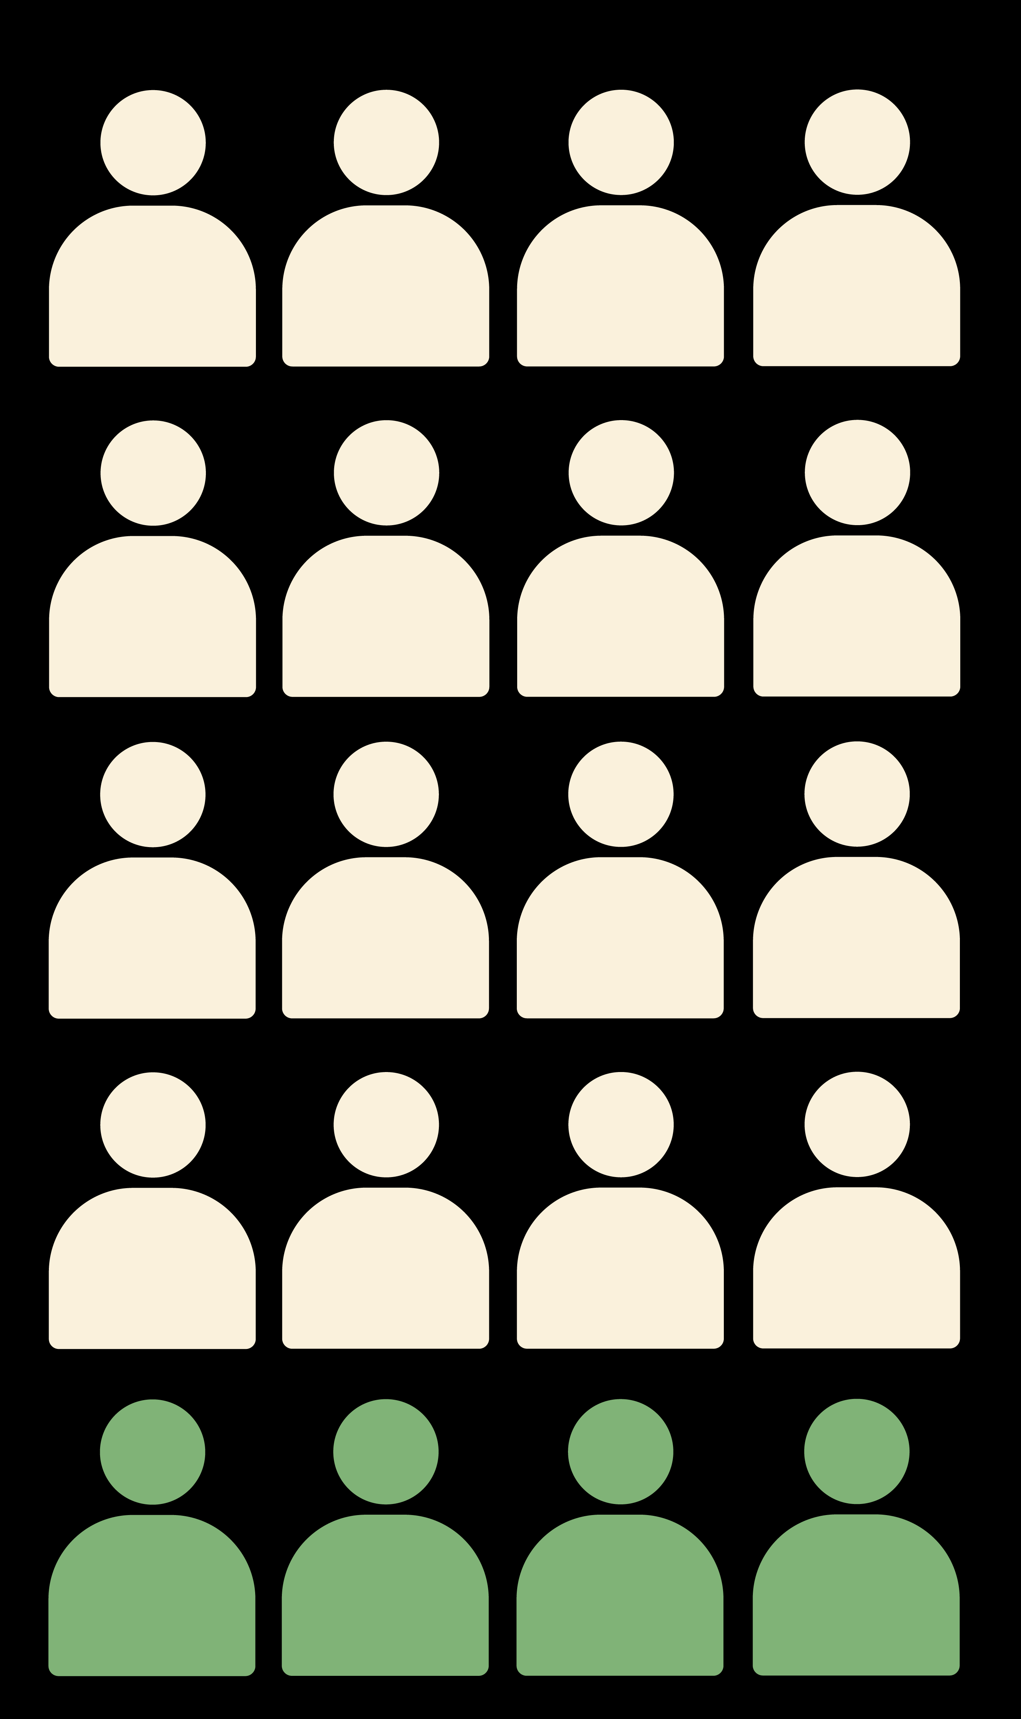
WHY NOW | resources
20% of people use 80% of resources
(Valtioneuvosto, 2020)
Creative Commons CC BY 4.0 2026 Jasmin Joshi, Vivian Katajainen, Otso Koiso-Kanttila, Caroline Sjöström, and Design for Government course at Aalto University
Notes:
https://julkaisut.valtioneuvosto.fi/server/api/core/bitstreams/bb58be7a-2cea-4e18-a220-4b99439ab317/content

Slide 21
WHY NOW | prevention
“Preventive work must be seen in financial terms. How much cheaper will treatment be if it is done on time?”
Expert from psychiatric outpatient clinic
*Translated from Finnish
Creative Commons CC BY 4.0 2026 Jasmin Joshi, Vivian Katajainen, Otso Koiso-Kanttila, Caroline Sjöström, and Design for Government course at Aalto University

Slide 22
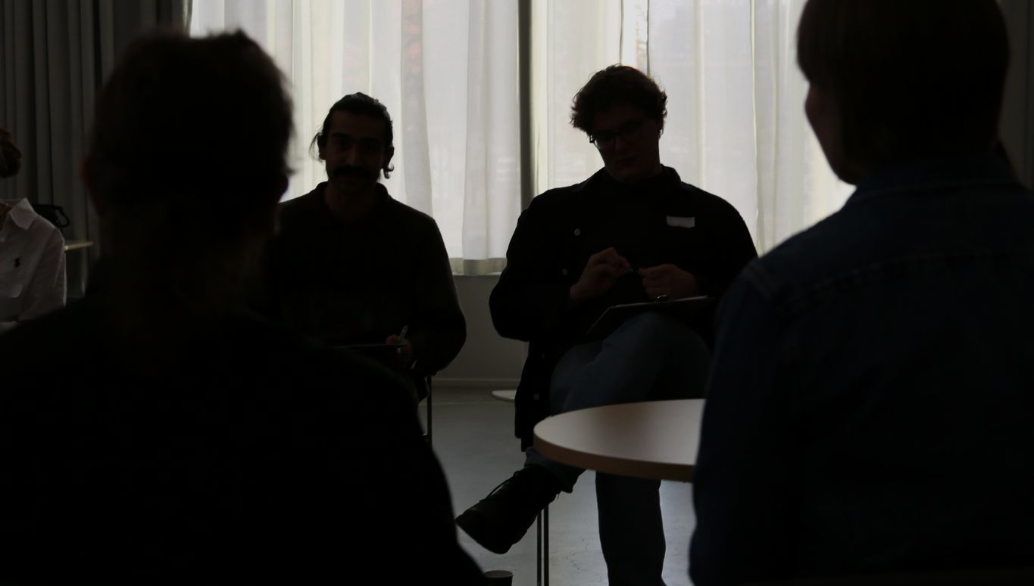
VISION | CARE
Our vision is of connected CARE.
The backbone of the Finnish welfare state where the holistic needs of people and communities are understood and met through interconnected solutions.
Creative Commons CC BY 4.0 2026 Jasmin Joshi, Vivian Katajainen, Otso Koiso-Kanttila, Caroline Sjöström, and Design for Government course at Aalto University
Notes:
Who are we? services->care - care will flow even if services fragmented
Reading the entry points, there are some adjustments we could still make to the vision. I think as it is, it does not necessarily fully reflect the depth that you are working with! In the entry points you have many good points about fostering a culture of care, about physical collaboration, about making care a tangible reality. Is there a way to make the vision more concrete so the “broadness” of the words used now doesn’t confuse us?
Mainly what I mean with this is that atm if you read it, one could think of many things. A tad more concreteness should make us go “ah, i get it! ambitious!"
Service oriented to purpose oriented (services on services on services is detached to life(event)-oriented
I still like this combo of "prosperity/care not as an add-on but as the basis of healthcare". The wording of “true needs” shifts away from this slightly, even if I know what you mean. Try to simplify a bit, being direct to what you mean, often time “bigger” words don’t explain what you mean properly. Try reformulating according to what we discussed in the last tutorial with Arianne as well. Be explicit - true needs or care as a core component of healthcare? Our meaning who? whose prosperity?
Jos
“Our care seeks to understand the support people need. We provide bilingual care that empowers and ensures the prosperity of individuals/communities/society.
Explain CARE concept

Slide 23
Where to start?
First steps towards connected CARE
Creative Commons CC BY 4.0 2026 Jasmin Joshi, Vivian Katajainen, Otso Koiso-Kanttila, Caroline Sjöström, and Design for Government course at Aalto University
Notes:
Thank you Jasmin.
"We propose three entry points where change can begin. These are not solutions to everything, but rather concrete starting points that can unlock further change."

Slide 24
Simplifying care by bringing broad expertise and care paths under one roof
ENTRY POINTS | collaboration
Creative Commons CC BY 4.0 2026 Jasmin Joshi, Vivian Katajainen, Otso Koiso-Kanttila, Caroline Sjöström, and Design for Government course at Aalto University
Notes:
“Firstly, we propose bringing broad expertise and care paths essentially under one roof."
This is a symbolic and literal representation of how we envision this .

Slide 25
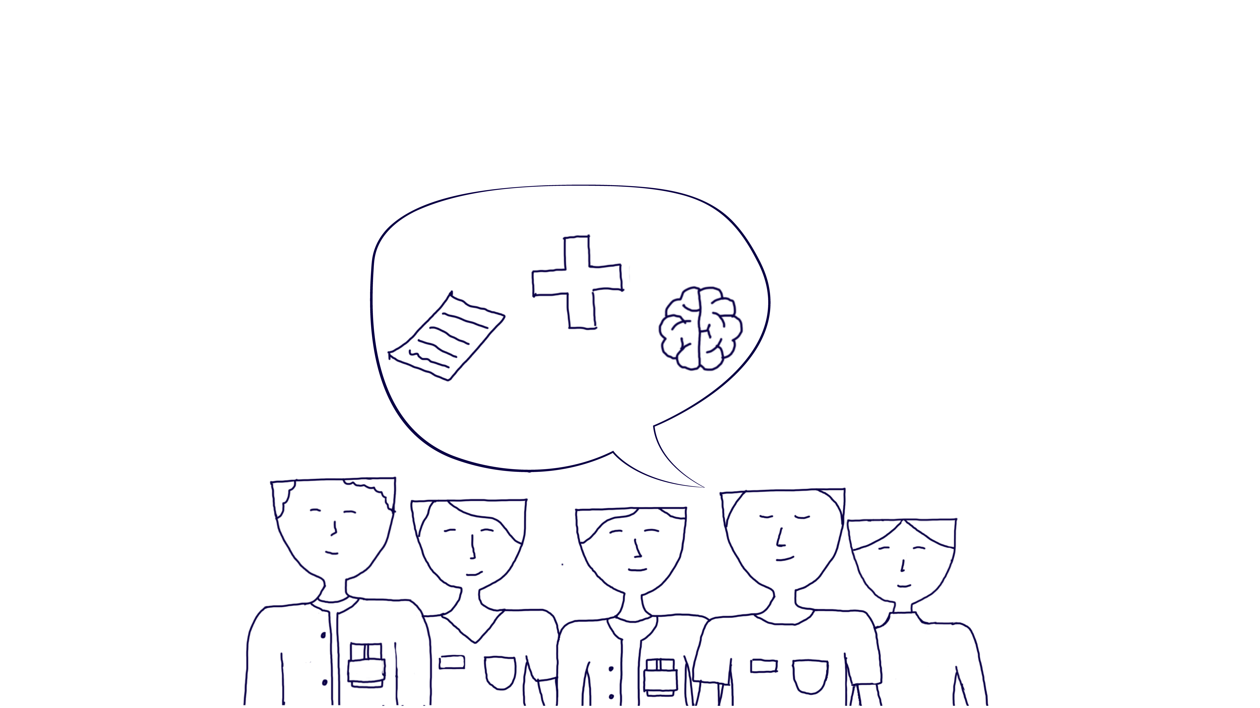
What does this mean
ENTRY POINTS | collaboration
Having multi-professional teams working together in the same place able to address patients with complex needs through simple paths
E.g. Omalääkäri concept
Similar models already in place: Netherlands (Flexible ACT) - outreaching multi-professional community care, now adopted in several other countries
Creative Commons CC BY 4.0 2026 Jasmin Joshi, Vivian Katajainen, Otso Koiso-Kanttila, Caroline Sjöström, and Design for Government course at Aalto University
Notes:
"This means that ideally smaller specialist multi-professional teams would be working in the same physical space dedicated to mental health and substance abuse needs. This could mean a psychiatrist, a social worker, a nurse, and a doctor who all collaboratively could address a patient's overlapping needs, without needing to send them across several services and locations.
This is not a new idea: Most inpatient hospital wards run on this set-up to ensure safe and appropriate discharges. It works, because they have close, oftentimes, physical collaboration. Finland's Omalääkäri model has components of this, the Ohjaamo centres already use a similar navigation model, and the Dutch outreaching community care model for persons with severe mental illness that has expanded to several countries, is a prime example.
“We are proposing to expand this model to also include services such as employment and benefit navigation, together with active empowerment. We believe that bringing providers closer together can be impactful.
Bringing care providers as close as possibe to collaborate smootlhy without friction or delays .
Evidence somehwat similar Omalääkäri but also in Holland and smaller scale Ohjaamo
Flexible ACT is a Dutch version of outreaching community care for persons with severe mental illness (SMI). FACT is also being adopted in many other countries. In Norway, Sweden, Denmark, Belgium, The Czech Republic, UK, Canada and Australia teams have been started.

Slide 26
Where it could help
ENTRY POINTS | collaboration
Allows opportunity for natural collaboration and smooth pathways to arise
Improves trust over time
Shorter care paths
Reduces bouncing of patients
Saves resources
Creative Commons CC BY 4.0 2026 Jasmin Joshi, Vivian Katajainen, Otso Koiso-Kanttila, Caroline Sjöström, and Design for Government course at Aalto University
Notes:
When providers share a space, natural collaboration happens. Care paths by default become shorter and patients bouncing around will be reduced, thus resources saved. Trust can also rebuild over time.

Slide 27
“Trust our professionals more. The system is the one with gaps, but professionals know.”
ENTRY POINTS | collaboration
-Special adviser
Creative Commons CC BY 4.0 2026 Jasmin Joshi, Vivian Katajainen, Otso Koiso-Kanttila, Caroline Sjöström, and Design for Government course at Aalto University
Notes:
Regardless, even under one roof, providers still need to share information across systems and not everyone can always be in the same place. But we still need to bring them closer through connection, which brings us to our second entry point.
OR ”Trust our professional more. The system is the one with the gaps, but professionals know what is going on and how to handle things.” – Kia
Symbolic and literal represetantion of how we envision this
Ossi + Suvi: Social workers guide patients forward effectively if they get that far in the system. The social workers are not the first point of contact to the patient, and neither is KELA.
Helena: Having monolingual healthcare centres could increase the feeling of inequality in patients, this is why we need more bilingual services. In Porvoo, we are developing a bilingual healthcare centre.
Kia: We need to guide the patient right. Focus should be on the pathways, how the information is shared between organisations, resource use…
Ossi: Money, politics, desire to be independent, and upkeep all factors that prevent the use of one system only.
What needs to change and how to provide a continuity of understanding?
Helena: There should be no gaps. No one should fall out of the system.
Suvi: The system should be thought about from the patient perspective, and how to make the system flow better and easier. The patient doesn’t necessarily understand the medical language from OmaKanta.
Kia: There needs to be one person to guide the patient. Ideally, there would only be one healthcare system for the entire country, because that would save a lot of money and
make communication easier.

Slide 28
Making diagnostic & application criteria more transparent between providers
ENTRY POINTS | transparency
Creative Commons CC BY 4.0 2026 Jasmin Joshi, Vivian Katajainen, Otso Koiso-Kanttila, Caroline Sjöström, and Design for Government course at Aalto University

Slide 29
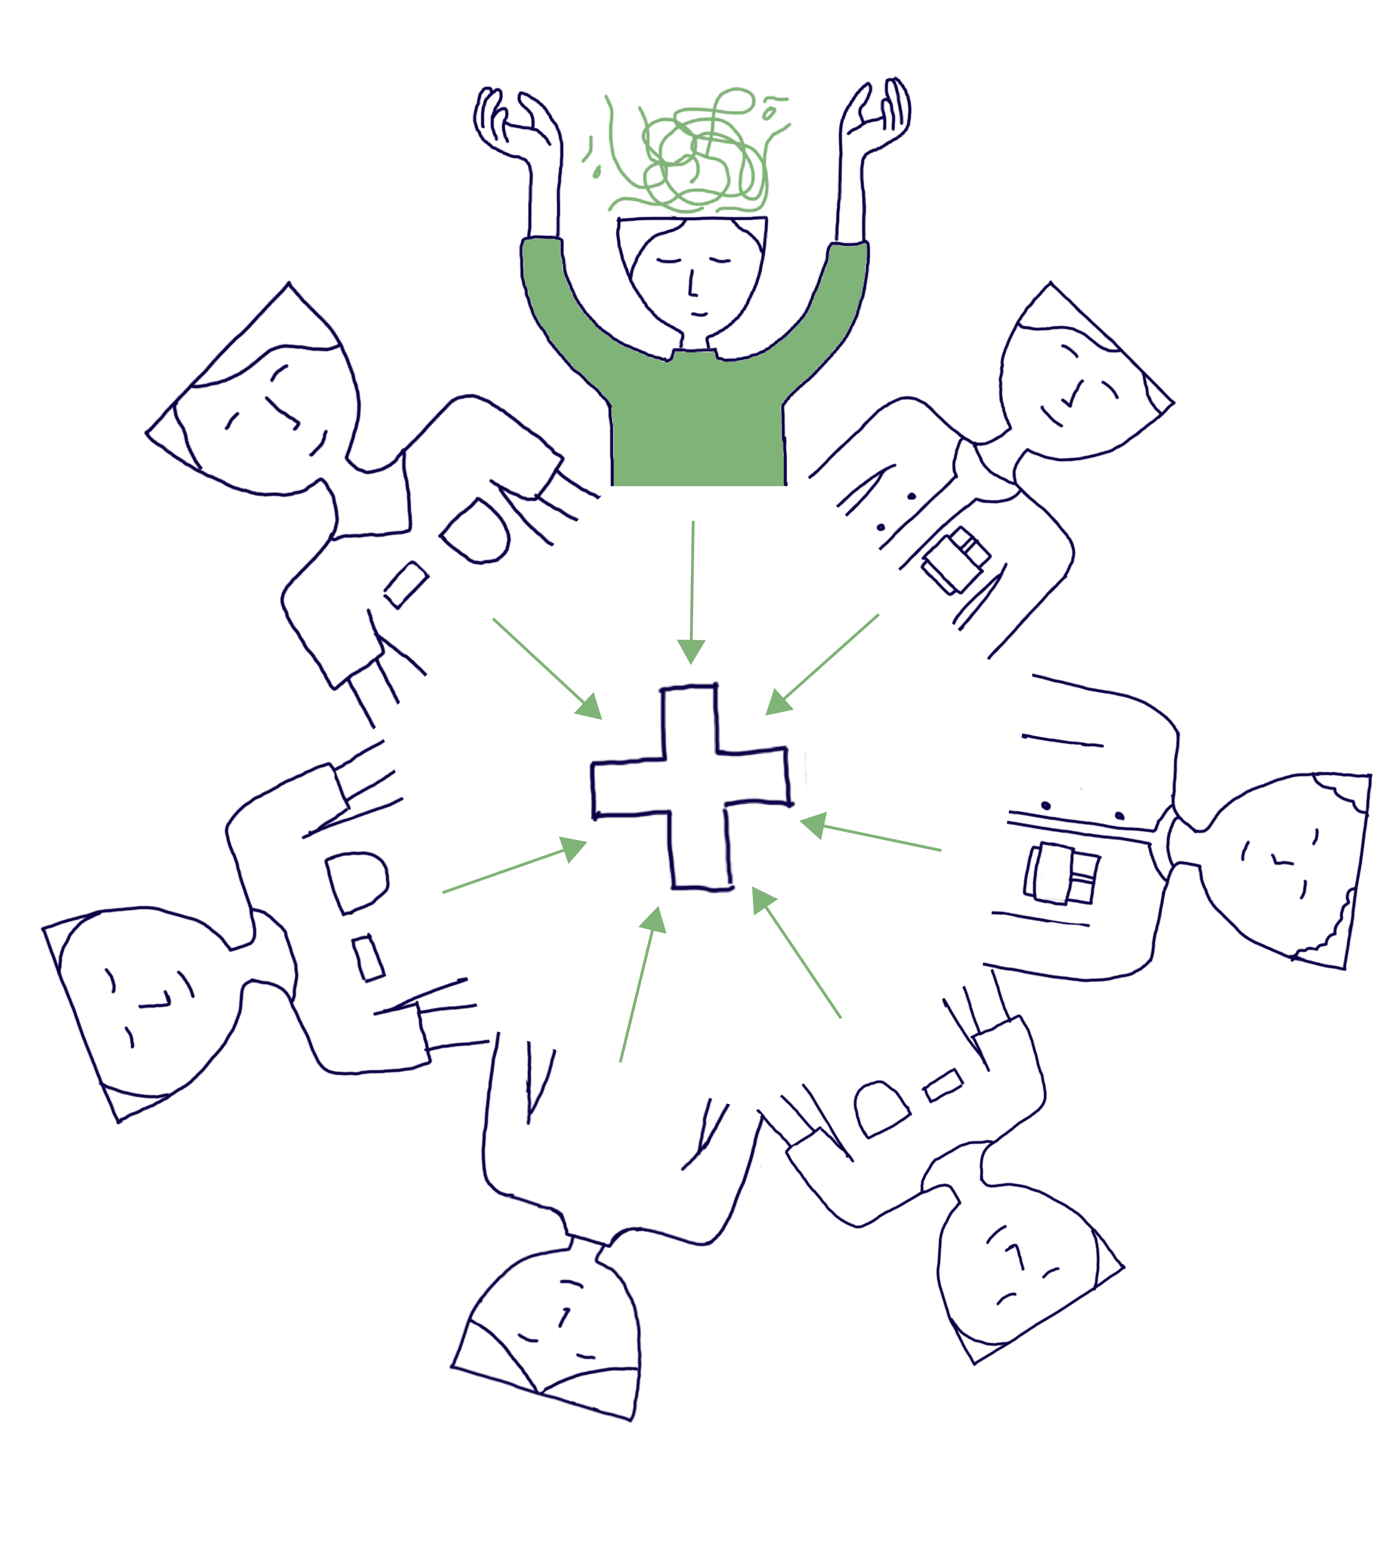
What it could mean
ENTRY POINTS | transparency
Technological solutions to bridge gaps between digital systems
Unifying systems between providers
More intense inter-professional working between providers to facilitate shared understanding
Creative Commons CC BY 4.0 2026 Jasmin Joshi, Vivian Katajainen, Otso Koiso-Kanttila, Caroline Sjöström, and Design for Government course at Aalto University
Notes:
Jos tämä kuva toimii (jees se holding hands in a wheel ) niin muokkaan et kaikilla on valkoiset topit

Slide 30
Where it could help
ENTRY POINTS | transparency
Reduces need for seesawing information sharing, making care faster and reducing administrative burden
Get the right treatment and medical statements the first time
Avoid disruptions to care and financial aid
Creative Commons CC BY 4.0 2026 Jasmin Joshi, Vivian Katajainen, Otso Koiso-Kanttila, Caroline Sjöström, and Design for Government course at Aalto University
Notes:
"For example, when a psychiatrist knows exactly what Kela needs in a medical statement, the application goes through the first time. No back-and-forth nor delays. It will also remove self-doubt among staff wondering if their justification will be accepted by Kela. Like this, we hope to remove friction points, and subsequently time and money are saved. But foremost, patient care is not delayed."
Each delay means friction means time and money and potentially decline in the persons health.
Having a system to get the benefit application right the first time, without I tbeing turned back.
"Seesawing" information sharing refers to a dynamic state of exchange where communication, data, or transparency fluctuates back and forth, frequently as a result of shifting social dynamics, trust levels, or varying access to information within a group

Slide 31
“There needs to be a checklist for making sure everyone receives equal service.”
ENTRY POINTS | transparency
-Care advisor
Creative Commons CC BY 4.0 2026 Jasmin Joshi, Vivian Katajainen, Otso Koiso-Kanttila, Caroline Sjöström, and Design for Government course at Aalto University
Notes:
Read Quote.
"And lastly, to address the language dimension specifically we'll talk about our third entry point:"
Kia sano tän round table yhteydessä:
Ossi: Old people +50 years old don’t benefit from systems that help young drug addicts for example. They have to figure it out by themselves. KELA has a strict criterion, can’t see the patient. The patients are just names on a list.
Kia: It is not customer friendly that you need to be very sick until you are noticed and given help. There needs to be a checklist for making sure everyone receives equal service. They have little money, which creates problems. They want to take more customers, but can’t when there is no money.

Slide 32
Improving awareness and accessibility of existing bilingual speaking services by mapping them
ENTRY POINTS | coherency
Creative Commons CC BY 4.0 2026 Jasmin Joshi, Vivian Katajainen, Otso Koiso-Kanttila, Caroline Sjöström, and Design for Government course at Aalto University
Notes:
Improving awareness and accessibility of existing bilingual services by mapping them."

Slide 33
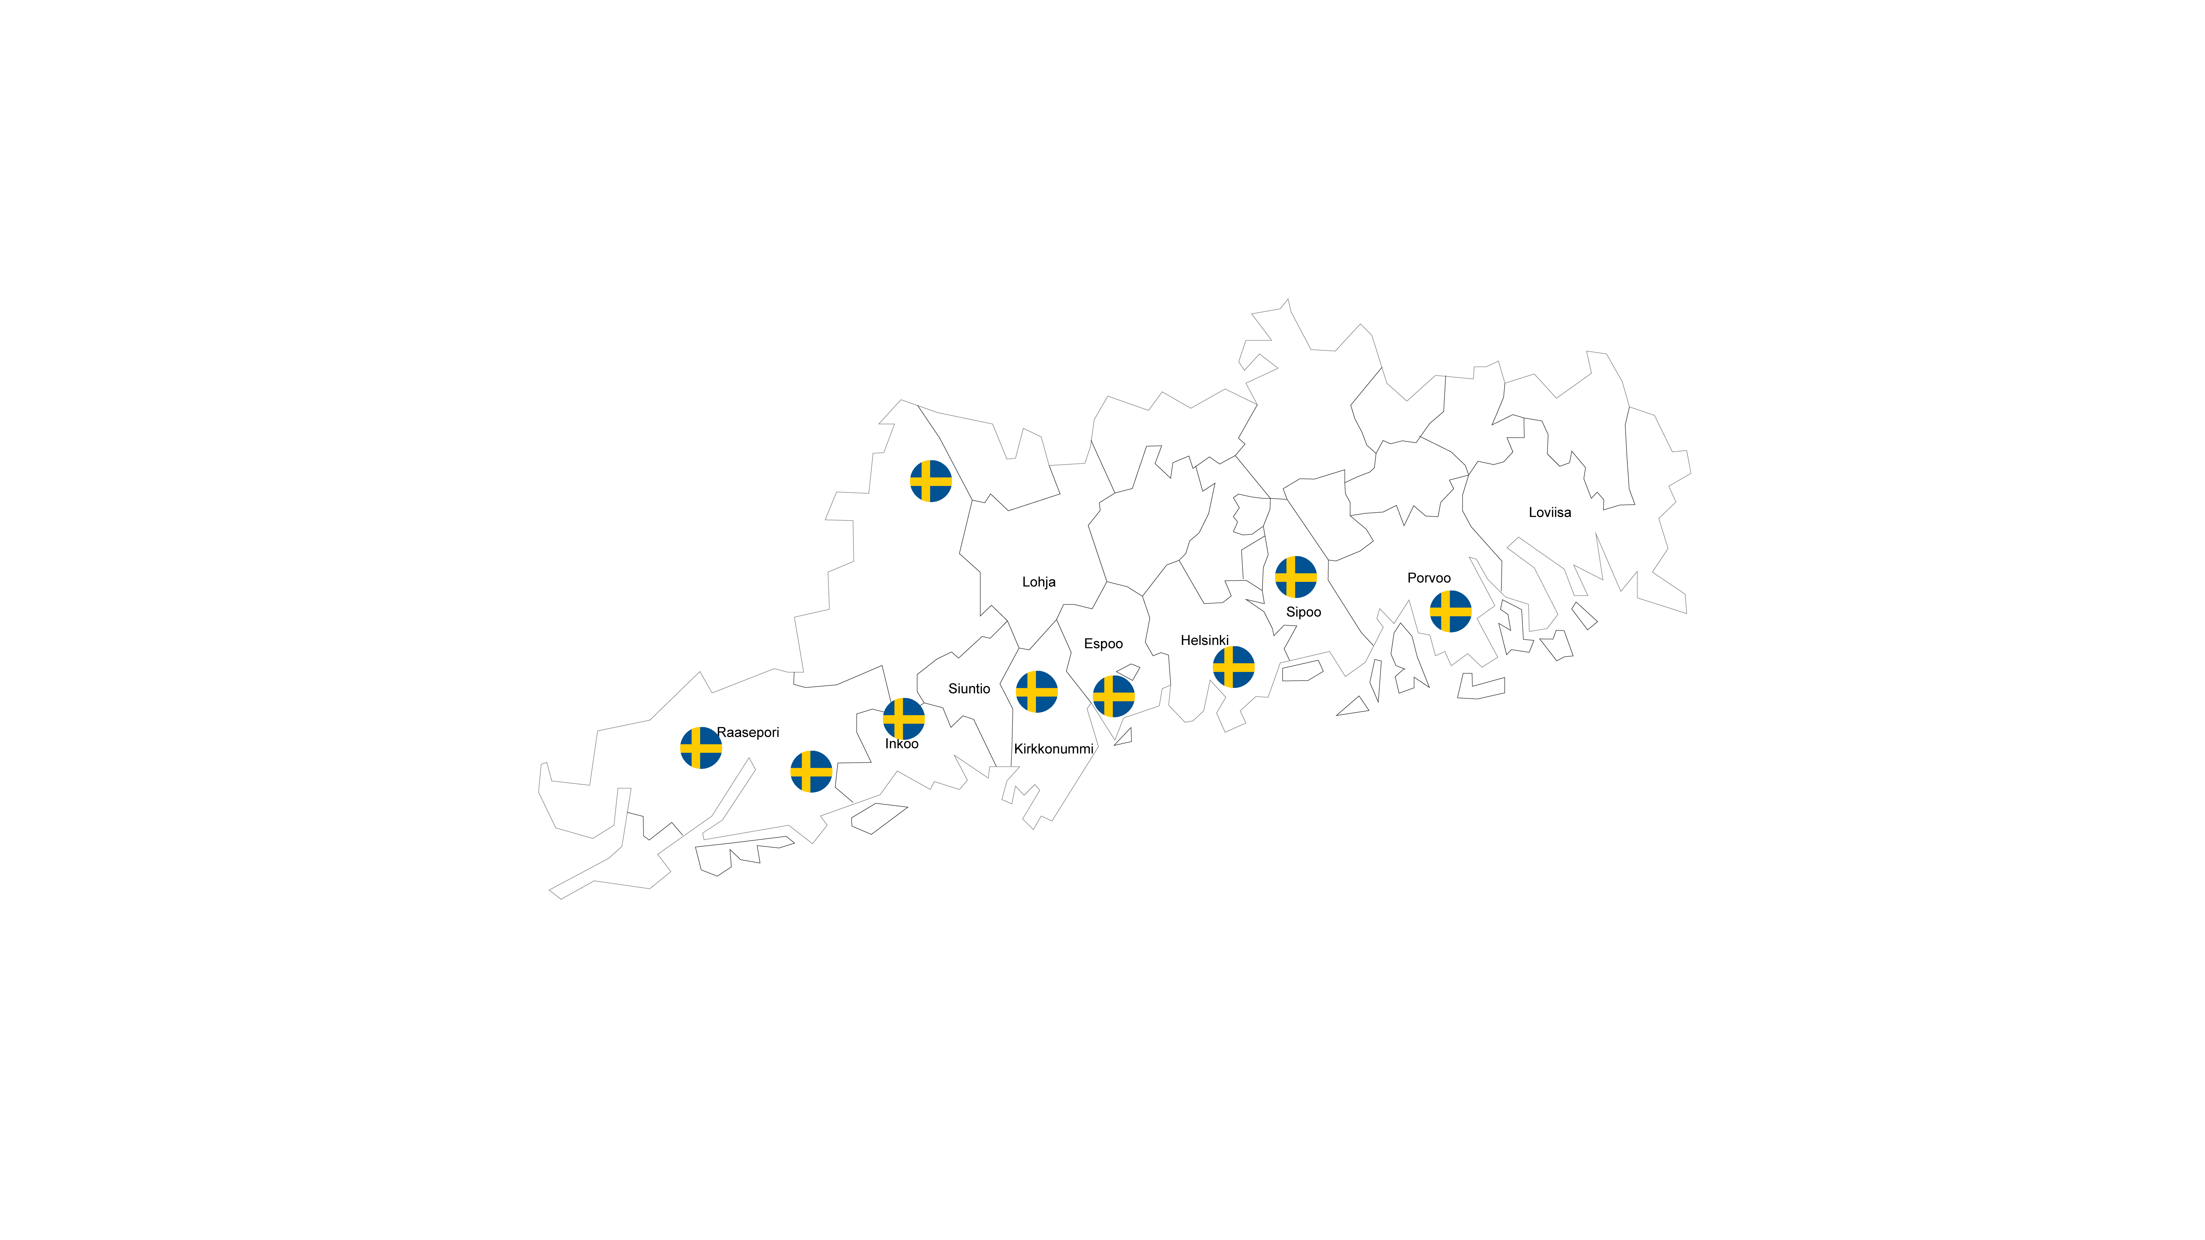
What it could mean
ENTRY POINTS | coherency
Creating a map for all providers & patients to use in guiding patients through care paths effectively
Mapping project already ongoing in LUVN
Creative Commons CC BY 4.0 2026 Jasmin Joshi, Vivian Katajainen, Otso Koiso-Kanttila, Caroline Sjöström, and Design for Government course at Aalto University
Notes:
"This empowers Swedish speakers to seek care in their own language, getting help in their emotional language, thus more effective care. Not only makes it care paths clearer but it raises awareness of services that already exists but are invisible to the people who need them. This is a scalable model that starts with Swedish, and can be extended to other languages over time, if needed.
"Creating a practical map that shows providers and patients where Swedish-language services actually exist. LUVN is already piloting a mapping strategy; matching Swedish-speaking patient volumes against Swedish-speaking doctors per facility. We propose scaling this into a shared, cross-organisational tool that is shared across providers and patients.
Hej,
nu är jag osäker på vilken karta du pratar om (kommer inte riktigt ihåg vad allt jag har nämnt under våra träffar 🙈). Vi har alltså redan kartor över den svenskspråkiga befolkningen enligt åldersgrupper och kommuner, som bas för behovet av svensk service. Men antar att det kanske inte var det du syftade på, utan på det pågående projektet vi har, där vi håller vi på att samla in info om den svenskspråkiga kundmängden samt den svenskkunniga personalen, för att se hur väl de matchar. Vi granskar detta per verksamhetsställe. Dvs hur många svenskspråkiga kunder finns det ex. inom öppna hälsovården på Hagalunds hälsocentral vs hur många svenskkunniga läkare och vårdare finns det i personalen på samma hälsocentral. I detta skede gör vi det endast för ett fåtal serviceområden, eftersom vi pga alla olika patient- och klientdatasystem (som vi haft fram till nu) har svårt att få data om den tidigare kundmängden. Dessa stickprov fungerar nu som piloter, och efter sommaren är planen att börja fundera på en PowerBi-rapport, där vi kunde följa upp denna info för alla våra tjänster. Därtill ska vi börja följa med de svenskspråkigas kundnöjdhet (inkl. om de fått service på önskat språk), och jämföra den med datan om kund- och personalmängd, för att se om vi lyckas styra kunderna rätt. Men även kundnöjdhet mäts ännu bara inom några få tjänster, men utvidgas nu helatiden efterhand, nu då vi fått samma patient- och klientdatasystem. Inom socialvården är kundnöjdheten dock lite svårare att mäta, så där dröjer det lite längre.
Var det detta du syftade på? Hoppas denna info hjälper er vidare! 🙂
Mvh,
Kia

Slide 34
Where it could help
ENTRY POINTS | coherency
Empowering Swedish speakers to seek care in their national language and lower threshold of using it in care
Makes care paths clearer and easier to navigate
Raises awareness of already existing care
Scalable model for other languages in the future
Creative Commons CC BY 4.0 2026 Jasmin Joshi, Vivian Katajainen, Otso Koiso-Kanttila, Caroline Sjöström, and Design for Government course at Aalto University

Slide 35
“I feel I have been stamped as a Finnish speaker in the care pathway and rarely get Swedish service.”
ENTRY POINTS | coherency
-Mental health patient about getting Swedish speaking care
Creative Commons CC BY 4.0 2026 Jasmin Joshi, Vivian Katajainen, Otso Koiso-Kanttila, Caroline Sjöström, and Design for Government course at Aalto University
Notes:
"One service user told us:
'I feel I have been stamped as a Finnish speaker in the care pathway and rarely get Swedish service.”
We don’t think this is the way it should be.

Slide 36
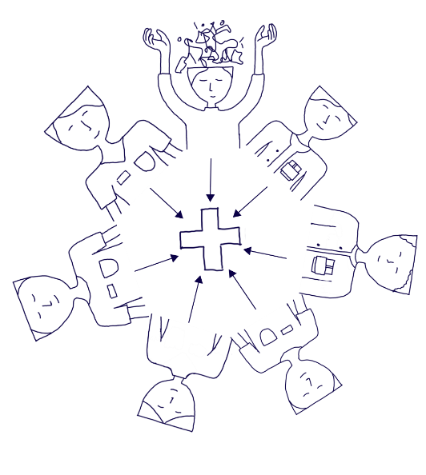
CONCLUSION | challenges and mitigations
Challenges:
Providers are independent organizations
Cost of initial investment
Hard to foster collaboration
Shortage in staff
Cost of initial investment despite long-term savings
Appropriate limiting in access to patient information
Getting usage and awareness to spread
Keeping map up to date
Mitigations:
Starting with small pilots
Slow integrations, morning coffees
Showing value through simplified system
Open and continuous communications
Accounting for all communicational languages in terminologies
Engaging & training employees to use system
Open map to wider usage to encourage usage and maintenance
Creative Commons CC BY 4.0 2026 Jasmin Joshi, Vivian Katajainen, Otso Koiso-Kanttila, Caroline Sjöström, and Design for Government course at Aalto University
Expert interviews
X
X
X
Notes:
"We are not naive about the barriers.
Providers are independent organisations with their own funding and incentives. Building cross-organisational collaboration is hard, and government has a role in aligning incentives.
There is a shortage of care providers. The initial investment costs are real, even when the long-term savings are clear. And for the bilingual map, sustaining it over time requires clear ownership."
"But many of these entry points build on things already in motion, and that’s why we believe in expanding on these concepts.

Slide 37
CONCLUSION
“Even if laws wouldn’t change, just changing the focus can bring change.”
-Expert from Kela
Creative Commons CC BY 4.0 2026 Jasmin Joshi, Vivian Katajainen, Otso Koiso-Kanttila, Caroline Sjöström, and Design for Government course at Aalto University
Notes:
Read quote.
"Care does not break because people stop caring. It breaks because the structures between them were not built for the people who need them most. This can change.
We have great colleagues here; we laugh and share ups and downs. That’s what keeps me here. –Social worker
Many patients are happy that we listen to them and stay with them. – Social worker
”Trust our professional more. The system is the one with the gaps, but professionals know what is going on and how to handle things.” – Kia
"We don’t forget our patients, but make sure they can contact us again easily." –
even if laws wouldn't change, just changing the focus can bring change. - ossi

Slide 38
Tack Kiitos Thank you
Creative Commons CC BY 4.0 2026 Jasmin Joshi, Vivian Katajainen, Otso Koiso-Kanttila, Caroline Sjöström, and Design for Government course at Aalto University

Slide 39
Sources
Literature
Interviews and fieldwork
The Finnish Institute for Health and Welfare, 2025. Asiakastyytyväisyys sosiaali- ja terveyspalveluissa pysynyt korkealla – luottamus järjestelmän toimivuuteen heikentynyt. Press release 15.5.2025. Available at: https://thl.fi/-/asiakastyytyvaisyys-sosiaali-ja-terveyspalveluissa-pysynyt-korkealla-luottamus-jarjestelman-toimivuuteen-heikentynyt (Accessed 20 May 2026)
Koivisto, J & Tiirinki, H, 2020. Monialaisen palvelutarpeen tunnistaminen sosiaali-, terveysja työvoimapalveluissa. Valtioneuvoston kanslia. Available at: https://julkaisut.valtioneuvosto.fi/server/api/core/bitstreams/bb58be7a-2cea-4e18-a220-4b99439ab317/content (Accessed: 18 May 2026)
Larsio, A., Malkamäki, S. and Kalliola, M. (2024) Tietomalleista tehoa sote-järjestelmään: Keinoja toiminnan muutokseen ja kustannusten kasvun hillitsemiseen. Helsinki: Sitra. Available at: https://www.sitra.fi/julkaisut/tietomalleista-tehoa-sote-jarjestelmaan/ (Accessed: 20 May 2026)
Ministry of Social Affairs and Health (STM) (2024-2026) Asiakasmaksutaulukot 2024–2026. Helsinki: Ministry of Social Affairs and Health.
Steinberg, M, 2026. Introduction to Entry Points: Types of interventions. Lecture slideS: Design for Government
Valtiovarainministeriö, 2026. Kevät 2026: työn, yrittämisen, kasvun ja turvallisuuden uudet panostukset. Hallituksen kehysriihen tiedotustilaisuus 22.4.2026. Available at: https://vm.fi/documents/194055633/260268652/Liite+6+VMin+esitysmateriaali+hallituksen+jtsriihi+220426.pdf (Accessed: 18 May 2026)
Interview with Social Worker, Wellbeing Services County (2026) Meeting, 12 March
Interview with care provider,HUS (2026) Meeting 25 March
Specialised care advisor, Wellbeing Services County (2026) Contribution to Design for Government Stakeholder Roundtable discussion. Unpublished, 24 March.
Specialist from Kela, Wellbeing Services County (2026) Contribution to Design for Government Stakeholder Roundtable discussion. Unpublished, 24 March.
Interview with mental care providers, Wellbeing Services County
Service user of 3rd sector mental health organization (2026) Participation in focus group of 3rd sector service use, 4 May
Interview with nurse manager and mental health nurse (2026) Semi-structured interview, 15 April
Interview with experience experts of a third sector organiser (2026) Semi-structured interview, 28 April
Creative Commons CC BY 4.0 2026 Jasmin Joshi, Vivian Katajainen, Otso Koiso-Kanttila, Caroline Sjöström, and Design for Government course at Aalto University
Notes:
Remember to update!
--> Mahtavaa kiitos et joku teki!!!

