Slide 1

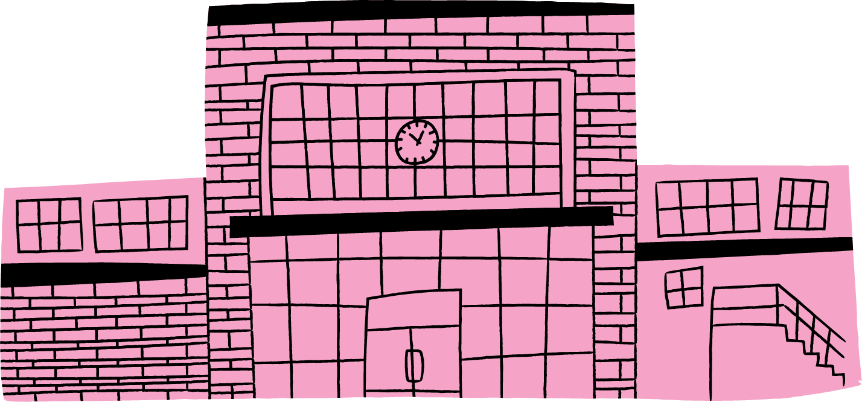

BUILDING INVESTMENT
Nicole Kajander, Jenna Karvonen, Henna Kyrö, Kerttu Parkkinen, Giovanna Usai
Design for Government 2026

Slide 2

Meet the team
REFRAMING / ANCHORING / RESEARCHING / TAKING ACTION / LEVERAGING / ENVISIONING
Giovanna Usai
Henna Kyrö
Collaborative and Industrial Design
Collaborative and Industrial Design
Jenna Karvonen
Creative Sustainability
BIZ
Nicole Kajander
Creative Sustainability
ARTS
Kerttu Parkkinen
Creative Sustainability
ARTS
Creative Commons CC BY 4.0 2026
Nicole Kajander · Jenna Karvonen · Henna Kyrö · Kerttu Parkkinen · Giovanna Usai
Design for Government course · Aalto University

Slide 3





REFRAMING / ANCHORING / RESEARCHING / TAKING ACTION / LEVERAGING / ENVISIONING
This is Alvar.
Since Midsummer, he has been doing the same thing everyday:
Spending and enjoying his time at the beach and park nearby.
Creative Commons CC BY 4.0 2026
Nicole Kajander · Jenna Karvonen · Henna Kyrö · Kerttu Parkkinen · Giovanna Usai
Design for Government course · Aalto University
Notes:
His name is Alvar. It’s July. The sun is out. Since Midsummer, he has been doing the same thing: spending and enjoying his days at the beach and park nearby, sometimes on a terrace with friends, his head tilted toward the sun. ​

Slide 4
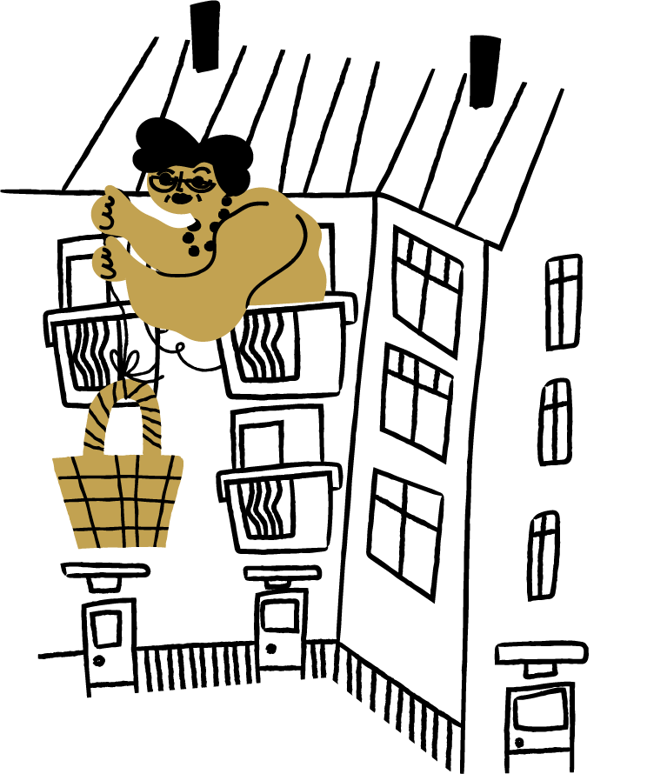

REFRAMING / ANCHORING / RESEARCHING / TAKING ACTION / LEVERAGING / ENVISIONING
This is Eila.
Every summer, she makes the same journey from the highest floor down to the cellar just to cool down and escape the afternoon heat.
She has done this for four summers now.
Creative Commons CC BY 4.0 2026
Nicole Kajander · Jenna Karvonen · Henna Kyrö · Kerttu Parkkinen · Giovanna Usai
Design for Government course · Aalto University
Notes:
Her name is Eila. Every summer, when the heat arrives, she makes the same journey. Her wobbly steps take her from the highest floor down to the cellar just to cool down and escape the afternoon heat. She’s done it for four summers now.

Slide 5


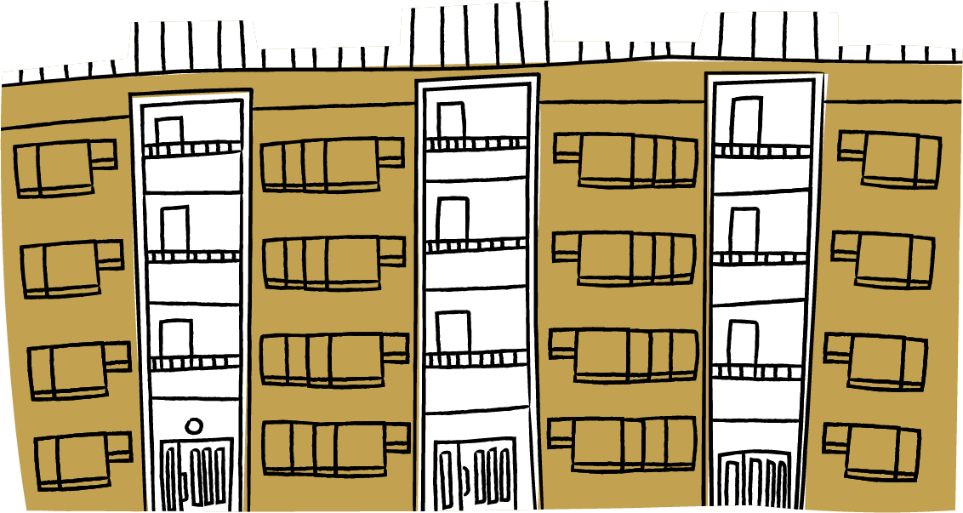
REFRAMING / ANCHORING / RESEARCHING / TAKING ACTION / LEVERAGING / ENVISIONING
The same summer.
Two completely different experiences.
The gap is widening.
The people who can’t escape their homes are about to face something
far more serious than discomfort.
Creative Commons CC BY 4.0 2026
Nicole Kajander · Jenna Karvonen · Henna Kyrö · Kerttu Parkkinen · Giovanna Usai
Design for Government course · Aalto University
Notes:
The same summer. Two completely different experiences. One is celebrated, the other is endured. And here's what matters: the gap is widening. Climate projections show hotter summers ahead. The people who can't escape their homes are about to face something far more serious than discomfort.​
This isn’t just a comfort problem: it is a system problem. Buildings are not being renovated. Housing companies are fragmented across the city, each struggling alone with the same challenge. The City is focusing on new buildings that reach the bare minimum requirements for greener infrastructure. Nothing changes until it becomes urgent.​
And by then? Sooner than later, Alvar will be complaning about the heat the same way Eila has been struggling for years.​
We know what is coming, and we are not prepared. We do not have to wait until it becomes a crisis. Rather than acting one day, let us start with Day 1.

Slide 6





REFRAMING / ANCHORING / RESEARCHING / TAKING ACTION / LEVERAGING / ENVISIONING
This isn’t just a comfort problem:
it is a systemic problem.
“Preventative maintanance is often post-poned. Costs are a major barrier to climate adaptation measures”
Housing Company shareholder, Kontula
“[With climate change] you should be prepared for the unexpected”
Housing Company shareholder, Herttoniemi
“We need new windows, new elevators, new heating system...”
Housing Company, Kontula
“Last year our elevator broke down, it was out for over 2 weeks because it’s an elevator from the 60s and they don’t make repairs for it anymore.”
Housing Company, Kontula
Creative Commons CC BY 4.0 2026
Nicole Kajander · Jenna Karvonen · Henna Kyrö · Kerttu Parkkinen · Giovanna Usai
Design for Government course · Aalto University
Notes:
This isn’t just a comfort problem: it is a system problem. Buildings are not being renovated. Housing companies are fragmented across the city, each struggling alone with the same challenge. The City is focusing on new buildings that reach the bare minimum requirements for greener infrastructure.
- Buildings are not being renovated
- Housing companies are alone while facing the same challenge
- The City is mostly focusing on new greener infrastructure>> To climate mitigation (and we want to give agency to climate adaptation / investment)

Slide 7






REFRAMING / ANCHORING / RESEARCHING / TAKING ACTION / LEVERAGING / ENVISIONING
Nothing changes until it becomes urgent.​
We know what is coming, and we are not prepared.
Creative Commons CC BY 4.0 2026
Nicole Kajander · Jenna Karvonen · Henna Kyrö · Kerttu Parkkinen · Giovanna Usai
Design for Government course · Aalto University
Notes:
Nothing changes until it becomes urgent.​ We know what is coming, and we are not prepared.
And by then? Sooner than later, Alvar will be complaning about the heat the same way Eila has been struggling for years.​
We do not have to wait until it becomes a crisis. Rather than acting one day....

Slide 8
REFRAMING / ANCHORING / RESEARCHING / TAKING ACTION / LEVERAGING / ENVISIONING
Reactive crisis management is not the only option.​​
Creative Commons CC BY 4.0 2026
Nicole Kajander · Jenna Karvonen · Henna Kyrö · Kerttu Parkkinen · Giovanna Usai
Design for Government course · Aalto University
Notes:
We do not have to wait until it becomes a crisis. Rather than acting one day, let us start with Day 1.

Slide 9
REFRAMING / ANCHORING / RESEARCHING / TAKING ACTION / LEVERAGING / ENVISIONING
Reactive crisis management is not the only option.​​
Climate adaptation shouldn’t be a sacrifice, but
an investment.
Creative Commons CC BY 4.0 2026
Nicole Kajander · Jenna Karvonen · Henna Kyrö · Kerttu Parkkinen · Giovanna Usai
Design for Government course · Aalto University
Notes:
We do not have to wait until it becomes a crisis. Rather than acting one day, let us start with Day 1.

Slide 10
REFRAMING / ANCHORING / RESEARCHING / TAKING ACTION / LEVERAGING / ENVISIONING
One day...
Creative Commons CC BY 4.0 2026
Nicole Kajander · Jenna Karvonen · Henna Kyrö · Kerttu Parkkinen · Giovanna Usai
Design for Government course · Aalto University

Slide 11


REFRAMING / ANCHORING / RESEARCHING / TAKING ACTION / LEVERAGING / ENVISIONING
One day...
Creative Commons CC BY 4.0 2026
Nicole Kajander · Jenna Karvonen · Henna Kyrö · Kerttu Parkkinen · Giovanna Usai
Design for Government course · Aalto University

Slide 12
REFRAMING / ANCHORING / RESEARCHING / TAKING ACTION / LEVERAGING / ENVISIONING
Concrete benefits
Creative Commons CC BY 4.0 2026
Nicole Kajander · Jenna Karvonen · Henna Kyrö · Kerttu Parkkinen · Giovanna Usai
Design for Government course · Aalto University
Notes:
Tangible benefits for
Housing company: savings, value increase of the building, individual would reduce costs and increa quality of life
Let’s invest in extisng buildings and the immediate outcome is reducing the managing costs
What if we designed a system where housing companies work together, the City enables them, and new financial instruments flow to the places that need them? ​
→ We often see buildings as the problem. They are leaking energy, they are inefficient, they need fixing. ​
But what if we flipped it? What if buildings are the lever?​
Housing companies are not obstacles. They are essential actors in city strategy. Fragmentation is not inevitable. Reactive crisis management is not the only option.​
It is not about making sacrifices. It is about recognizing that climate investment creates value at every level. ​
That is how we build for the future we know is coming.

Slide 13


REFRAMING / ANCHORING / RESEARCHING / TAKING ACTION / LEVERAGING / ENVISIONING
INDIVIDUAL
Increased quality of everyday life
Reduced long-term costs
More security for the future
Concrete benefits
City of Helsinki, Carbon-neutral Helsinki Action Plan (2026); Hajian, H., et al. (2024); Helen (2021), Committed to Helsinki’s climate targets of carbon neutrality by 2030 and zero emissions by 2040; City of Helsinki, Climate and Nature, Helsinki City Strategy 2025–2029; Housing company interviews HC1, HC2, HC3, HC4, HC5 and HC6 (2026); Housing manager interview HM1 (2026); Kiinteistöliitto (n.d.). Energiatehokkuus.
Creative Commons CC BY 4.0 2026
Nicole Kajander · Jenna Karvonen · Henna Kyrö · Kerttu Parkkinen · Giovanna Usai
Design for Government course · Aalto University
Notes:
Tangible benefits for
Housing company: savings, value increase of the building, individual would reduce costs and increa quality of life
Let’s invest in extisng buildings and the immediate outcome is reducing the managing costs
What if we designed a system where housing companies work together, the City enables them, and new financial instruments flow to the places that need them? ​
→ We often see buildings as the problem. They are leaking energy, they are inefficient, they need fixing. ​
But what if we flipped it? What if buildings are the lever?​
Housing companies are not obstacles. They are essential actors in city strategy. Fragmentation is not inevitable. Reactive crisis management is not the only option.​
It is not about making sacrifices. It is about recognizing that climate investment creates value at every level. ​
That is how we build for the future we know is coming.

Slide 14

REFRAMING / ANCHORING / RESEARCHING / TAKING ACTION / LEVERAGING / ENVISIONING
HOUSING COMPANY
Better long term (maintenance) planning
Lower long-term maintenance costs
Increased value of property
Annila et al. (2024); City of Helsinki, Carbon-neutral Helsinki Action Plan 2026; Hajian, H., et al. (2024); Helen (2021), Committed to Helsinki’s climate targets of carbon neutrality by 2030 and zero emissions by 2040; City of Helsinki, Climate and Nature, Helsinki City Strategy 2025–2029; Helsinki Region Environmental Services. (n.d.). Adaptation. HSY; Housing company interviews HC1, HC2, HC3, HC4, HC5 and HC6 (2026); Housing manager interview HM1 and HM2 (2026); Kautto, N. (2021), HSY.
INDIVIDUAL
Increased quality of everyday life
Reduced long-term costs
More security for the future
Concrete benefits
City of Helsinki, Carbon-neutral Helsinki Action Plan (2026); Hajian, H., et al. (2024); Helen (2021), Committed to Helsinki’s climate targets of carbon neutrality by 2030 and zero emissions by 2040; City of Helsinki, Climate and Nature, Helsinki City Strategy 2025–2029; Housing company interviews HC1, HC2, HC3, HC4, HC5 and HC6 (2026); Housing manager interview HM1 (2026); Kiinteistöliitto (n.d.). Energiatehokkuus.
Creative Commons CC BY 4.0 2026
Nicole Kajander · Jenna Karvonen · Henna Kyrö · Kerttu Parkkinen · Giovanna Usai
Design for Government course · Aalto University
Notes:
Tangible benefits for
Housing company: savings, value increase of the building, individual would reduce costs and increa quality of life
Let’s invest in extisng buildings and the immediate outcome is reducing the managing costs
What if we designed a system where housing companies work together, the City enables them, and new financial instruments flow to the places that need them? ​
→ We often see buildings as the problem. They are leaking energy, they are inefficient, they need fixing. ​
But what if we flipped it? What if buildings are the lever?​
Housing companies are not obstacles. They are essential actors in city strategy. Fragmentation is not inevitable. Reactive crisis management is not the only option.​
It is not about making sacrifices. It is about recognizing that climate investment creates value at every level. ​
That is how we build for the future we know is coming.

Slide 15
REFRAMING / ANCHORING / RESEARCHING / TAKING ACTION / LEVERAGING / ENVISIONING
HOUSING COMPANY
Better long term (maintenance) planning
Lower long-term maintenance costs
Increased value of property
Annila et al. (2024); City of Helsinki, Carbon-neutral Helsinki Action Plan 2026; Hajian, H., et al. (2024); Helen (2021), Committed to Helsinki’s climate targets of carbon neutrality by 2030 and zero emissions by 2040; City of Helsinki, Climate and Nature, Helsinki City Strategy 2025–2029; Helsinki Region Environmental Services. (n.d.). Adaptation. HSY; Housing company interviews HC1, HC2, HC3, HC4, HC5 and HC6 (2026); Housing manager interview HM1 and HM2 (2026); Kautto, N. (2021), HSY.
INDIVIDUAL
Increased quality of everyday life
Reduced long-term costs
More security for the future
Concrete benefits
BUILDING
City of Helsinki, Carbon-neutral Helsinki Action Plan (2026); Hajian, H., et al. (2024); Helen (2021), Committed to Helsinki’s climate targets of carbon neutrality by 2030 and zero emissions by 2040; City of Helsinki, Climate and Nature, Helsinki City Strategy 2025–2029; Housing company interviews HC1, HC2, HC3, HC4, HC5 and HC6 (2026); Housing manager interview HM1 (2026); Kiinteistöliitto (n.d.). Energiatehokkuus.
Increased property value
Stronger preparedness and resilience for future conditions
Annila et al. (2024); City of Helsinki, Carbon-neutral Helsinki Action Plan (2026); City of Helsinki, Climate and Nature, Helsinki City Strategy 2025–2029; City of Helsinki Urban Environment Division. Land Use and Planning Review 2025, 2025; Hajian, H., et al. (2024); Helen (2021), Committed to Helsinki’s climate targets of carbon neutrality by 2030 and zero emissions by 2040; Helsinki Region Environmental Services. (n.d.). Adaptation. HSY; Housing company interviews HC1, HC2, HC3, HC4, HC5 and HC6 (2026); Renovation company interview (2026); Housing manager interview HM1 and HM2 (2026); Kautto, N. (2021), HSY; Kiinteistöliitto (n.d.). Energiatehokkuus.
Creative Commons CC BY 4.0 2026
Nicole Kajander · Jenna Karvonen · Henna Kyrö · Kerttu Parkkinen · Giovanna Usai
Design for Government course · Aalto University
Notes:
Tangible benefits for
Housing company: savings, value increase of the building, individual would reduce costs and increa quality of life
Let’s invest in extisng buildings and the immediate outcome is reducing the managing costs
What if we designed a system where housing companies work together, the City enables them, and new financial instruments flow to the places that need them? ​
→ We often see buildings as the problem. They are leaking energy, they are inefficient, they need fixing. ​
But what if we flipped it? What if buildings are the lever?​
Housing companies are not obstacles. They are essential actors in city strategy. Fragmentation is not inevitable. Reactive crisis management is not the only option.​
It is not about making sacrifices. It is about recognizing that climate investment creates value at every level. ​
That is how we build for the future we know is coming.

Slide 16
REFRAMING / ANCHORING / RESEARCHING / TAKING ACTION/ LEVERAGING / ENVISIONING
Climate investment starts with integrating housing companies as essential actors within the city strategy.
We aim to unlock new financial instruments, incentives,
and collaborative models.
We want to support healthier and more resilient living environments while reducing long-term costs, strengthening property value, improving environmental performance,
and expanding equitable access to climate
financing opportunities.
Creative Commons CC BY 4.0 2026
Nicole Kajander · Jenna Karvonen · Henna Kyrö · Kerttu Parkkinen · Giovanna Usai
Design for Government course · Aalto University
Notes:
Start with: climate investment, focusing on clim ate investment, climate investment looks like this,
by intergrating HC… visible benefits: they become and are esswntial partenrs within the city strategy
Leverage incentives across different actros for collaboration

Slide 17

ANCHORING
Creative Commons CC BY 4.0 2026
Nicole Kajander · Jenna Karvonen · Henna Kyrö · Kerttu Parkkinen · Giovanna Usai
Design for Government course · Aalto University

Slide 18
1
REFRAMING / ANCHORING / RESEARCHING / TAKING ACTION/ LEVERAGING / ENVISIONING
Rising energy and maintenance costs
Long-term planning and preventive investments are becoming financially relevant not only from a sustainability perspective, but from an economic and operational one.
City of Helsinki, Carbon-neutral Helsinki Action Plan; Helen (2021), Committed to Helsinki’s climate targets of carbon neutrality by 2030 and zero emissions by 2040; Frost, R. (2024), Helsinki is building the world’s largest heat pump to keep its homes warm, Euronews; Directive (EU) 2024/1275 on the energy performance of buildings​
Creative Commons CC BY 4.0 2026
Nicole Kajander · Jenna Karvonen · Henna Kyrö · Kerttu Parkkinen · Giovanna Usai
Design for Government course · Aalto University

Slide 19
1
REFRAMING / ANCHORING / RESEARCHING / TAKING ACTION/ LEVERAGING / ENVISIONING
2
Rising energy and maintenance costs
Helsinki’s building stock is aging and renovations are needed
Long-term planning and preventive investments are becoming financially relevant not only from a sustainability perspective, but from an economic and operational one.
Sustainability-related renovation improvements can be positioned as integrated components of building investments that are already taking place.
City of Helsinki, Carbon-neutral Helsinki Action Plan; Helen (2021), Committed to Helsinki’s climate targets of carbon neutrality by 2030 and zero emissions by 2040; Frost, R. (2024), Helsinki is building the world’s largest heat pump to keep its homes warm, Euronews; Directive (EU) 2024/1275 on the energy performance of buildings​
City of Helsinki, Carbon-neutral Helsinki Action Plan; Helen (2021), Committed to Helsinki’s climate targets of carbon neutrality by 2030 and zero emissions by 2040; Rakentamislaki 751/2023 [Building Act], Finlex; Annila et al. (2024), Opas rakennukseen kohdistuvien ilmastoriskien ja sopeutumisratkaisujen arvioimiseksi, RATEKO; Interview Rakennusteollisuus RT Manager of Technical Regulations and Legislation and Quality​
Creative Commons CC BY 4.0 2026
Nicole Kajander · Jenna Karvonen · Henna Kyrö · Kerttu Parkkinen · Giovanna Usai
Design for Government course · Aalto University

Slide 20

1
REFRAMING / ANCHORING / RESEARCHING / TAKING ACTION/ LEVERAGING / ENVISIONING
2
3
Rising energy and maintenance costs
Helsinki’s building stock is aging and renovations are needed
Public discussion around resilience and preparedness
are growing ​
Long-term planning and preventive investments are becoming financially relevant not only from a sustainability perspective, but from an economic and operational one.
Sustainability-related renovation improvements can be positioned as integrated components of building investments that are already taking place.
This creates a broader societal context where proactive sustainability investment into housing and living environments becomes easier to justify and communicate.
City of Helsinki, Carbon-neutral Helsinki Action Plan; Helen (2021), Committed to Helsinki’s climate targets of carbon neutrality by 2030 and zero emissions by 2040; Frost, R. (2024), Helsinki is building the world’s largest heat pump to keep its homes warm, Euronews; Directive (EU) 2024/1275 on the energy performance of buildings​
City of Helsinki, Carbon-neutral Helsinki Action Plan; Helen (2021), Committed to Helsinki’s climate targets of carbon neutrality by 2030 and zero emissions by 2040; Rakentamislaki 751/2023 [Building Act], Finlex; Annila et al. (2024), Opas rakennukseen kohdistuvien ilmastoriskien ja sopeutumisratkaisujen arvioimiseksi, RATEKO; Interview Rakennusteollisuus RT Manager of Technical Regulations and Legislation and Quality​
City of Helsinki, Climate and Nature, Helsinki City Strategy 2025–2029; City of Helsinki (2025), Climate change: Helsinki tightens emission reduction target and invests in adaptation. ​
Creative Commons CC BY 4.0 2026
Nicole Kajander · Jenna Karvonen · Henna Kyrö · Kerttu Parkkinen · Giovanna Usai
Design for Government course · Aalto University

Slide 21

1
REFRAMING / ANCHORING / RESEARCHING / TAKING ACTION/ LEVERAGING / ENVISIONING
2
3
4
Rising energy and maintenance costs
Helsinki’s building stock is aging and renovations are needed
Public discussion around resilience and preparedness
are growing ​
Preparing of Helsinki City strategy 2029–2033 & climate action plan
Long-term planning and preventive investments are becoming financially relevant not only from a sustainability perspective, but from an economic and operational one.
Sustainability-related renovation improvements can be positioned as integrated components of building investments that are already taking place.
This creates a broader societal context where proactive sustainability investment into housing and living environments becomes easier to justify and communicate.
The updating of the city strategy and climate program create a timely opportunity to reconsider which actors are positioned as central contributors to Helsinki’s future sustainability and resilience goals.
City of Helsinki, Carbon-neutral Helsinki Action Plan; Helen (2021), Committed to Helsinki’s climate targets of carbon neutrality by 2030 and zero emissions by 2040; Frost, R. (2024), Helsinki is building the world’s largest heat pump to keep its homes warm, Euronews; Directive (EU) 2024/1275 on the energy performance of buildings​
City of Helsinki, Carbon-neutral Helsinki Action Plan; Helen (2021), Committed to Helsinki’s climate targets of carbon neutrality by 2030 and zero emissions by 2040; Rakentamislaki 751/2023 [Building Act], Finlex; Annila et al. (2024), Opas rakennukseen kohdistuvien ilmastoriskien ja sopeutumisratkaisujen arvioimiseksi, RATEKO; Interview Rakennusteollisuus RT Manager of Technical Regulations and Legislation and Quality​
City of Helsinki, Climate and Nature, Helsinki City Strategy 2025–2029; City of Helsinki (2025), Climate change: Helsinki tightens emission reduction target and invests in adaptation. ​
City of Helsinki, Development that respects nature and makes the city more attractive, Helsinki City Strategy 2025–2029; City of Helsinki, Ambitious Climate Objectives ​
Creative Commons CC BY 4.0 2026
Nicole Kajander · Jenna Karvonen · Henna Kyrö · Kerttu Parkkinen · Giovanna Usai
Design for Government course · Aalto University

Slide 22

1
REFRAMING / ANCHORING / RESEARCHING / TAKING ACTION/ LEVERAGING / ENVISIONING
2
3
4
5
Rising energy and maintenance costs
Helsinki’s building stock is aging and renovations are needed
Public discussion around resilience and preparedness
are growing ​
Preparing of Helsinki City strategy 2029–2033 & climate action plan
New housing finance regulation
coming into force
Long-term planning and preventive investments are becoming financially relevant not only from a sustainability perspective, but from an economic and operational one.
Sustainability-related renovation improvements can be positioned as integrated components of building investments that are already taking place.
This creates a broader societal context where proactive sustainability investment into housing and living environments becomes easier to justify and communicate.
The updating of the city strategy and climate program create a timely opportunity to reconsider which actors are positioned as central contributors to Helsinki’s future sustainability and resilience goals.
1st of June 2026, a new bill is coming to boost the housing market, which extents the time frame of loan payments.
This shows an interest from governmental level towards the housing market.
City of Helsinki, Carbon-neutral Helsinki Action Plan; Helen (2021), Committed to Helsinki’s climate targets of carbon neutrality by 2030 and zero emissions by 2040; Frost, R. (2024), Helsinki is building the world’s largest heat pump to keep its homes warm, Euronews; Directive (EU) 2024/1275 on the energy performance of buildings​
City of Helsinki, Carbon-neutral Helsinki Action Plan; Helen (2021), Committed to Helsinki’s climate targets of carbon neutrality by 2030 and zero emissions by 2040; Rakentamislaki 751/2023 [Building Act], Finlex; Annila et al. (2024), Opas rakennukseen kohdistuvien ilmastoriskien ja sopeutumisratkaisujen arvioimiseksi, RATEKO; Interview Rakennusteollisuus RT Manager of Technical Regulations and Legislation and Quality​
City of Helsinki, Climate and Nature, Helsinki City Strategy 2025–2029; City of Helsinki (2025), Climate change: Helsinki tightens emission reduction target and invests in adaptation. ​
City of Helsinki, Development that respects nature and makes the city more attractive, Helsinki City Strategy 2025–2029; City of Helsinki, Ambitious Climate Objectives ​
City of Helsinki, Development that respects nature and makes the city more attractive, Helsinki City Strategy 2025–2029; City of Helsinki, Ambitious Climate Objectives ​
Creative Commons CC BY 4.0 2026
Nicole Kajander · Jenna Karvonen · Henna Kyrö · Kerttu Parkkinen · Giovanna Usai
Design for Government course · Aalto University

Slide 23
RESEARCHING
Creative Commons CC BY 4.0 2026
Nicole Kajander · Jenna Karvonen · Henna Kyrö · Kerttu Parkkinen · Giovanna Usai
Design for Government course · Aalto University

Slide 24





REFRAMING / ANCHORING / RESEARCHING / TAKING ACTION / LEVERAGING / ENVISIONING
Creative Commons CC BY 4.0 2026
Nicole Kajander · Jenna Karvonen · Henna Kyrö · Kerttu Parkkinen · Giovanna Usai
Design for Government course · Aalto University
Notes:
Different columns: HC one by one, how many people and form where
Specialist: all the parties consulting/working with HC
City of Helsinki: orcesteri
Property managers:
https://avoindata.suomi.fi/data/en_GB/dataset/helsingin-kaupungin-talousarviotiedot/resource/837c00b0-4a80-416b-ba9f-58bc6c2ab373

Slide 25



REFRAMING / ANCHORING / RESEARCHING / TAKING ACTION / LEVERAGING / ENVISIONING
Property Managers
Housing Companies
Experts
3
6
13+
Creative Commons CC BY 4.0 2026
Nicole Kajander · Jenna Karvonen · Henna Kyrö · Kerttu Parkkinen · Giovanna Usai
Design for Government course · Aalto University

Slide 26
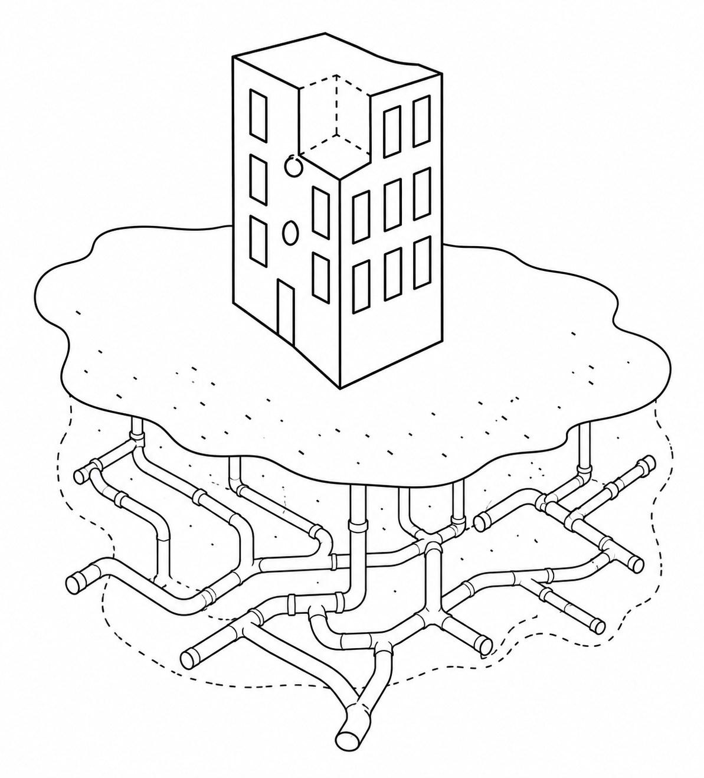









INSIGHT 1
REFRAMING / ANCHORING / RESEARCHING / TAKING ACTION / LEVERAGING / ENVISIONING
Shareholder
The responsibilities of the built environment are fragmented. This makes it difficult to understand and take action.
Housing company
City of Helsinki or Housing company
HSY
Creative Commons CC BY 4.0 2026
Nicole Kajander · Jenna Karvonen · Henna Kyrö · Kerttu Parkkinen · Giovanna Usai
Design for Government course · Aalto University

Slide 27
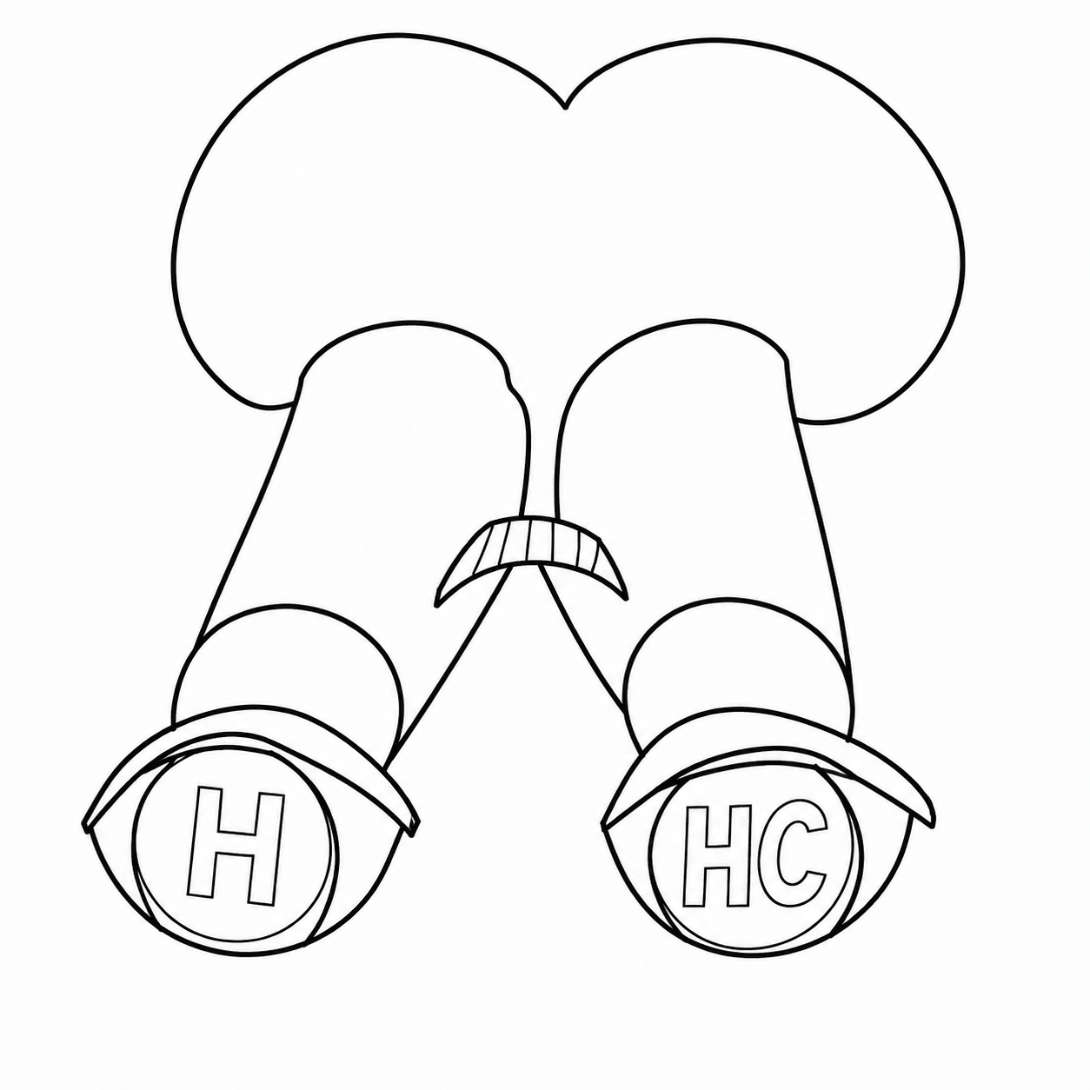
REFRAMING / ANCHORING / RESEARCHING / TAKING ACTION / LEVERAGING / ENVISIONING
“Even if something could be done, the city probably wouldn’t allow it.”
Housing Company, Herttoniemi 1
”
INSIGHT 2
”Communication is never enough. There is bottlenecks with reaching housing companies, so to be able to share information to them.”
Expert from HSY
Housing companies don’t
feel recognized as key stakeholders in the context of climate investment by the
City of Helsinki​.
“Residents are responsible for maintaining value but lack control over structural decisions affecting that value.“
Housing Company, Kontula
”We have some ways to reach housing companies and get them as customers (for our climate projects), but it is not enough. We are lacking contacts, which makes it harder to reach them."
Expert from HSY
Creative Commons CC BY 4.0 2026
Nicole Kajander · Jenna Karvonen · Henna Kyrö · Kerttu Parkkinen · Giovanna Usai·
Design for Government course · Aalto University
Notes:
”Communication is never enough. There is bottlenecks with reaching housing companies, so to be able to share information to them.” - Expert from HSY
”We have some ways to reach housing companies and get them as customers (for our climate projects), but it is not enough. We are lacking contacts, which makes it harder to reach them. - Expert from City of Helsinki

Slide 28
TAKING ACTION
Creative Commons CC BY 4.0 2026
Nicole Kajander · Jenna Karvonen · Henna Kyrö · Kerttu Parkkinen · Giovanna Usai
Design for Government course · Aalto University
Notes:
OPPORTUNITIES
(ENTRY POINTS)
How do we make climate investment happen?

Slide 29

REFRAMING / ANCHORING / RESEARCHING / TAKING ACTION / LEVERAGING / ENVISIONING
1
2
3
Integrating housing companies into
the city strategy
Encouraging climate investment through government backed loans
Utilizing property tax as a financial instrument
Creative Commons CC BY 4.0 2026
Nicole Kajander · Jenna Karvonen · Henna Kyrö · Kerttu Parkkinen · Giovanna Usai
Design for Government course · Aalto University
Notes:
"Leverage financial instruments to incentivize climate investment"

Slide 30

REFRAMING / ANCHORING / RESEARCHING / TAKING ACTION / LEVERAGING / ENVISIONING
Entry point 1:
Integrating housing companies
into the city strategy
“Helsinki city’s climate unit doesn’t really work with housing companies.”
Specialist, City of Helsinki
Currently, housing companies feel unseen and unheard by the City.
By integrating housing companies to the strategy, the City would improve communication and foster an environment for co-creation.
“Residents are responsible for maintaining value, but lack control over structural decisions affecting that value.“
Housing Company, Kontula
“Even if something could be done, the city probably wouldn’t allow it.”
Housing Company, Herttoniemi 1
Case study: Amsterdam “Our city of Tomorrow” and “Roadmap Amsterdam Climate Neutral 2050” explicitly named housing corporations as necessary co-actors in the city strategy, with concrete commitments and dedicated financial support attached.
Creative Commons CC BY 4.0 2026
Nicole Kajander · Jenna Karvonen · Henna Kyrö · Kerttu Parkkinen · Giovanna Usai
Design for Government course · Aalto University
Notes:
Put a real example how to ingrate HC to the strategy, wording or cocreating.
Find from the climate adapattion plan where we could put the HC in the strategy
Municipality of Amsterdam. (2023). Our City of Tomorrow. City of Amsterdam. Retrieved from https://www.amsterdam.nl/en/policy/policy-sustainability-energy/
Municipality of Amsterdam. (2020). Roadmap Amsterdam Climate Neutral 2050. City of Amsterdam. Retrieved from https://openresearch.amsterdam/nl/page/48130/roadmap-amsterdam-climate-neutral-2050

Slide 31
REFRAMING / ANCHORING / RESEARCHING / TAKING ACTION / LEVERAGING / ENVISIONING
Entry point 1:
Integrating housing companies
into the city strategy
”More nature and greenery will be added to the built-up areas of the city.
We will draw up an action plan to make the built environment greener
in new areas and issue recommendations for sufficient canopy cover and water-absorbing surfaces in every area of Helsinki.” (Helsinki City Strategy 2025-2029)
Creative Commons CC BY 4.0 2026
Nicole Kajander · Jenna Karvonen · Henna Kyrö · Kerttu Parkkinen · Giovanna Usai
Design for Government course · Aalto University
Notes:
Put a real example how to ingrate HC to the strategy, wording or cocreating.
Find from the climate adapattion plan where we could put the HC in the strategy

Slide 32
REFRAMING / ANCHORING / RESEARCHING / TAKING ACTION / LEVERAGING / ENVISIONING
Entry point 1:
Integrating housing companies
into the city strategy
”More nature and greenery will be added to the built-up areas of the city.
We will draw up an action plan to make the built environment greener
in new areas and issue recommendations for sufficient canopy cover and water-absorbing surfaces in every area of Helsinki.” (Helsinki City Strategy 2025-2029)
We develop areas together with housing companies and residents to ensure that measures respond to local needs and accelerate renovation and renewal investments.
Creative Commons CC BY 4.0 2026
Nicole Kajander · Jenna Karvonen · Henna Kyrö · Kerttu Parkkinen · Giovanna Usai
Design for Government course · Aalto University
Notes:
Put a real example how to ingrate HC to the strategy, wording or cocreating.
Find from the climate adapattion plan where we could put the HC in the strategy

Slide 33

REFRAMING / ANCHORING / RESEARCHING / TAKING ACTION / LEVERAGING / ENVISIONING
Entry point 2:
Encouraging climate investment through
government backed loans for renovations
Due to the current economy, people avoid debt and loans. Additionally, people do not have resources for needed and mandatory renovations.
To boost the housing market, the bill could be used as an financial instrument to invest into existing buildings, reducing managing costs and turning crisis management into crisis preparedness.
”The Finnish economy is moving out of a sluggish growth phase, but there is no strong growth anticipated in the immediate years ahead.”
Press Release in December 2025, Bank of Finland
”The decline in consumer confidence has persisted for an exceptionally long period, prompting households to postpone purchases.”
Debt Management Annual Review 2025, State Treasury
”Apartments and housing market are often the biggest asset to Finns.”
Housing Company, Meilahti
Reference: On 7th of May 2026, Ministry of Finance announced a approval of a bill to boost the stagnated housing market. The Government has proposed that the bill be approved by the President of the Republic and enter into force on 1st of June.
Creative Commons CC BY 4.0 2026
Nicole Kajander · Jenna Karvonen · Henna Kyrö · Kerttu Parkkinen · Giovanna Usai
Design for Government course · Aalto University
Notes:
Who are the kley actors to housing comapnies. Shared responsibility, managers etc
Let’s invest in extisng buildings and the immediate outcome is reducing the managing costs
References: https://www.treasuryfinland.fi/annualreview2025/operating-environment/
https://www.suomenpankki.fi/en/news-and-topical/press-releases-and-news/releases/2025/finnish-economys-recovery-moving-modestly-forward/
https://valtioneuvosto.fi/en/-/10623/reform-of-housing-finance-regulation-supports-housing-market-through-added-flexibility

Slide 34
REFRAMING / ANCHORING / RESEARCHING / TAKING ACTION / LEVERAGING / ENVISIONING
Entry point 2:
New housing finance regulation from 1st June 2026
INDIVIDUAL
HOUSING COMPANY
Max. loan term
30 years 40 years
Max. loan term
30 years 40 years
Loan-to-value ratio
95%
90%
}
Interest period only
95%
1 year 1-2 years
Creative Commons CC BY 4.0 2026
Nicole Kajander · Jenna Karvonen · Henna Kyrö · Kerttu Parkkinen · Giovanna Usai
Design for Government course · Aalto University
Notes:
Individual: buying a home. Easier access to home ownership by allowing higher loan ratio and longer repayment time
Housing companies: Renovations and new constructions. More flexibility to finance projects with higher dept, longer loans and interest-only periods

Slide 35





REFRAMING / ANCHORING / RESEARCHING / TAKING ACTION / LEVERAGING / ENVISIONING
Entry point 3:
Utilizing property tax as a financial instrument
Currently, the City’s property tax is redirected and used for the City’s infrastructure and services.
Leveraging existing financial instruments could support housing companies and motivate climate investment. This could potentially create a climate investment fund distributed equally to the most vulnerable.
Case study: Italy: Superbonus 110%, Introduced a tax credit of up to 110% for energy-efficiency and seismic retrofits of buildings (from 2020; later reduced rates). Triggered a sharp increase in renovation projects, especially energy retrofits in apartment buildings.
Creative Commons CC BY 4.0 2026
Nicole Kajander · Jenna Karvonen · Henna Kyrö · Kerttu Parkkinen · Giovanna Usai
Design for Government course · Aalto University
Notes:
Leveraging existing financial instruments to support and motivate climate investment
Italy: Superbonus 110%, Introduced a tax credit of up to 110% for energy-efficiency and seismic retrofits of buildings (from 2020; later reduced rates). Triggered a sharp increase in renovation projects, especially energy retrofits in apartment buildings. (International Energy Agency, n.d.)

Slide 36

REFRAMING / ANCHORING / RESEARCHING / TAKING ACTION / LEVERAGING / ENVISIONING
Entry point 3:
Property tax criteria
Living building rate 0,41% (in Helsinki)
Land Tax Criteria:
Building Tax Criteria:
Location
Building type
Plot size
Size
Zoning & building rights
Construction year
Regional land value
Replacement/rebuilding value
Municipality tax rate
Condition & age deductions
Renovation & technical systems
Municipality tax rate
Land rate 1.30%
(in Helsinki)
Creative Commons CC BY 4.0 2026
Nicole Kajander · Jenna Karvonen · Henna Kyrö · Kerttu Parkkinen · Giovanna Usai
Design for Government course · Aalto University

Slide 37
REFRAMING / ANCHORING / RESEARCHING / TAKING ACTION / LEVERAGING / ENVISIONING
Entry point 3:
How does property tax work?
The Finnish government sets the legal framework and maximum tax rates
The City decides the local property tax rates within the limits set by the government
Property owners & housing companies pay property tax
Property tax revenue goes to the City of Helsinki budget and is used for services and development
Creative Commons CC BY 4.0 2026
Nicole Kajander · Jenna Karvonen · Henna Kyrö · Kerttu Parkkinen · Giovanna Usai
Design for Government course · Aalto University

Slide 38
REFRAMING / ANCHORING / RESEARCHING / TAKING ACTION / LEVERAGING / ENVISIONING
Entry point 3:
Budget rethinking
City of Helsinki’s 2025 estimated budget. 5,9 billion €
Urban infrastructure and development
28% (=1.6bn)
20%
Social, health and rescue services
20% (=1.2bn)
28%
City of Helsinki, Estimated budget 2025.
https://www.hel.fi/static/Helsinki/talousarvio/Helsingin-kaupungin-talousarvio-2025.pdf
Creative Commons CC BY 4.0 2026
Nicole Kajander · Jenna Karvonen · Henna Kyrö · Kerttu Parkkinen · Giovanna Usai
Design for Government course · Aalto University
Notes:
28% → 48%
Cit of Helsinki 2025 profit around 300 million
Use part of property tax money as a ”source of income”. This is City’s handover back to the people
What if we think green and yellow money to
Be seen as interconnected?

Slide 39
REFRAMING / ANCHORING / RESEARCHING / TAKING ACTION / LEVERAGING / ENVISIONING
Entry point 3:
Budget rethinking
City of Helsinki’s 2025 estimated budget. 5,9 billion €
Urban infrastructure and development
28% (=1.6bn)
20%
48%
Social, health and rescue services
20% (=1.2bn)
28%
City of Helsinki, Estimated budget 2025.
https://www.hel.fi/static/Helsinki/talousarvio/Helsingin-kaupungin-talousarvio-2025.pdf
Creative Commons CC BY 4.0 2026
Nicole Kajander · Jenna Karvonen · Henna Kyrö · Kerttu Parkkinen · Giovanna Usai
Design for Government course · Aalto University
Notes:
28% → 48%
Cit of Helsinki 2025 profit around 300 million
Use part of property tax money as a ”source of income”. This is City’s handover back to the people
What if we think green and yellow money to
Be seen as interconnected?

Slide 40
REFRAMING / ANCHORING / RESEARCHING / TAKING ACTION / LEVERAGING / ENVISIONING
Everyone deserves
to have a healthy home.
Pathways Housing First Institute (2026). https://www.pathwayshousingfirst.org/about-us
Y-Säätiö, Asunto ensin-malli (2025). https://ysaatio.fi/asunto-ensin/asunto-ensin-malli/
Creative Commons CC BY 4.0 2026
Nicole Kajander · Jenna Karvonen · Henna Kyrö · Kerttu Parkkinen · Giovanna Usai
Design for Government course · Aalto University
Notes:
https://materialbank.myhelsinki.fi/search/all/media/8569?showFilters=true&search=home&sortBy=relevance
“About Us.” Pathways Housing First Institute, Pathways Housing First Institute, https://www.pathwayshousingfirst.org/about-us.
“Asunto ensin -malli.” Y-Säätiö, https://ysaatio.fi/asunto-ensin/asunto-ensin-malli/.
MyHelsinki Material Bank, Helsinki Marketing, https://materialbank.myhelsinki.fi/search/all/media/8569?showFilters=true&search=home&sortBy=relevance.

Slide 41
LEVERAGING
Creative Commons CC BY 4.0 2026
Nicole Kajander · Jenna Karvonen · Henna Kyrö · Kerttu Parkkinen · Giovanna Usai
Design for Government course · Aalto University
Notes:
HOW COULD WE UTILIZE THESE OPPORTUNITIES?

Slide 42
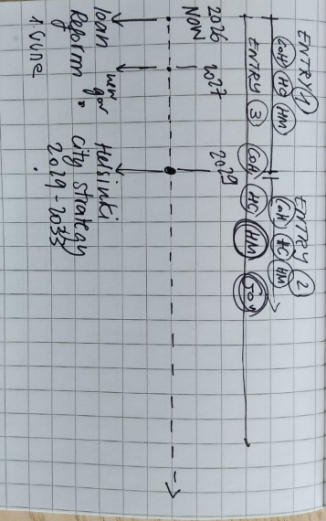
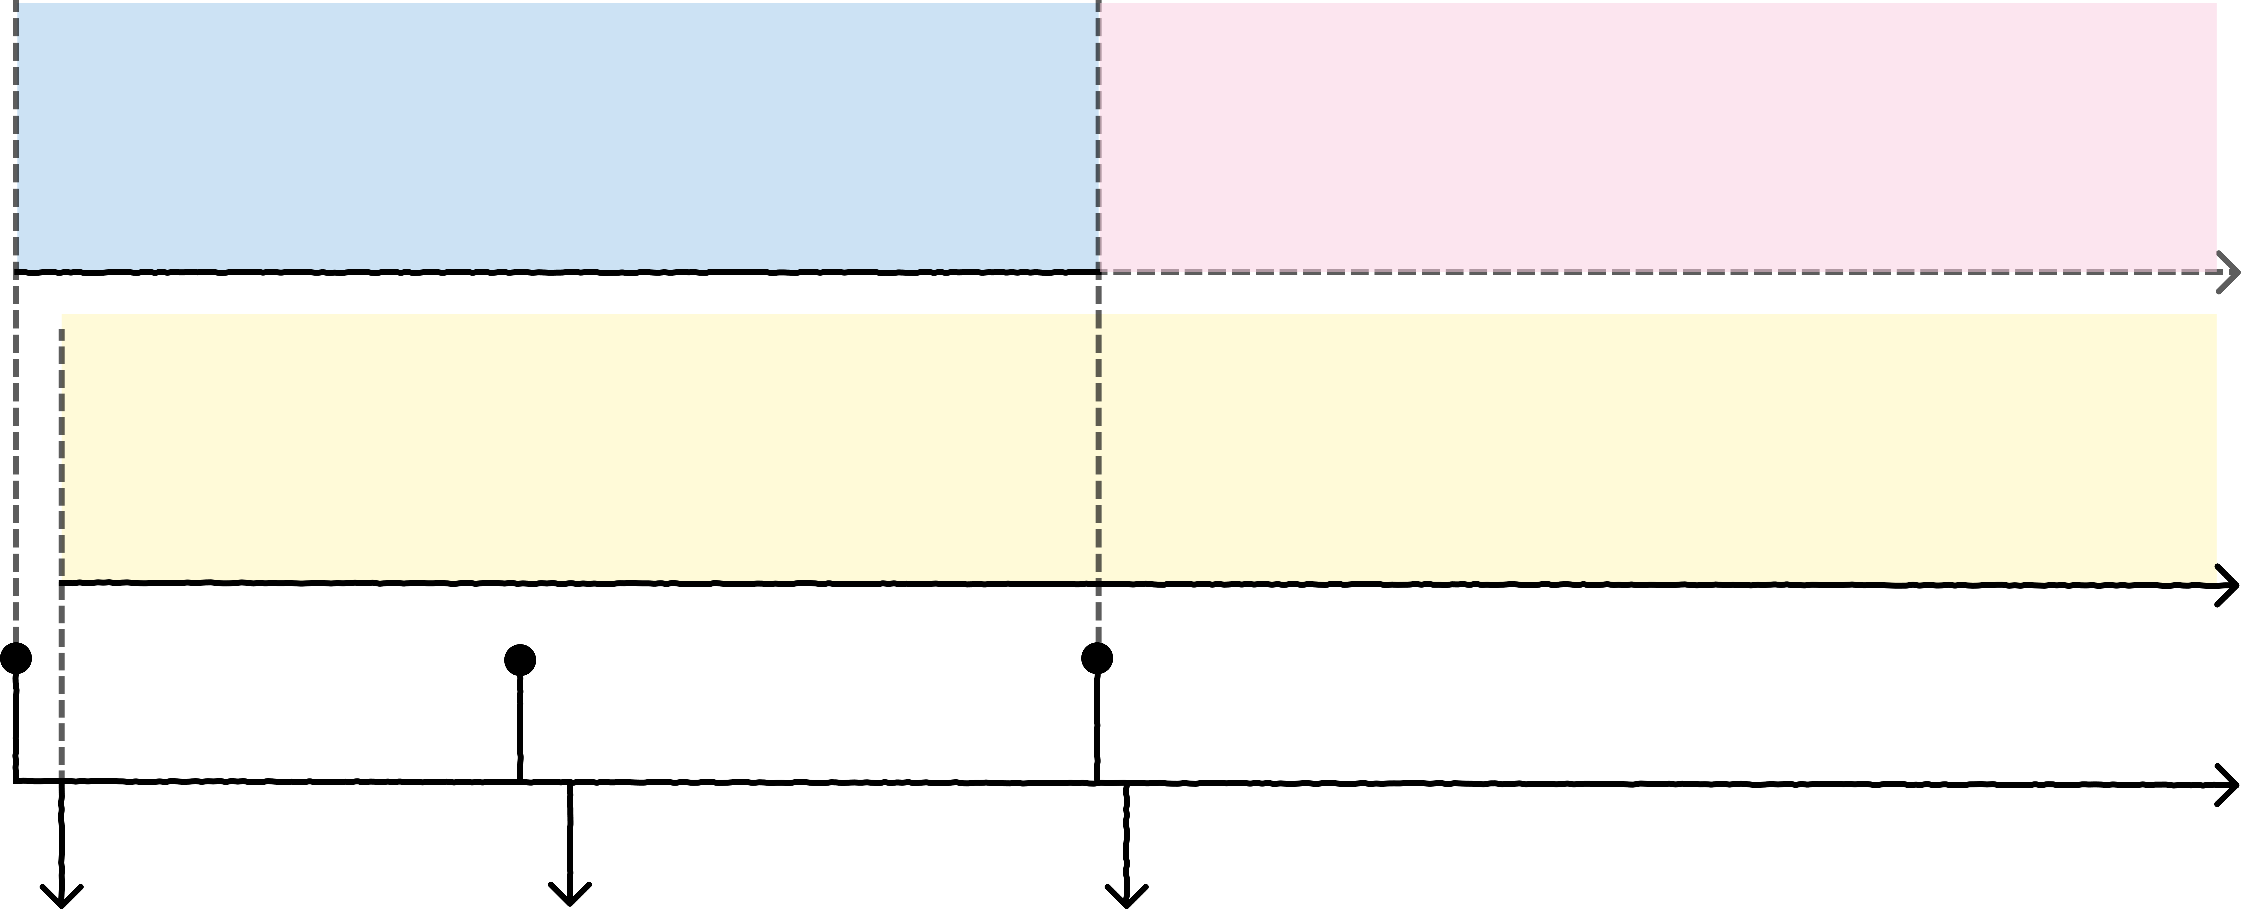
REFRAMING / ANCHORING / RESEARCHING / TAKING ACTION / LEVERAGING / ENVISIONING
ENTRY POINT 1:
Integrating housing companies in the Helsinki City Strategy 2029-2033
Actors involved:
City of Helsinki, Housing companies, Property managers
ENTRY POINT 3:
Utilizing property tax as a financial instrument
Actors involved:
City of Helsinki, Government, Housing companies, Property managers
ENTRY POINT 2:
Encouraging climate investment through government backed loans and renovations
Actors involved:
Government, City of Helsinki, Property managers, Housing companies
2026 (NOW)
2027
2029
LOAN REFORM
[1st June 2026]
NEW GOVERNMENT ELECTIONS
[18th April 2027]
HELSINKI CITY STRATEGY 2029-2033
[2029]
Creative Commons CC BY 4.0 2026
Nicole Kajander · Jenna Karvonen · Henna Kyrö · Kerttu Parkkinen · Giovanna Usai
Design for Government course · Aalto University
Notes:
REAL TIMELINE WITH DATES ETC.

Slide 43
ENVISIONING
Creative Commons CC BY 4.0 2026
Nicole Kajander · Jenna Karvonen · Henna Kyrö · Kerttu Parkkinen · Giovanna Usai
Design for Government course · Aalto University

Slide 44
REFRAMING / ANCHORING / RESEARCHING / TAKING ACTION / LEVERAGING / ENVISIONING
In the age of increasing vulnerability, we envision awakening passive housing stock into a powerful urban force, transforming ordinary buildings into a distributed system of climate resilience.
By starting with Helsinki, we see the opportunity for the
city to become a bold forerunner in reimagining how entire
urban environments prepare, adapt, and thrive in the face
of a changing future.
The stronger and more future-ready our buildings become, the stronger our city becomes. Every building prepared for heatwaves, flooding, and environmental stress becomes part of a larger protective network, strengthening the city’s collective ability to withstand disruption and flourish through uncertainty.
Creative Commons CC BY 4.0 2026
Nicole Kajander · Jenna Karvonen · Henna Kyrö · Kerttu Parkkinen · Giovanna Usai
Design for Government course · Aalto University
Notes:
(By using property taxation as a financial instrument, we see the opportunity to activate climate adaptation through a system already embedded across the entire housing stock, unlocking the potential for transformation at the scale of the whole city.)
((Our long-term vision is a new nationwide framework where climate adaptation is no longer treated as a temporary response, but as a permanent force shaping how we invest in, care for, and future-proof the built environment.))

Slide 45
One day…
Creative Commons CC BY 4.0 2026
Nicole Kajander · Jenna Karvonen · Henna Kyrö · Kerttu Parkkinen · Giovanna Usai
Design for Government course · Aalto University

Slide 46
One day...
Creative Commons CC BY 4.0 2026
Nicole Kajander · Jenna Karvonen · Henna Kyrö · Kerttu Parkkinen · Giovanna Usai
Design for Government course · Aalto University

